Slide 1

Forming Expressions
Full lesson PowerPoint, including I Do, We Do, You Do Example Sheet(s).

Slide 2
 | Forming Expressions

Slide 3
Variables
A variable is a number we don’t know yet. We use a letter to represent this.

Slide 4
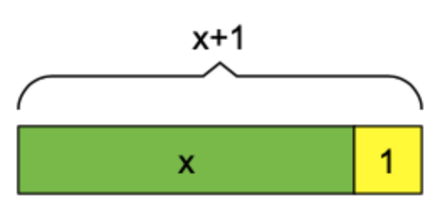
Forming Expressions (1)
I DO | WE DO | YOU DO
Use a diagram to write an expression for: 1 more than x 3 more than x 5 more than x | Use a diagram to write an expression for: 1 more than y 2 more than y 4 more than y | Use a diagram to write an expression for: 1 more than x 2 more than x 5 more than x 5 more than y 3 more than y

Slide 5
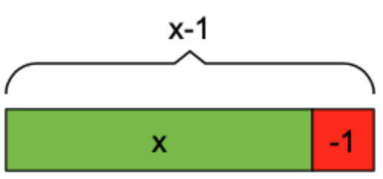
Forming Expressions (2)
I DO | WE DO | YOU DO
Use a diagram to write an expression for: 1 less than x 3 less than x 5 less than x | Use a diagram to write an expression for: 1 less than y 2 less than y 4 less than y | Use a diagram to write an expression for: 1 less than x 2 less than x 5 less than x 5 less than y 3 less than y

Slide 6

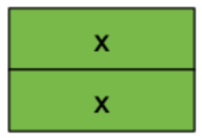
Forming Expressions (3)
I DO | WE DO | YOU DO
Use a diagram to write an expression for: 2 lots of x 3 lots of x Half of x | Use a diagram to write an expression for: 2 lots of y 5 lots of y A quarter of y | Use a diagram to write an expression for: 2 lots of z 3 lots of z A third of z
OR

Slide 7
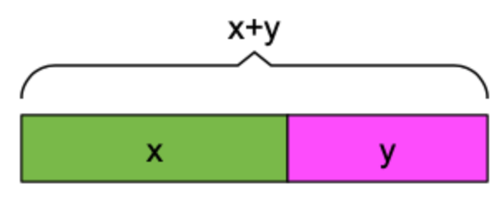
Forming Expressions (y)
I DO | WE DO | YOU DO
Use a diagram to write an expression for: y added to x x added to y x subtracted from y | Use a diagram to write an expression for: x plus two lots of y Two lots of x plus y y subtracted from x | Use a diagram to write an expression for: The total of x and y x plus three lots of y y subtracted from two lots of x Extension: a) x plus y subtract z b) x squared c) y squared plus 1

Slide 8
WE DO
Harry has 20 sweets, Sam gives him 5 more. How many sweets does Harry have now? | Harry has x sweets, Sam gives him y more. How many sweets does Harry have now?
Harry has 20 sweets, he gives 5 to Sam. How many sweets does Harry have now? | Harry has x sweets, he gives y to Sam. How many sweets does Harry have now?
Harry buys a bag of 30 sweets. He then goes into the shop and buys another bag of 30 sweets. How many sweets does Harry have now? | Harry buys a bag of x sweets. He then goes into the shop and buys another bag of x sweets. How many sweets does Harry have now?
Harry buys a bag of 50 sweets. He shares those 50 sweets equally between himself and 4 others. How many sweets does Harry have now? | Harry buys a bag of x sweets. He shares those x sweets equally between himself and 4 others. How many sweets does Harry have now?

Slide 9
Complete the grid by applying the operation on the top to the expression on the left each time. A couple have been done for you.
 | Add 1 | Add 3 | Subtract 2 | Double | Square
a | a + 1
b |  | b + 3
2b |  |  |  | 4b
c + 1
c + 3
d - 1 |  |  | d - 3
d - 4
2e + 1 |  |  |  |  | (2e + 1)²
2e - 1
2f - 2

Slide 10
Complete the grid by applying the operation on the top to the expression on the left each time. A couple have been done for you.
 | Add 1 | Add 3 | Subtract 2 | Double | Square
a | a + 1
b |  | b + 3
2b |  |  |  | 4b
c + 1
c + 3
d - 1 |  |  | d - 3
d - 4
2e + 1 |  |  |  |  | (2e + 1)²
2e - 1
2f - 2

Slide 11
Answers
 | Add 1 | Add 3 | Subtract 2 | Double | Square
a | a + 1 | a + 3 | a - 2 | 2a | a²
b | b + 1 | b + 3 | b - 2 | 2b | b²
2b | 2b + 1 | 2b + 3 | 2b - 2 | 4b | 4b²
c + 1 | c + 2 | c + 4 | c - 1 | 2c + 2 | (c + 1)²
c + 3 | a + 4 | c + 6 | c + 1 | 2c + 6 | (c + 3)²
d - 1 | d | d + 2 | d - 3 | d - 2 | (d - 1)²
d - 4 | d - 3 | d - 1 | d - 6 | 2d - 8 | (d - 4)²
2e + 1 | 2e + 2 | 2e + 4 | 2e - 1 | 4e + 2 | (2e + 1)²
2e - 1 | 2e | 2e + 2 | 2e - 3 | 4e - 2 | (2e - 1)²
2f - 2 | 2f - 1 | 2f + 1 | 2f - 4 | 4f - 4 | (2f - 2)²

