Slide 1
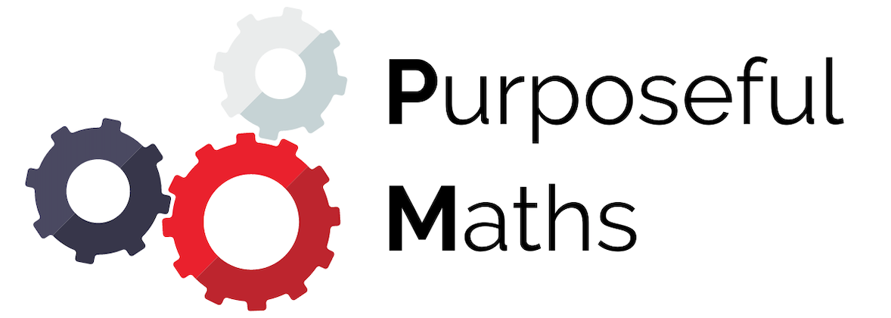
Function Notation
Full lesson PowerPoint, including I Do, We Do, You Do Example Sheet(s).

Slide 2
 | Function Notation

Slide 3
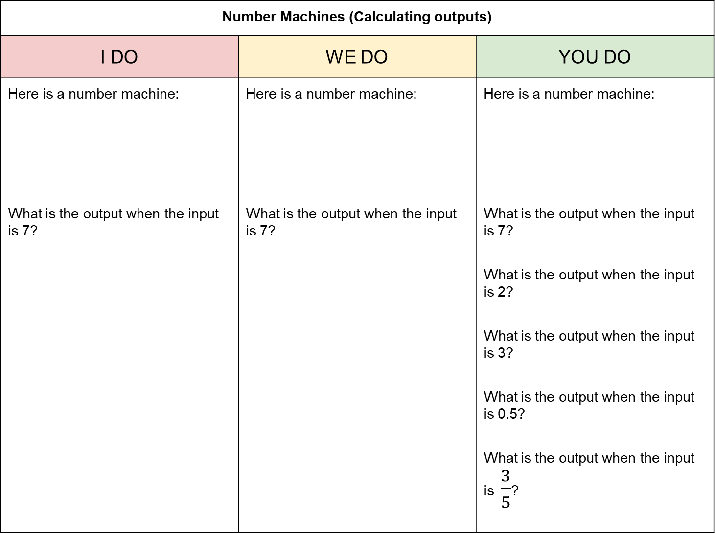
Number Machines (Calculating outputs)
I DO | WE DO | YOU DO
Here is a number machine: What is the output when the input is 7? | Here is a number machine: What is the output when the input is 7? | Here is a number machine: What is the output when the input is 7? What is the output when the input is 2? What is the output when the input is 3? What is the output when the input is 0.5? What is the output when the input is $\frac{3}{5}$?
Input | → | x 3 | → | - 2 | → | Output
Input | → | - 2 | → | x 3 | → | Output
Input | → | x 5 | → | + 2 | → | Output

Slide 4

Substitution
I DO | WE DO | YOU DO
Here is an expression: $$3x−2$$ What is the value of this expression when $x=7$ | Here is an expression: $$3(x−2)$$ What is the value of this expression when $x=7$ | Here is an expression: $$5x+2$$ What is the value of this expression when $x=7$ What is the value of this expression when $x=2$ What is the value of this expression when $x=3$ What is the value of this expression when $x=0.5$ What is the value of this expression when $x=\frac{3}{5}$

Slide 5

Function Notation
I DO | WE DO | YOU DO
Here is a function: $$f\left(x\right)=3x−2$$ Calculate the value of $f(7)$ | Here is an expression: $$f\left(x\right)=3(x−2)$$ Calculate the value of $f(7)$ | Here is an expression: $$f\left(x\right)=5x+2$$ Calculate the value of $f(7)$ Calculate the value of $f(2)$ Calculate the value of $f(3)$ Calculate the value of $f(0.5)$ Calculate the value of $f(\frac{3}{5})$

Slide 6
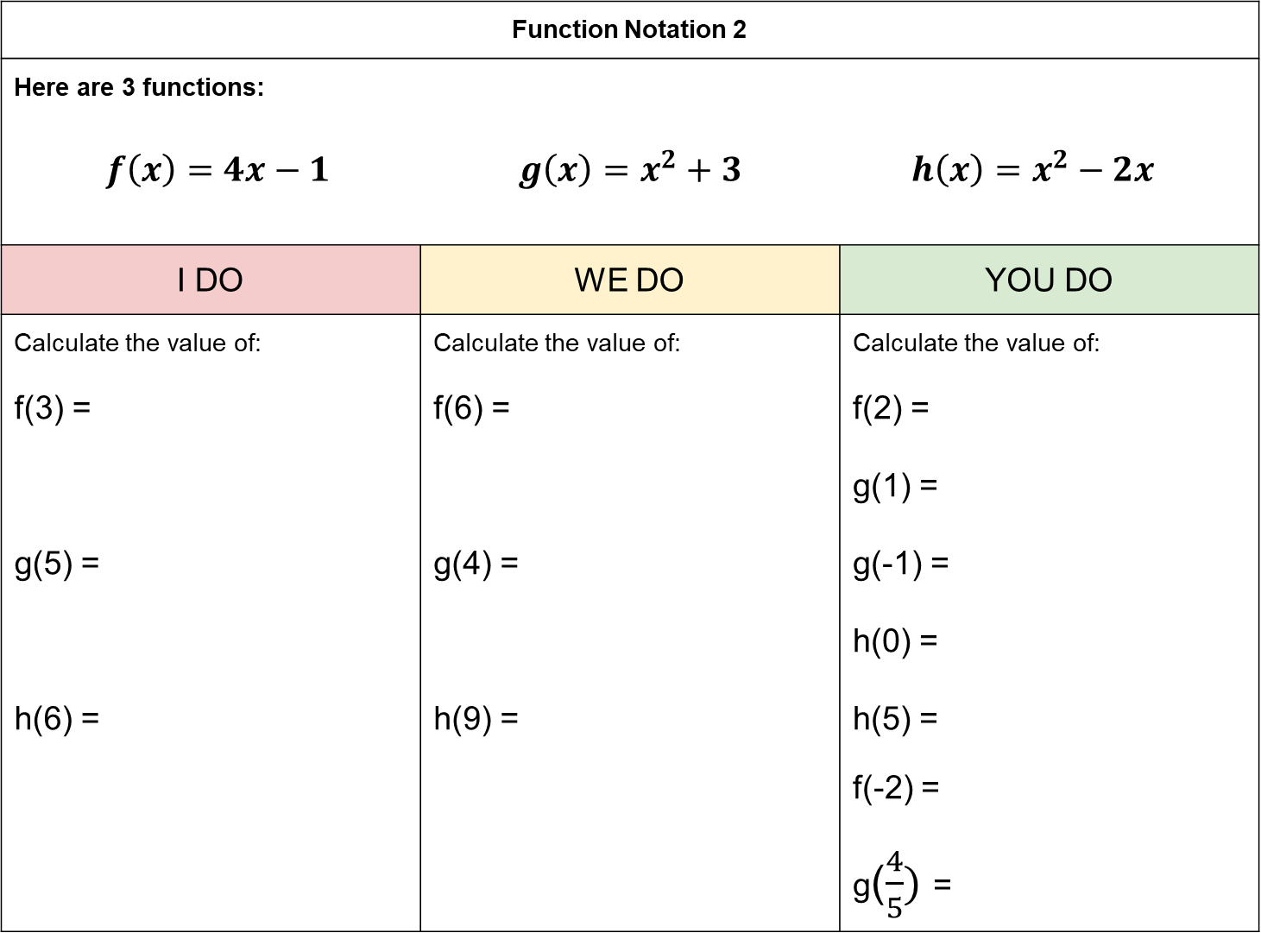
Function Notation 2
Here are 3 functions: $f\left(x\right)=4x−1$ $g\left(x\right)=x^{2}+3$ $h\left(x\right)=x^{2}−2x$
I DO | WE DO | YOU DO
Calculate the value of: f(3) = g(5) = h(6) = | Calculate the value of: f(6) = g(4) = h(9) = | Calculate the value of: f(2) = g(1) = g(-1) = h(0) = h(5) = f(-2) = g($\frac{4}{5})$ =

