Slide 1

Solving Using Quadratic Formula (a≠1)
Multiple I Do, We Do, You Do Example Sheets.

Slide 2
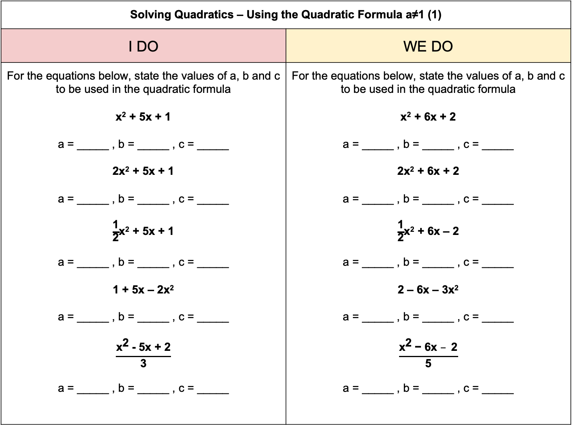
Solving Quadratics – Using the Quadratic Formula a≠1 (1)
I DO | WE DO
For the equations below, state the values of a, b and c to be used in the quadratic formula x² + 5x + 1 a = _____ , b = _____ , c = _____ 2x² + 5x + 1 a = _____ , b = _____ , c = _____ $\frac{\text{1}}{\text{2}}$x² + 5x + 1 a = _____ , b = _____ , c = _____ 1 + 5x – 2x² a = _____ , b = _____ , c = _____ $$\frac{{\text{x}}^{\text{2}} \text{− 5}\text{x}\text{ + 2}}{\text{3}}$$ a = _____ , b = _____ , c = _____ | For the equations below, state the values of a, b and c to be used in the quadratic formula x² + 6x + 2 a = _____ , b = _____ , c = _____ 2x² + 6x + 2 a = _____ , b = _____ , c = _____ $\frac{\text{1}}{\text{2}}$x² + 6x – 2 a = _____ , b = _____ , c = _____ 2 – 6x – 3x² a = _____ , b = _____ , c = _____ $$\frac{{\text{x}}^{\text{2}} \text{− 6}\text{x} –\text{ 2}}{\text{5}}$$ a = _____ , b = _____ , c = _____

Slide 3
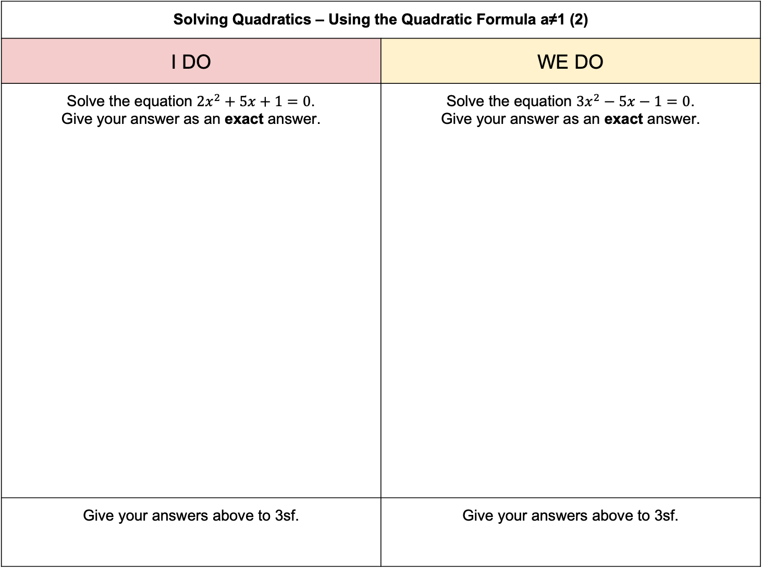
Solving Quadratics – Using the Quadratic Formula a≠1 (2)
I DO | WE DO
Solve the equation $2x^{2}+5x+1=0$. Give your answer as an exact answer. | Solve the equation $3x^{2}−5x−1=0$. Give your answer as an exact answer.
Give your answers above to 3sf. | Give your answers above to 3sf.

Slide 4
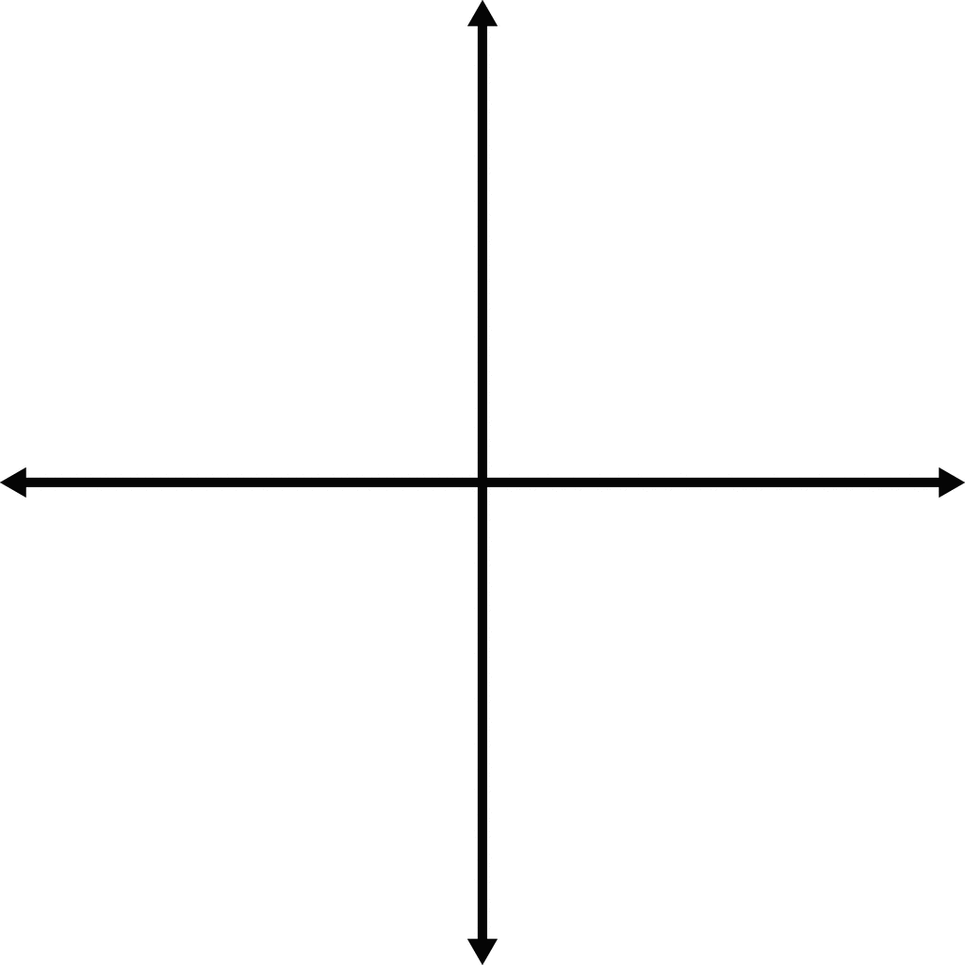
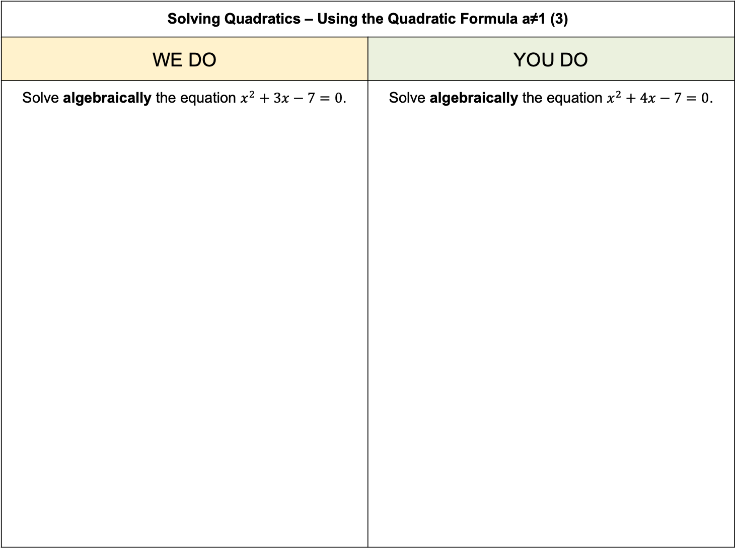

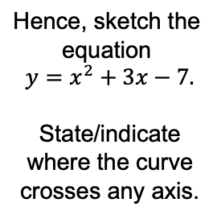
Solving Quadratics – Using the Quadratic Formula a≠1 (3)
WE DO | YOU DO
Solve algebraically the equation $x^{2}+3x−7=0$. | Solve algebraically the equation $x^{2}+4x−7=0$.
$$\text{Hence}\text{, }\text{sketch} \text{the} \text{equation}$$
$${y=x}^{2}+3x−7\text{.}$$
State/indicate where the curve crosses any axis.
$$\text{Hence}\text{, }\text{sketch} \text{the} \text{equation}$$
$${y=x}^{2}+3x−7\text{.}$$
State/indicate where the curve crosses any axis.

Slide 5

Solving Quadratics – Using the Quadratic Formula a≠1 (4)
WE DO | YOU DO
Solve algebraically the equation ${2x}^{2}+3x−5=0$. | Solve algebraically the equation ${3x}^{2}+4x−5=0$.
$$\text{Hence}\text{, }\text{sketch} \text{the} \text{equation}$$
$${y=x}^{2}+3x−7\text{.}$$
State/indicate where the curve crosses any axis.
$$\text{Hence}\text{, }\text{sketch} \text{the} \text{equation}$$
$${y=x}^{2}+3x−7\text{.}$$
State/indicate where the curve crosses any axis.

Slide 6
Solving Quadratics – Using the Quadratic Formula a≠1 (5)
ODD-ONE-OUT
Which of the following equations is the odd-one-out? Why?
$$y=2x^{2}+3x−7$$ | $$y=2x^{2}−3x−7$$ | $$y=2x^{2}+3x+7$$

