Slide 1

There are multiple approach to teaching Pie Charts, therefore, we have adapted these resources into two versions A and B; this will determine which I Do, We Do, You Do slides you use.
Version A uses the approach of calculating the fraction of a circle used to find the angle to be drawn.
Version B uses the approach of determining the number of degrees represented a unit of frequency.

Slide 2
Introduction to Pie Charts
Full lesson PowerPoint, including I Do, We Do, You Do Example Sheet(s).

Slide 3
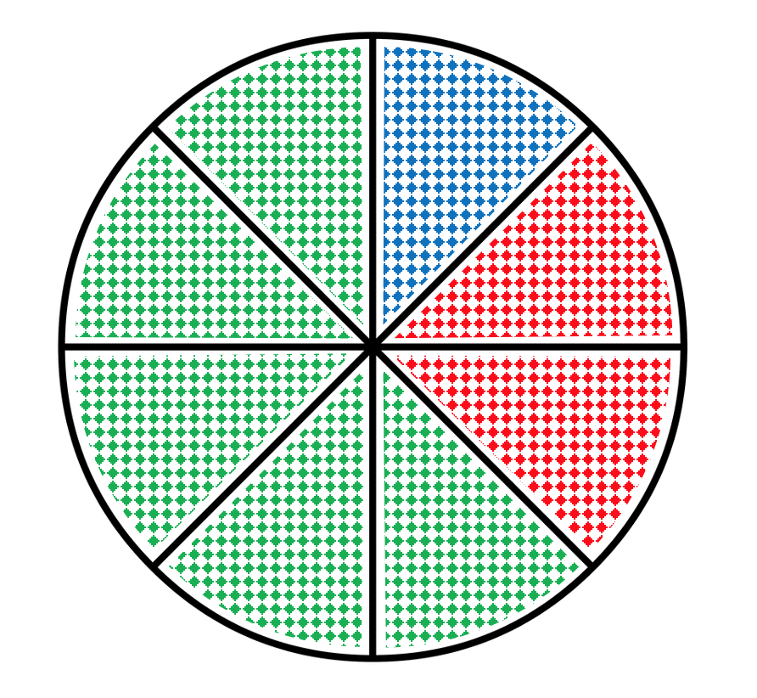
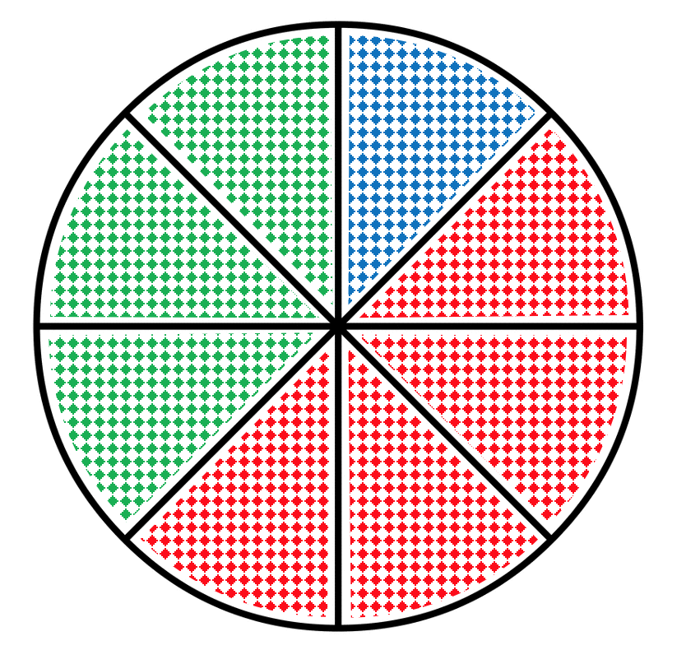
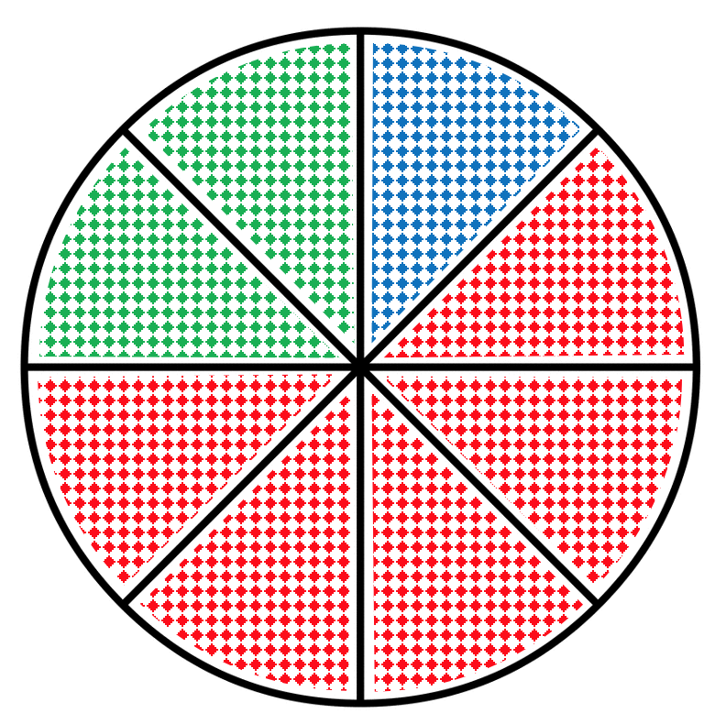
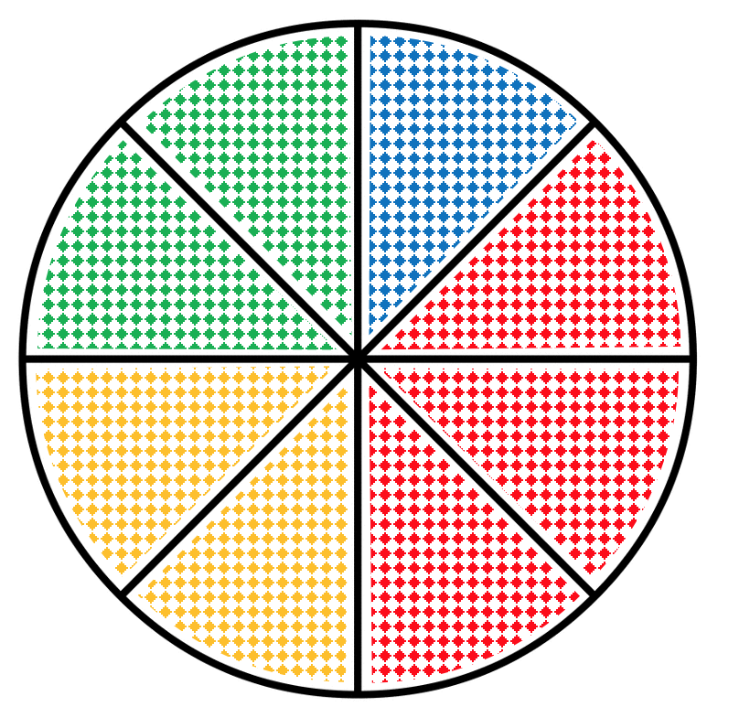
Introduction to Pie Charts – Finding Frequencies (1)
I DO | WE DO | YOU DO
The pie chart below represents the colour that people preferred: Each sector represents ___ people Complete the frequency table below: | The pie chart below represents the colour that people preferred: Each sector represents ___ people Complete the frequency table below: | The pie charts below represents the colour that people preferred. Complete each frequency table a) Each sector represents ___ people b) Each sector represents ___ people
 | Freq
Blue | 8
Red
Green
 | Freq
Blue | 8
Red
Green
Yellow
Colour | Frequency
Blue | 5
Red
Green
Colour | Frequency
Blue | 8
Red
Green

Slide 4
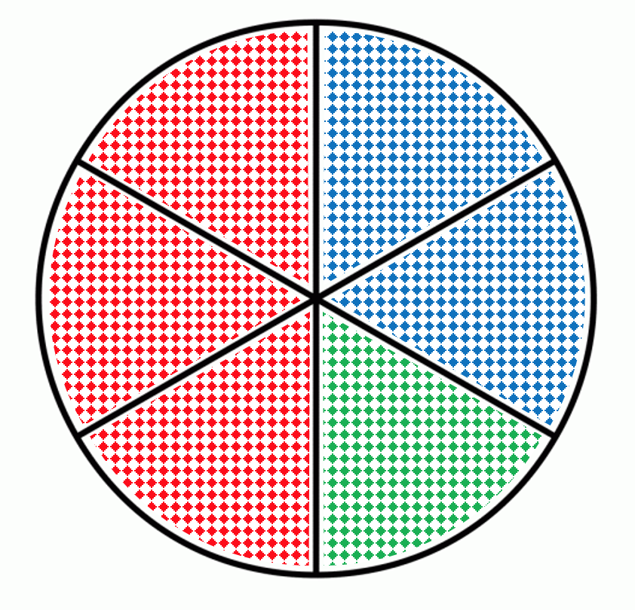
Introduction to Pie Charts – Finding Frequencies (2)
I DO | WE DO | YOU DO
The pie chart below represents the colour that people preferred: Each sector represents ___ people Complete the frequency table below: The total frequency is _____ | The pie chart below represents the colour that people preferred: Each sector represents ___ people Complete the frequency table below: The total frequency is _____ | Use the pie chart below to complete the four tables below.
a) | Freq
Blue
Red
Green | 12
Yellow
Total
b) | Freq
Blue
Red | 12
Green
Yellow
Total
Colour | Frequency
Blue | 12
Red
Green
Colour | Frequency
Blue
Red | 12
Green
c) | Freq
Blue
Red | 24
Green
Yellow
Total
d) | Freq
Blue
Red
Green
Yellow | 16
Total

Slide 5
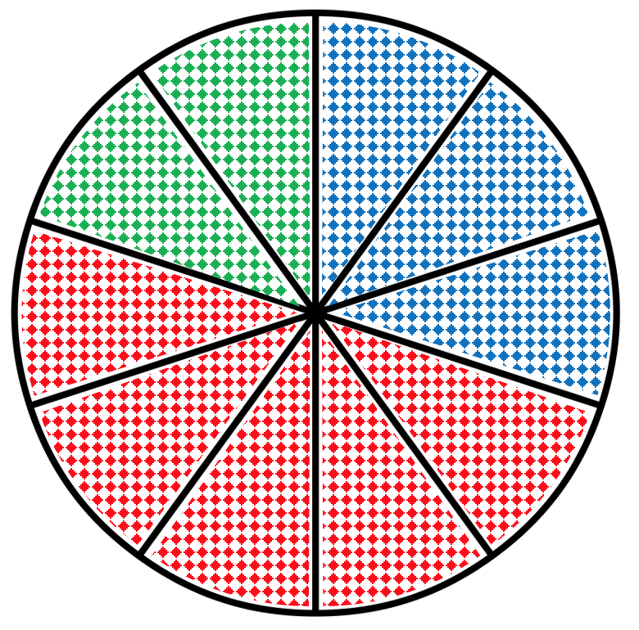
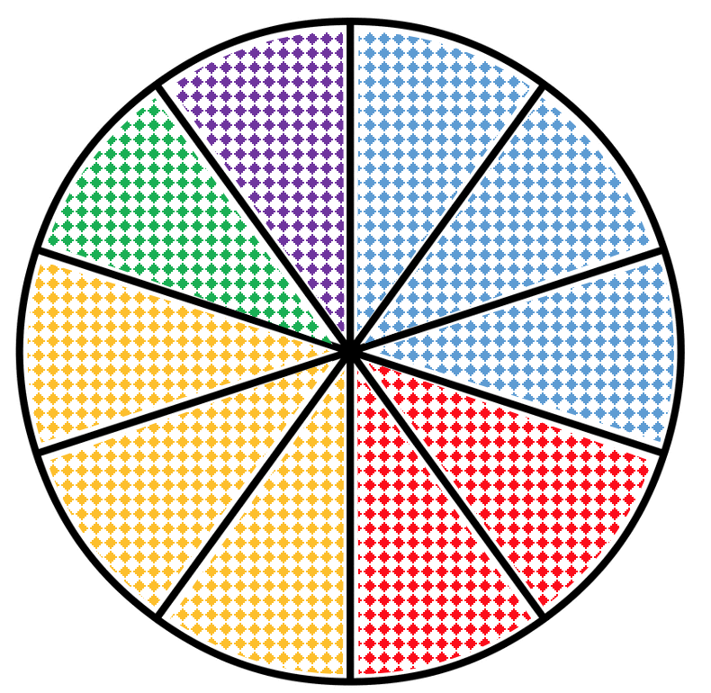
Introduction to Pie Charts – Finding Frequencies (3)
I DO | WE DO
The pie chart below represents the colour that 60 people preferred: Each sector represents ___ people Complete the frequency table below: | The pie chart below represents the colour that 60 people preferred: Each sector represents ___ people Complete the frequency table below:
Colour | Frequency
Blue
Red | 12
Yellow
Green
Purple
Colour | Frequency
Blue
Red
Green

Slide 6
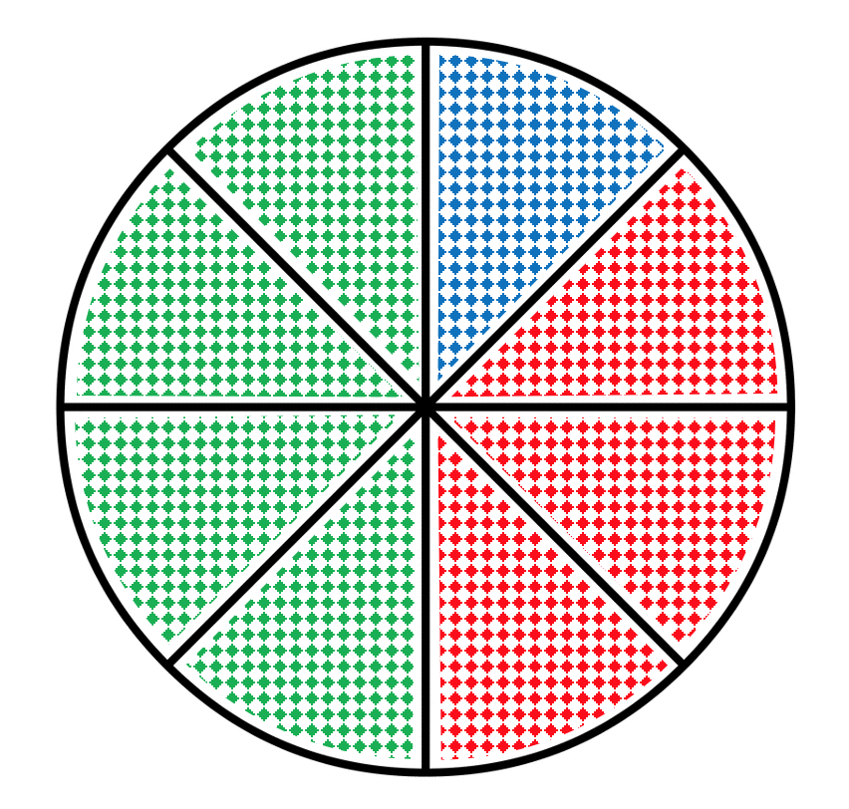
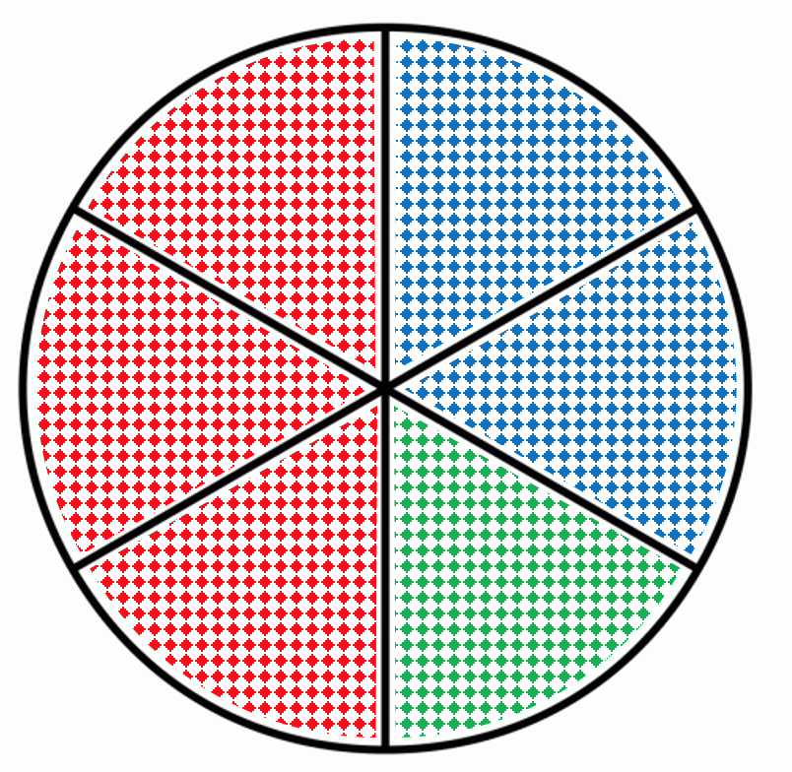
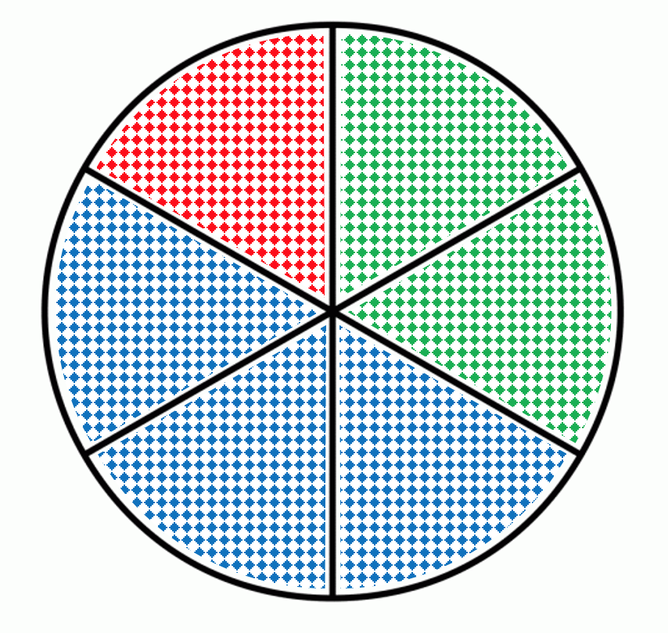
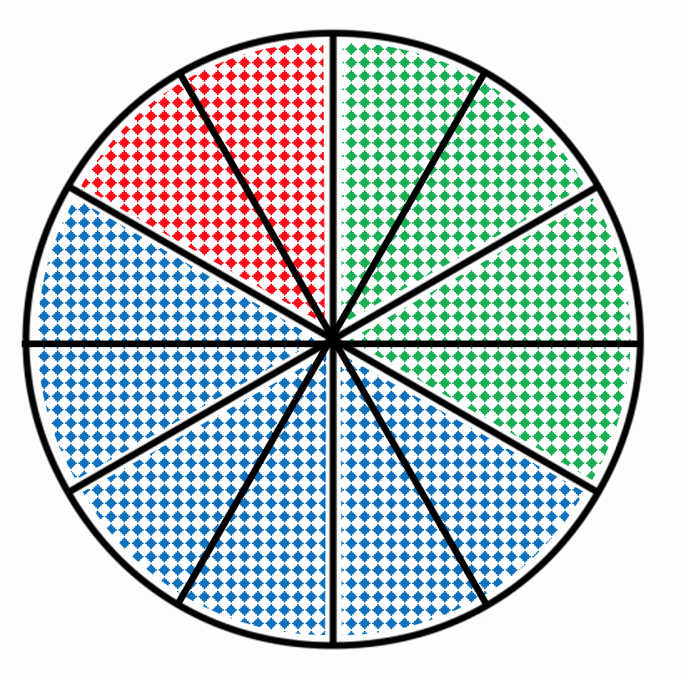
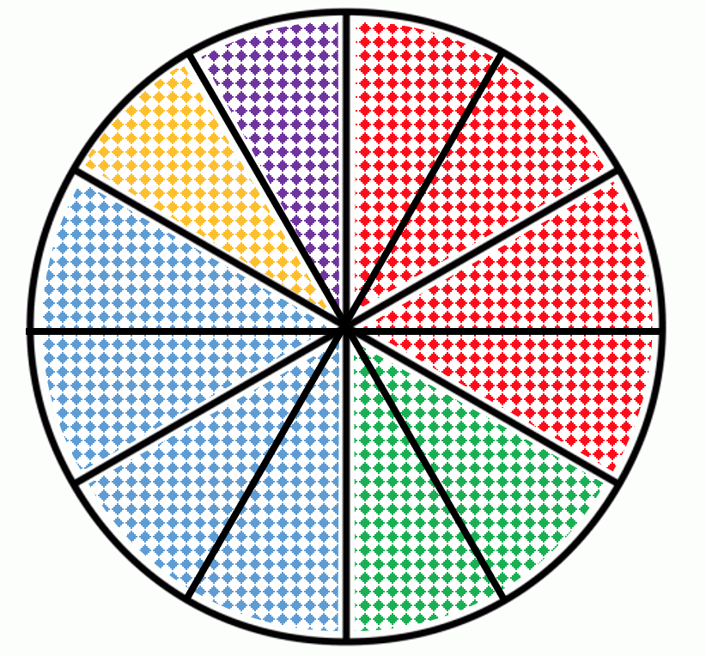
Introduction to Pie Charts – Finding Frequencies (3)
YOU DO
Use the pie chart below to complete the tables next to it.
a) | b)
c) | d)
e) | f) Total Frequency is 48
Colour | Freq
Blue
Red
Green
Total | 32
Colour | Freq
Blue
Red
Green
Total | 64
Colour | Freq
Blue
Red
Green
Total | 48
Colour | Freq
Blue
Red
Green
Total | 48
Colour | Freq
Blue
Red
Green
Total | 48

Slide 7
Introduction to Pie Charts – Finding Proportions
I DO | WE DO | YOU DO
The pie chart below represents the colour that people preferred: Write down the fraction of each colour preferred. | The pie chart below represents the colour that people preferred: Write down the fraction of each colour preferred. | The pie charts below represents the colour that people preferred. Write down the fraction of each colour preferred. a) b)
 | Fraction
Blue
Red
Green
 | Fraction
Blue
Red
Green
Yellow
Colour | Fraction
Blue
Red
Green
Colour | Fraction
Blue
Red
Green

Slide 8
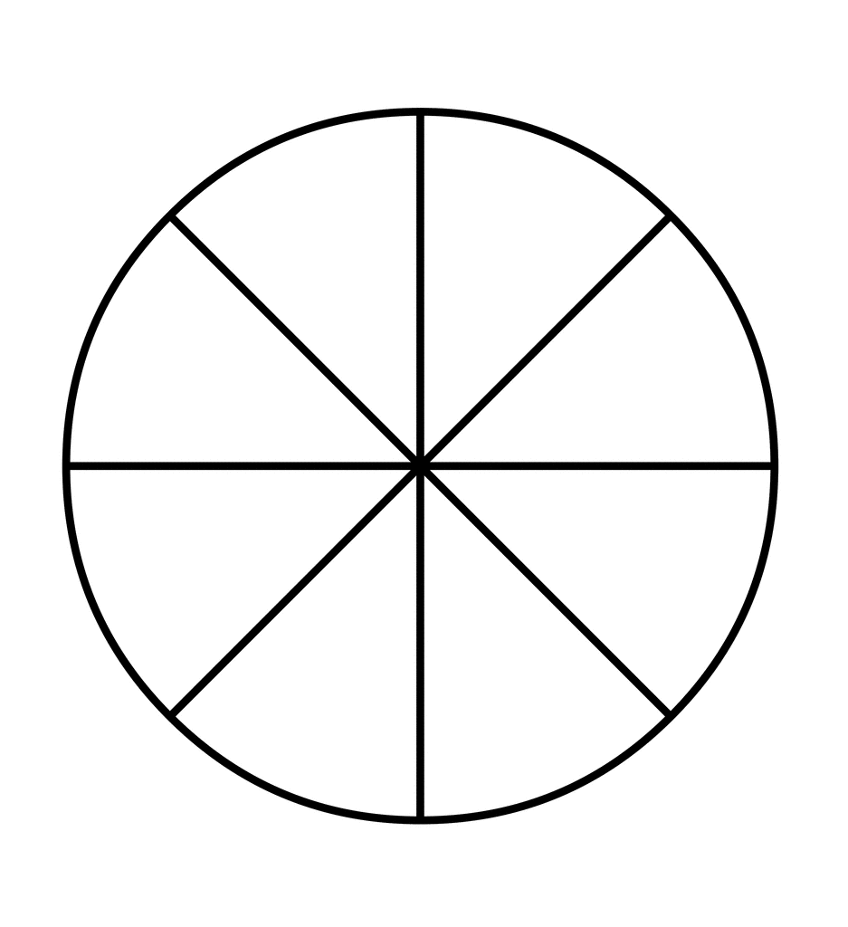
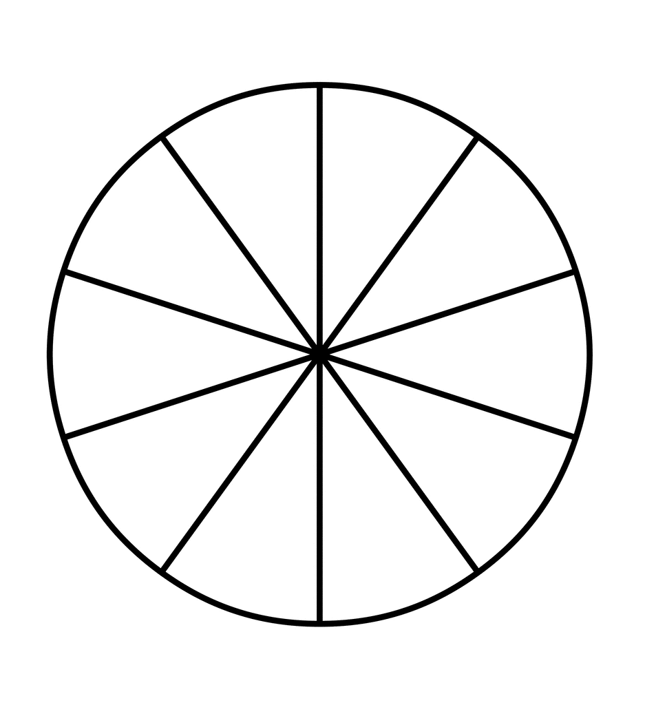
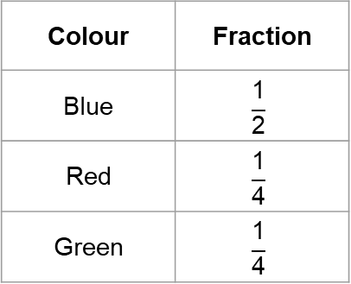
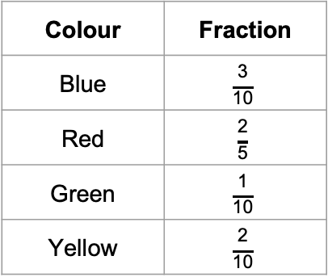
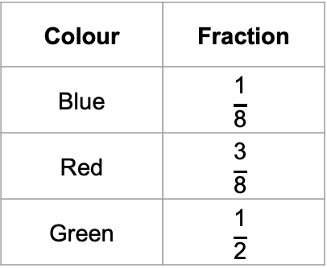
Introduction to Pie Charts – Drawing Proportions (1)
I DO | WE DO | YOU DO
The table below shows the fraction of all the people surveyed favourite colour Complete and label the pie chart. | The table below shows the fraction of all the people surveyed favourite colour Complete and label the pie chart. | The table below shows the fraction of all the people surveyed favourite colour Complete and label the pie chart.
Colour | Fraction
Blue | $$\frac{\text{1}}{\text{2}}$$
Red | $$\frac{\text{1}}{\text{4}}$$
Green | $$\frac{\text{1}}{\text{4}}$$
Colour | Fraction
Blue | $$\frac{\text{1}}{\text{8}}$$
Red | $$\frac{\text{3}}{\text{8}}$$
Green | $$\frac{\text{1}}{\text{2}}$$
Colour | Fraction
Blue | $$\frac{\text{3}}{\text{10}}$$
Red | $$\frac{\text{2}}{\text{5}}$$
Green | $$\frac{\text{1}}{\text{10}}$$
Yellow | $$\frac{\text{2}}{\text{10}}$$

Slide 9
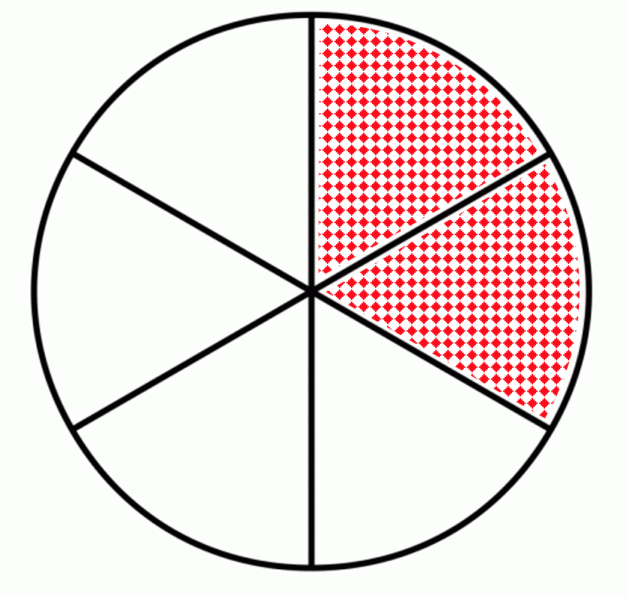
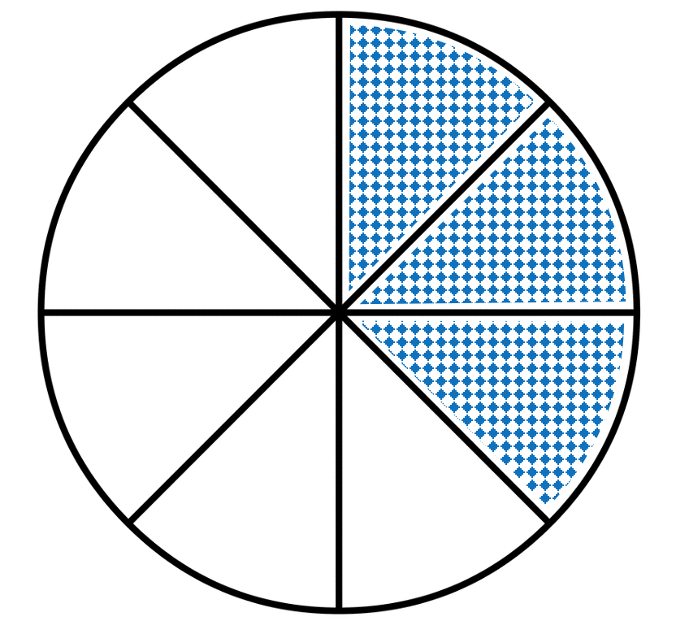
Introduction to Pie Charts – Drawing Proportions (2)
I DO | WE DO
Here is an INCOMPLETE pie chart. The table below gives some more information. Complete BOTH the table AND the pie chart. | Here is an INCOMPLETE pie chart. The table below gives some more information. Complete BOTH the table AND the pie chart.
Colour | Fraction | Frequency
Blue
Red
Green | ½
Total |  | 60
Colour | Fraction | Frequency
Blue |  | 24
Red |  | 16
Green
Total

Slide 10
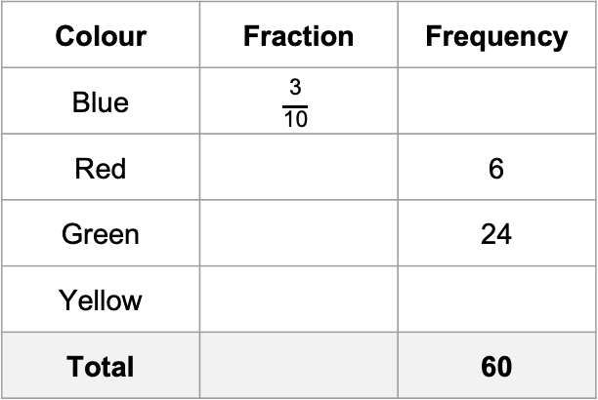
Introduction to Pie Charts – Drawing Proportions (2)
YOU DO 1 | YOU DO 2
Here is an INCOMPLETE pie chart. The table below gives some more information. Complete BOTH the table AND the pie chart. | Here is an INCOMPLETE pie chart. The table below gives some more information.
Colour | Fraction | Frequency
Blue |  | 30
Red | ½
Green
Total
Colour | Fraction | Frequency
Blue | $$\frac{\text{3}}{\text{10}}$$
Red |  | 6
Green |  | 24
Yellow
Total |  | 60

