Slide 1
Direct Proportion $$y∝x^{2}, y∝x^{3}, y∝\sqrt{x}$$
Full lesson PowerPoint, including I Do, We Do, You Do Example Sheet(s).

Slide 2
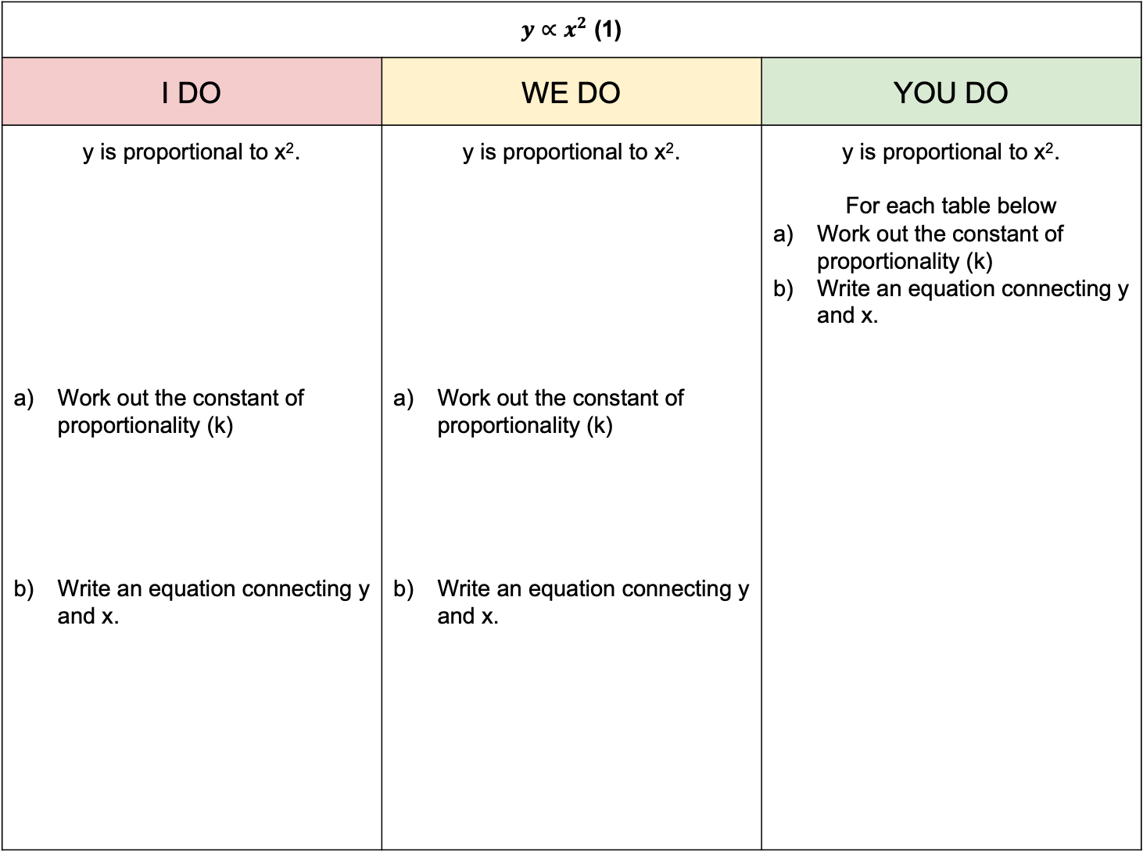
$y∝x^{2}$ (1)
I DO | WE DO | YOU DO
y is proportional to x². Work out the constant of proportionality (k) Write an equation connecting y and x. | y is proportional to x². Work out the constant of proportionality (k) Write an equation connecting y and x. | y is proportional to x². For each table below Work out the constant of proportionality (k) Write an equation connecting y and x.
X | 1 | 2 | 5
Y | 3 | 12 | 75
X | 1 | 3 | 7
Y | 5 | 45 | 245
X | 1 | 2 | 3
Y | 2 | 8 | 18
X | 1 | 3 | 5
Y | 6 | 54 | 150
X | 2 | 5 | 10
Y | 12 | 75 | 300

Slide 3
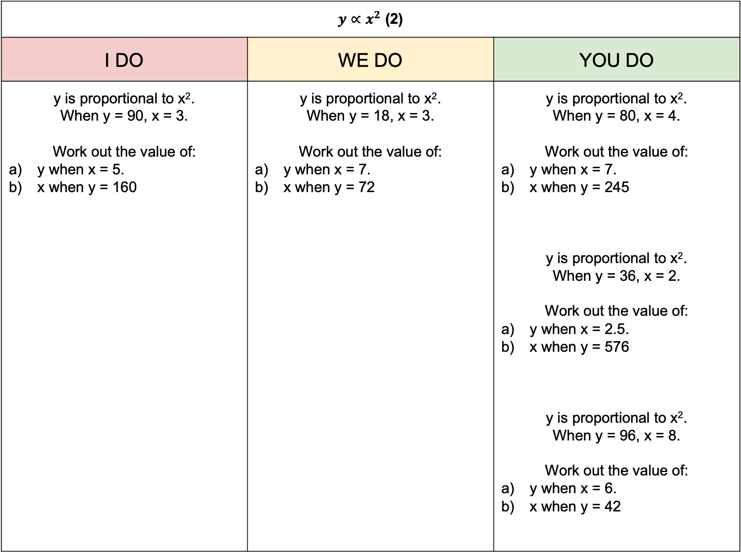
$y∝x^{2}$ (2)
I DO | WE DO | YOU DO
y is proportional to x². When y = 90, x = 3. Work out the value of: y when x = 5. x when y = 160 | y is proportional to x². When y = 18, x = 3. Work out the value of: y when x = 7. x when y = 72 | y is proportional to x². When y = 80, x = 4. Work out the value of: y when x = 7. x when y = 245 y is proportional to x². When y = 36, x = 2. Work out the value of: y when x = 2.5. x when y = 576 y is proportional to x². When y = 96, x = 8. Work out the value of: y when x = 6. x when y = 42

Slide 4
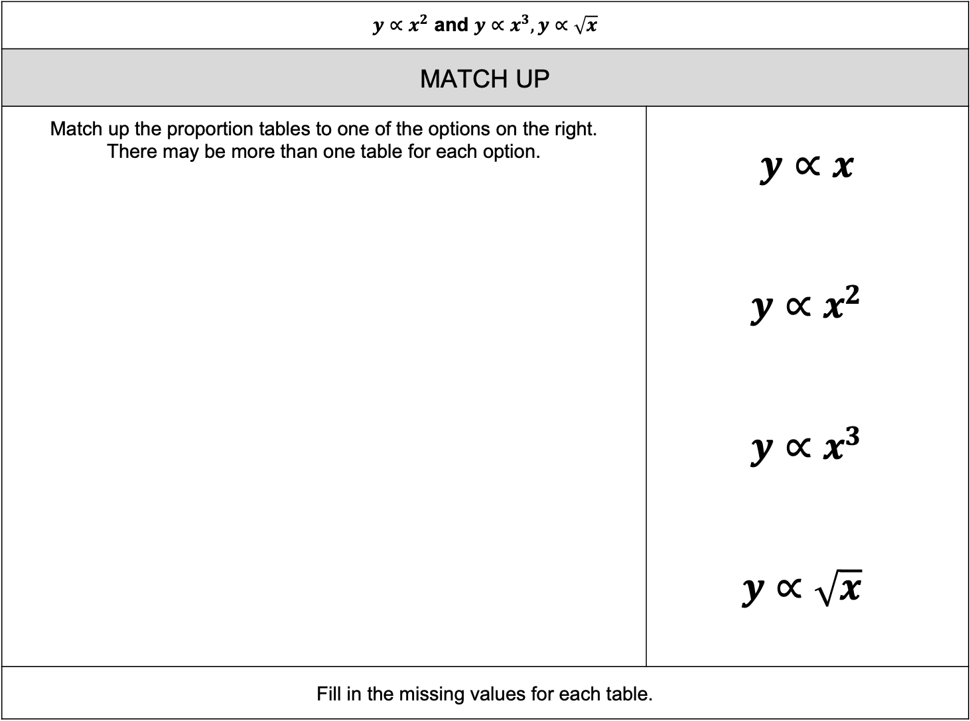
$y∝x^{2}$ and $y∝x^{3}, y∝\sqrt{x}$
MATCH UP | YOU DO
Match up the proportion tables to one of the options on the right. There may be more than one table for each option. | $$y∝x$$ $$y∝x^{2}$$ $$y∝x^{3}$$ $y∝\sqrt{x}$
Fill in the missing values for each table.
X | 1 | 4 | 5
Y | 2 | 32 | 50 | 98
X | 1 | 3 |  | 10
Y | 6 | 18 | 24
X | 16 | 25 |  | 100
Y | 8 | 10 | 12
X | 1 | 2 | 3
Y | 4 | 16 |  | 250

Slide 5
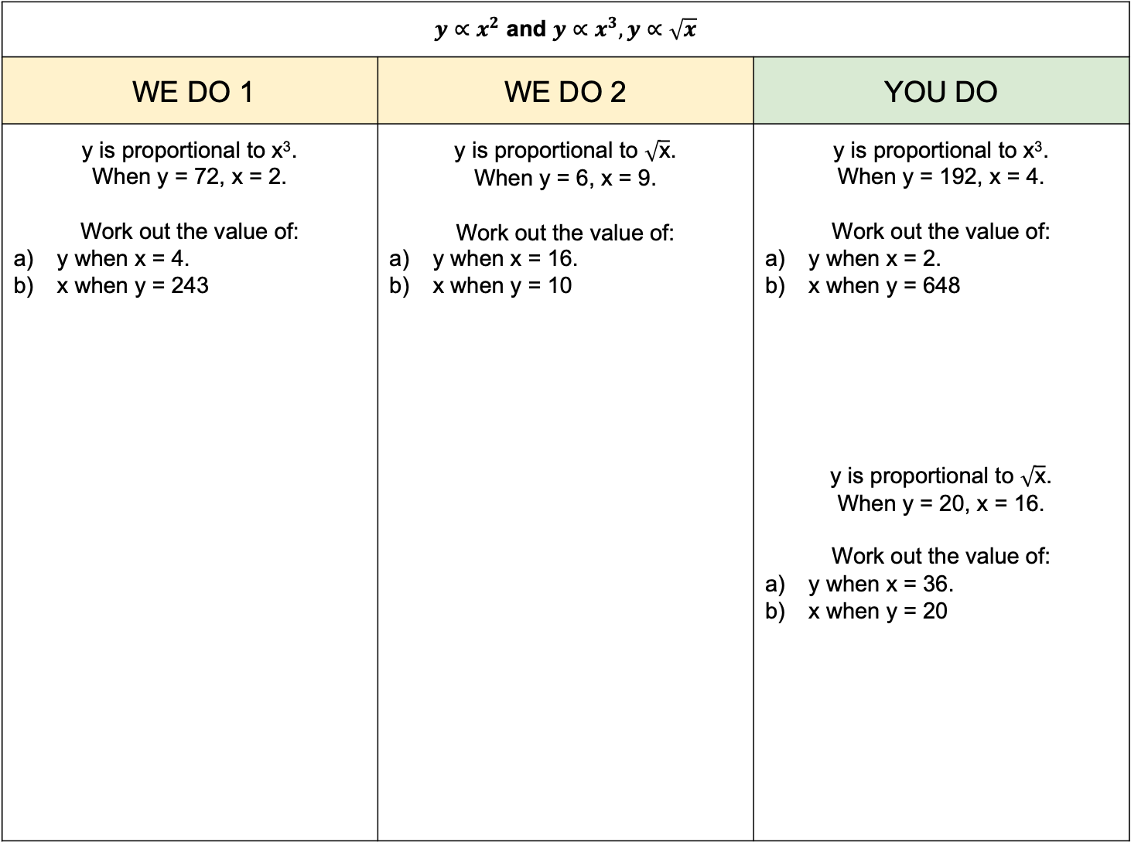
$y∝x^{2}$ and $y∝x^{3}, y∝\sqrt{x}$
WE DO 1 | WE DO 2 | YOU DO
y is proportional to x³. When y = 72, x = 2. Work out the value of: y when x = 4. x when y = 243 | y is proportional to $\sqrt{\text{x}}$. When y = 6, x = 9. Work out the value of: y when x = 16. x when y = 10 | y is proportional to x³. When y = 192, x = 4. Work out the value of: y when x = 2. x when y = 648 y is proportional to $\sqrt{\text{x}}$. When y = 20, x = 16. Work out the value of: y when x = 36. x when y = 20

