Slide 1
Prime Factor Decomposition
Full lesson PowerPoint, including I Do, We Do, You Do Example Sheet(s).

Slide 2
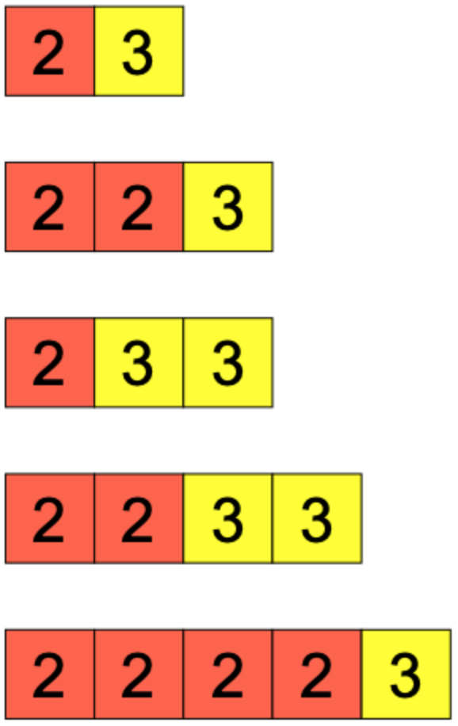
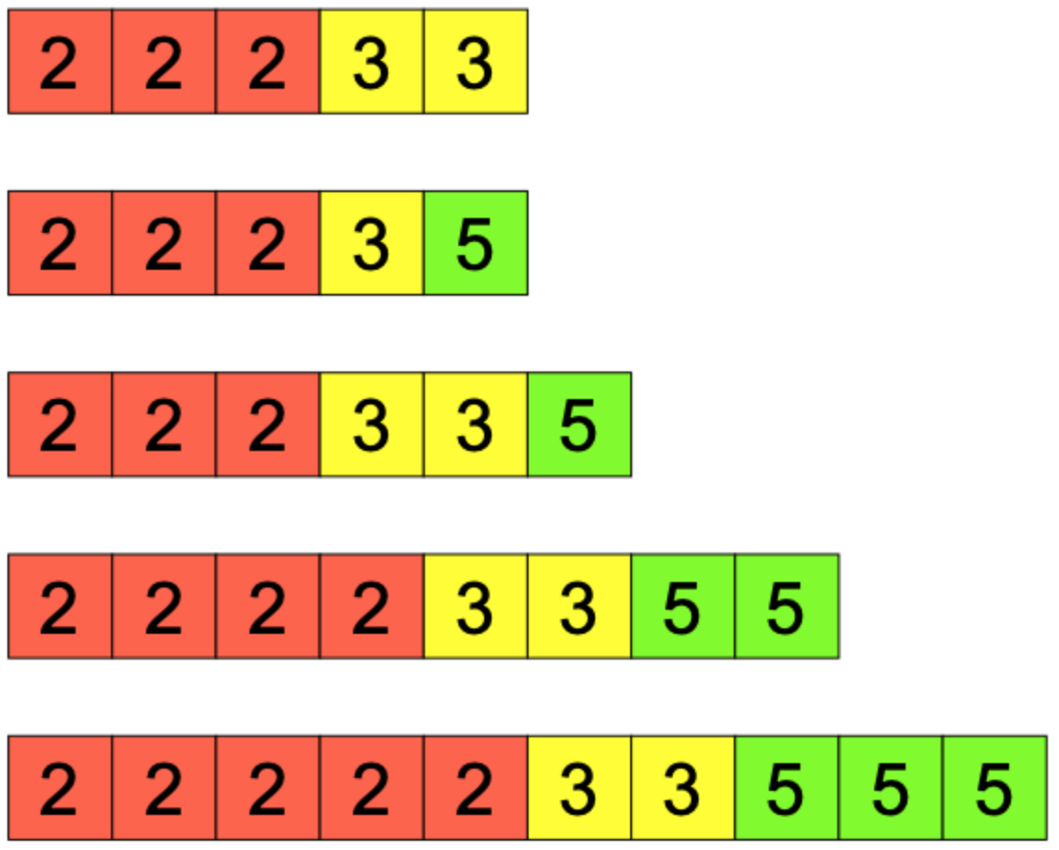
Using Prime Factor Tiles
I DO | WE DO | YOU DO
A number is represented using the prime factor tiles below: What is the number? Write the number as a product of prime factors in index form. | A number is represented using the prime factor tiles below: What is the number? Write the number as a product of prime factors in index form. | For each of the representations below, write down: The number it represents The number as a product of prime factors in index form

Slide 3
Using Prime Factor Tiles – Types of Numbers
I DO | WE DO | YOU DO
Represent the number 100 using Prime Factor Tiles. What type of number is 100? Redraw the Prime Factor Tile diagram to confirm your answer above. | Represent the number 144 using Prime Factor Tiles. What type of number is 144? Redraw the Prime Factor Tile diagram to confirm your answer above. | Represent the number 64 using Prime Factor Tiles. What type of number is 64? Redraw the Prime Factor Tile diagram to confirm your answer above. Is this the only answer?

Slide 4
Prime Factor Decomposition
I DO | WE DO | YOU DO
Represent the number 50 as a product of prime factors. Use a different pair of factors in your first step, do you get the same answer? | Represent the number 56 as a product of prime factors. Use a different pair of factors in your first step, do you get the same answer? | Represent each of the following numbers as a product of prime factors 6 12 18 36 48 72 120 360 3600 36000

Slide 5
Prime Factor Decomposition
I DO | WE DO | YOU DO
2ª x 3^{b} x 5^{c} represents a number as a product of prime factors. What are the three smallest numbers that this could represent? What would a, b and c be in each case? What is the smallest square number that this number could be? | 2ª x 3^{b} x 7^{c} represents a number as a product of prime factors. What are the three smallest numbers that this could represent? What would a, b and c be in each case? What is the smallest square number that this number could be? | 2ª x 5^{b} x 7^{c} represents a number as a product of prime factors. What are the three smallest numbers that this could represent? What would a, b and c be in each case? What is the smallest square number that this number could be? What is the smallest cube number that this number could be?

