Slide 1
Squares, Square Roots, Cubes and Cube Roots
Full lesson PowerPoint, including I Do, We Do, You Do Example Sheet(s).

Slide 2
Square Numbers and Square Roots
I DO | WE DO | YOU DO
Use a diagram to find the value of 4². | Use a diagram to find the value of 5^{2.} | Use a diagram to find the value of 3^{2.} Use a diagram to find the value of 6^{2.}
I DO | WE DO | YOU DO
Use a diagram to find the value of $\sqrt{\text{16}}$ | Use a diagram to find the value of $\sqrt{\text{25}}$ | Use a diagram to find the value of $\sqrt{\text{9}}$ Use a diagram to find the value of $\sqrt{\text{36}}$

Slide 3
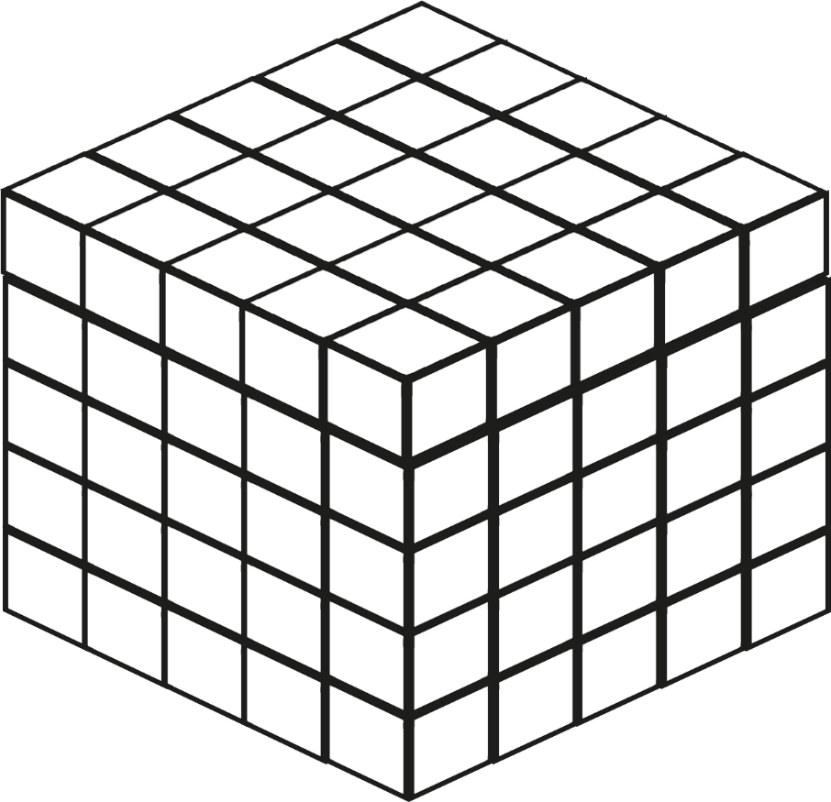
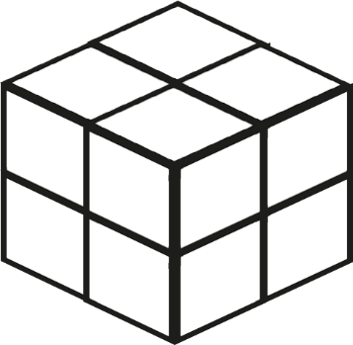
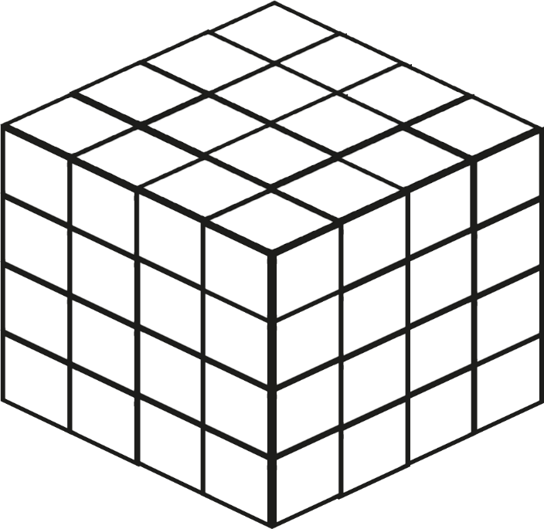
Cube Numbers and Cube Roots
I DO | WE DO | YOU DO
How many cubes make up this diagram? What is the relationship between the volume and the length of each side? | How many cubes make up this diagram? What is the relationship between the volume and the length of each side? | How many cubes make up this diagram? What is the relationship between the volume and the length of each side?

Slide 4
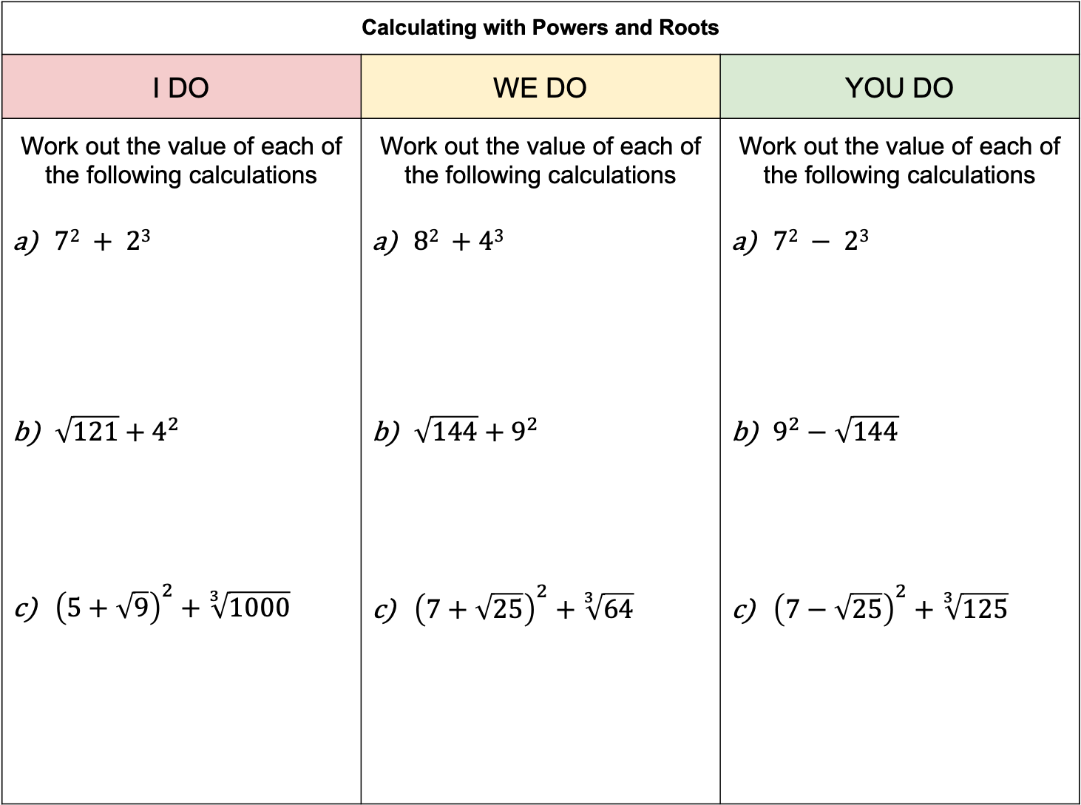
Calculating with Powers and Roots
I DO | WE DO | YOU DO
Work out the value of each of the following calculations $72 + 23$ $\sqrt{121}+4^{2}$ ${\left(5+\sqrt{9}\right)}^{2}+\sqrt[3]{1000}$ | Work out the value of each of the following calculations $82 +43$ $\sqrt{144}+9^{2}$ ${\left(7+\sqrt{25}\right)}^{2}+\sqrt[3]{64}$ | Work out the value of each of the following calculations $72 − 23$ $9^{2}−\sqrt{144}$ ${\left(7−\sqrt{25}\right)}^{2}+\sqrt[3]{125}$

Slide 5
Write a value that could go in each part of the Venn diagram with a letter.
If it is impossible to find a number for any part, explain why.
Even Number
Square Number
A
B
C
D

Slide 6
Prime Number
Square Number
A
B
C
D

Slide 7
Square Number
Cube Number
A
B
C
D

Slide 8
Square Number
Cube Number
A
B
D
G
E
F
H
C
Factor of 32

