Slide 1
Adding and Subtracting Surds
Full lesson PowerPoint, including I Do, We Do, You Do Example Sheet(s).

Slide 2
 | Adding and Subtracting Surds

Slide 3
 |  |  | Adding and Subtracting Surds
Learning Outcomes
 | I help simplifying surds
 | I can add and subtract surds when given pictorially (Grade 5)
 | I can add and subtract surds without the need for simplification (Grade 5)
 | I can add and subtract surds where one or more surds need simplifying (Grade 6)
 | I can apply my knowledge to a geometrical problems (Grade 6/7)

Slide 4
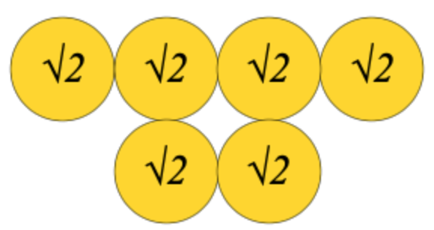
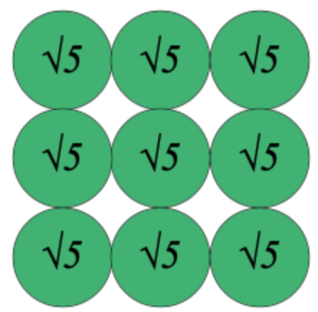
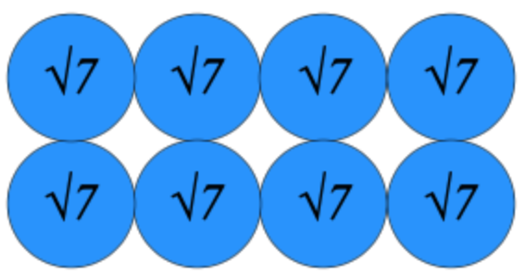
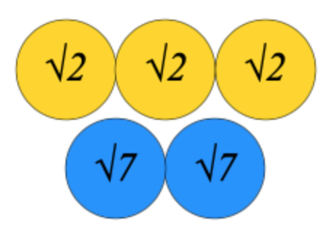
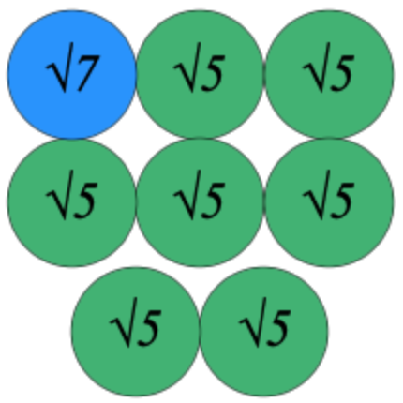
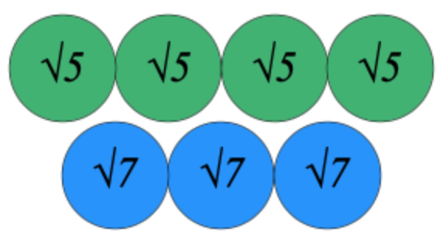
Adding and Subtracting Surds – Pictorial Representations
I DO | WE DO | YOU DO
Write the representation shown below in the form $\text{a}\sqrt{\text{b}}$ | Write the representation shown below in the form $\text{a}\sqrt{\text{b}}$ | Write the representation shown below in the form $\text{a}\sqrt{\text{b}}$
Write the representation shown below in the form $\text{a}\sqrt{\text{b}}$ + $\text{c}\sqrt{\text{d}}$ | Write the representation shown below in the form$\text{a}\sqrt{\text{b}}$ + $\text{c}\sqrt{\text{d}}$ | Write the representation shown below in the form $\text{a}\sqrt{\text{b}}$ + $\text{c}\sqrt{\text{d}}$

Slide 5
Adding and Subtracting Surds 1
I DO | WE DO | YOU DO
Write the following in its simplest form $$\sqrt{\text{6}}\text{ +} \sqrt{\text{6}}\text{ +}\sqrt{\text{6}}$$ Write the following in its simplest form $$\sqrt{\text{5}}\text{ +} \sqrt{\text{5}}\text{ +}\sqrt{\text{6}}$$ | Write the following in its simplest form $$\sqrt{\text{8}}\text{ +} \sqrt{\text{8}}\text{ +}\sqrt{\text{8}}$$ Write the following in its simplest form $$\sqrt{\text{5}}\text{ +} \sqrt{\text{5}}\text{ +}\sqrt{\text{6}} \text{+}\sqrt{\text{6}}$$ | Write the following in its simplest form $$\sqrt{\text{10}} \text{+} \sqrt{\text{10}} \text{+}\sqrt{\text{10}}$$ Write the following in its simplest form $$\sqrt{\text{5}} \text{+} \sqrt{\text{6}} \text{+}\sqrt{\text{6}} \text{+}\sqrt{\text{6}}$$

Slide 6
Adding and Subtracting Surds 2
I DO | WE DO | YOU DO
Write the following in its simplest form $$\sqrt{\text{20}}\text{ +} \sqrt{\text{20}}\text{ +}\sqrt{\text{20}}$$ | Write the following in its simplest form $$\sqrt{\text{20}}\text{ +} \sqrt{\text{20}}\text{ +}\sqrt{\text{20}} \text{+}\sqrt{\text{20}}$$ | Write the following in its simplest form $$\sqrt{\text{18}} \text{+} \sqrt{\text{18}} \text{+}\sqrt{\text{18}} \text{+}\sqrt{\text{18}}$$

Slide 7
Adding and Subtracting Surds 3
I DO | WE DO | YOU DO
Write the following in the form a$\sqrt{\text{b}}$ $$\text{5}\sqrt{\text{2}}\text{ + }\text{3}\sqrt{\text{2}}$$ Write the following in the form a$\sqrt{\text{b}}$ $$\text{9}\sqrt{\text{10}} − \sqrt{\text{10 }}\text{+ }\text{5}\sqrt{\text{10}}$$ | Write the following in the form a$\sqrt{\text{b}}$ $$\text{5}\sqrt{\text{7}}\text{ + }\text{3}\sqrt{\text{7}}$$ Write the following in the form a$\sqrt{\text{b}}$ $$\text{9}\sqrt{\text{10}} + \sqrt{\text{10 }}− \text{5}\sqrt{\text{10}}$$ | Write the following in the form a$\sqrt{\text{b}}$ $$\text{5}\sqrt{\text{7}}\text{ + }\text{2}\sqrt{\text{7}}$$ Write the following in the form a$\sqrt{\text{b}}$ $$\text{9}\sqrt{\text{10}} − \sqrt{\text{10 }}− \text{5}\sqrt{\text{10}}$$

Slide 8
Adding and Subtracting Surds 4
I DO | WE DO | YOU DO
Write the following in its simplest form $$\sqrt{\text{18}}\text{ + }\sqrt{\text{36}}$$ Write the following in its simplest form $$\sqrt{\text{75}} − \sqrt{\text{48} }$$ | Write the following in its simplest form $$\sqrt{\text{96}}\text{ + }\sqrt{\text{54}}$$ Write the following in its simplest form $$\text{3}\sqrt{\text{27}} +2\sqrt{12}$$ | Write the following in its simplest form $$\sqrt{\text{108}} \text{−} \sqrt{\text{48}}$$ Write the following in its simplest form $$\text{3}\sqrt{\text{48}} + \sqrt{\text{27} }$$

