Slide 1
Comparing Fractions
I Do, We Do, You Do Examples

Slide 2
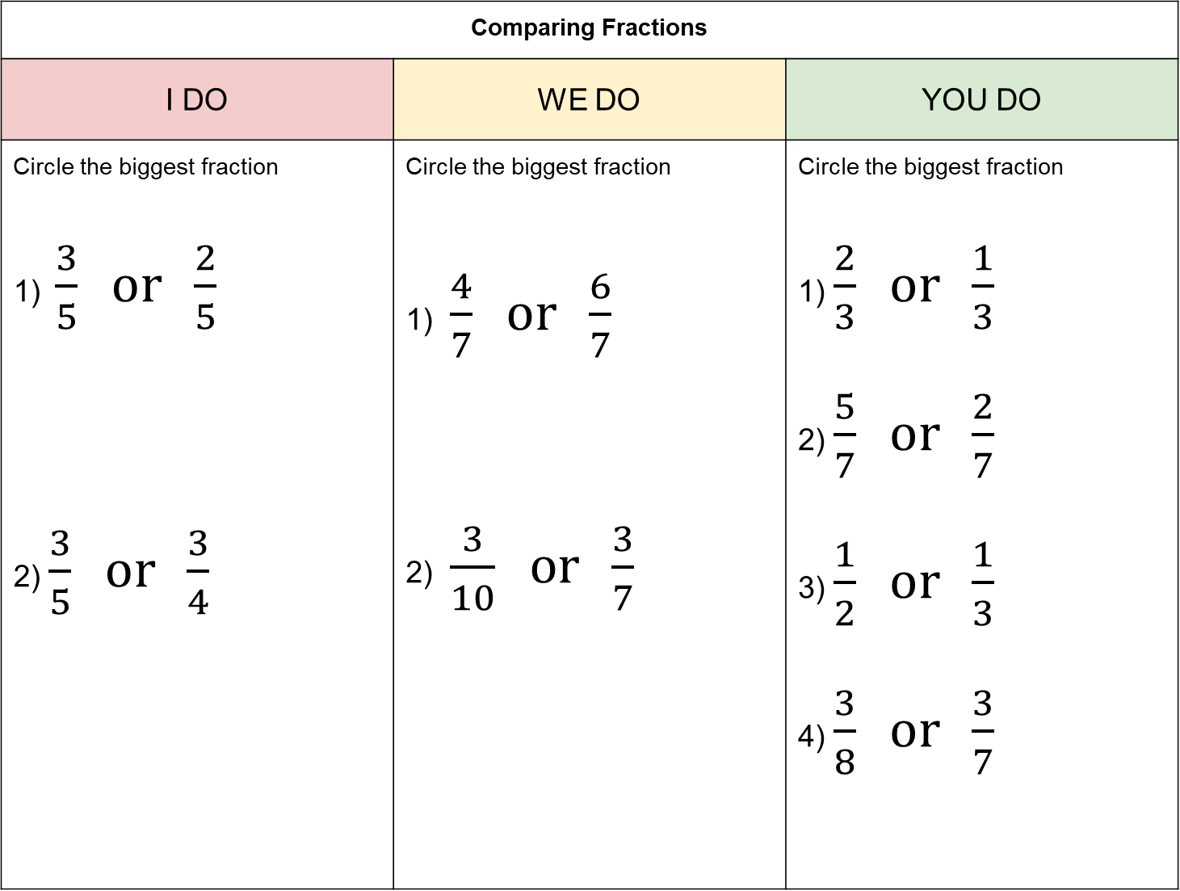
Comparing Fractions
I DO | WE DO | YOU DO
Circle the biggest fraction 1) $\frac{3}{5} or \frac{2}{5}$ 2) $\frac{3}{5} or \frac{3}{4}$ | Circle the biggest fraction 1) $\frac{4}{7} or \frac{6}{7}$ 2) $\frac{3}{10} or \frac{3}{7}$ | Circle the biggest fraction 1) $\frac{2}{3} or \frac{1}{3}$ 2) $\frac{5}{7} or \frac{2}{7}$ 3) $\frac{1}{2} or \frac{1}{3}$ 4) $\frac{3}{8} or \frac{3}{7}$
?
?
?

Slide 3
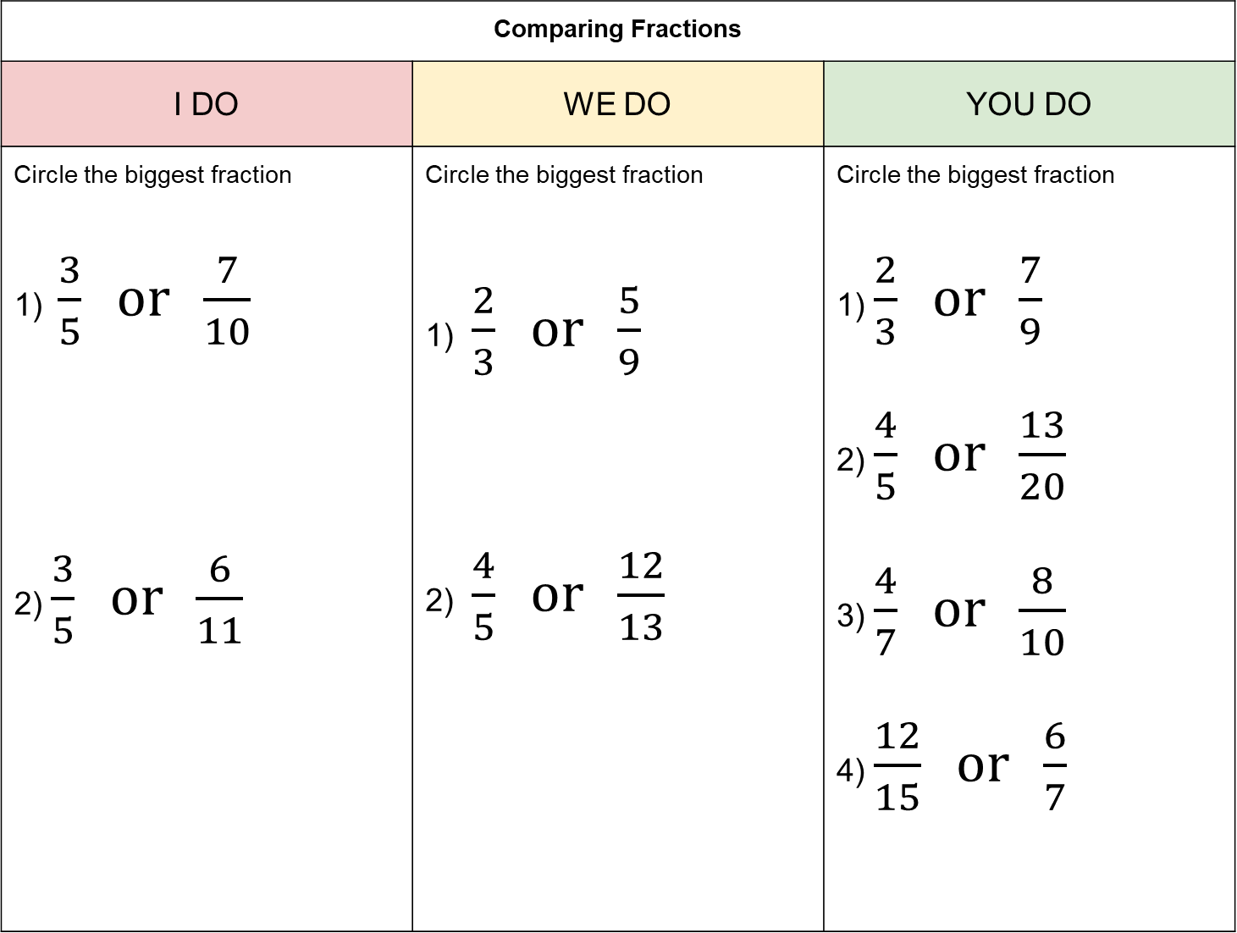
Comparing Fractions
I DO | WE DO | YOU DO
Circle the biggest fraction 1) $\frac{3}{5} or \frac{7}{10}$ 2) $\frac{3}{5} or \frac{6}{11}$ | Circle the biggest fraction 1) $\frac{2}{3} or \frac{5}{9}$ 2) $\frac{4}{5} or \frac{12}{13}$ | Circle the biggest fraction 1) $\frac{2}{3} or \frac{7}{9}$ 2) $\frac{4}{5} or \frac{13}{20}$ 3) $\frac{4}{7} or \frac{8}{10}$ 4) $\frac{12}{15} or \frac{6}{7}$
?
?
?

Slide 4
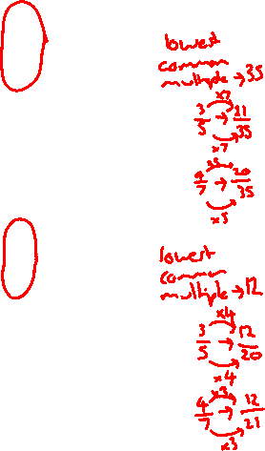
Comparing Fractions
I DO | WE DO | YOU DO
Circle the biggest fraction 1) $\frac{3}{5} or \frac{4}{7}$ 2) $\frac{3}{5} or \frac{4}{7}$ | Circle the biggest fraction 1) $\frac{2}{3} or \frac{3}{5}$ 2) $\frac{4}{7} or \frac{9}{15}$ | Circle the biggest fraction 1) $\frac{2}{3} or \frac{4}{5}$ 2) $\frac{3}{8} or \frac{5}{12}$ 3) $\frac{3}{7} or \frac{4}{11}$ 4) $\frac{2}{9} or \frac{5}{13}$
?
?
?

