Slide 1

Volume of a Cuboid
Full lesson PowerPoint, including I Do, We Do, You Do Example Sheet(s).

Slide 2
 | Volume of a Cuboid

Slide 3
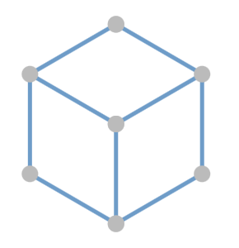
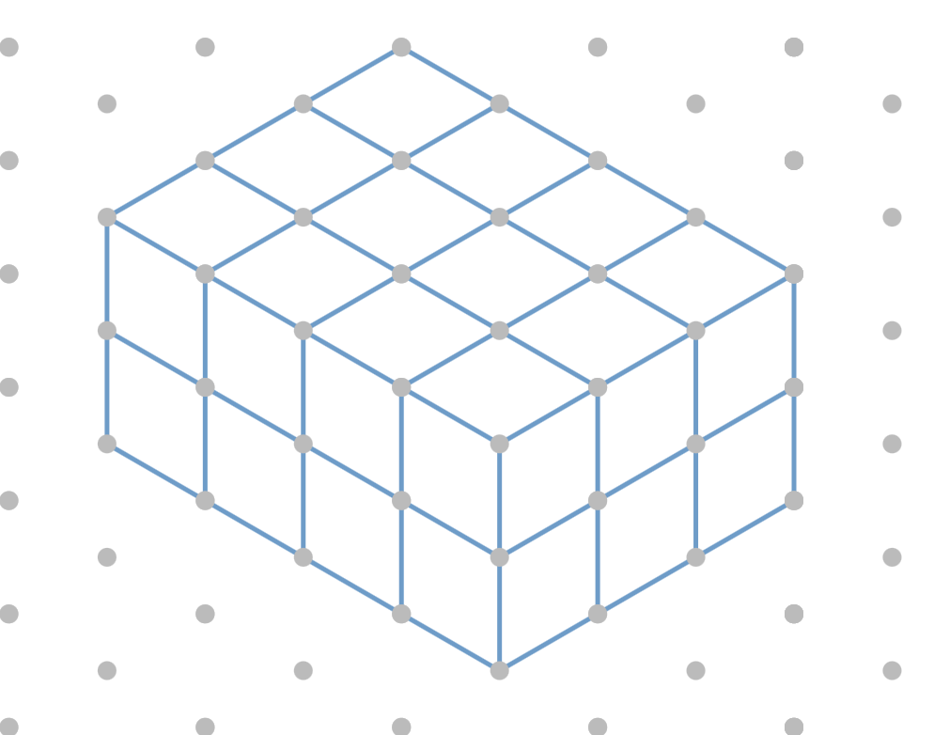
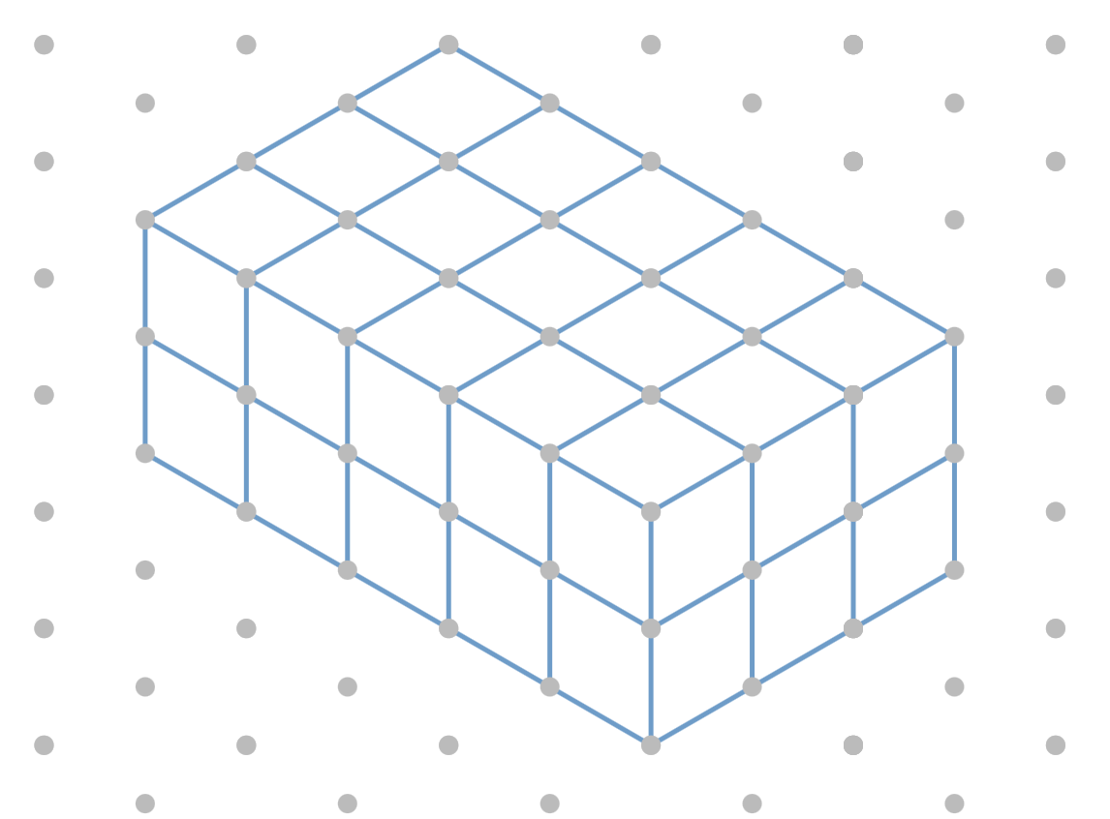
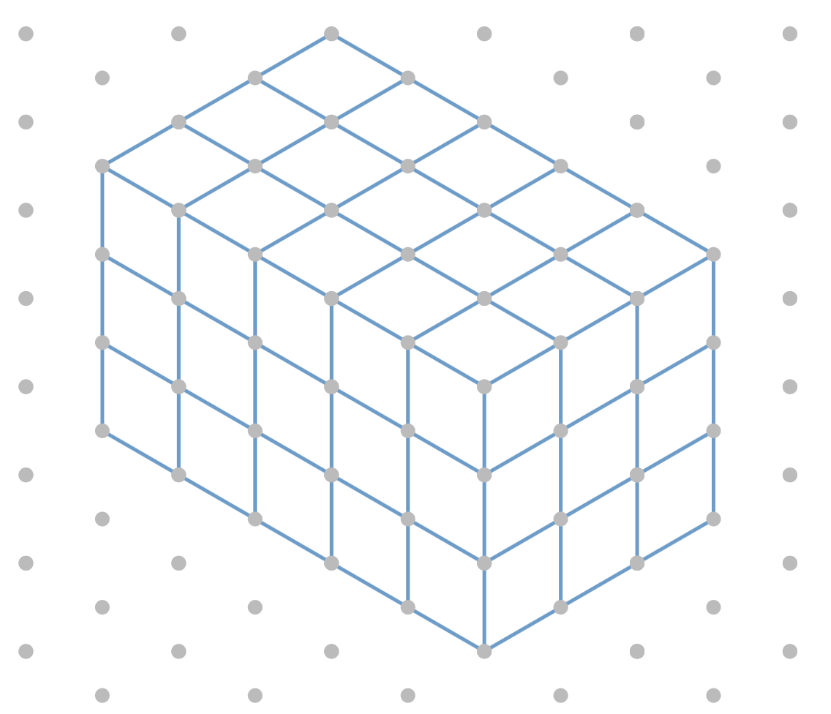
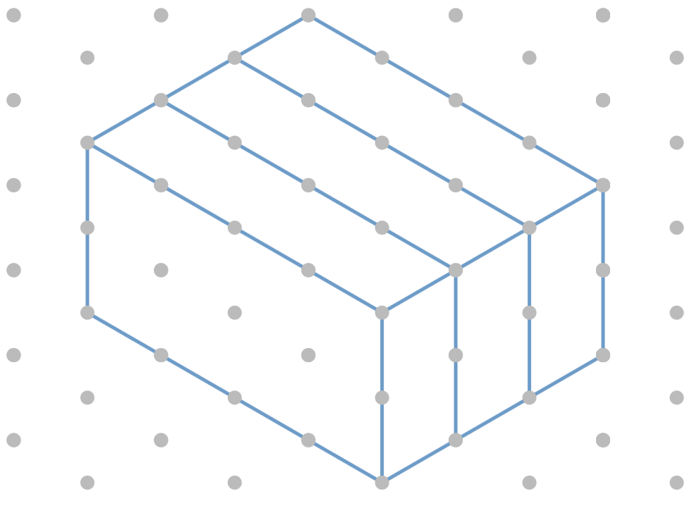
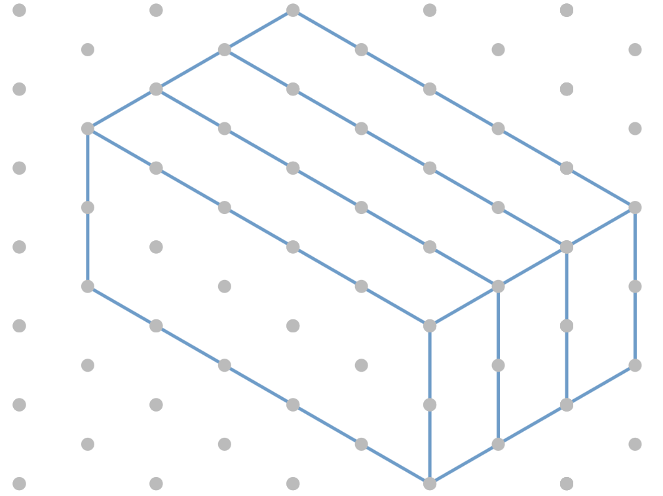
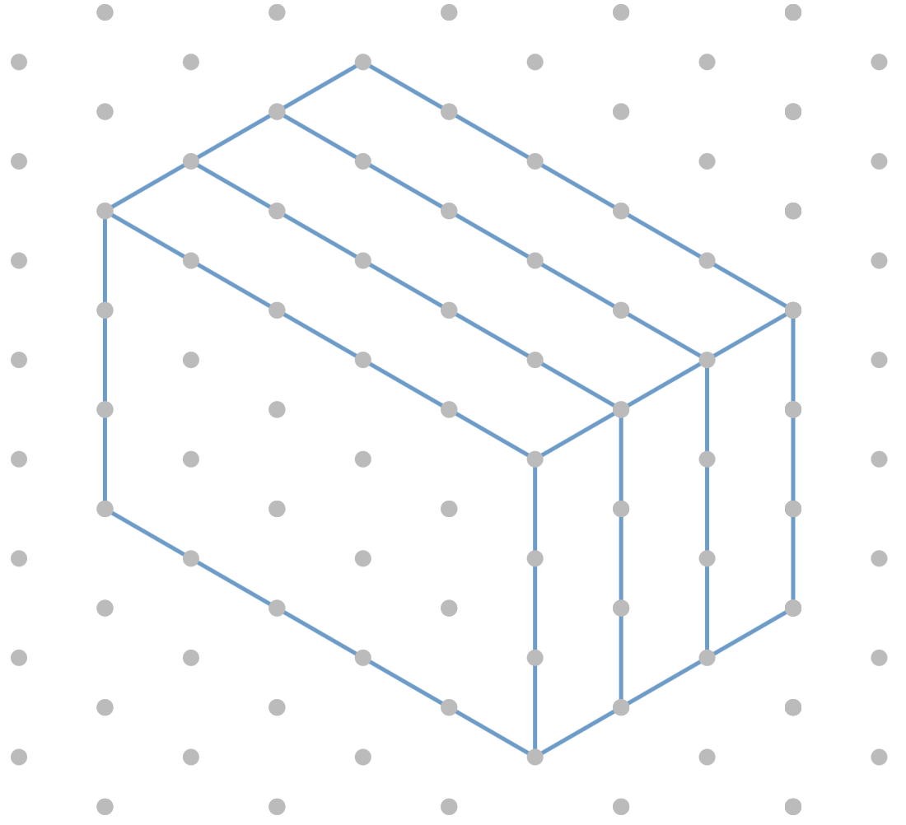
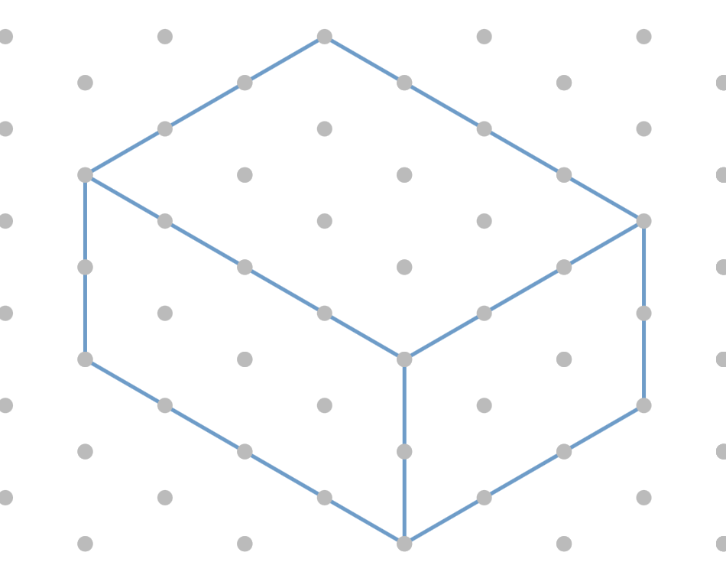
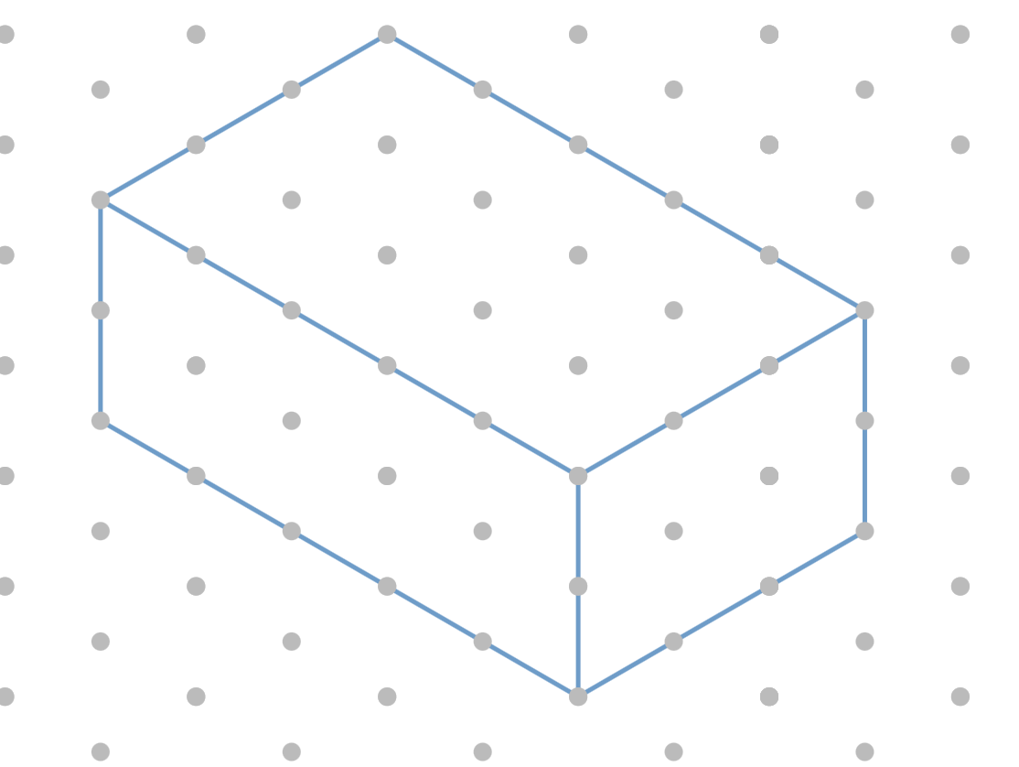
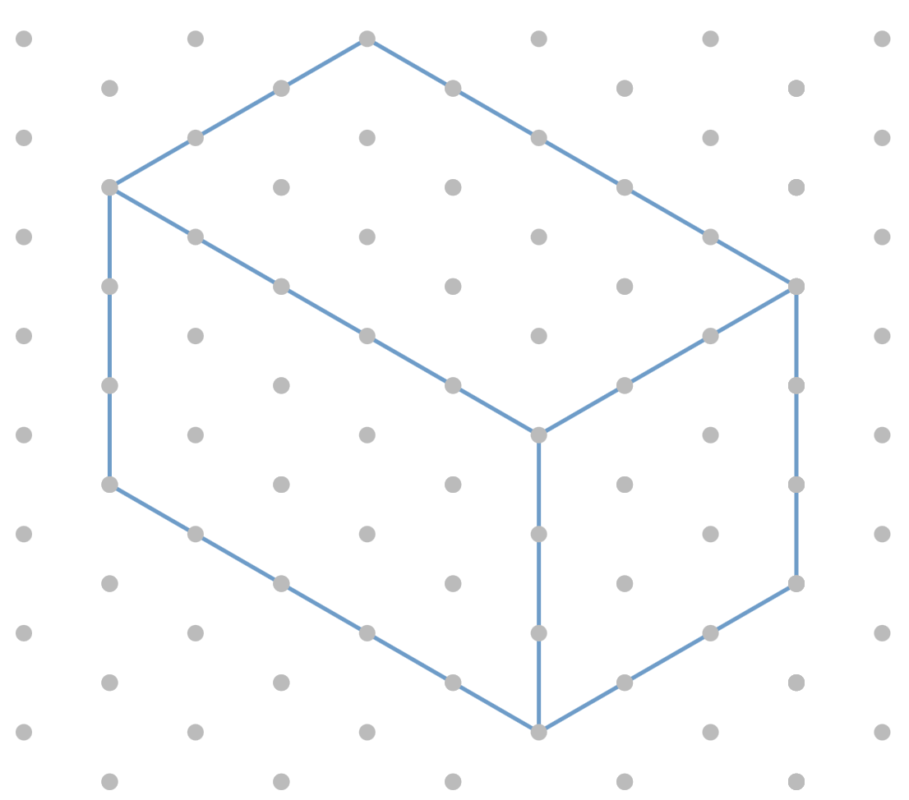
Volume of a Cuboid using Cross-Section
I DO | WE DO | YOU DO
For each of the following shapes:
a) Write down the length of each dimension | b) Shade in the cross-section of each shape | c) Calculate the volume of the shape.
= 1cm³

Slide 4
Volume of a Cuboid using Cross-Section
I DO | WE DO | YOU DO
By calculating the area of the cross-section, calculate the volume of each of the following cuboids. All dimensions are in cm.
4
4
5
2
3
2
6
6
6
5
2
7

Slide 5
Volume of a Cuboid
YOU DO
By calculating the area of the cross-section, calculate the volume of each of the following cuboids. All dimensions are in cm. WORK ACROSS NOT DOWN.
3
3
3
5
1
5
2
5
4
3
6
6
10
4
10
4
10
8
9
9
9
10
8
15
12
15
1.2

Slide 6
Volume – Working Backwards
I DO | WE DO | YOU DO
Work out the missing dimension given the volume of the shape. All dimensions are in cm.
Volume = 60cm³
Volume = 120cm³
Volume = 240cm³
3
3
3
2
2
?
?
?
20
Volume = 300cm³
3
?
20

Slide 7
Volume – Working Backwards
YOU DO
Work out the missing dimension given the volume of the shape. All dimensions are in cm. WORK ACROSS NOT DOWN.
There are multiple answers for this last question.
V=10cm³
V=10cm³
V=20cm³
2
?
?
5
?
5
2
5
2
V=30cm³
V=60cm³
V=60cm³
?
?
?
5
2
5
2
10
2
V=60cm³
V=72cm³
V=144cm³
?
?
?
5
4
6
4
?
?

