Slide 1
Simplifying Surds
I Do, We Do, You Do Examples

Slide 2
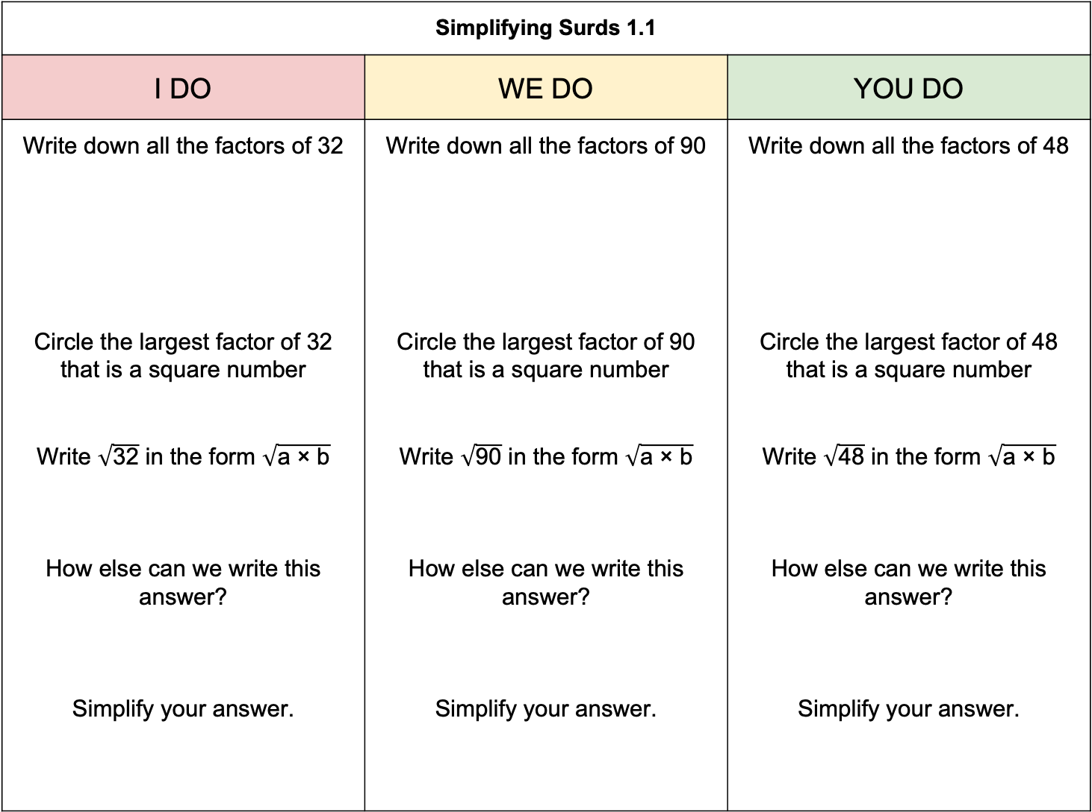
Simplifying Surds 1.1
I DO | WE DO | YOU DO
Write down all the factors of 32 Circle the largest factor of 32 that is a square number Write $\sqrt{\text{32}}$ in the form $\sqrt{\text{a} \text{×} \text{b}}$ How else can we write this answer? Simplify your answer. | Write down all the factors of 90 Circle the largest factor of 90 that is a square number Write $\sqrt{\text{90}}$ in the form $\sqrt{\text{a}\text{ × }\text{b}}$ How else can we write this answer? Simplify your answer. | Write down all the factors of 48 Circle the largest factor of 48 that is a square number Write $\sqrt{\text{48}}$ in the form $\sqrt{\text{a}\text{ × }\text{b}}$ How else can we write this answer? Simplify your answer.

Slide 3
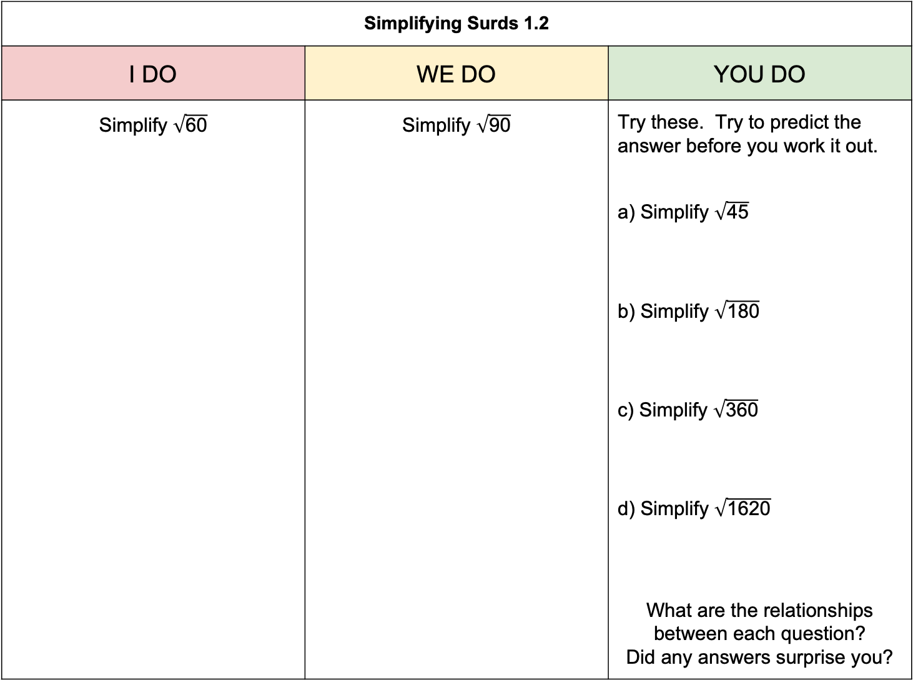
Simplifying Surds 1.2
I DO | WE DO | YOU DO
Simplify $\sqrt{\text{60}}$ | Simplify $\sqrt{\text{9}\text{0}}$ | Try these. Try to predict the answer before you work it out. a) Simplify $\sqrt{\text{45}}$ b) Simplify $\sqrt{\text{180}}$ c) Simplify $\sqrt{\text{360}}$ d) Simplify $\sqrt{\text{1620}}$ What are the relationships between each question? Did any answers surprise you?

