Slide 1
nth Term of a Linear Sequences (Using Cuisenaire Rods)
Full lesson PowerPoint with emphasis on understanding how to calculate the linear sequences through using Cuisenaire Rods.

Slide 2
Generating sequences recap:
Copy the nth term in your books followed by the first 5 terms of the sequence
3n + 2
5n + 4
6n – 3
½ n + 3
-3n + 2
5, 8, 11, 14, 17
9, 14, 19, 24, 29
3, 9, 15, 21, 27
3.5, 4, 4.5, 5, 5.5
-1, -4, -7, -10, -13
?
?
?
?
?

Slide 3
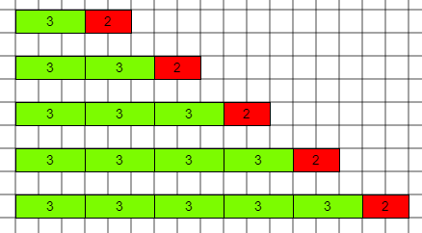
Describe what is happening in this sequence

Slide 4
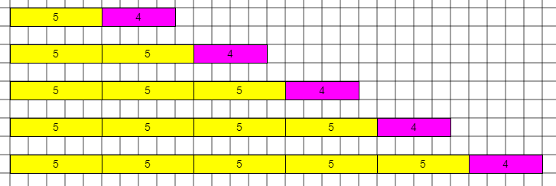
What about these?

Slide 5
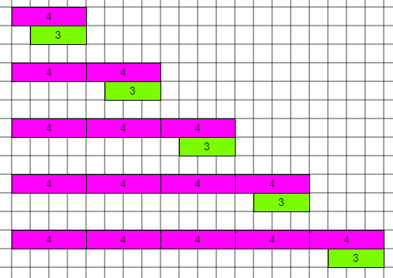
What could this show?

Slide 6
Describe what the picture would look like for this sequence
7, 13, 19, 25, 31

Slide 7
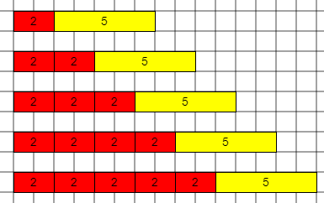
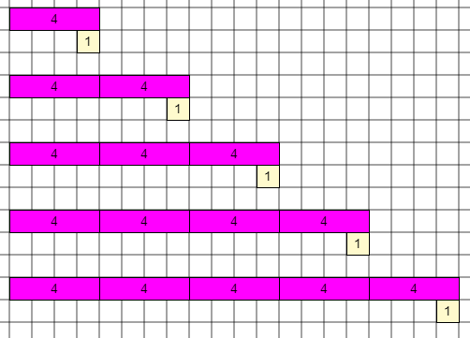
What about these sequences
7, 9, 11, 13, 15 3, 7, 11, 15, 19

Slide 8
What were our rules?
How would we write the nth term for:
10, 16, 22, 28, 34
Diagram if needed

Slide 9
Write the nth term for these sequences
8, 15, 22, 29, 36
9, 16, 23, 30, 37
6, 13, 20, 27, 34
?
7n + 1
7n + 2
7n - 1
?
?
Can you spot any links?

Slide 10
Now try these:
Extension:
Find the nth term for the following sequences:
4, 12, 20, 28
9, 10, 11, 12
6, 10, 14, 18
1, 6, 11, 16
4, 11, 18, 25
17, 13, 9, 5
8n – 4
n + 8
4n + 2
5n – 4
7n – 3
-4n + 21
Find the 125th term in this sequence:
7, 11, 15, 19, …
?
?
?
?
?
nth term = 4n +3
125th term = 4 x 125 + 3
= 503
?
?

