Slide 1
Formal Direct Proportion
Full lesson PowerPoint, including I Do, We Do, You Do Example Sheet(s).

Slide 2
Direct Proportion Tables (1)
I DO | WE DO | YOU DO
X and Y are directly proportional in the tables below. For each table, find the missing value in two different ways.
a) b) | a) b) | a) b) c) d)
X | 1
Y | 7 | 28
X | 1 | 2
Y | 6
X | 1
Y | 7 | 28
X | 1
Y | 7 | 35
X | 1 | 4
Y |  | 22
X |  | 4
Y | 24 | 32
X | 1 | 7
Y |  | 35
X |  | 6
Y | 14 | 42

Slide 3
Direct Proportion Tables (2)
I DO | WE DO | YOU DO
X and Y are directly proportional in the tables below. For each a) Find the constant of proportionality (k) b) Find the missing value(s) c) Write an equation connecting Y and Y.
 |  | a) b) c)
X | 1 | 2
Y | 5
X | 1 | 9
Y |  | 27
X | 1 | 8
Y | 4
X | 1 | 10
Y |  | 50
X |  | 12
Y | 30 | 72

Slide 4
Formal Direct Proportion (1)
I DO | WE DO | YOU DO
X and Y are directly proportional. When X = 1, Y = 3. Write an equation linking X and Y and find the constant of proportionality (k). Use your answer to part a) to find the value of Y when X = 4. Use your answer to part a) to find the value of X when Y = 30. | X and Y are directly proportional. When X = 1, Y = 5. Write an equation linking X and Y and find the constant of proportionality (k). Use your answer to part a) to find the value of Y when X = 4. Use your answer to part a) to find the value of X when Y = 30. | X and Y are directly proportional. When X = 1, Y = 6. Write an equation linking X and Y and find the constant of proportionality (k). Use your answer to part a) to find the value of Y when X = 4. Use your answer to part a) to find the value of X when Y = 42.

Slide 5
Formal Direct Proportion (2)
I DO | WE DO | YOU DO
X and Y are directly proportional. When X = 2, Y = 12. Write an equation linking X and Y and find the constant of proportionality (k). Use your answer to part a) to find the value of Y when X = 4. Use your answer to part a) to find the value of X when Y = 72. | X and Y are directly proportional. When X = 3, Y = 12. Write an equation linking X and Y and find the constant of proportionality (k). Use your answer to part a) to find the value of Y when X = 4. Use your answer to part a) to find the value of X when Y = 72. | X and Y are directly proportional. When X = 3, Y = 24. Write an equation linking X and Y and find the constant of proportionality (k). Use your answer to part a) to find the value of Y when X = 9. Use your answer to part a) to find the value of X when Y = 72.

Slide 6
Formal Direct Proportion (3)
I DO | WE DO | YOU DO
X and Y are directly proportional. When X = 2, Y = 20. a) Find Y when X = 5. b) Find X when Y = 90. | X and Y are directly proportional. When X = 4, Y = 20. a) Find Y when X = 5. b) Find X when Y = 90. | X and Y are directly proportional. When X = 2, Y = 20. a) Find Y when X = 3. b) Find X when Y = 100. When X = 5, Y = 40. a) Find Y when X = 15. b) Find X when Y = 100.

Slide 7
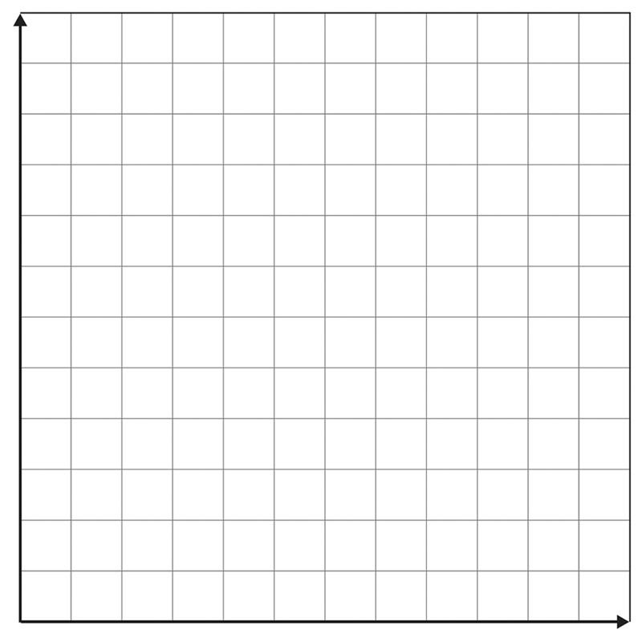
Plotting Direct Proportion
I DO | WE DO | YOU DO
X and Y are directly proportional. When X = 5, Y = 40. a) Find Y when X = 2. b) Find X when Y = 8. c) Plot this on the axes below. | X and Y are directly proportional. When X = 4, Y = 20. a) Find Y when X = 3. b) Find X when Y = 35. c) Plot this on the axes below. | X and Y are directly proportional. When X = 5, Y = 20. a) Find Y when X = 2. b) Find X when Y = 32. c) Plot this on the axes below.
EXTENSION: What key features do you notice a Direct Proportion Graph always has?

