Slide 1
Scatter Graphs & Correlation
Full lesson PowerPoint, including I Do, We Do, You Do Example Sheet(s).

Slide 2
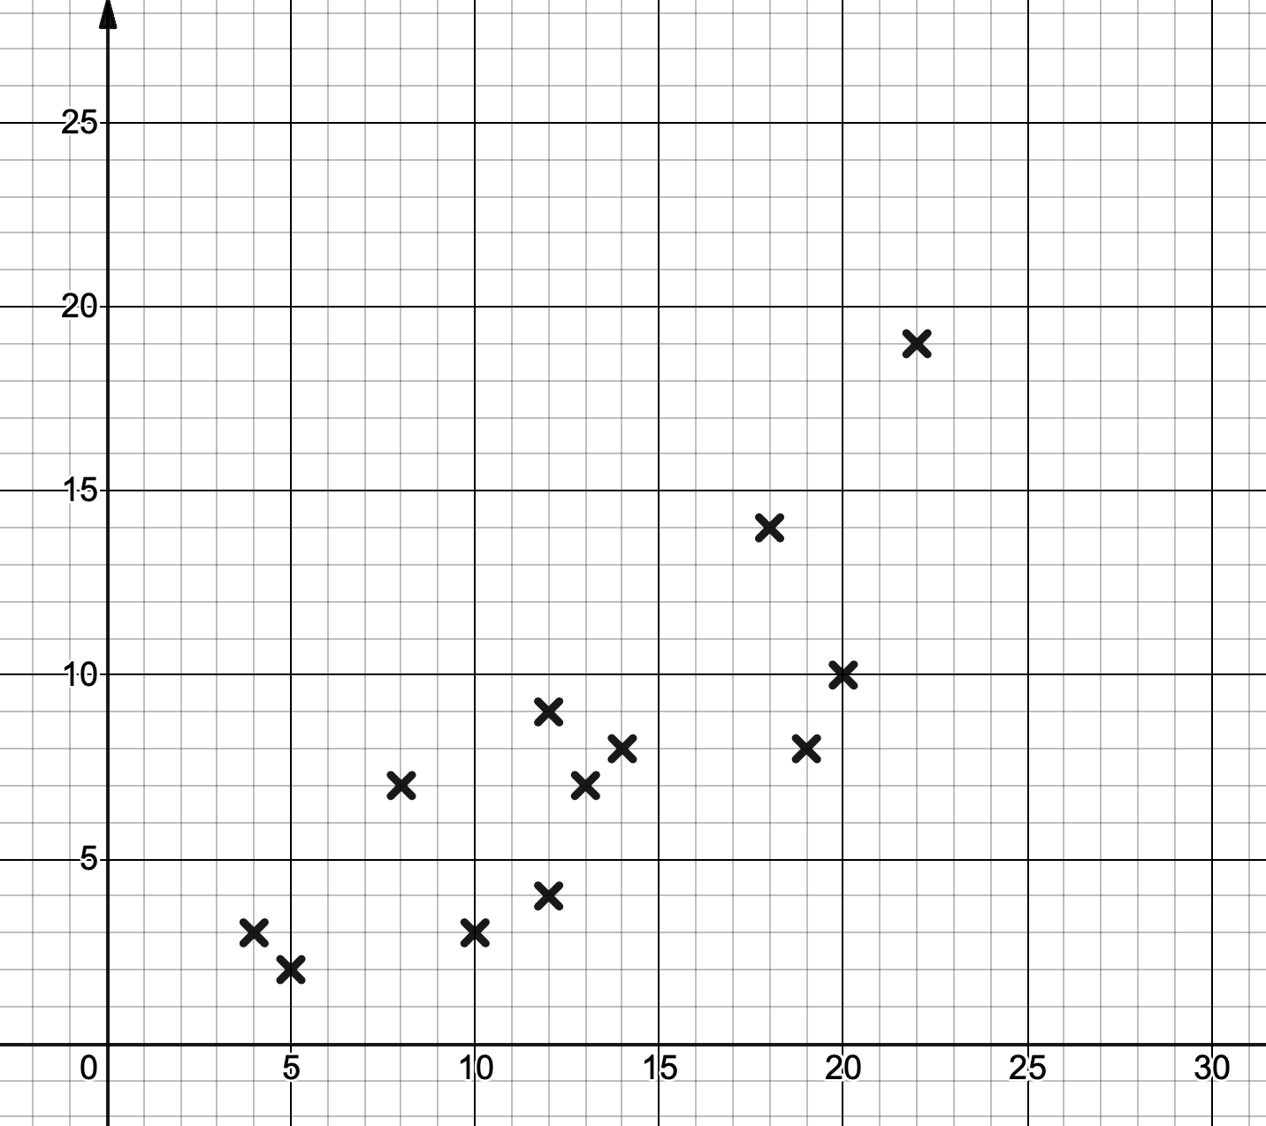
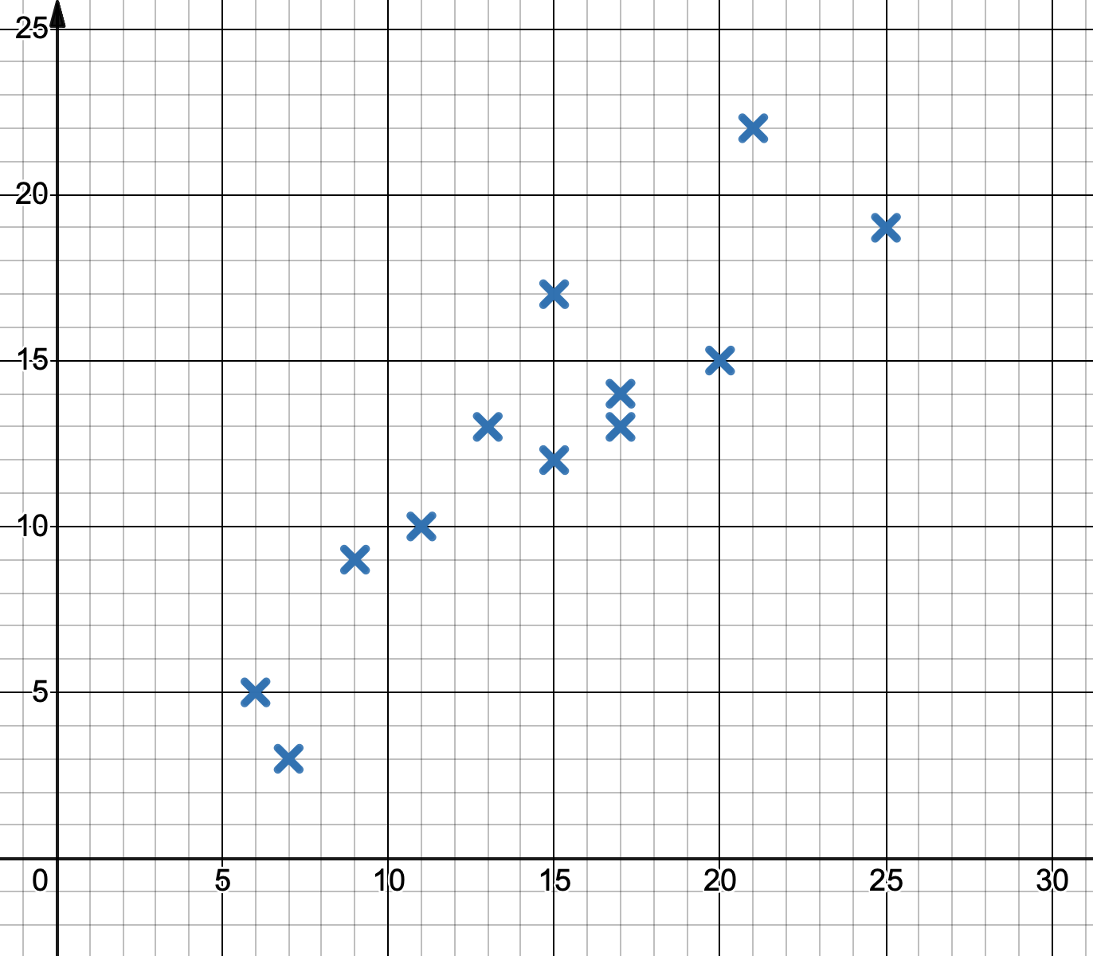
Plotting Points on a Scatter Graph
WE DO | YOU DO
The scatter graphs below show the temperatures on certain days and the number of ice creams sold in a shop. Complete each set of data by plotting the final five points given in the table.
Temp (ºC) | 15 | 12 | 16 | 23 | 25
Ice Creams Sold | 10 | 5 | 12 | 25 | 26
Temp (ºC) | 10 | 15 | 18 | 9 | 22
Ice Creams Sold | 5 | 9 | 22 | 6 | 17
Ice Creams Sold
Ice Creams Sold
Temp (ºC)
Temp (ºC)

Slide 3
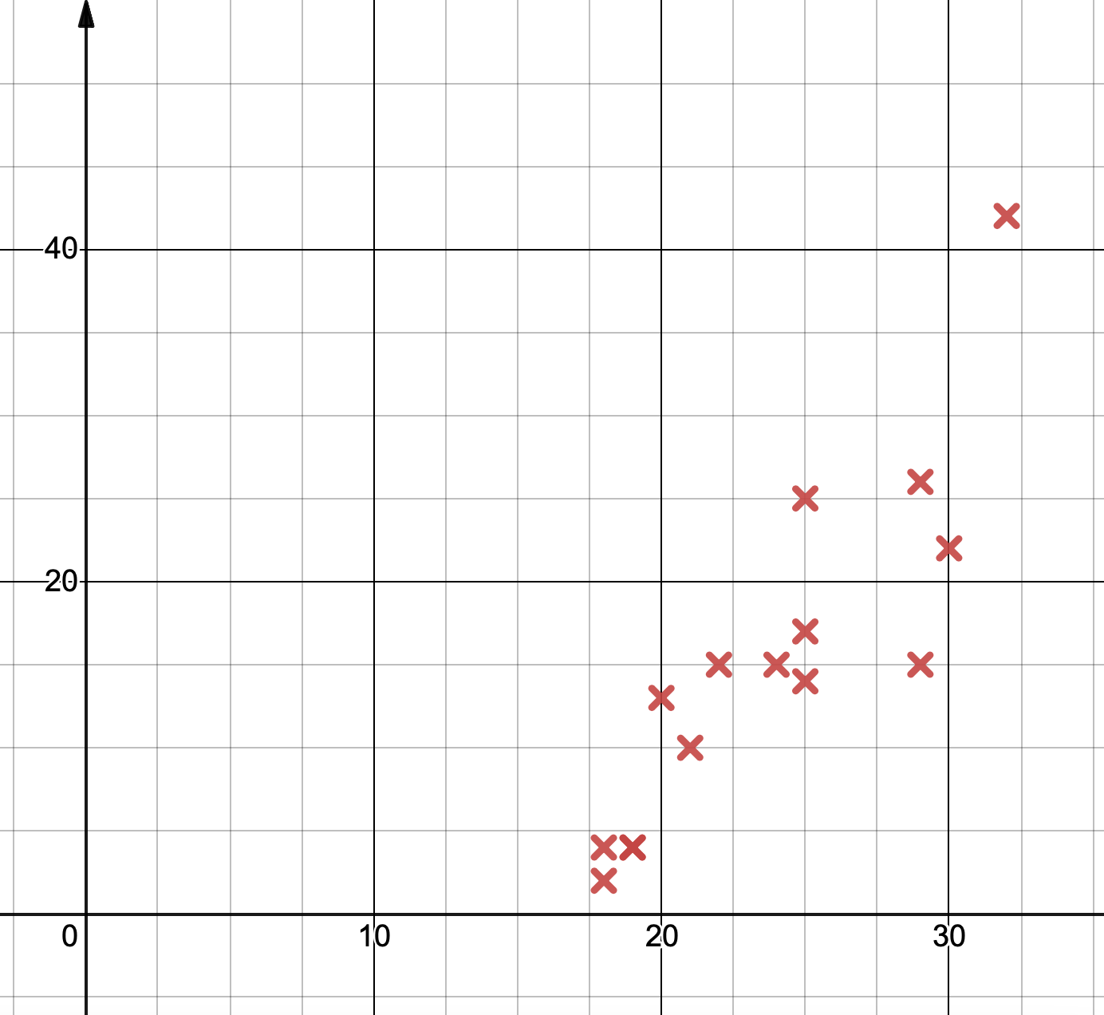
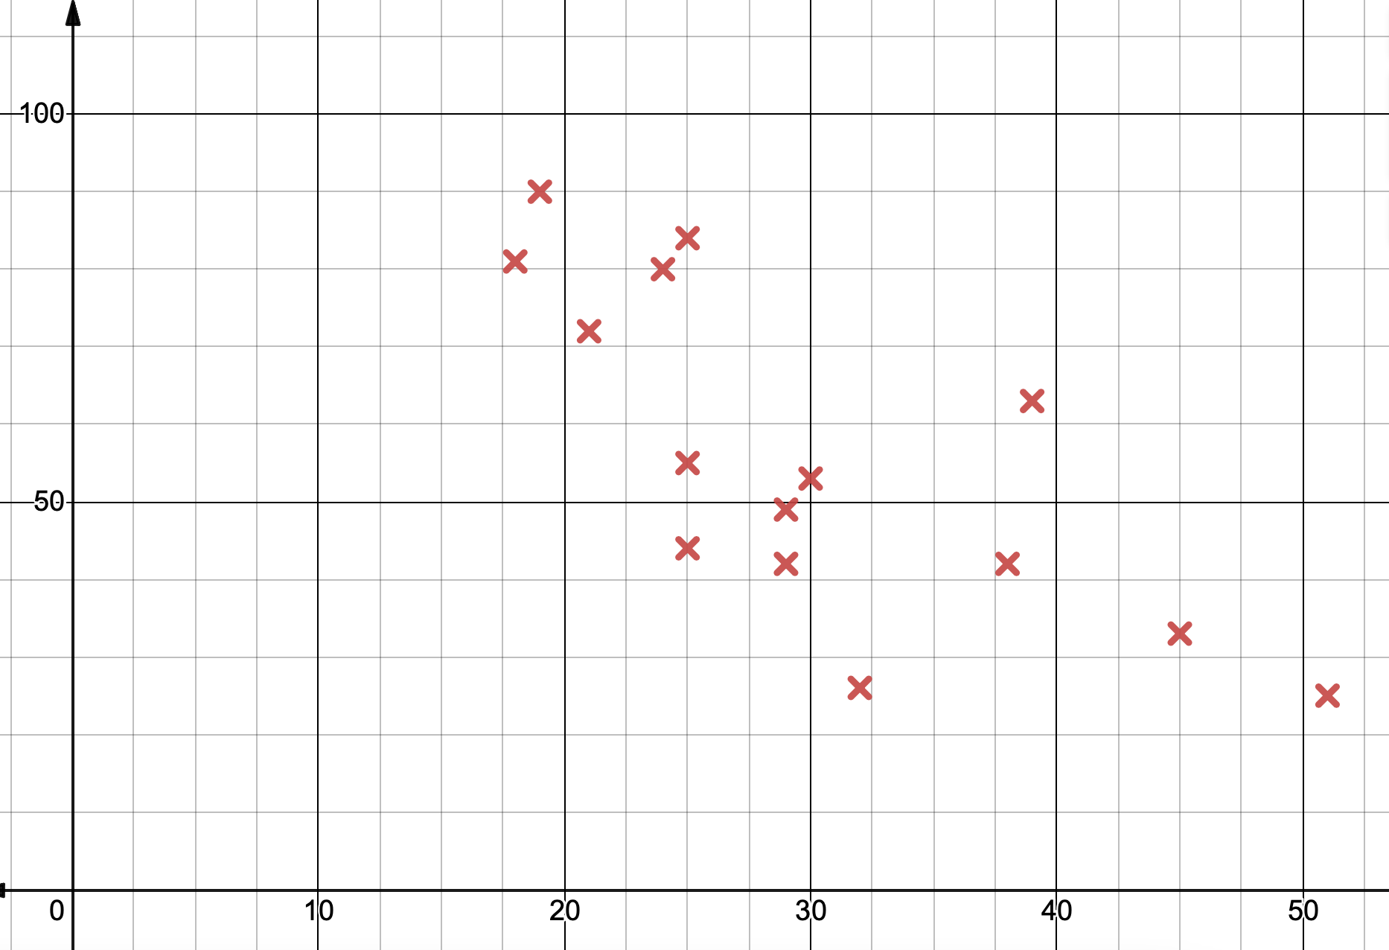
Correlation and Interpreting Scatter Graphs
WE DO | YOU DO 1
For each set of data below, state: a The type of correlation shown b An interpretation for the data
Average number of minutes played by a group of football players at different ages.
Number of appearances by a group of football players by age..
Number of minutes per game
Number of times played
Age
Age

Slide 4
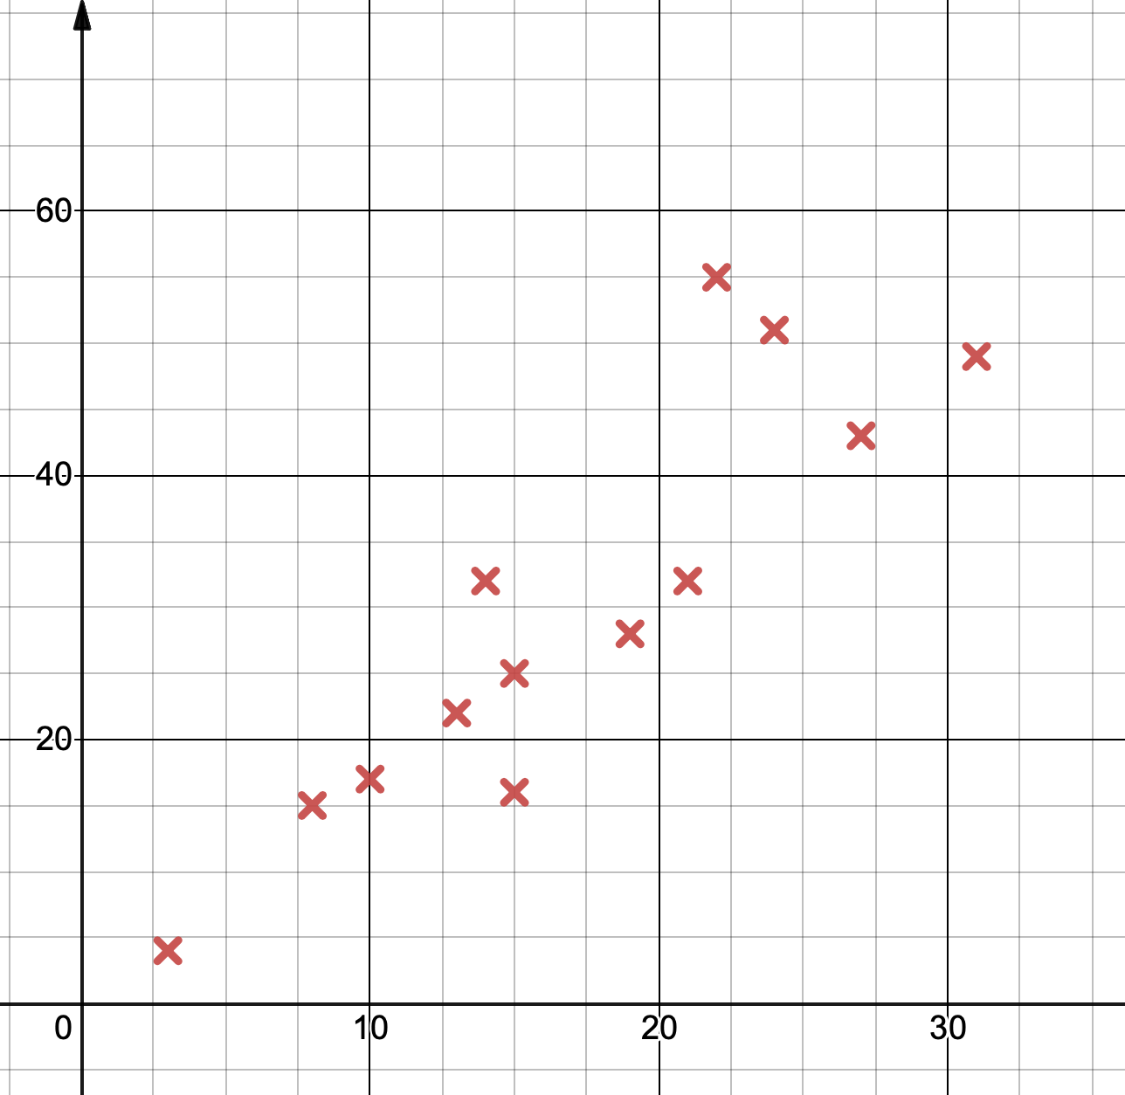
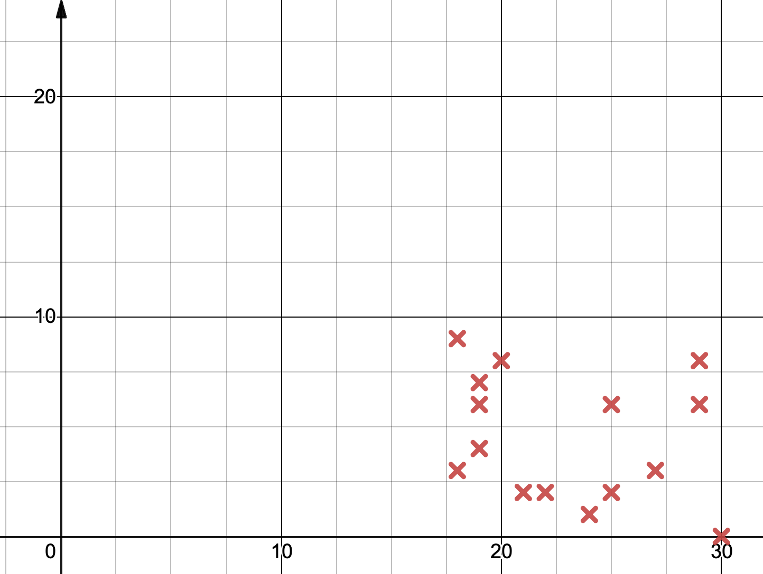
Correlation and Interpreting Scatter Graphs
YOU DO 2 | YOU DO 3
For each set of data below, state: a The type of correlation shown b An interpretation for the data
Number of goals scored by a group of football players by age.
Number of games played compared with shots taken at goal.
Shots
Number of Goals Scored
Age
Games

Slide 5
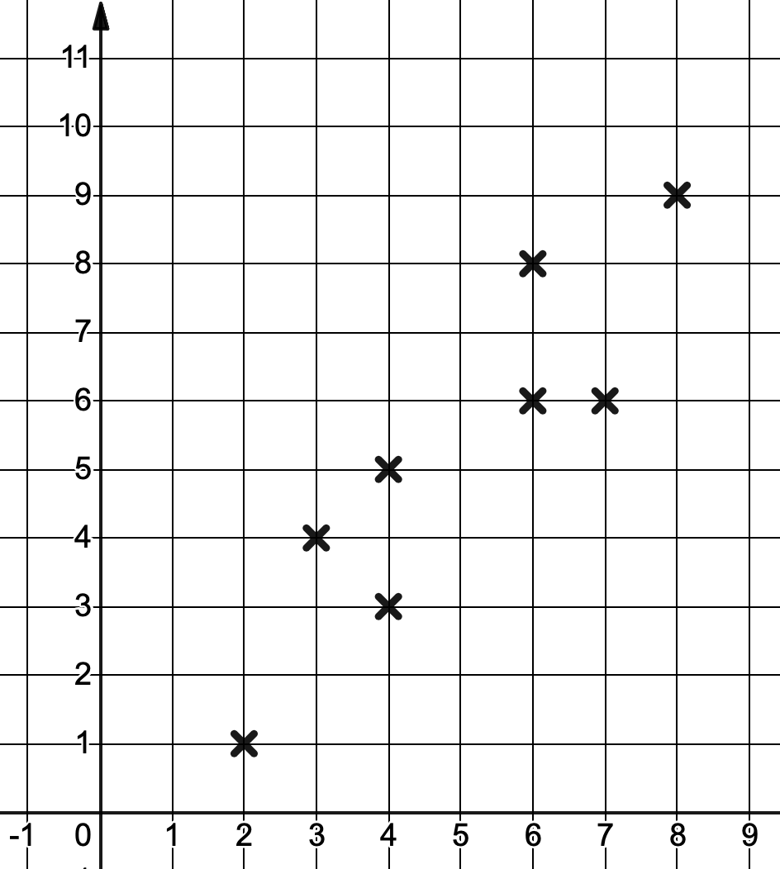
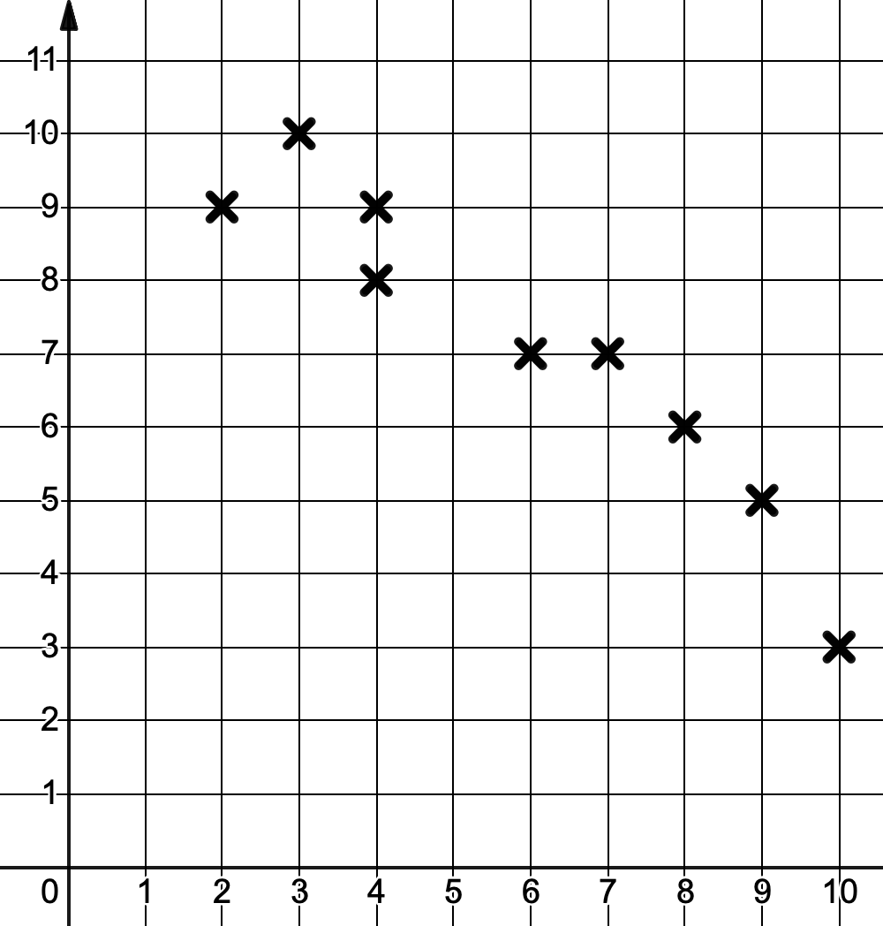
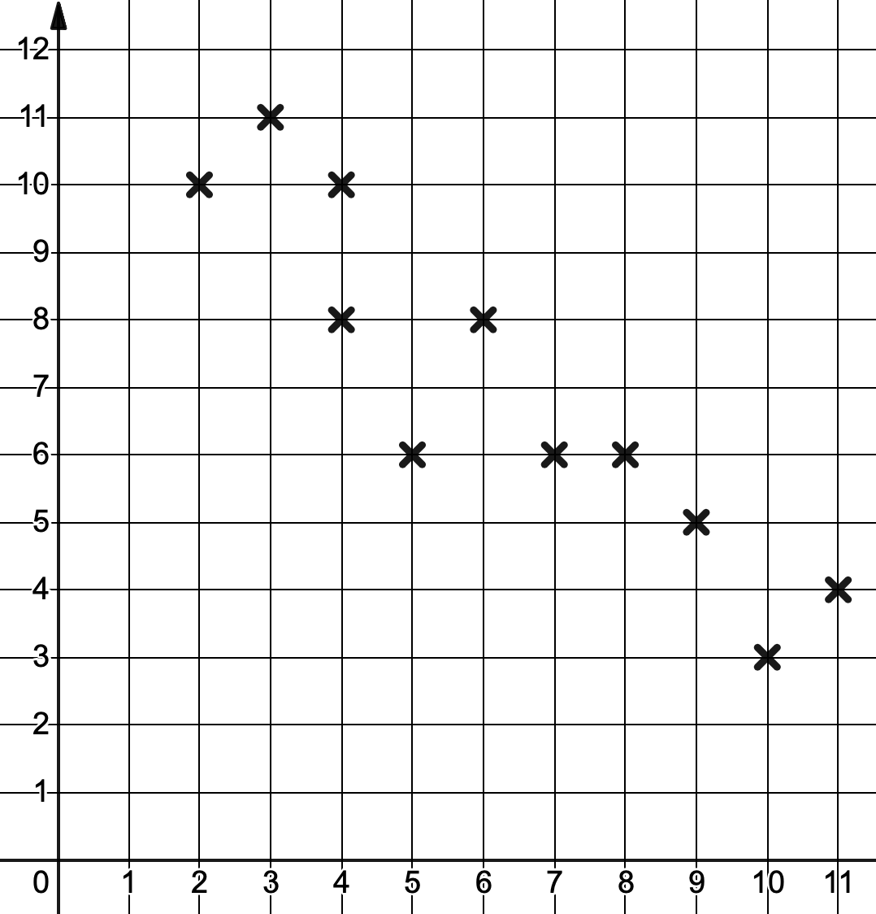
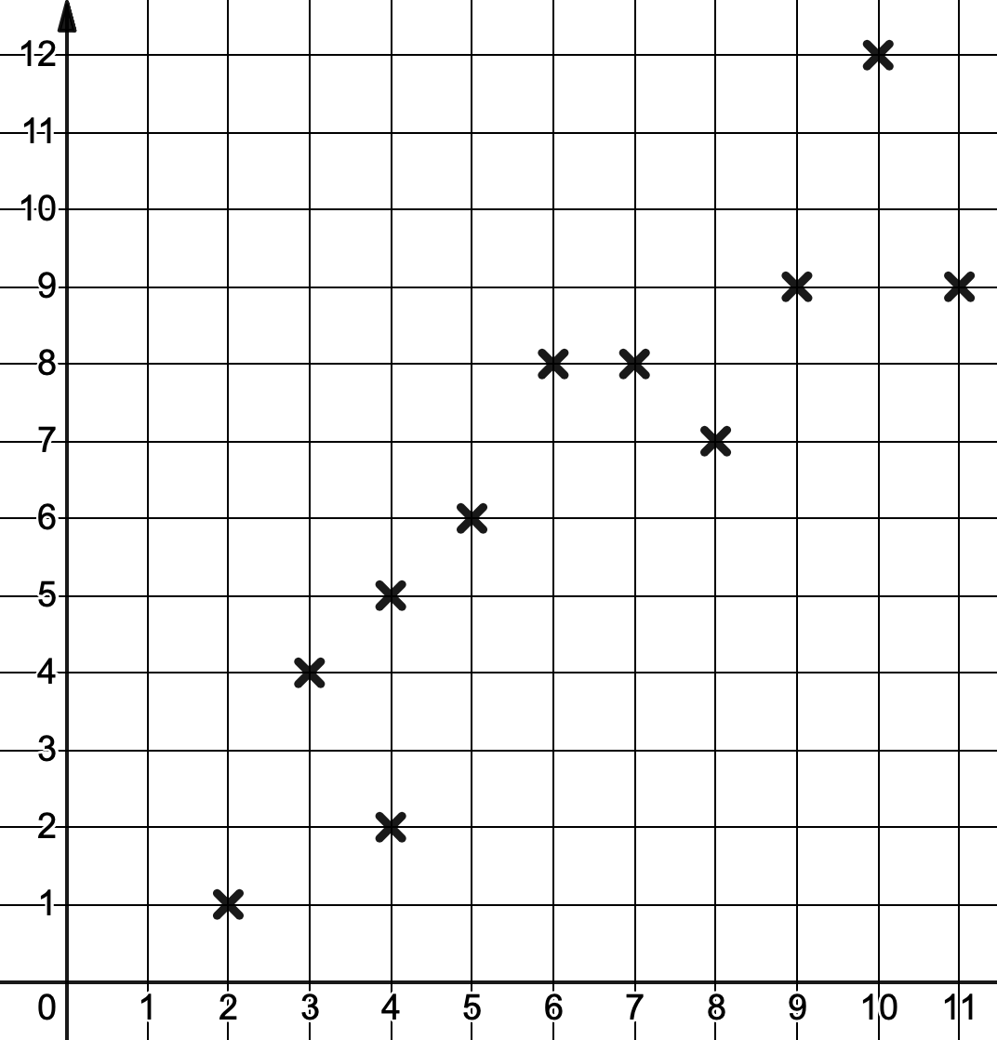
Lines of Best Fits
I DO | WE DO | YOU DO
For each scatter graph below: a State the type of correlation shown b Draw a line of best fit for the data

Slide 6
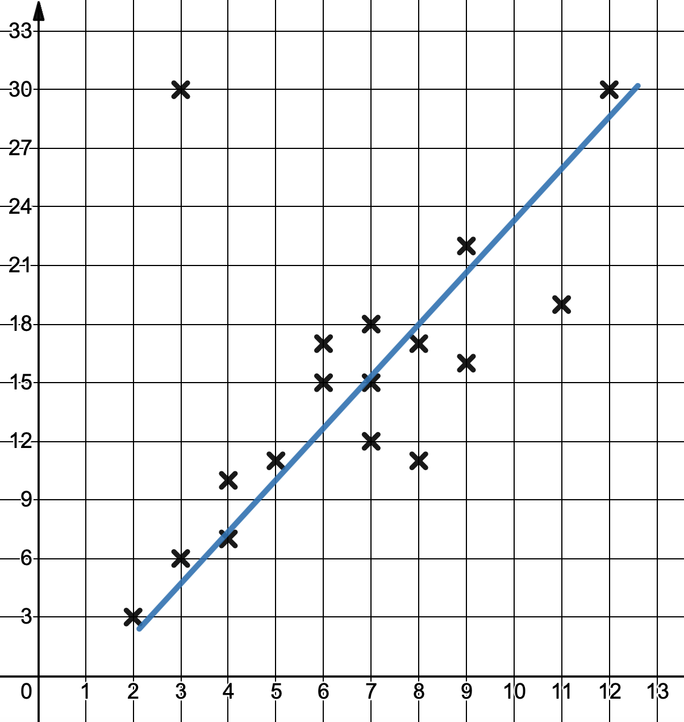
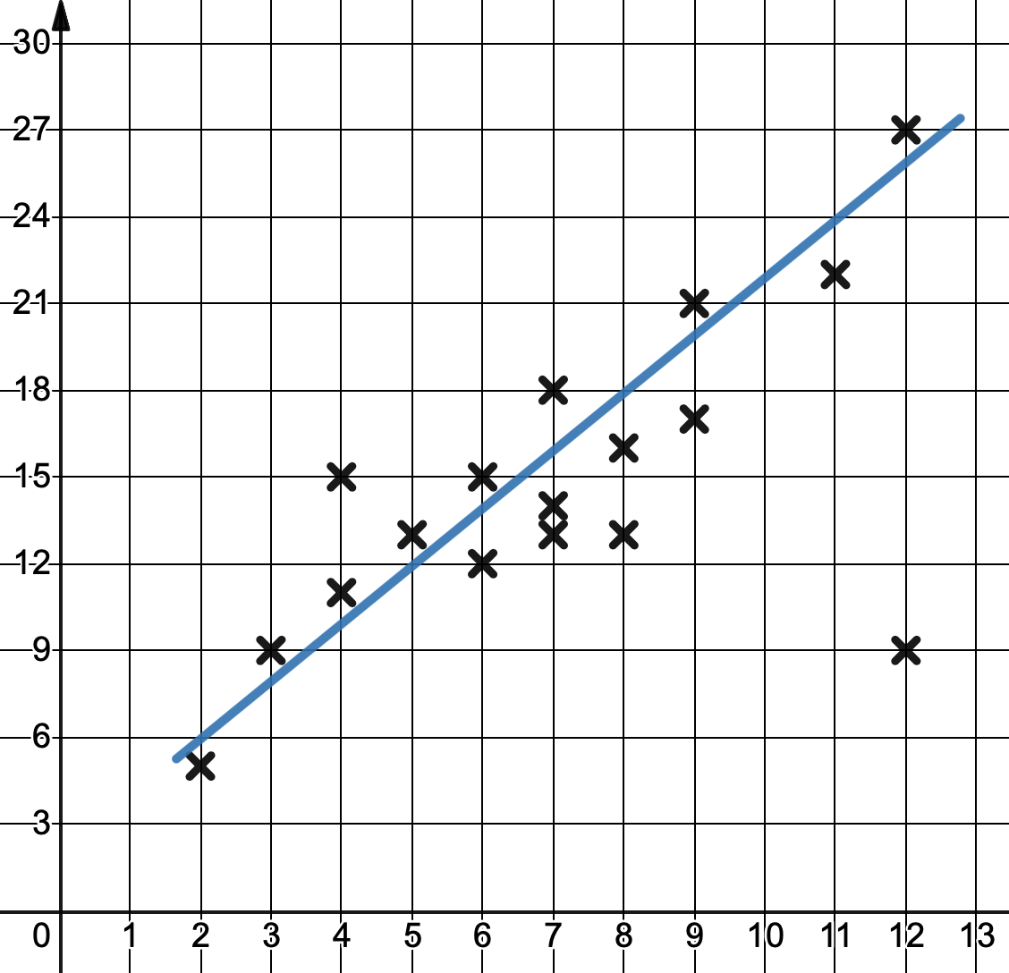
Correlation and Interpreting Scatter Graphs
WE DO | YOU DO 1
The scatter graph below shows the temperature and the number of hours of sunlight in City A . Write down the co-ordinate of the outlier. Write an interpretation for the data shown. The temperature is forecast to be 18ºC, how many hours of sunlight should the City A expect to have? A day is forecast to have 6 hours of sunlight, what is the most likely temperature? | The scatter graph below shows the temperature and the number of hours of sunlight in City B . Write down the co-ordinate of the outlier. Write an interpretation for the data shown. The temperature is forecast to be 24ºC, how many hours of sunlight should the City B expect to have? A day is forecast to have 8 hours of sunlight, what is the most likely temperature?
Temperature (ºC)
Temperature (ºC)
Sunlight Hours
Sunlight Hours

Slide 7
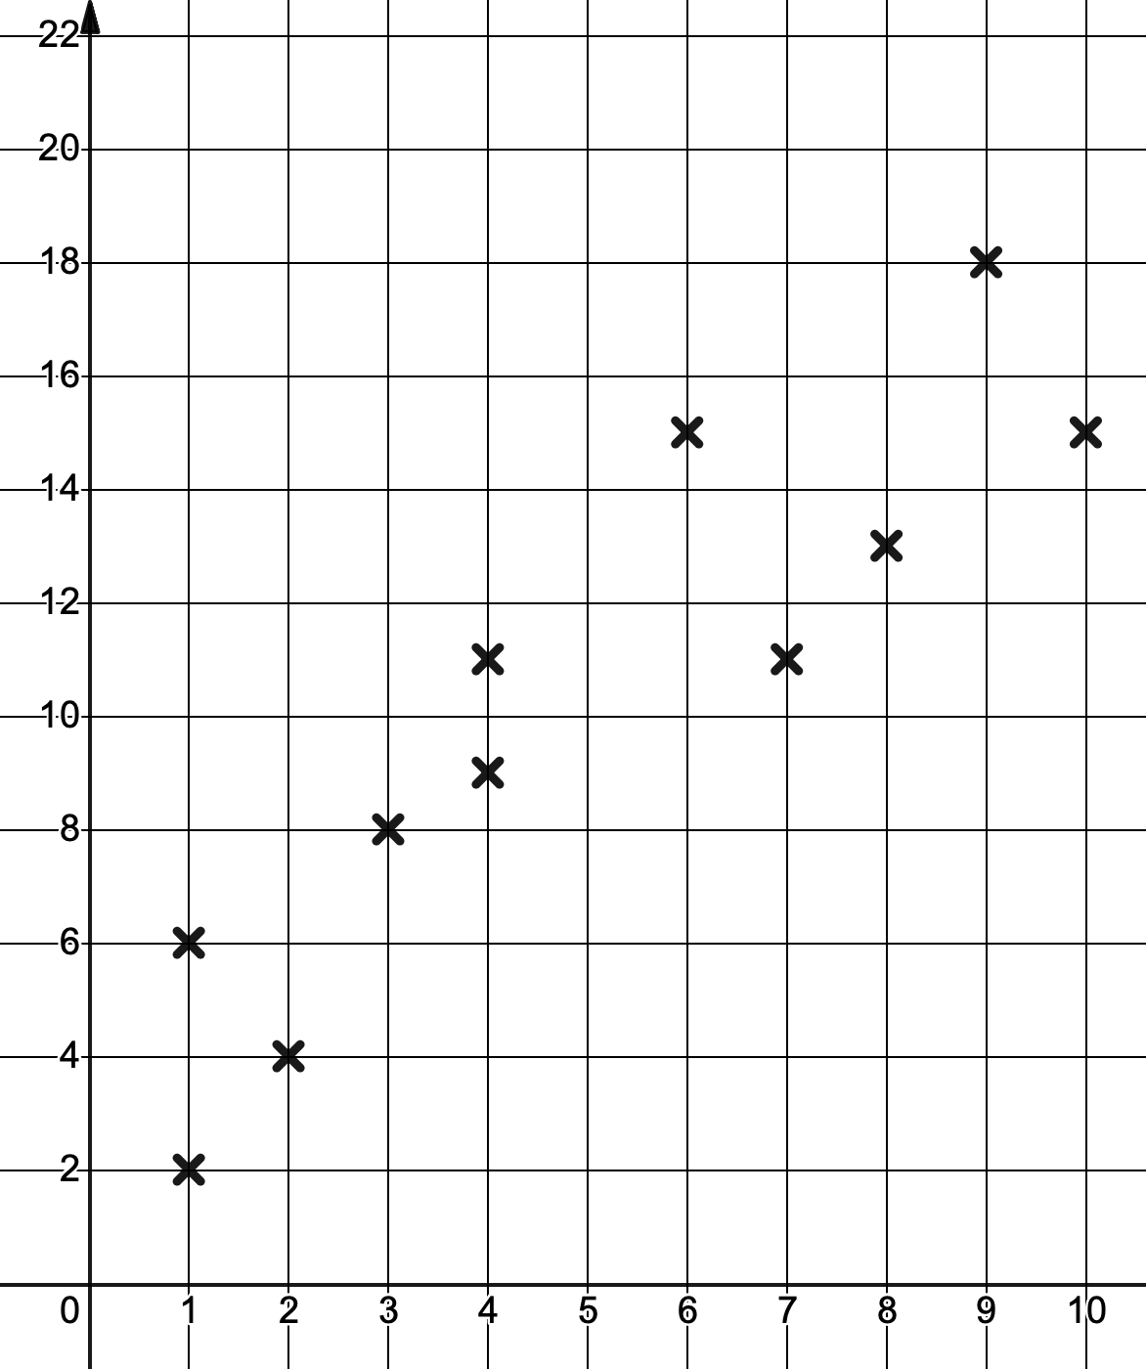
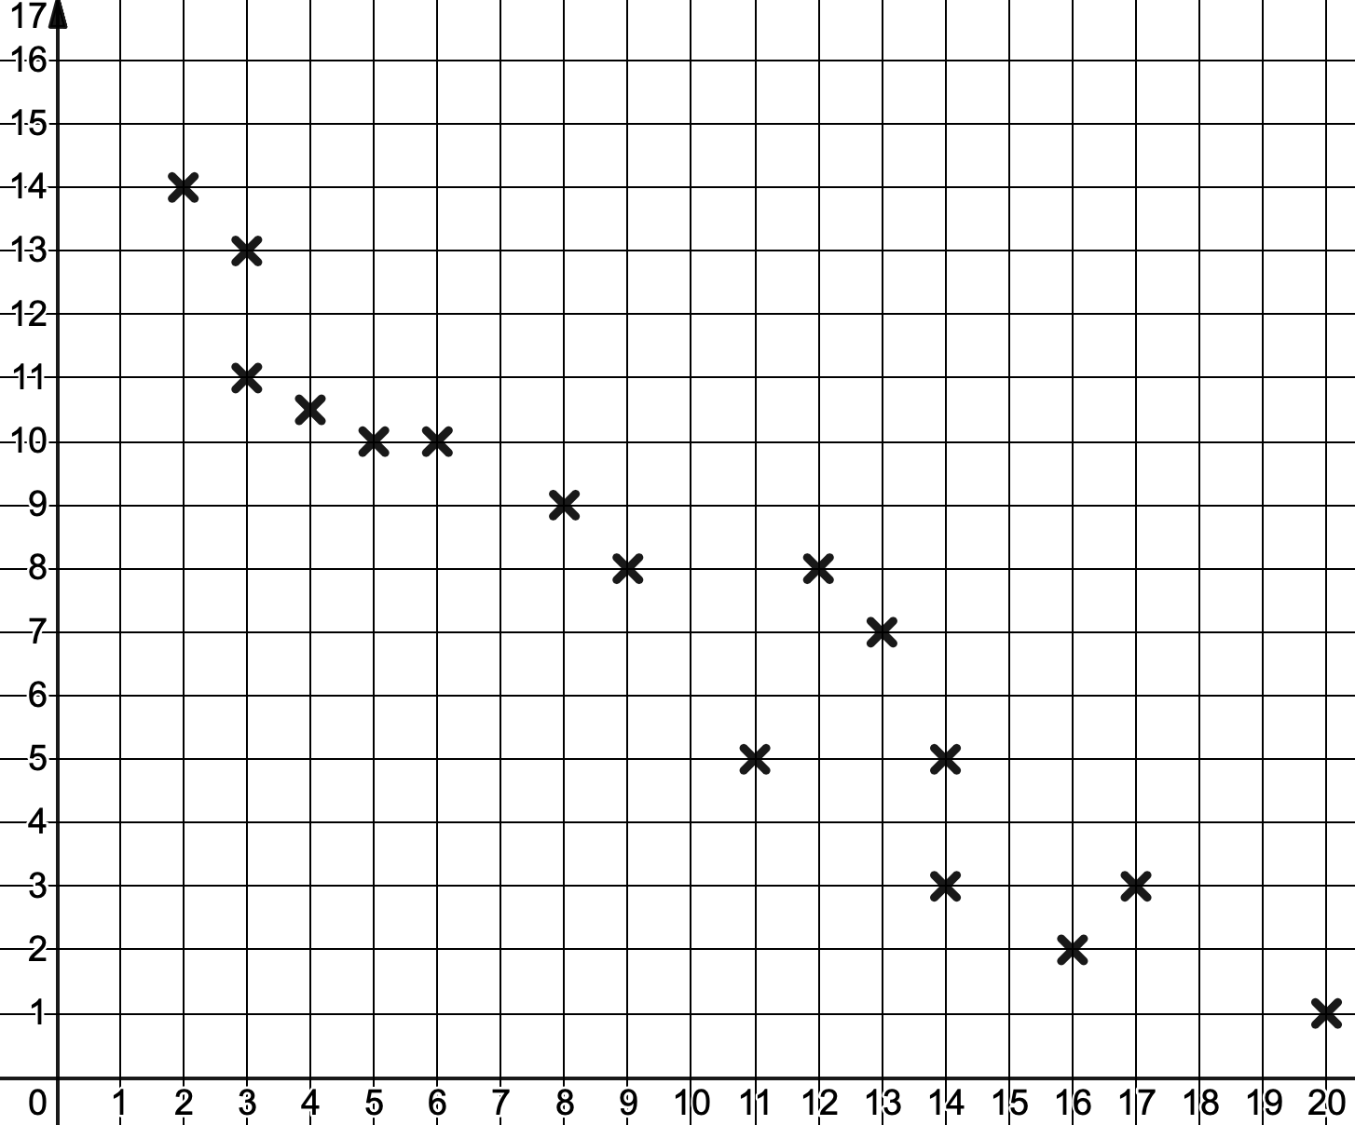
Correlation and Interpreting Scatter Graphs
YOU DO 2 | YOU DO 3
The scatter graph below shows the age and value (in £’000) of some antiques. Write an interpretation for the data shown. Draw a line of best fit on the diagram. What value would you expect a 5-year-old antique to have? | The scatter graph below shows how many antiques have been made and their value (in £’000). Write an interpretation for the data shown. Draw a line of best fit on the diagram. How many £12,000 antiques would you expect to have been made?
Value (£’000)
Value (£’000)
Age (Years)
Quantity

