Slide 1
Collecting like terms

Slide 2
Negatives…
1
$$x$$
$$x$$
-1
1
1
1
$$x$$
$$− x$$
$$x$$
$x^{2}$
$$− x^{2}$$
$$y$$
$$−y$$
$$y^{2}$$
$$−y^{2}$$

Slide 3
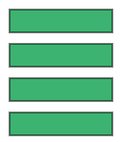
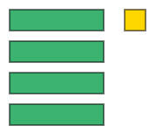
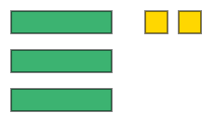
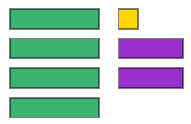
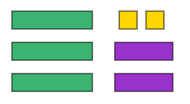
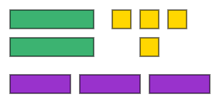
Don’t forget to | Reflect | Expect | Check | Explain | for each question
I DO
Simplify the following: 1) 2) 3)
WE DO
Simplify the following: 1) 2) 3)
YOU DO
Simplify the following: 1) 2) 3)
$$3x$$
$3x+2$
$3x+2+2y$

Slide 4
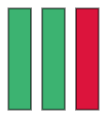
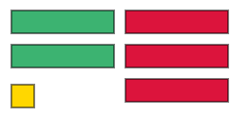
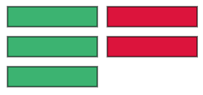
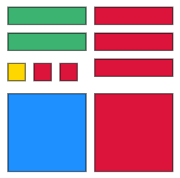
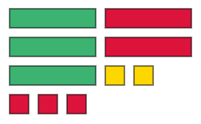
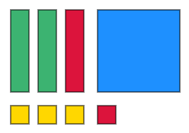
Don’t forget to | Reflect | Expect | Check | Explain | for each question
I DO
Simplify the following: 1) 2)
WE DO
Simplify the following: 1) 2)
YOU DO
Simplify the following: 1) 2)
Are there any zero pairs?
$$=x$$
Are there any zero pairs?
$$=x −1$$

Slide 5
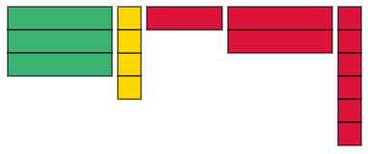
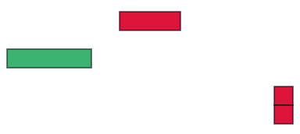
Don’t forget to | Reflect | Expect | Check | Explain | for each question
I DO
Simplify the following expressions: $$3x+4 −y −2x −6$$
WE DO
Simplify the following expressions: $$4x+3+y+2x −3$$
YOU DO
Simplify the following expressions: $$4x−3+y −x −6$$
Draw the diagram
Are there any zero pairs?
$$=x −y −2$$

Slide 6
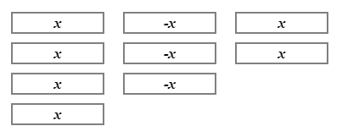
Task
Simplify the following expressions
e.g. | $4x−3x+2x$ |  | $3x$
1. | $3x−2x+5x$
2. | $7y+2y−5y$
3. | $4x+2x−8x$
4. | $3x+2y−5x+4y$
?

Slide 7
5. | $6y−4y+2x+3x$
6. | $3x−x^{2}+5x+3x^{2}$
7. | $5x−3x+4x^{2}−4x+2x^{2}$
8. | $3x^{2}−2y^{2}+4x^{2}−x^{2}$
9. | $4y+6y^{2}−3y^{2}−9y$

Slide 8
10. | $3x+4−5x−8$
11. | $7x+3y−4+2x+7$
12. | $2x+3x−6y+x^{2}−2y+x+3y$
13. | $−3x−y^{2}+5y−6x+3x^{2}+5y^{2}$
14. | $6x+3x^{2}−4x−2x^{2}−x^{2}−2x$
15. | $4x+3−x−7+y^{2}$

Slide 9
16. | $2\left(x+3\right)+x$
17. | $3\left(x−1\right)+2x−7$
18. | $3x−5y+ 4\left(x+2y−3\right)$
19. | $2\left(x+3\right)+4(2x−1)$
20. | $3\left(x+2\right)−2(x−4)$

Slide 10
Answers
1) $6x$
2) $4y$
3) $−2x$
4) $−2x+6y$
5) $2y+5x$
6) $2x^{2}+8x$
7) $6x^{2}−2x$
8) $6x^{2}−2y^{2}$
9) $3y^{2}−5y$
10) $−2x −4$
11) $9x+3y −4$
12) $x^{2}+6x −5y$
13) $3x^{2}+4y^{2}−9x+5y$
14) $0$
15) $y^{2}+3x−4$
16) $3x+6$
17) $5x−10$
18) $7x+3y−12$
19) $10x+2$
20) $x+14$

