Slide 1

Drawing Pie Charts
Full lesson PowerPoint, including I Do, We Do, You Do Example Sheet(s).

Slide 2
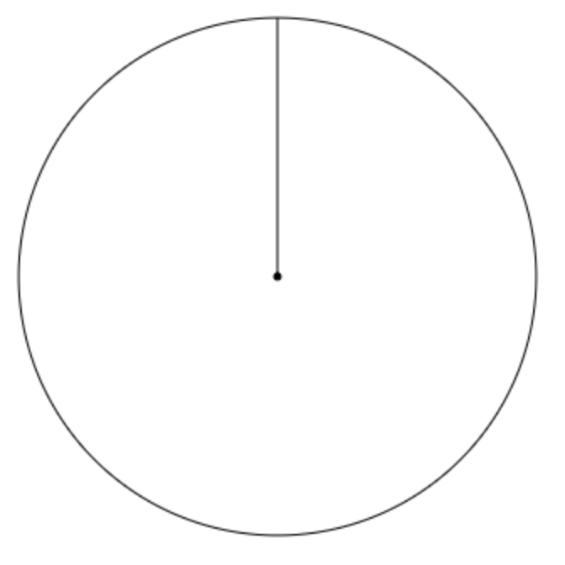
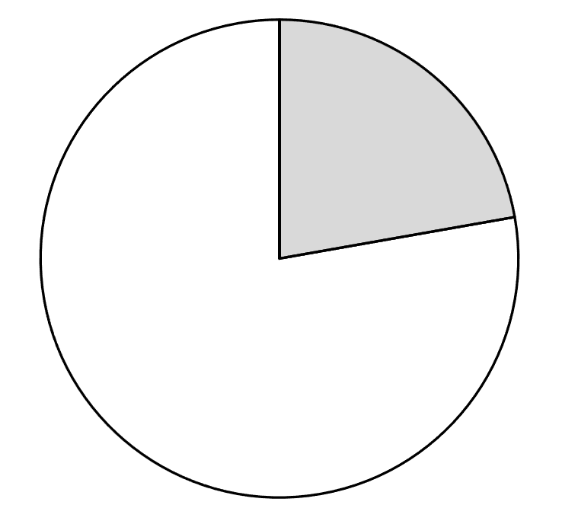
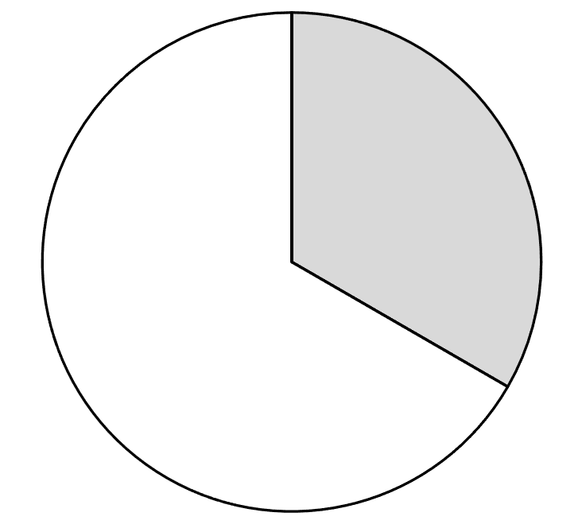
Drawing Pie Charts (1)
I DO | WE DO
Two blank pie chart diagrams are shown below. For each Add an angle of 60° from the line marked with a L. Use an angle fact to write down the remaining angle. Use a protractor to check your answer to part b). | Two blank pie chart diagrams are shown below. For each Add an angle of 100° from the line marked with a L. Use an angle fact to write down the remaining angle. Use a protractor to check your answer to part b).
L
L
L
L

Slide 3
Drawing Pie Charts (1)
YOU DO 1 | YOU DO 2
Two blank pie chart diagrams are shown below. For each Add an angle of 50° from the line marked with a L. Use an angle fact to write down the remaining angle. Use a protractor to check your answer to part b). | Two blank pie chart diagrams are shown below. For each Add an angle of 130° from the line marked with a L. Use an angle fact to write down the remaining angle. Use a protractor to check your answer to part b).
L
L
L
L

Slide 4
Drawing Pie Charts (2)
I DO | WE DO
On the diagram below draw: an angle of 100° clockwise from the initial line marked L angle of 80° clockwise from the angle just drawn | On the diagram below draw: an angle of 200° clockwise from the initial line marked L angle of 75° clockwise from the angle just drawn
L
L

Slide 5
Drawing Pie Charts (2)
YOU DO 1 | YOU DO 2
On the diagram below draw: an angle of 80° clockwise from the initial line marked L angle of 110° clockwise from the angle just drawn | On the diagram below draw: an angle of 40° clockwise from the initial line marked L angle of 55° clockwise from the angle just drawn
L
L

Slide 6
Drawing Pie Charts (2)
YOU DO 3 | YOU DO 4
On the diagram below draw: an angle of 55° clockwise from the initial line marked L angle of 40° clockwise from the angle just drawn | On the diagram below draw: an angle of 145° clockwise from the initial line marked L angle of 130° clockwise from the angle just drawn
L
L

Slide 7
Drawing Pie Charts (2)
YOU DO 5 | YOU DO 6
On the diagram below draw: an angle of 105° clockwise from the initial line marked L angle of 170° clockwise from the angle just drawn | On the diagram below draw: an angle of 145° clockwise from the initial line marked L angle of 210° clockwise from the angle just drawn
L
L

Slide 8
Drawing Pie Charts (3)
I DO | WE DO
Use the information in the table to draw the pie chart. Make sure you use a pencil and a ruler! | Colour | Frequency | Angle
 | Blue | 18 | 180°
 | Red | 10 | 100°
 | Green | 8 | 80°
 | Total | 36 | 360°
Use the information in the table to draw the pie chart. Make sure you use a pencil and a ruler! | Colour | Frequency | Angle
 | Blue | 30 | 150°
 | Red | 16 | 80°
 | Green | 16 | 80°
 | Yellow | 10 | 50°
 | Total | 72 | 360°

Slide 9
Drawing Pie Charts (3)
YOU DO 1 | YOU DO 2
Use the information in the table to draw the pie chart. Make sure you use a pencil and a ruler! | Colour | Frequency | Angle
 | Blue | 18 | 180°
 | Red | 12 | 120°
 | Green | 6 | 60°
 | Total | 36 | 360°
Use the information in the table to draw the pie chart. Make sure you use a pencil and a ruler! | Colour | Frequency | Angle
 | Blue | 36 | 144°
 | Red | 26 | 104°
 | Green | 18 | 72°
 | Yellow | 10 | 40°
 | Total | 90 | 360°

Slide 10
Drawing Pie Charts (4)
I DO | WE DO
Complete the table below, then use it to draw the pie chart. | Complete the table below, then use it to draw the pie chart.
Colour | Frequency | Angle
Blue | 80
Red | 70
Green | 30
Total | 180 | 360°
Colour | Frequency | Angle
Blue |  | 180°
Red | 25
Green |  | 30°
Total | 60 | 360°

Slide 11
Drawing Pie Charts (4)
YOU DO 1 | YOU DO 2
Complete the table below, then use it to draw the pie chart. | Complete the table below, then use it to draw the pie chart.
Colour | Frequency | Angle
Blue | 45
Red | 25
Green | 20
Total | 90 | 360°
Colour | Frequency | Angle
Blue | 90
Red | 60
Green | 20
Yellow | 10
Total | 180 | 360°

Slide 12
Drawing Pie Charts (4)
YOU DO 3 | YOU DO 4
Complete the table below, then use it to draw the pie chart. | Complete the table below, then use it to draw the pie chart.
Colour | Frequency | Angle
Blue | 15
Red | 12
Green | 6
Yellow | 3
Total | 36
Colour | Frequency | Angle
Blue | 16
Red |  | 100°
Green | 6
Yellow |  | 40°
Total | 36

Slide 13
Drawing Pie Charts (4)
YOU DO 5 | YOU DO 6
Complete the table below, then use it to draw the pie chart. | Complete the table below, then use it to draw the pie chart.
Colour | Frequency | Angle
Blue |  | 180°
Red | 6
Green |  | 36°
Yellow
Total | 20
Colour | Frequency | Angle
Blue |  | 144°
Red | 20
Green |  | 81°
Yellow
Total | 80

Slide 14
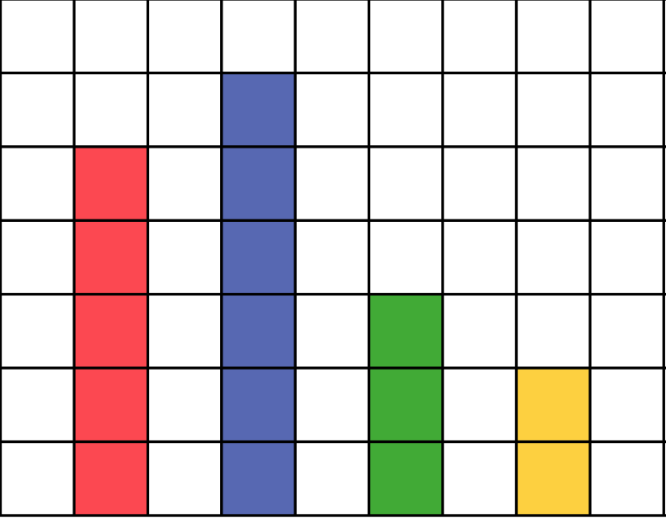
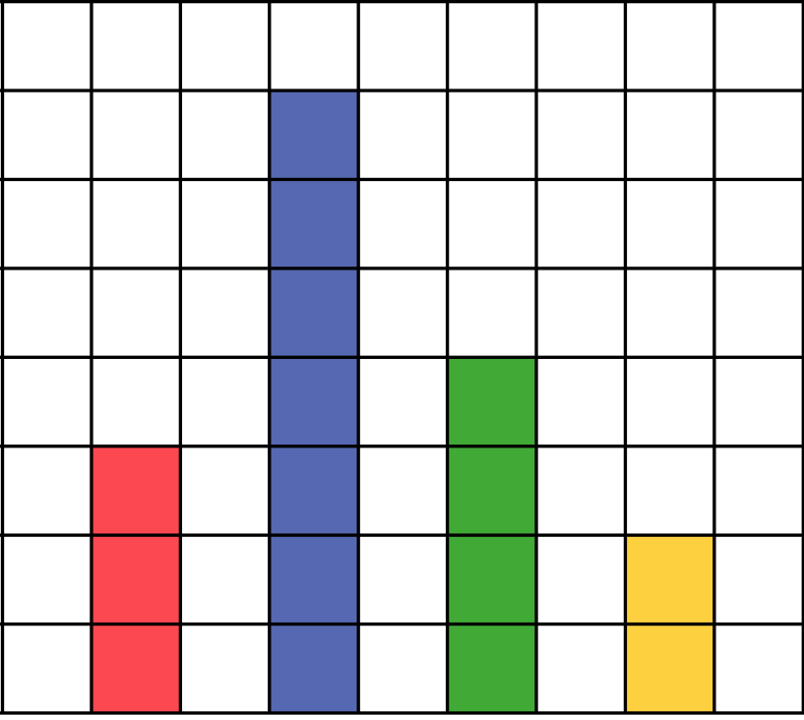
Drawing Pie Charts (5)
I DO | WE DO
Draw a pie chart to represent the data represented by the bar chart. | Draw a pie chart to represent the data represented by the bar chart.
28
20
R B G Y
R B G Y

Slide 15
Drawing Pie Charts (5)
YOU DO 1 | YOU DO 2
Draw a pie chart to represent the data represented by the bar chart. | Draw a pie chart to represent the data represented by the bar chart.
42
40
R B G Y
R B G Y

Slide 16
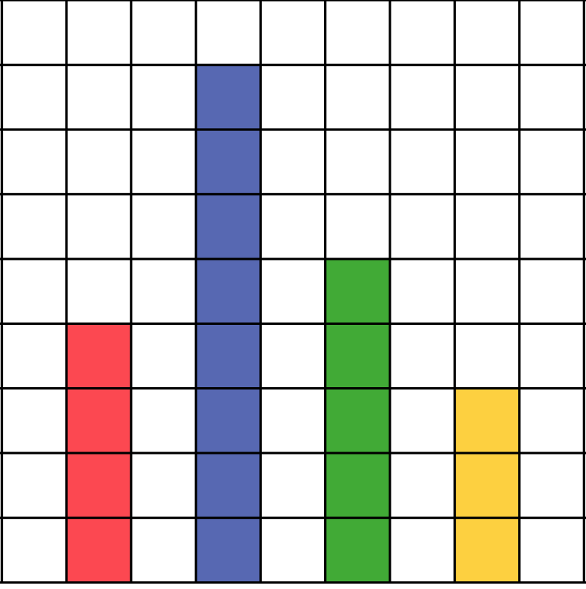
Drawing Pie Charts (5)
YOU DO 3 | YOU DO 4
Draw a pie chart to represent the data represented by the bar chart. | Draw a pie chart to represent the data represented by the bar chart.
48
96
R B G Y
R B G Y

Slide 17
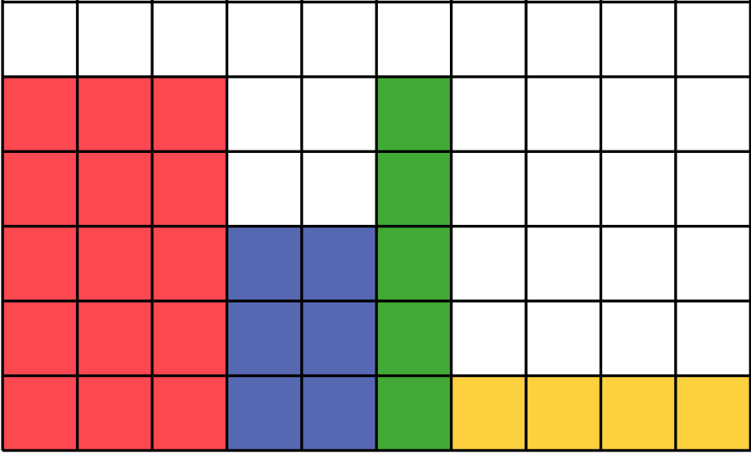
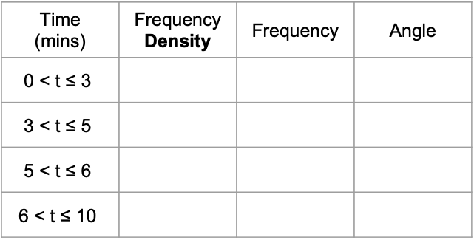
Drawing Pie Charts – Drawing a Pie Chart from a Histogram
EXTENSION PROBLEM
A group of students were asked how many minutes it took them to walk to school. The histogram below shows this data. Complete the frequency table and then draw the associated pie chart.
Frequency
Density
5
0 3 5 6 10
Time (mins) | Frequency Density | Frequency | Angle
$$\text{0 < }\text{t}\text{ ≤ 3}$$
$$\text{3 < }\text{t}\text{ ≤ 5}$$
$$\text{5 < }\text{t}\text{ ≤ 6}$$
$$\text{6 < }\text{t}\text{ ≤ 10}$$

