Slide 1
Equivalent Fractions
I Do, We Do, You Do Examples

Slide 2
Which diagrams show $\frac{1}{2}$shaded in?

Slide 3
Equivalent Fractions
Fractions that have different numerators and denominators that represent the same value or proportion of the whole
Examples
$$\frac{1}{2}=\frac{2}{4}$$
$$\frac{9}{12}=\frac{3}{4}$$
$$1\frac{1}{5}=\frac{12}{10}$$
Non – Examples
$$\frac{1}{2}=\frac{1}{4}$$
$$\frac{9}{12}=\frac{7}{12}$$
$$1\frac{1}{5}=2\frac{2}{10}$$

Slide 4
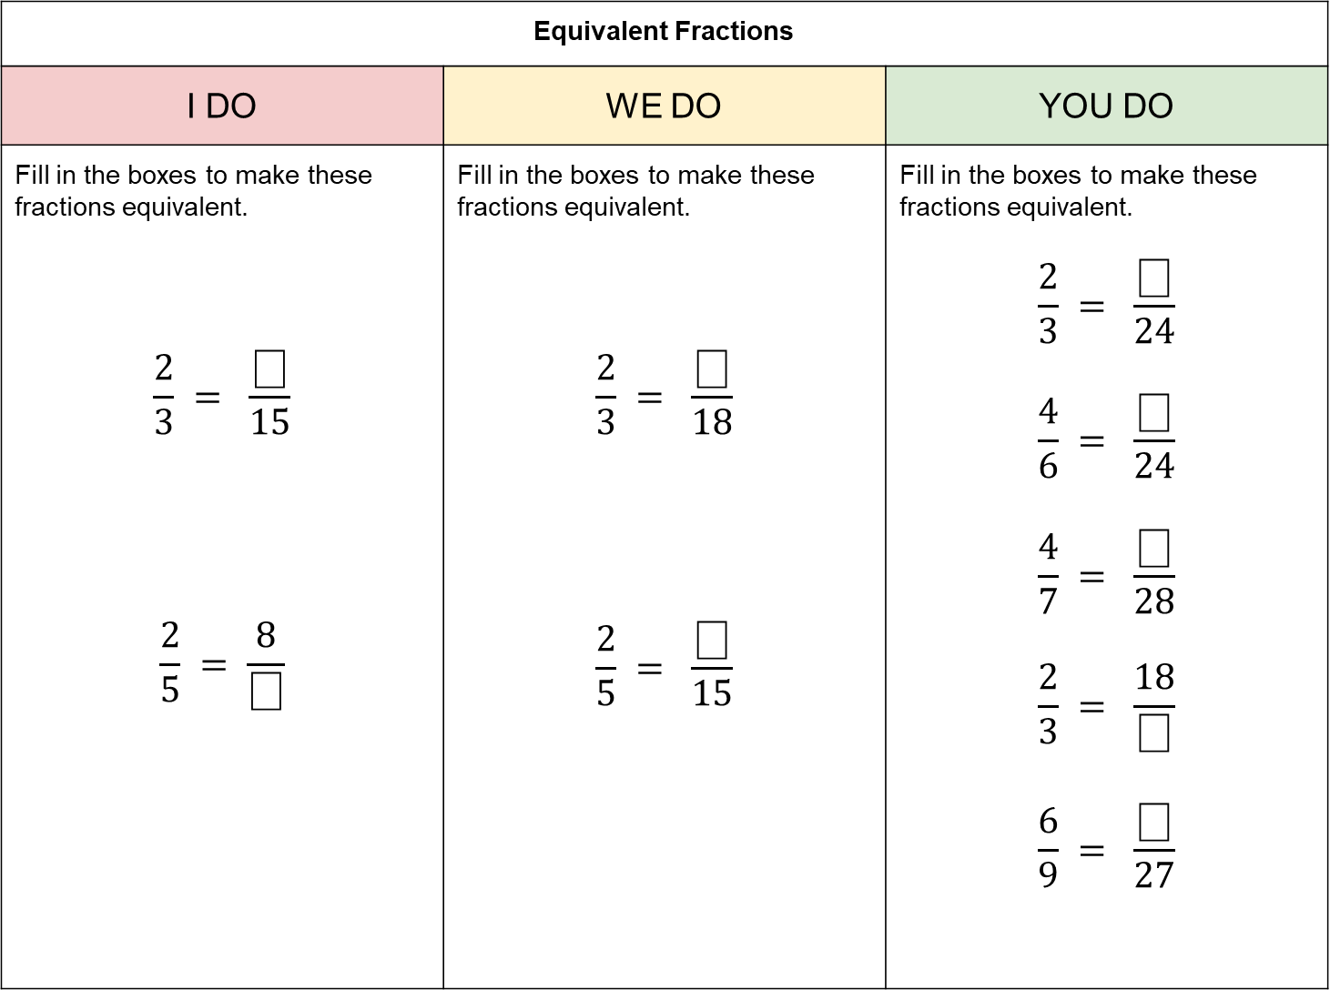
Equivalent Fractions
I DO | WE DO | YOU DO
Fill in the boxes to make these fractions equivalent. $$\frac{2}{3} = \frac{⎕}{15}$$ $$\frac{2}{5} = \frac{8}{⎕}$$ | Fill in the boxes to make these fractions equivalent. $$\frac{2}{3} = \frac{⎕}{18}$$ $$\frac{2}{5} = \frac{⎕}{15}$$ | Fill in the boxes to make these fractions equivalent. $$\frac{2}{3} = \frac{⎕}{24}$$ $$\frac{4}{6} = \frac{⎕}{24}$$ $$\frac{4}{7} = \frac{⎕}{28}$$ $$\frac{2}{3} = \frac{18}{⎕}$$ $$\frac{6}{9} = \frac{⎕}{27}$$
?
?
?

Slide 5
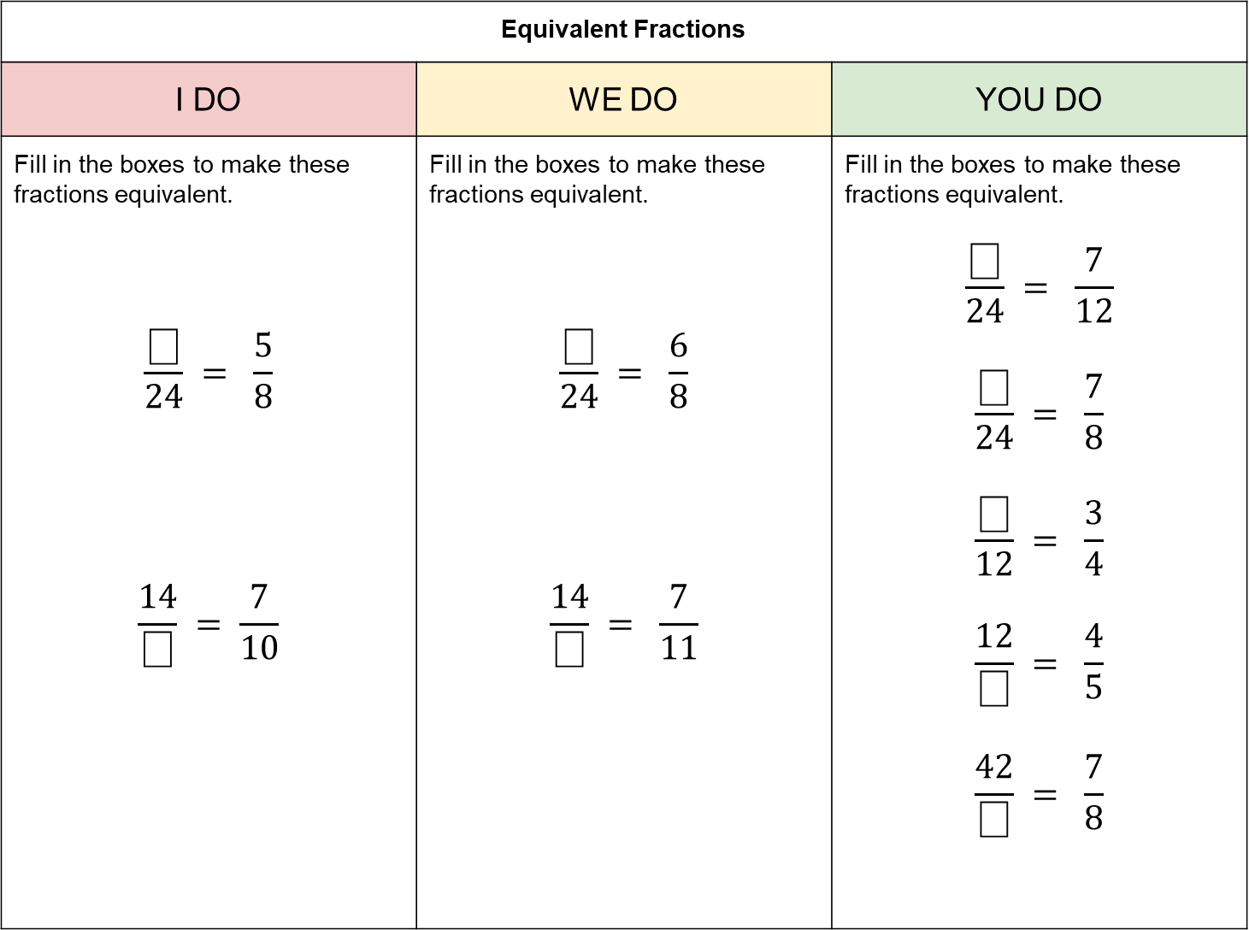
Equivalent Fractions
I DO | WE DO | YOU DO
Fill in the boxes to make these fractions equivalent. $$\frac{⎕}{24} = \frac{5}{8}$$ $$\frac{14}{⎕} = \frac{7}{10}$$ | Fill in the boxes to make these fractions equivalent. $$\frac{⎕}{24} = \frac{6}{8}$$ $$\frac{14}{⎕} = \frac{7}{11}$$ | Fill in the boxes to make these fractions equivalent. $$\frac{⎕}{24} = \frac{7}{12}$$ $$\frac{⎕}{24} = \frac{7}{8}$$ $$\frac{⎕}{12} = \frac{3}{4}$$ $$\frac{12}{⎕} = \frac{4}{5}$$ $$\frac{42}{⎕} = \frac{7}{8}$$
?
?
?

Slide 6


Simplest Form
A fraction is in its simplest form if 1 is the only common factor of its numerator and denominator.
Examples
$$\frac{1}{2}$$
$$\frac{3}{4}$$
$$1\frac{2}{5}$$
Non – Examples
$$\frac{2}{4}$$
$$\frac{9}{15}$$
$$1\frac{2}{10}$$

Slide 7
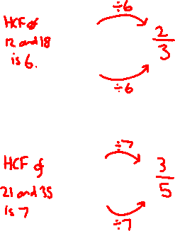
Equivalent Fractions
I DO | WE DO | YOU DO
Write these fractions in their simplest form. $$\frac{12}{18} =$$ $$\frac{21}{35} =$$ | Write these fractions in their simplest form. $$\frac{18}{24} =$$ $$\frac{36}{63} =$$ | Write these fractions in their simplest form. $$\frac{12}{20} =$$ $$\frac{6}{10} =$$ $$\frac{7}{21} =$$ $$\frac{33}{121} =$$ $$\frac{3}{10} =$$
?
?
?

