Slide 1
HCF, LCM and Venn Diagrams
Full lesson PowerPoint, including I Do, We Do, You Do Example Sheet(s).

Slide 2
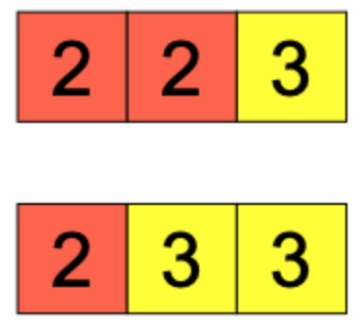
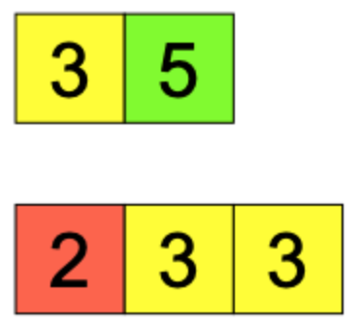
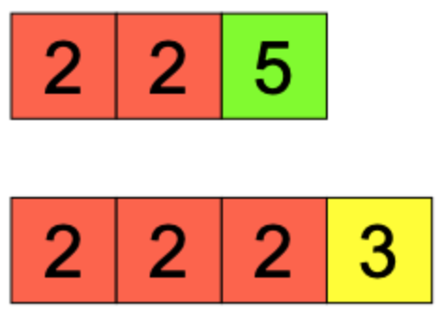
HCF
I DO | WE DO | YOU DO
The prime factor tiles below represent 12 and 18 respectively. Use the diagram to calculate the HCF of 12 and 18. | The prime factor tiles below represent 15 and 18 respectively. Use the diagram to calculate the HCF of 15 and 18. | The prime factor tiles below represent 20 and 24 respectively. Use the diagram to calculate the HCF of 20 and 24.

Slide 3
LCM
I DO | WE DO | YOU DO
The prime factor tiles below represent 12 and 18 respectively. Add to the diagrams above to make them identical. Write down the LCM of 12 and 18. | The prime factor tiles below represent 15 and 18 respectively. Add to the diagrams above to make them identical. Write down the LCM of 15 and 18. | The prime factor tiles below represent 20 and 24 respectively. Add to the diagrams above to make them identical. Write down the LCM of 20 and 24.

Slide 4
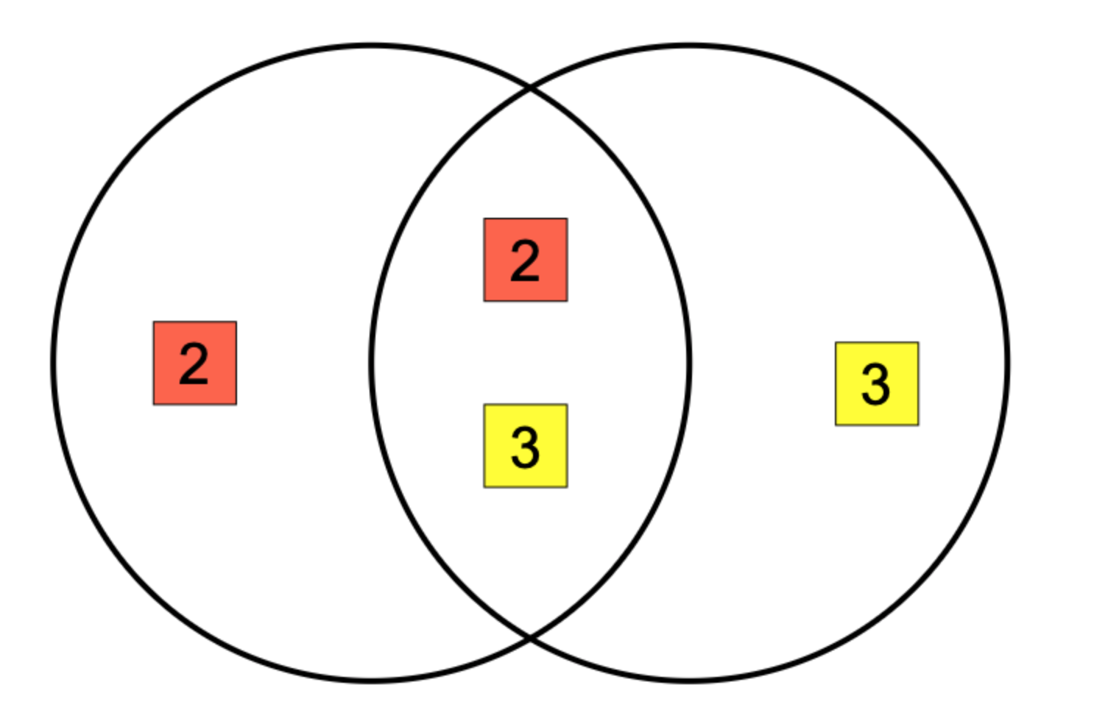
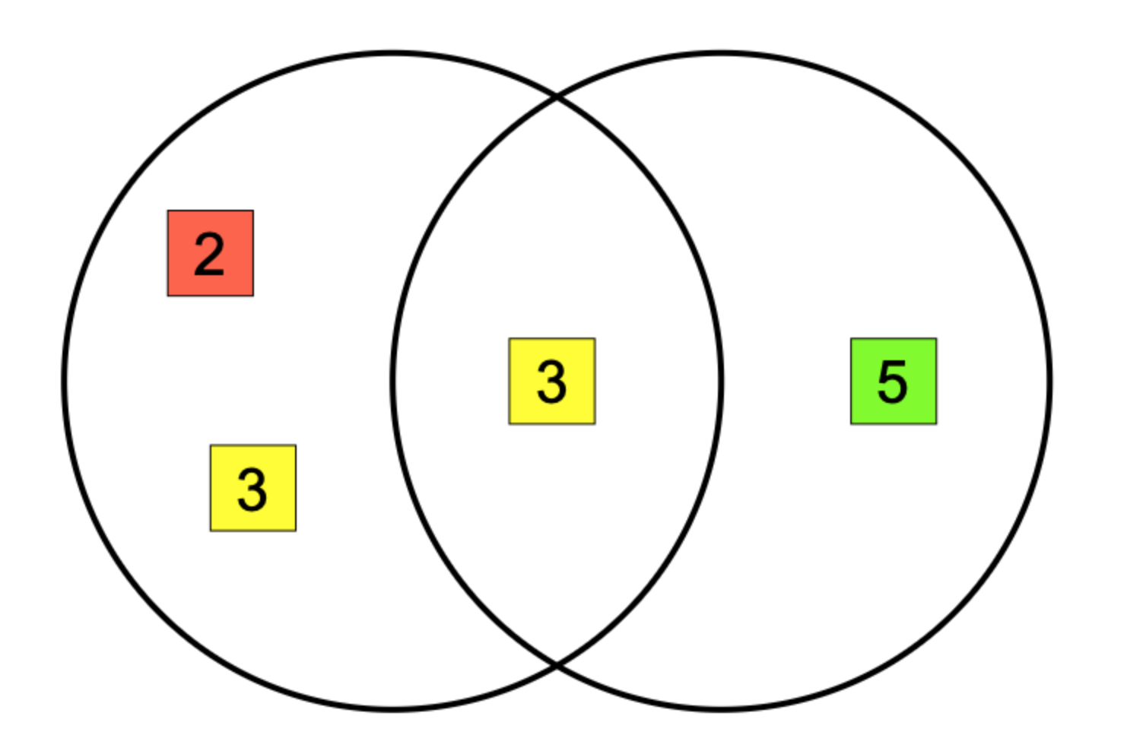
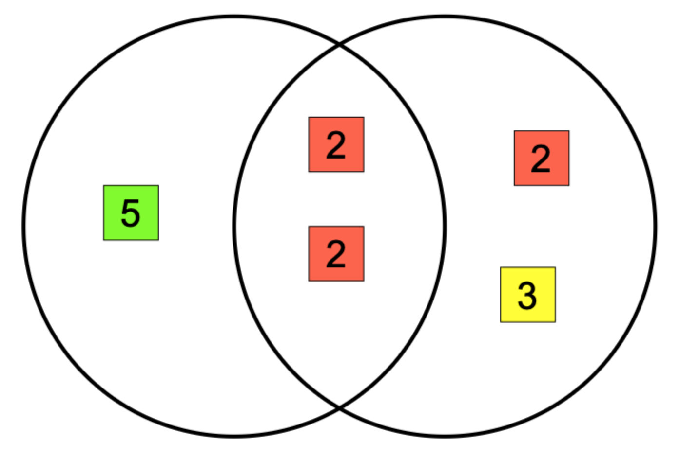
Prime Factors and Venn Diagrams (1)
I DO | WE DO | YOU DO
The Venn Diagram below represents the numbers 12 and 18. Show where the number 12 is represented in the Venn Diagram. Show where the number 18 is represented in the Venn Diagram. We know the HCF of 12 and 18 is 6, where is this represented in the Venn Diagram? We know the LCM of 12 and 18 is 36, where is this represented in the Venn Diagram? | The Venn Diagram below represents the numbers 15 and 18. Show where the number 15 is represented in the Venn Diagram. Show where the number 15 is represented in the Venn Diagram. We know the HCF of 15 and 18 is 3, where is this represented in the Venn Diagram? We know the LCM of 15 and 18 is 90, where is this represented in the Venn Diagram? | The Venn Diagram below represents the numbers 20 and 24. Show where the number 20 is represented in the Venn Diagram. Show where the number 24 is represented in the Venn Diagram. We know the HCF of 20 and 24 is 4, where is this represented in the Venn Diagram? We know the LCM of 20 and 24 is 120, where is this represented in the Venn Diagram?

Slide 5
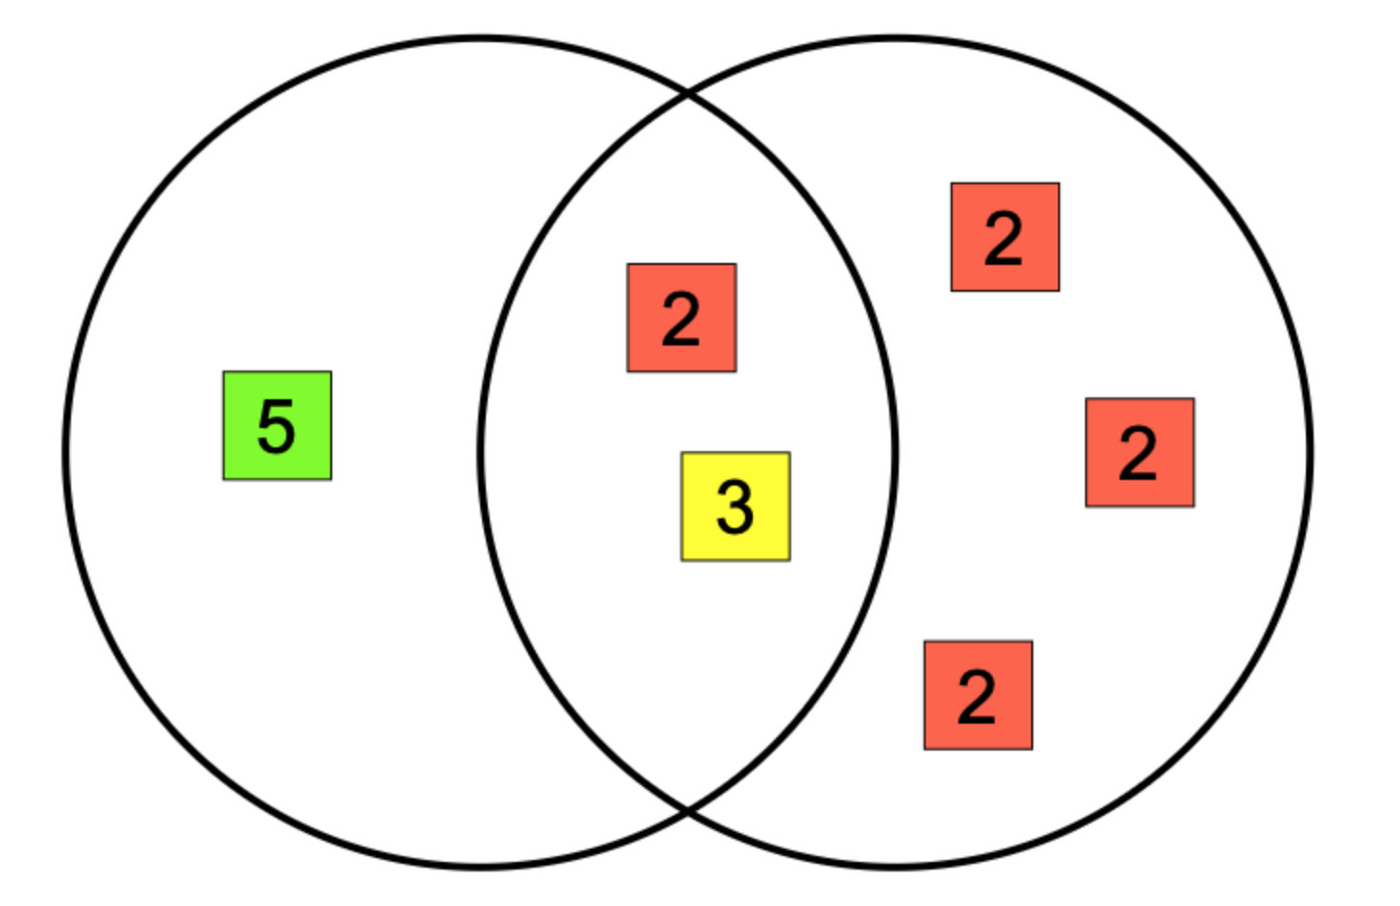
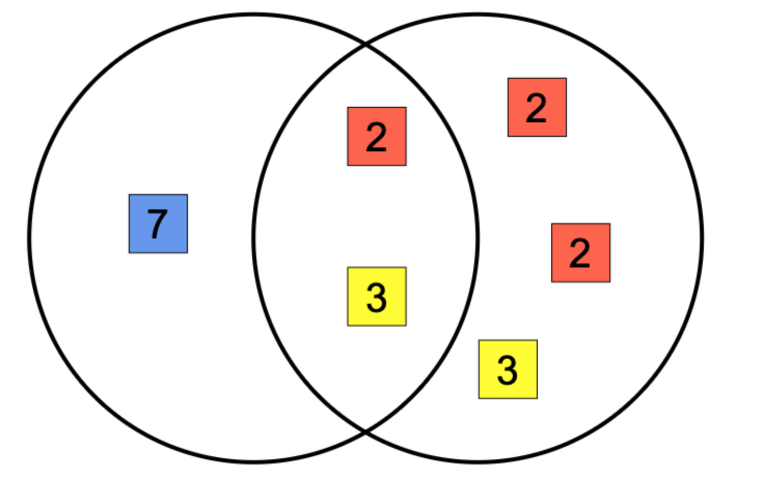
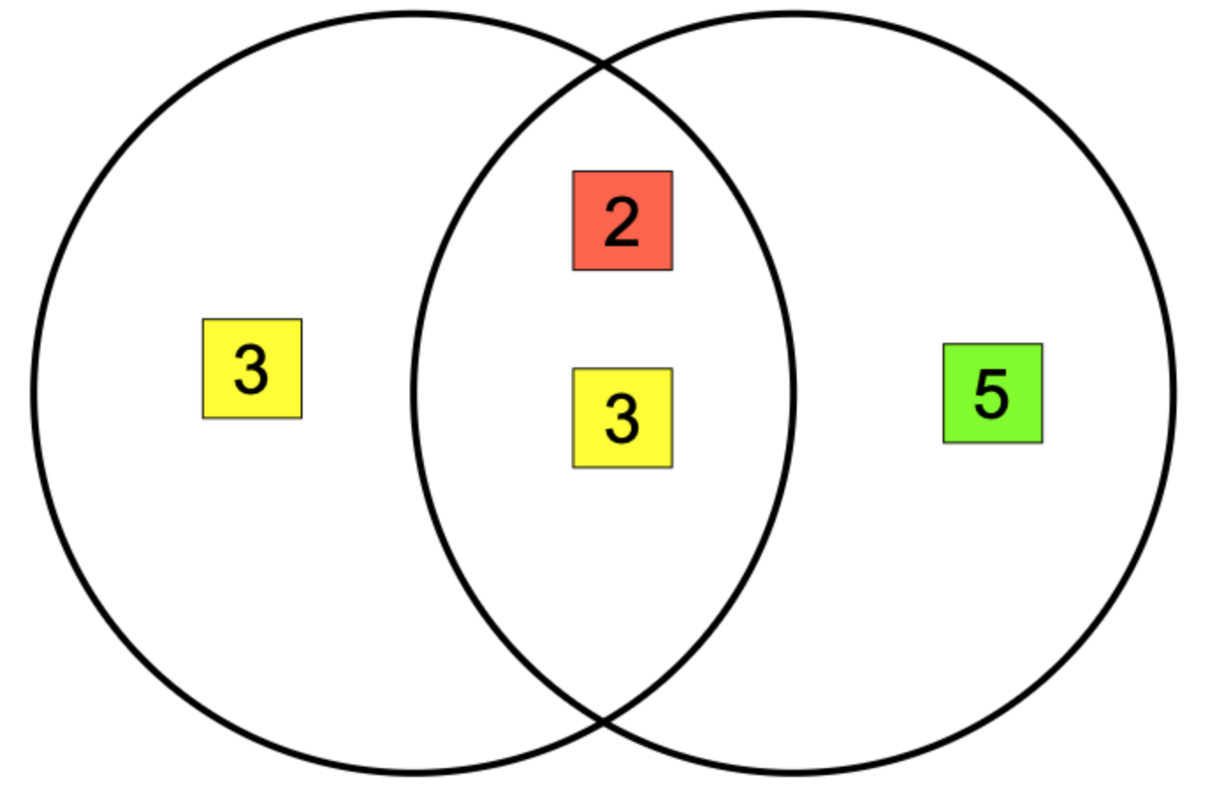
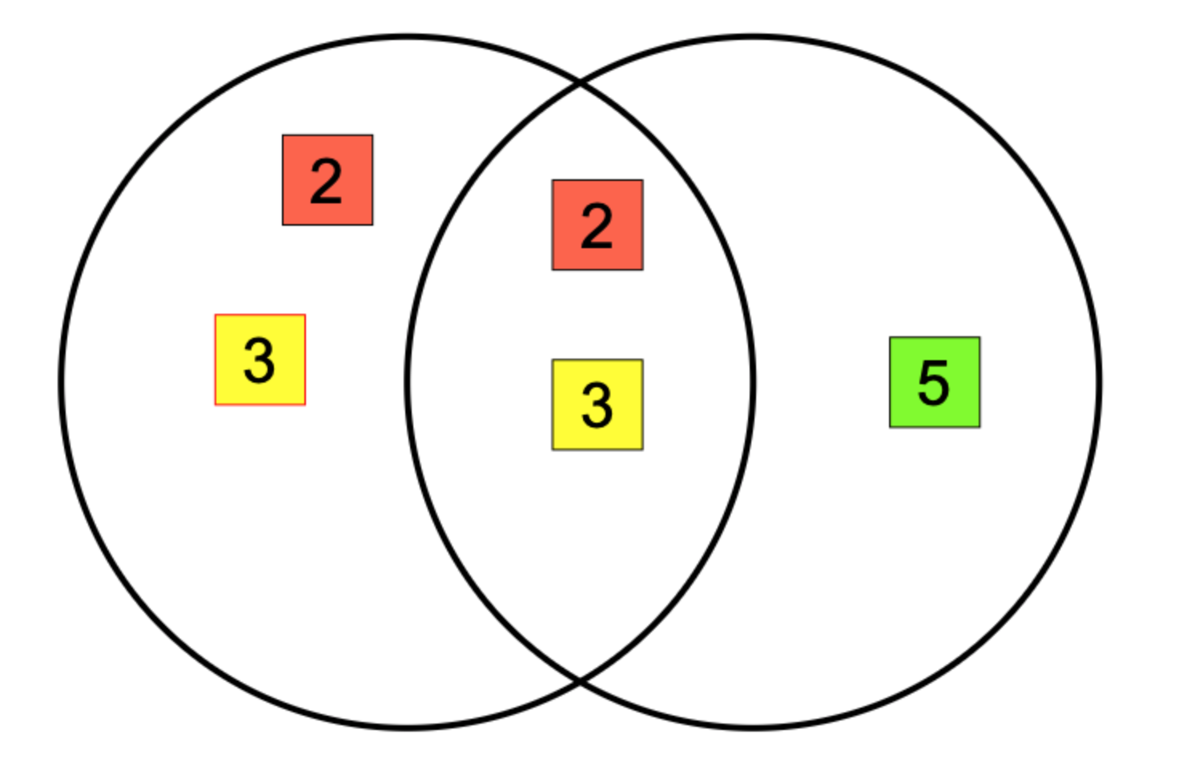
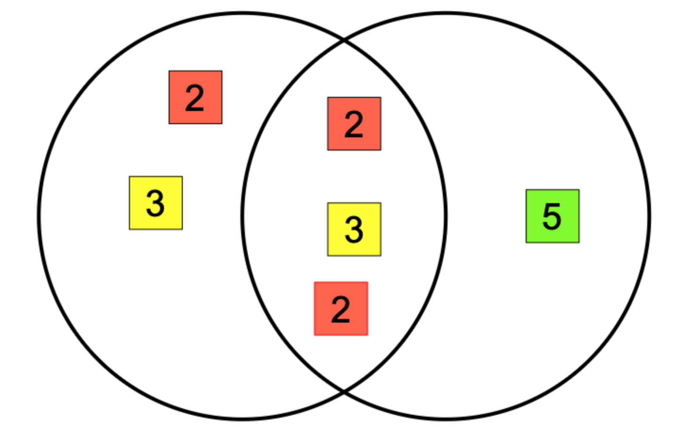
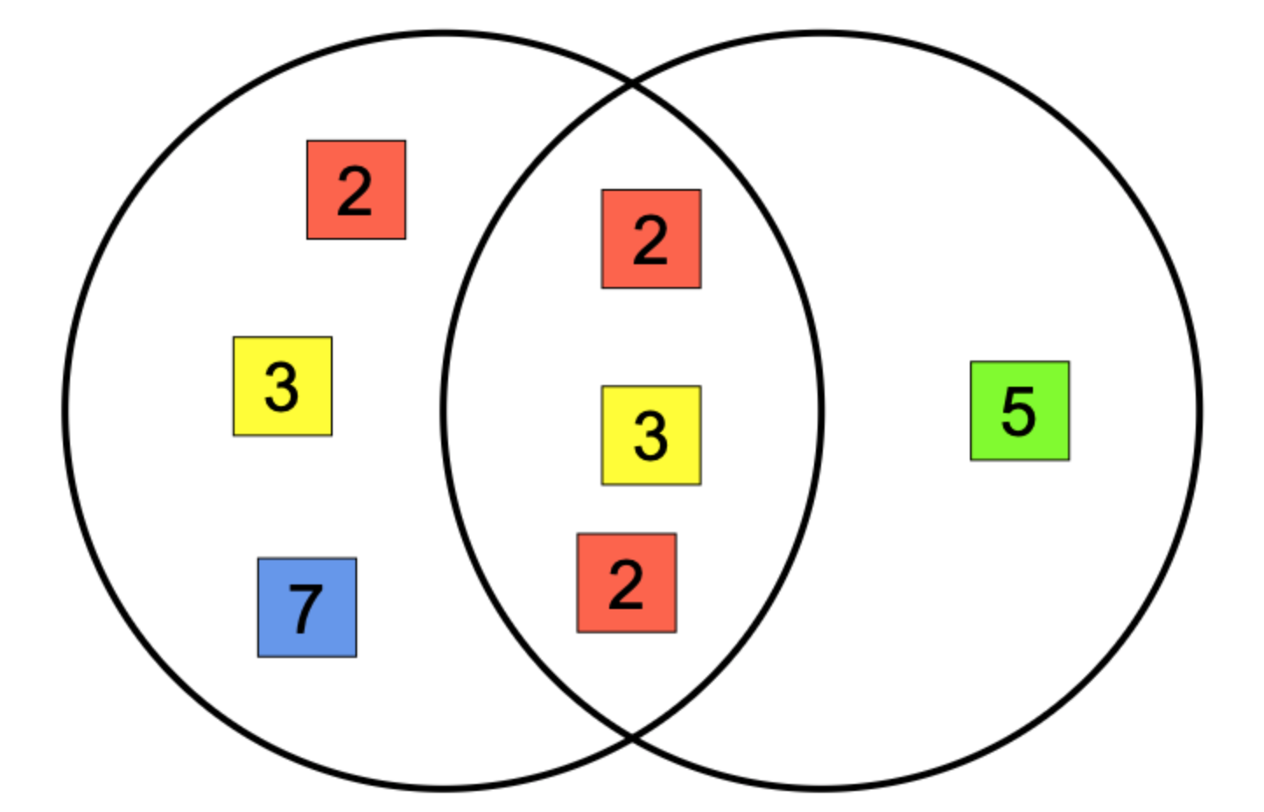
Prime Factors and Venn Diagrams (2)
I DO | WE DO | YOU DO
Write down the two numbers represented by the Venn Diagram above. Write down the LCM for these two numbers. Write down the HCF for these two numbers. | Write down the two numbers represented by the Venn Diagram above. Write down the LCM for these two numbers. Write down the HCF for these two numbers. | For each Venn Diagram below, write down: The two numbers represented The LCM The HCF

Slide 6
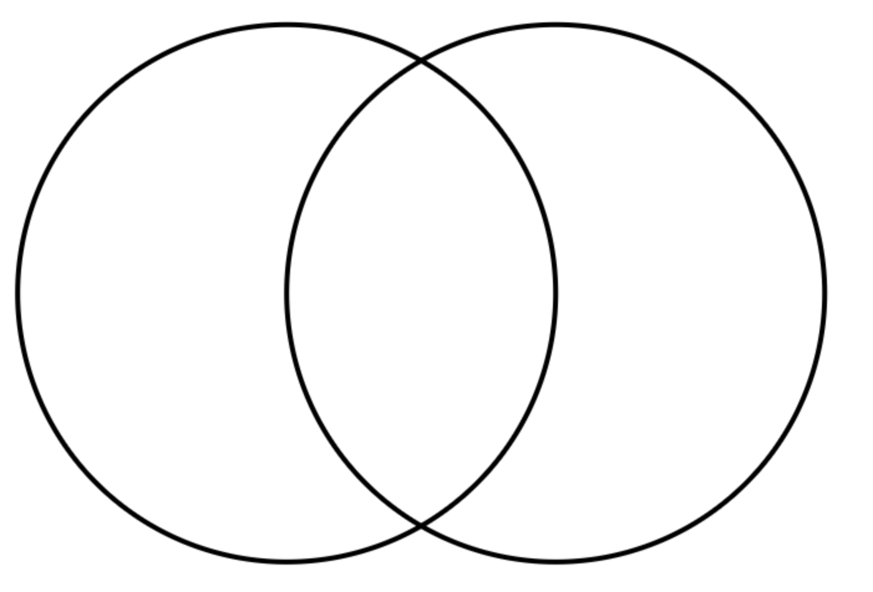
Prime Factors and Venn Diagrams (3)
I DO | WE DO | YOU DO
Using 24 = 2 x 2 x 2 x 3 40 = 2 x 2 x 2 x 5 Complete the Venn Diagram below Hence, write down the: LCM of 24 and 40 HCF of 24 and 40 | Using 28 = 2 x 2 x 7 42 = 2 x 3 x 7 Complete the Venn Diagram below Hence, write down the: LCM of 28 and 42 HCF of 28 and 42 | Use the prime factor decompositions given to complete the Venn and find the HCF and LCM a) 48 = 2 x 2 x 2 x 2 x 3 60 = 2 x 2 x 3 x 5 LCM = HCF = b) 80 = 2 x 2 x 2 x 2 x 5 60 = 2 x 2 x 3 x 5 LCM = HCF = b) 120 = 2 x 2 x 2 x 3 x 5 84 = 2 x 2 x 3 x 7 LCM = HCF =

Slide 7
Prime Factors and Venn Diagrams (4)
I DO | WE DO | YOU DO
Write 20 and 44 as a product of prime factors. Use a Venn Diagram to find the LCM and HCF of 20 and 44. | Write 28 and 44 as a product of prime factors. Use a Venn Diagram to find the LCM and HCF of 28 and 44. | Write 32 and 56 as a product of prime factors. Use a Venn Diagram to find the LCM and HCF of 32 and 56.

