Slide 1

3D Trigonometry
Full lesson PowerPoint, including I Do, We Do, You Do Example Sheet(s).

Slide 2
 | 3D Trigonometry

Slide 3
 |  |  | 3D Trigonometry
Learning Outcomes
 | I need help with trigonometry
 | I can identify, draw and label 2D triangles from a 3D diagram (Grade 6)
 | I can find missing sides in a 3D shape (Grade 8)
 | I can find missing angles in a 3D shape (Grade 8)
 | I can apply my knowledge to more complex 3D trigonometry problems (Grade 9)

Slide 4
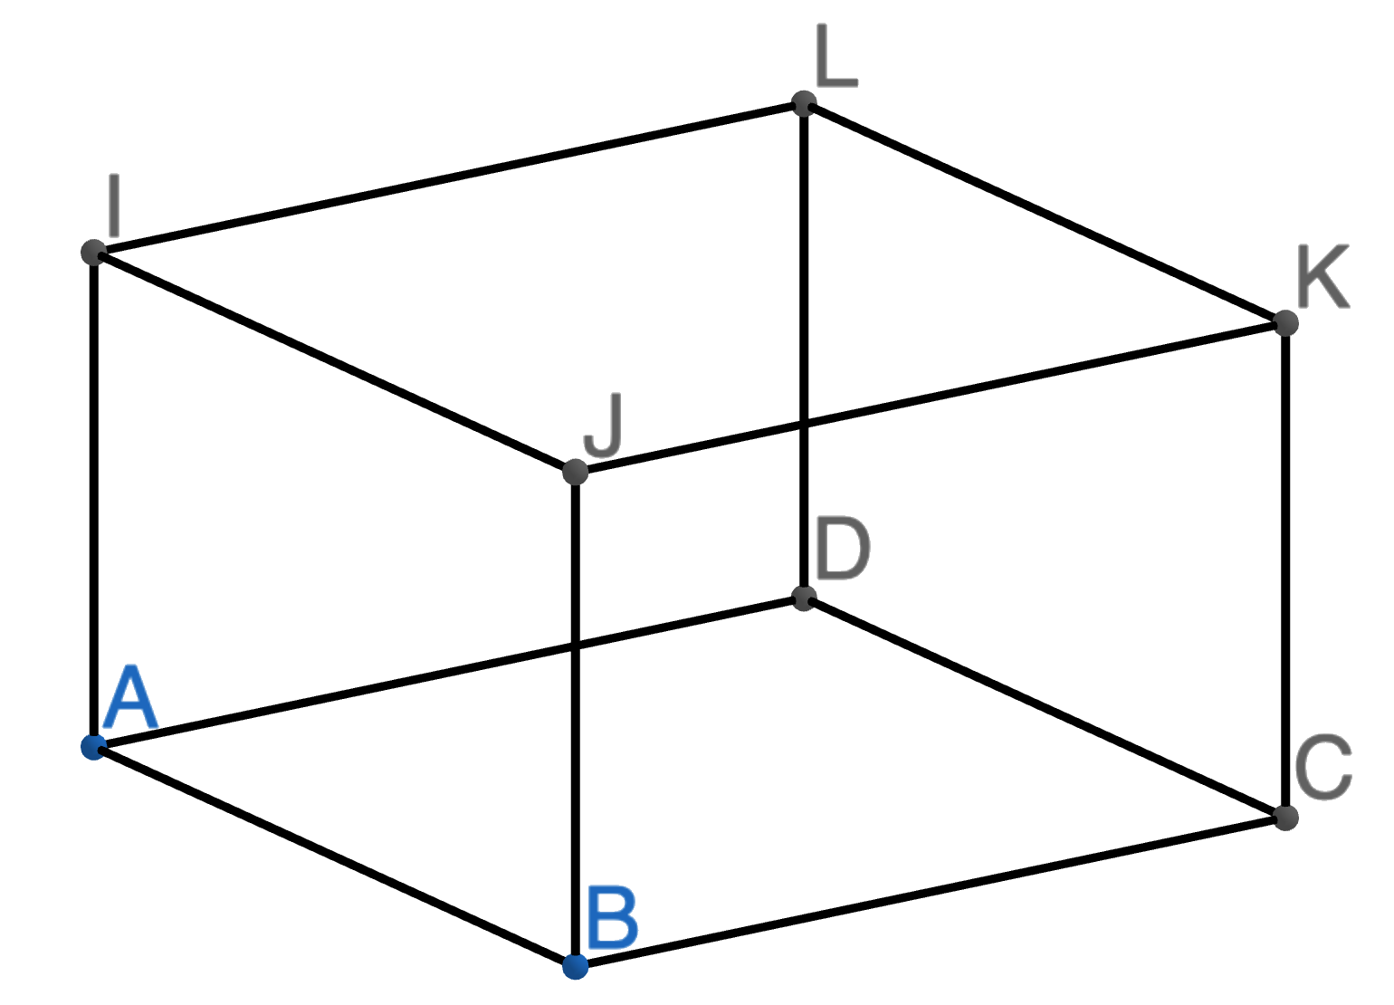
Identifying Triangles in 3D Shapes
I DO | WE DO | YOU DO
Draw and shade the triangle required on each corresponding diagram below.
Triangle ABJ Triangle BCK Triangle ACK | Triangle IJK Triangle IAD | Triangle BCJ Triangle CDK Triangle IAC

Slide 5
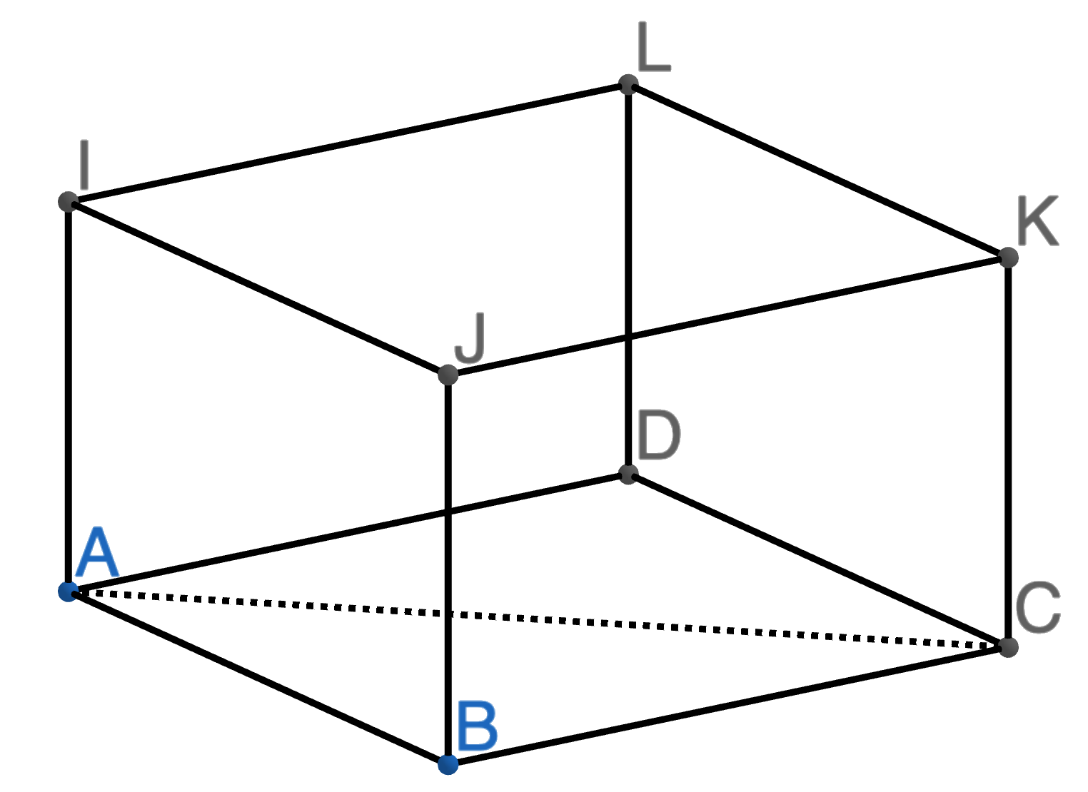
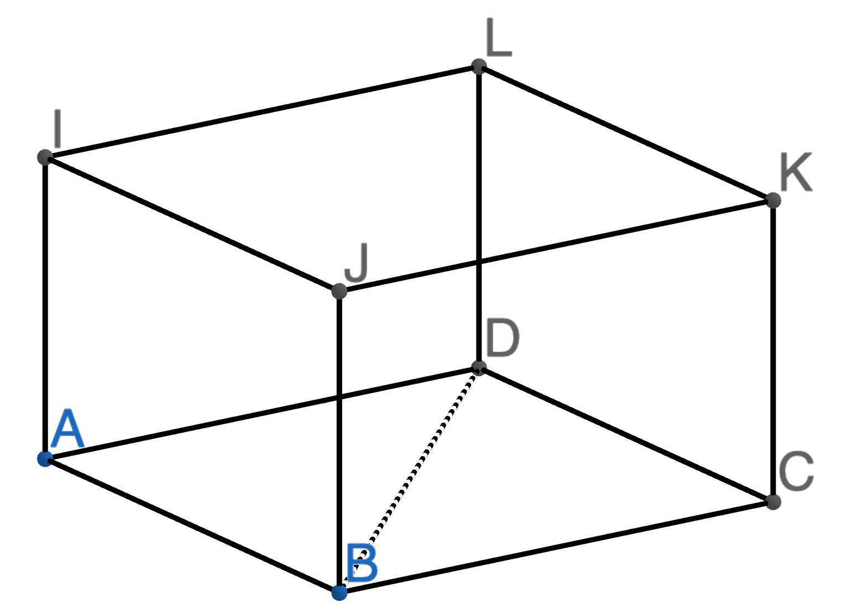
Calculating One Missing Side in a 3D Shape
I DO | WE DO | YOU DO
Here is a cuboid ABCDIJKL Calculate the exact length of side AC | Here is a cuboid ABCDIJKL Calculate the exact length of side BD | Here is a cuboid ABCDIJKL Calculate the exact length of side AC Calculate the exact length of side BD What do you notice?
5cm
6cm
30°
60°
30°
7cm
10cm

Slide 6
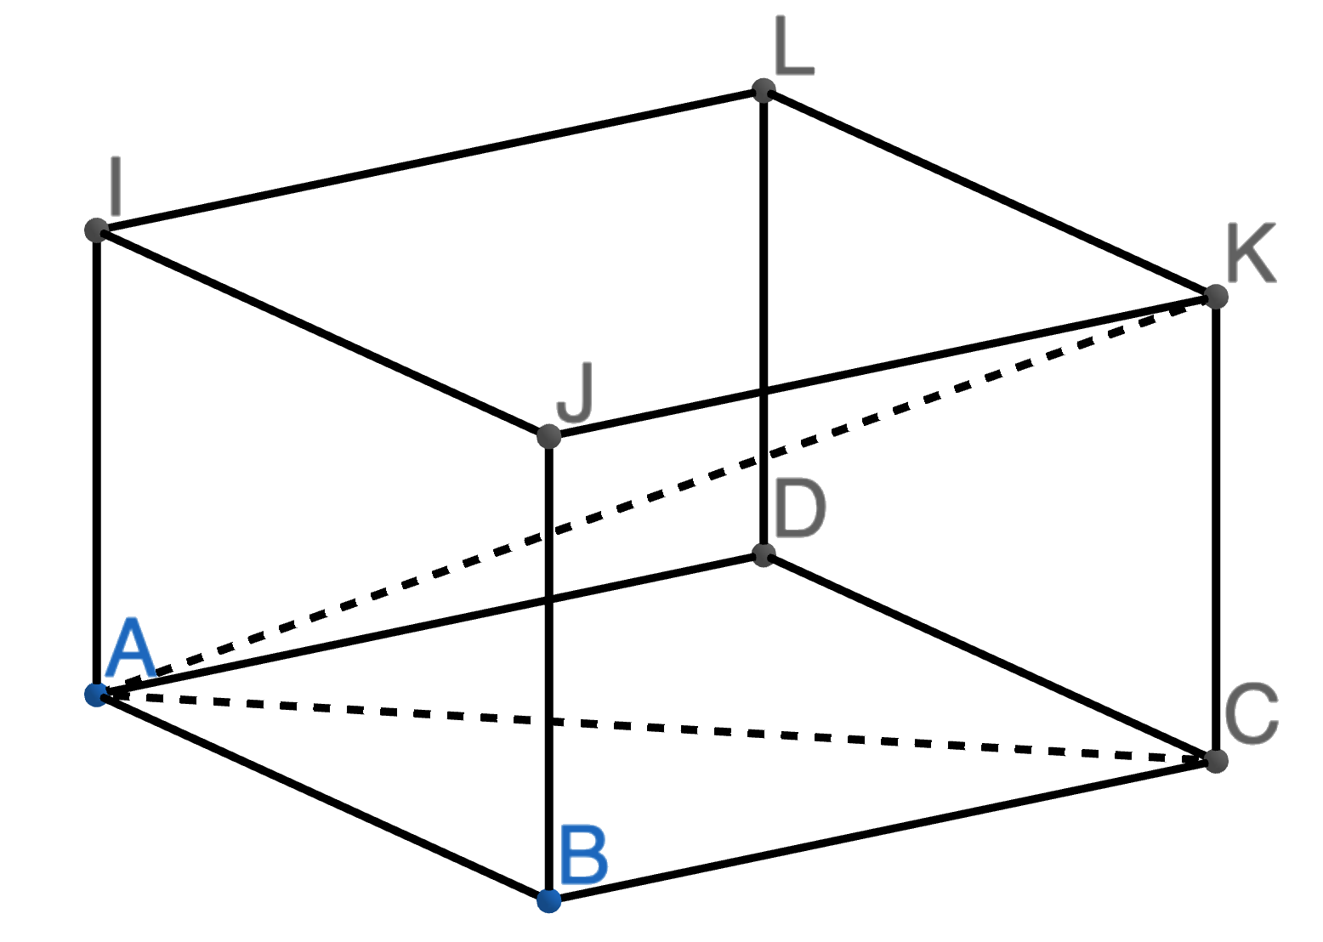
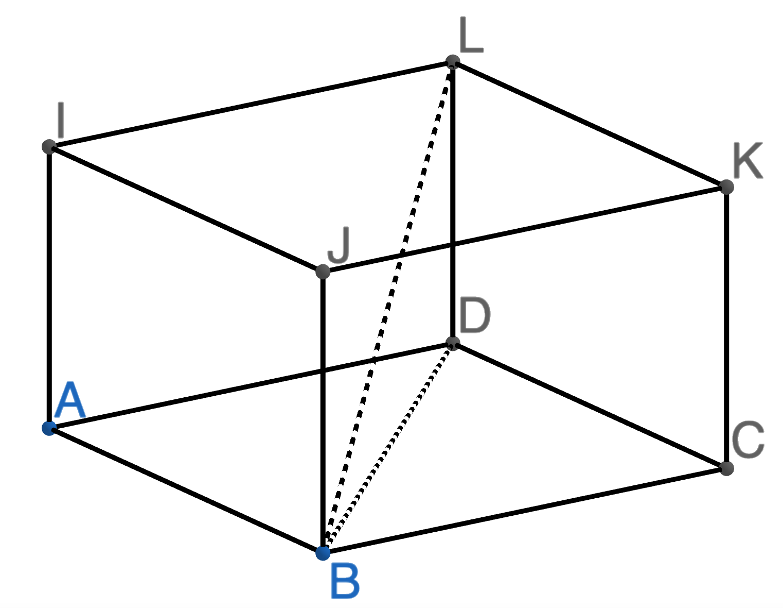
Calculating One Missing Side in a 3D Shape
I DO | WE DO | YOU DO 1
Here is a cuboid ABCDIJKL By finding side AC first, find the length of side AK. Give your answers in exact form and to 2dp. | Here is a cuboid ABCDIJKL By finding side BD first, find the length of side BL. Give your answers in exact form and to 2dp. | Here is a cuboid ABCDIJKL By finding side AC first, find the length of side AK. Give your answers in exact form and to 2dp.
5cm
7cm
5cm
11cm
60°
30°
30°
9cm
9cm

Slide 7
Calculating One Missing Side in a 3D Shape
YOU DO 2 | YOU DO 3 | YOU DO 4
Here is a cuboid ABCDIJKL By finding side AC first, find the length of side AK. Give your answers in exact form and to 2dp. | Here is a cuboid ABCDIJKL By finding side BD first, find the length of side BL. Give your answers in exact form and to 2dp. | Here is a cuboid ABCDIJKL By finding side BD first, find the length of side BL. Give your answers in exact form and to 2dp.
5cm
5cm
5cm
9cm
60°
60°
9cm
60°
9cm

Slide 8
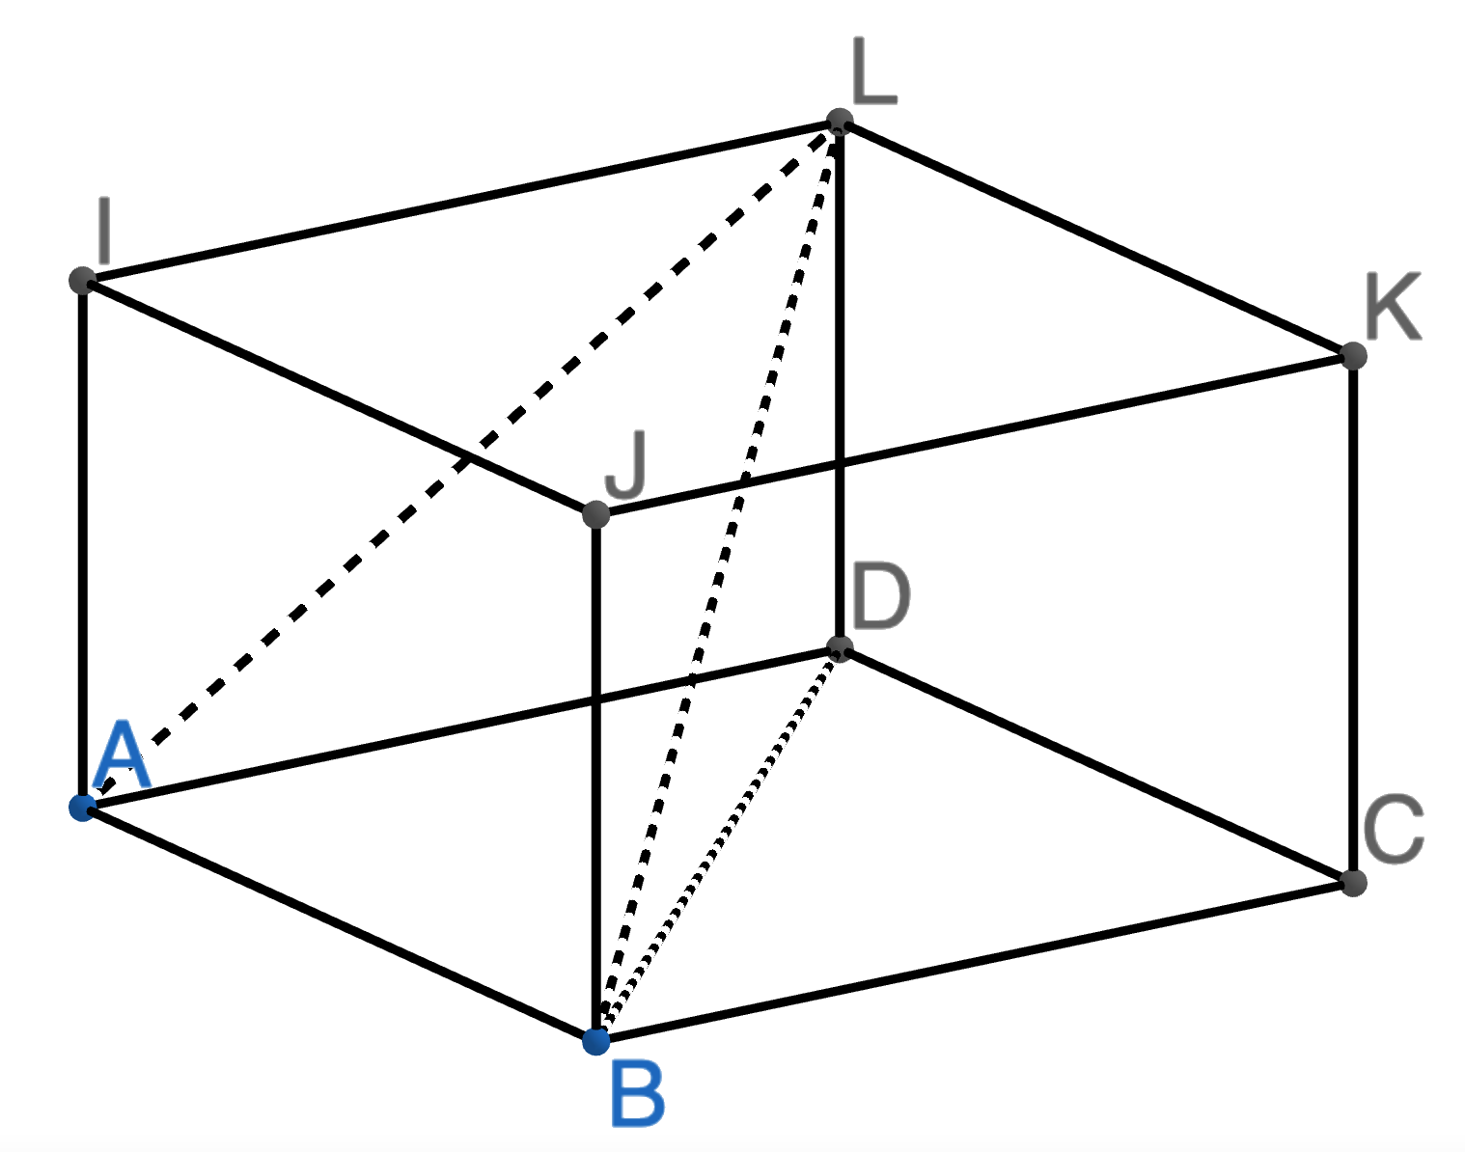
Calculating One Missing Side in a 3D Shape
YOU DO 5 | YOU DO 6 | YOU DO 7
Here is a cuboid ABCDIJKL By finding side BD first, find the length of side DL. Give your answers in exact form and to 2dp. | Here is a cuboid ABCDIJKL By finding side BD first, find the length of side BL. Give your answer to 2dp. | Here is a cuboid ABCDIJKL By finding side BD first, find the length of side AL. Give your answers to 2dp.
5cm
5cm
5cm
60°
40°
40°
9cm
9cm
9cm

Slide 9
Calculating Angle in a 3D Shape
I DO | WE DO | YOU DO
Here is a cuboid ABCDIJKL Calculate the missing angle BAC | Here is a cuboid ABCDIJKL Calculate the missing angle BDC | Here is a cuboid ABCDIJKL Calculate the missing angle BAC Calculate the missing angle BDC What do you notice?
5cm
4cm
7cm
4cm
10cm
11cm

Slide 10
Calculating One Missing Side in a 3D Shape
I DO | WE DO | YOU DO 1
Here is a cuboid ABCDIJKL By finding side AC first, find the size of angle CAK | Here is a cuboid ABCDIJKL By finding side BD first, find the size of angle DBL | Here is a cuboid ABCDIJKL By finding side AC first, find the size of angle CAK
5cm
7cm
6cm
11cm
60°
30°
30°
8cm
9cm

Slide 11
Calculating One Missing Side in a 3D Shape
YOU DO 2 | YOU DO 3 | YOU DO 4
Here is a cuboid ABCDIJKL By finding side AC first, find the size of angle CKA | Here is a cuboid ABCDIJKL By finding side BD first, find the size of angle DLB | Here is a cuboid ABCDIJKL By finding side BD first, find the size of angle DBL
6cm
6cm
6cm
9cm
60°
60°
9cm
60°
9cm

Slide 12
Calculating One Missing Side in a 3D Shape
YOU DO 5 | YOU DO 6 | YOU DO 7
Here is a cuboid ABCDIJKL By finding side BD first, find the size of angle DBL | Here is a cuboid ABCDIJKL By finding side BD first, find the size of angle DBL | Here is a cuboid ABCDIJKL By finding side BD first, find the size of angle DAL
6cm
3cm
3cm
20°
20°
40°
9cm
9cm
9cm

Slide 13
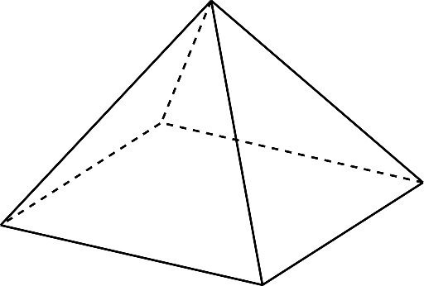
Trigonometry with Pyramids (1)
WE DO | YOU DO
Here is a square-based pyramid ABCDE. E is a vertex directly above the centre of the base. | Here is a square-based pyramid ABCDE. E is a vertex directly above the centre of the base.
E
E
Calculate the length of AC
Calculate angle ACE
Work out the height of the pyramid
Give all answers to 2dp
Calculate the length of AC
Calculate angle ACE
Work out the height of the pyramid
Give all answers to 2dp
7cm
9cm
D
D
C
C
A
A
5cm
B
5cm
B

Slide 14
Trigonometry with Pyramids (2)
WE DO | YOU DO
Here is a rectangular-based pyramid ABCDE. E is a vertex directly above the centre of the base. | Here is a rectangular-based pyramid ABCDE. E is a vertex directly above the centre of the base.
E
E
Work out the height of the pyramid
Work out the angle between face ABE and the base ABCD.
Give all answers to 2dp
Work out the height of the pyramid
Work out the angle between face ABE and the base ABCD.
Give all answers to 2dp
15cm
16cm
D
D
C
C
A
11cm
A
12cm
5cm
B
6cm
B

