Slide 1

Box Plots
Full lesson PowerPoint, including I Do, We Do, You Do Example Sheet(s).

Slide 2
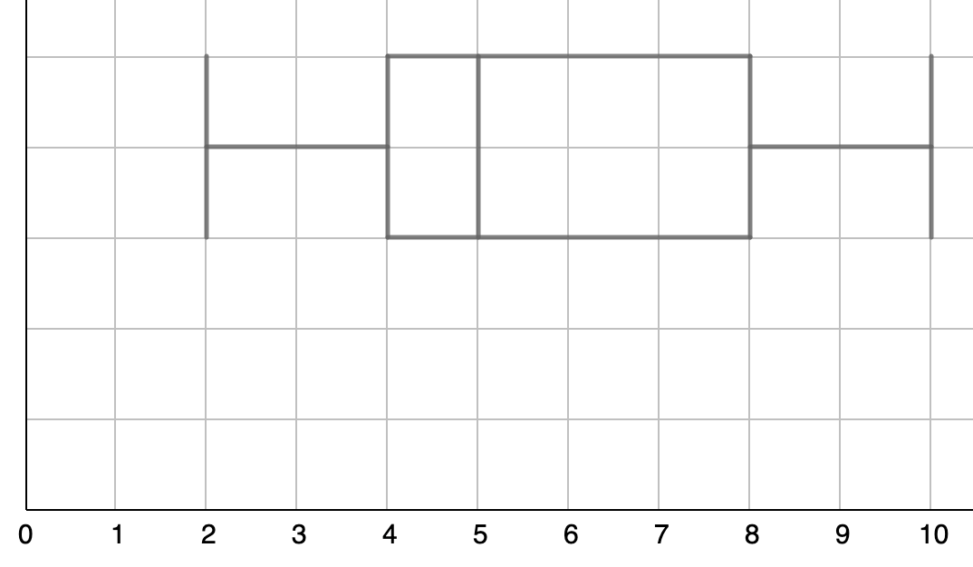
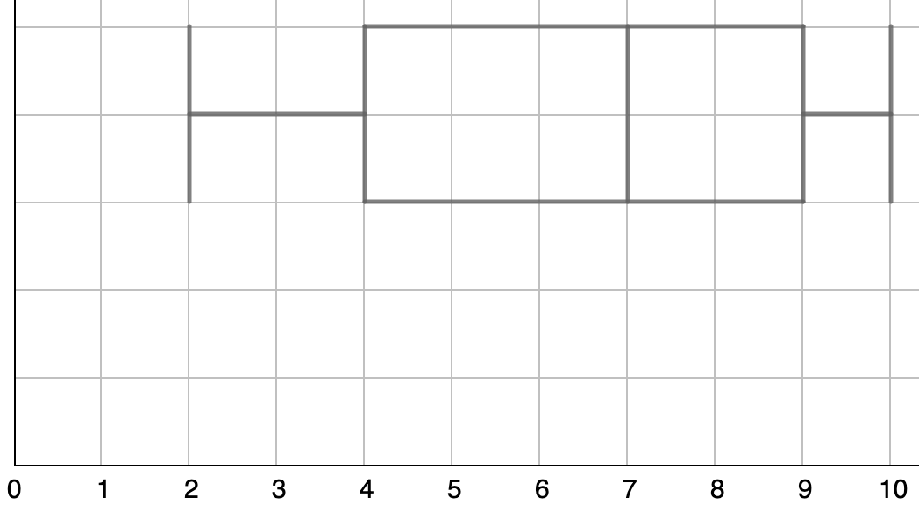
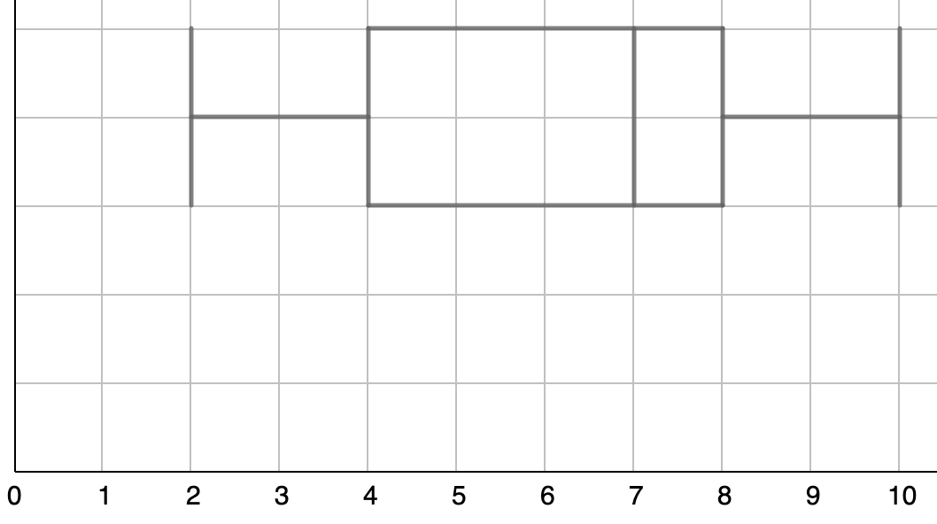
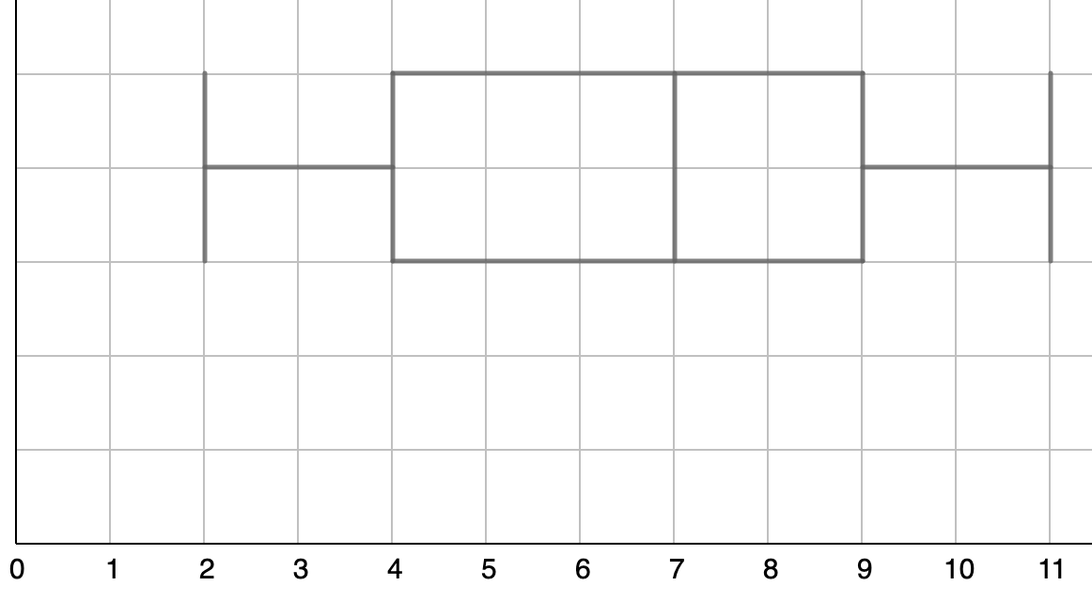
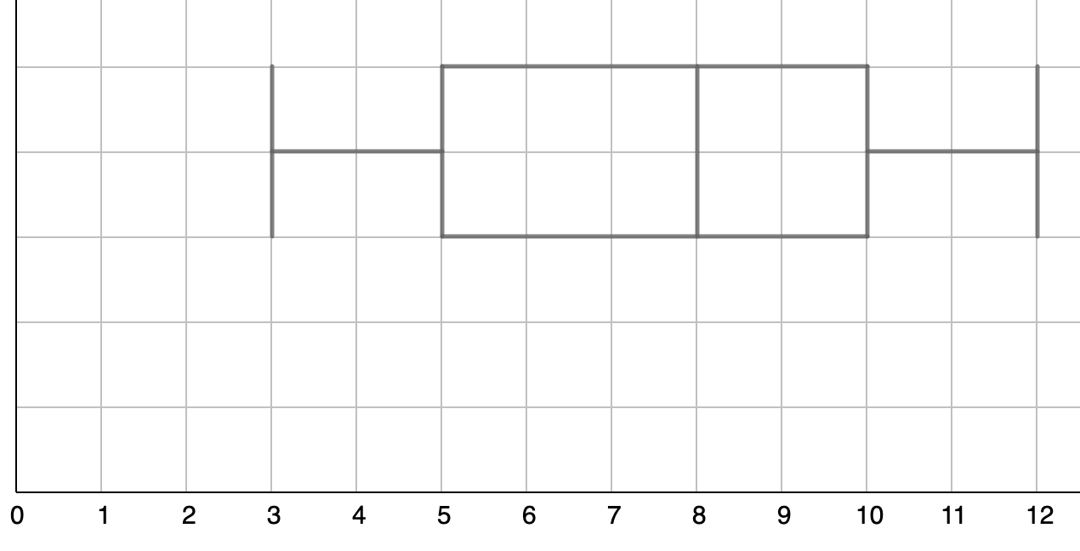
Identifying Key Values from a Box Plot
I DO | WE DO | YOU DO
For each of the box plots below, indicate the position and value of: a Median b Lowest value c Highest value d Lower Quartile (LQ) e Upper Quartile (UQ) f Inter-Quartile Range (IQR)

Slide 3
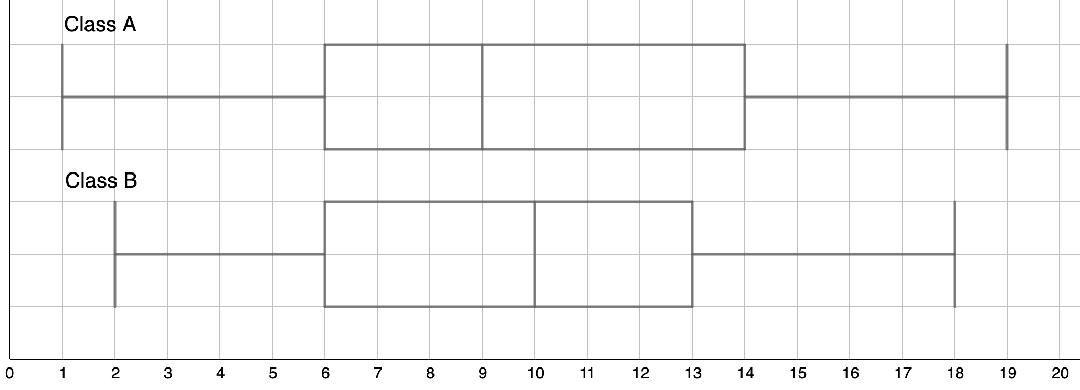
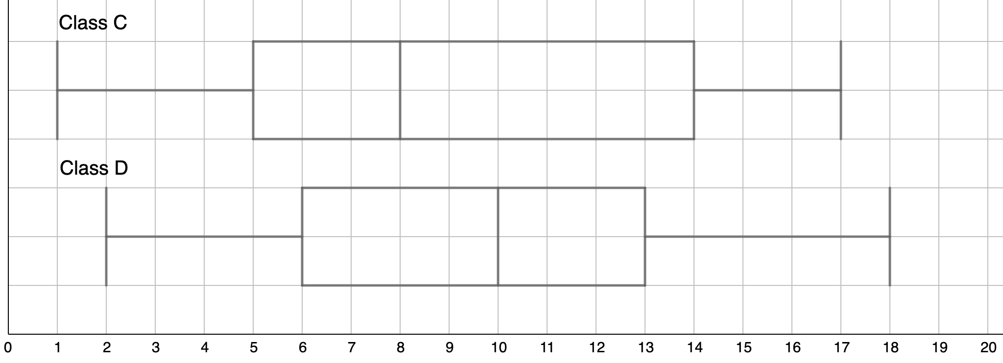
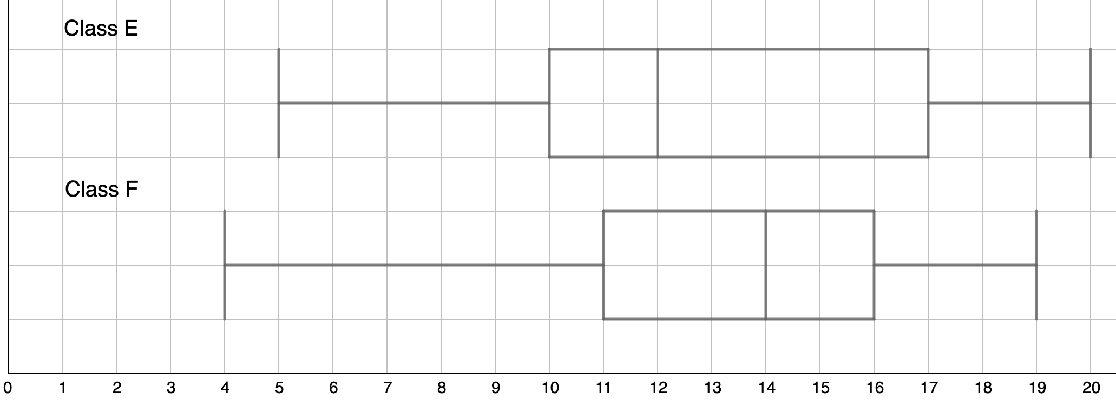
Comparing Data Sets
Each diagram shows the scores (out of 20) that two different classes scored in a spelling test. Compare the two classes’ performances.
WE DO
YOU DO 1
YOU DO 2
Extension: Put the classes A to E in order of ability. Give reasons why you have ordered the classes the way you have.

Slide 4
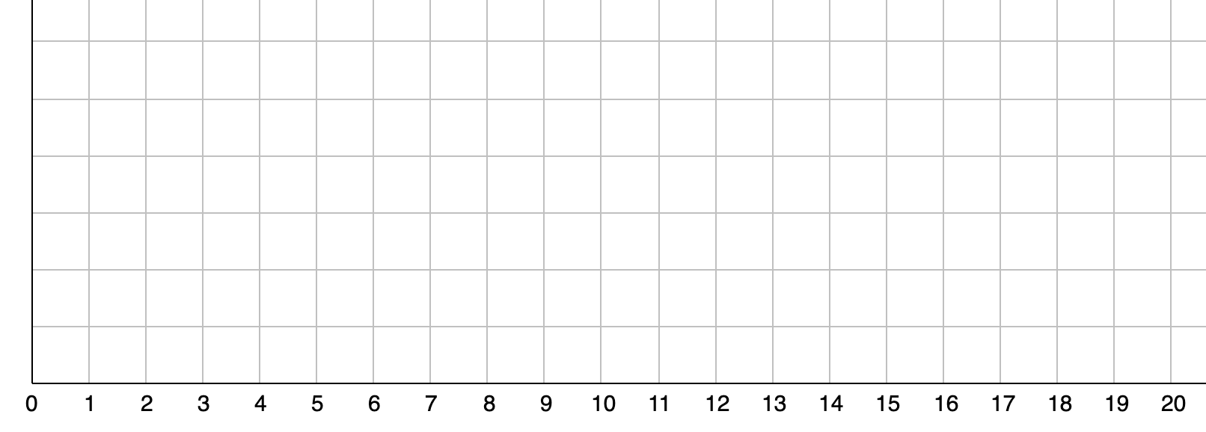
Drawing a Box Plot
Draw the box plot from the key data given below.
WE DO
WE DO
YOU DO 1
Min | LQ | Med | UQ | Max
3 | 8 | 11 | 13 | 17
Min | LQ | Med | UQ | Max
5 | 11 | 14 | 16 | 19
Min | LQ | Med | UQ | Max
4 | 11 | 14 | 16 | 20

Slide 5
Drawing a Box Plot
Draw the box plot from the key data given below.
YOU DO 2
YOU DO 3
YOU DO 4
Min | LQ | Med | UQ | Max
4 | 10 | 13 | 15 | 20
Min | LQ | Med | UQ | Max
3 | 9 | 12 | 14 | 19
Min | LQ | Med | UQ | Max
1 | 7 | 10 | 12 | 17

Slide 6
Drawing a Box Plot
Draw the box plot and complete the key data where necessary.
YOU DO 5 | Range = 17
YOU DO 6 | Range = 17 Inter-Quartile Range = 6
YOU DO 7 | Range = 16.5 Inter-Quartile Range = 4.5
Min | LQ | Med | UQ | Max
1 | 7 | 10 | 12
Min | LQ | Med | UQ | Max
3 |  | 10 | 12
Min | LQ | Med | UQ | Max
3 | 7.5 | 10

Slide 7
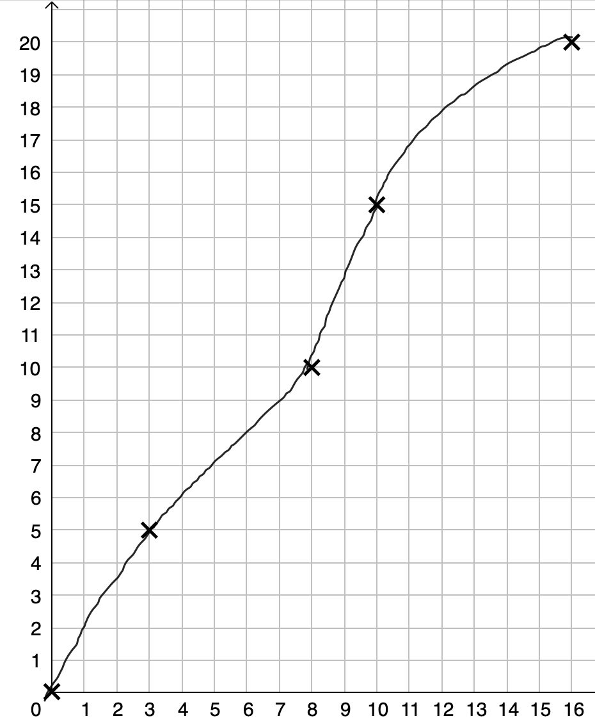
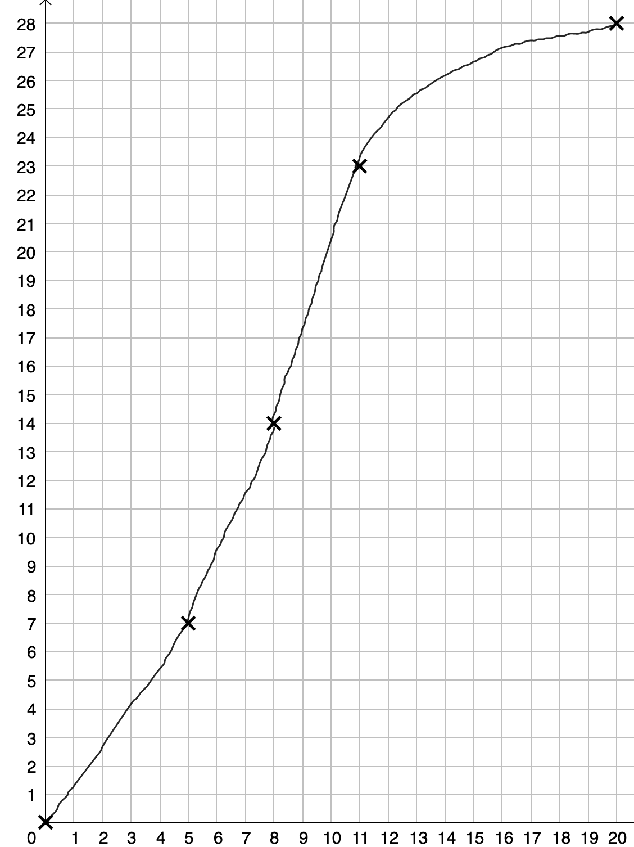
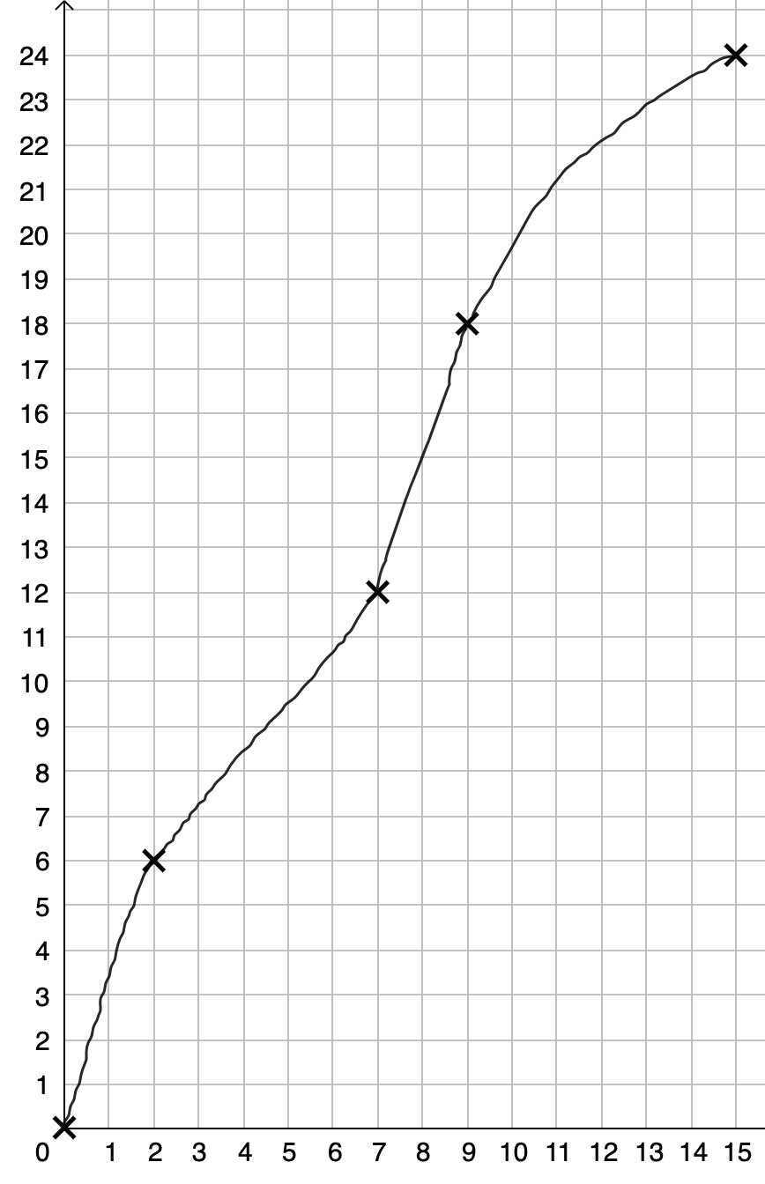
Drawing a Box Plot from a Cumulative Frequency Table
I DO | WE DO | YOU DO 1
The cumulative frequency table shows the distribution of marks over different tests. Use the information to plot the box plot. The minimum and maximum mark for each test is also indicated.
Test 1 Min = 0, Max = 16 | Test 2 Min = 0, Max = 20 | Test 3 Min = 0, Max = 16
Cumulative
Frequency
Cumulative
Frequency
Cumulative
Frequency
Marks
Marks
Marks

Slide 8
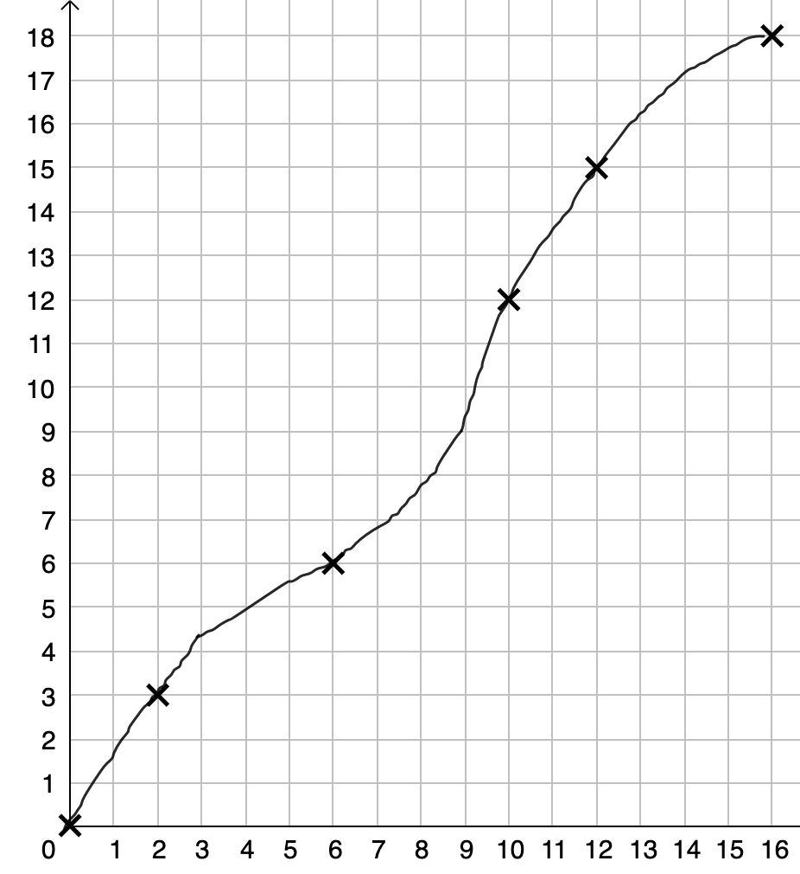
Drawing a Box Plot from a Cumulative Frequency Table
YOU DO 2 | YOU DO 3 | YOU DO 4
The cumulative frequency table shows the distribution of marks over different tests. Use the information to plot the box plot. The minimum and maximum mark for each test is also indicated.
Test 4 Min = 0, Max = 15 | Test 5 Min = 3, Max = 15 | Test 6 Min = 1, Max = 15
Cumulative
Frequency
Cumulative
Frequency
Cumulative
Frequency
Marks
Marks
Marks

