Slide 1
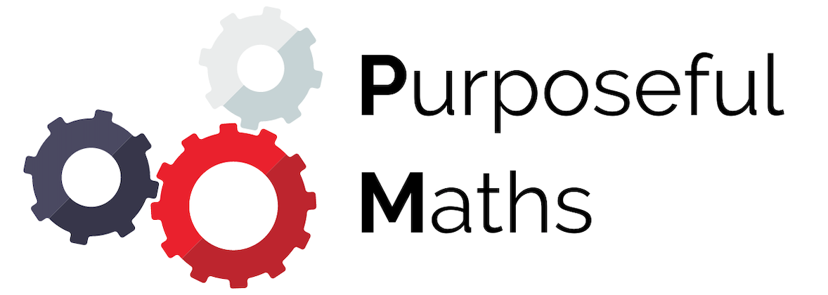
Using a multiplier to calculate percentages
Full lesson PowerPoint, including I Do, We Do, You Do Example Sheet(s).

Slide 2
 | Using a multiplier to calculate percentages

Slide 3
Writing Percentages as decimals
I DO | WE DO | YOU DO
Write the following percentages as decimals 25% 50% 5% 0.5% 150% | Write the following percentages as decimals 75% 80% 8% 0.8% 250% | Write the following percentages as decimals 90% 93% 3% 0.3% 450% 12% 1.2% 0.0012%

Slide 4
Multiplier method with a calculator
I DO | WE DO | YOU DO
Calculate the following percentages of amounts, using the multiplier method 13% of 50 50% of 13 5% of 24 0.5% of 24 150% of 24 | Calculate the following percentages of amounts, using the multiplier method 75% of 84 80% of 84 8% of 84 0.8% of 84 250% of 84 | Calculate the following percentages of amounts, using the multiplier method 90% of 26 93% of 26 3% of 26 0.3% of 26 450% of 26 12% of 26 1.2% of 26

Slide 5
Multiplier method without a calculator
I DO | WE DO | YOU DO
Calculate the following percentages of amounts, using the multiplier method. You can use a calculator 17% of 50 50% of 17 | Calculate the following percentages of amounts, using the multiplier method. You can use a calculator 13% of 20 20% of 13 Can you explain why this works? | Calculate the following percentages of amounts, using the multiplier method. You MAY NOT use a calculator 26% of 10 38% of 50 12% of 200 14.5% of 20 24% of 150

