Slide 1
Solving Quadratic Inequalities
Full lesson PowerPoint, including I Do, We Do, You Do Example Sheet(s).

Slide 2
 | Solving Quadratic Inequalities

Slide 3
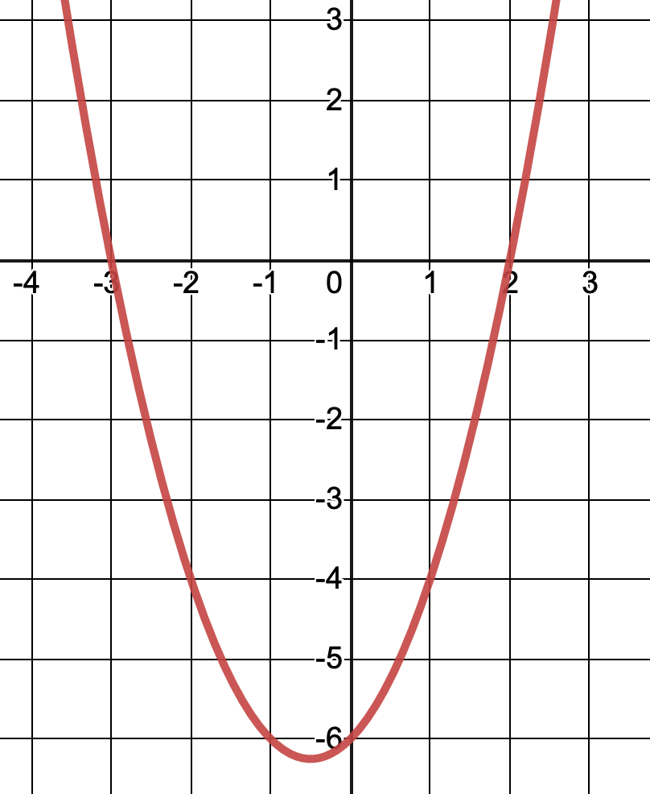
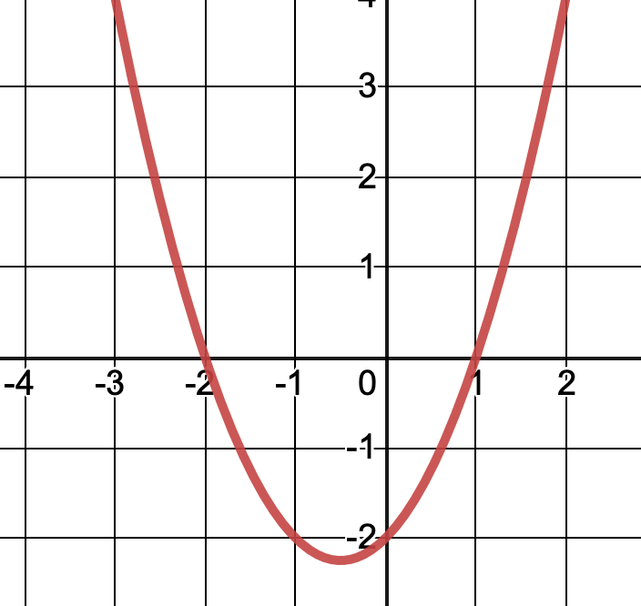
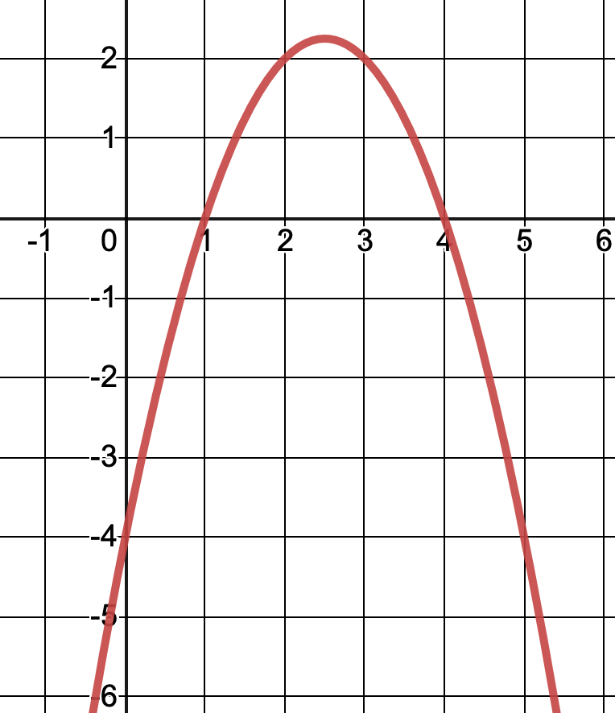
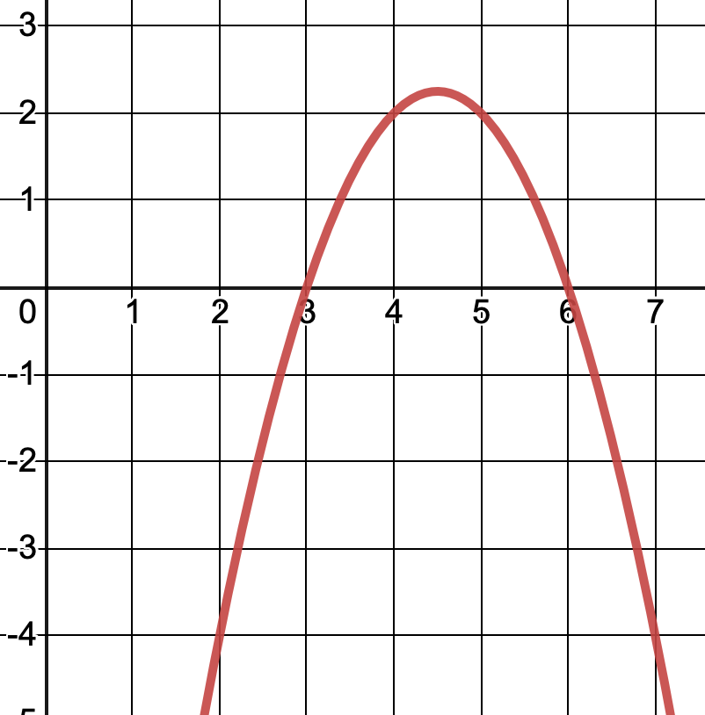
Solving Quadratic Inequalities Graphically
I DO | WE DO
Here is the graph of $$y=(x+3)(x−2)$$ Show which part of the graph that represents $$\left(x+3\right)\left(x−2\right)<0$$ State the solution set of $$\left(x+3\right)\left(x−2\right)<0$$ | Here is the graph of $$y=(x+2)(x−1)$$ Show which part of the graph that represents $$\left(x+2\right)\left(x−1\right)<0$$ State the solution set of $$\left(x+2\right)\left(x−1\right)<0$$
Here is the graph of $$y=(4−x)(x−1)$$ Show which part of the graph that represents $$\left(4−x\right)\left(x−1\right)<0$$ State the solution set of $$\left(4−x\right)\left(x−1\right)<0$$ | Here is the graph of $$y=(3−x)(x−6)$$ Show which part of the graph that represents $$\left(3−x\right)\left(x−6\right)<0$$ State the solution set of $$\left(3−x\right)\left(x−6\right)<0$$

Slide 4
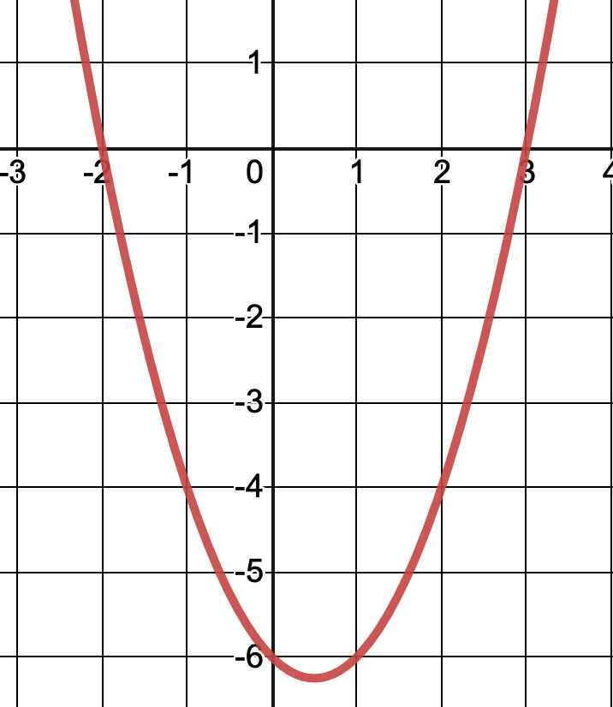
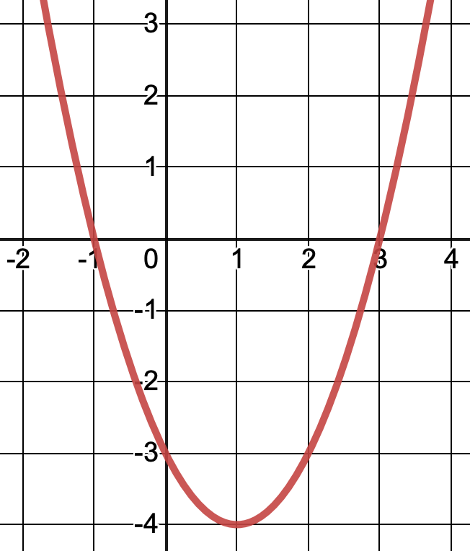
Solving Quadratic Inequalities Graphically
YOU DO 1 – 4 | WE DO
1) Here is the graph of $$y=(x+2)(x−3)$$ Show which part of the graph that represents $$\left(x+2\right)\left(x−3\right)<0$$ State the solution set of $$\left(x+2\right)\left(x−3\right)<0$$ | 2) Here is the graph of $$y=(x+2)(x−3)$$ Show which part of the graph that represents $$\left(x+2\right)\left(x−3\right)>0$$ State the solution set of $$\left(x+2\right)\left(x−3\right)>0$$
3) Here is the graph of $$y=(x+1)(x−3)$$ Show which part of the graph that represents $$\left(x+1\right)\left(x−3\right)<0$$ State the solution set of $$\left(x+1\right)\left(x−3\right)<0$$ | 4) Here is the graph of $$y=(−x+6)(x−3)$$ Show which part of the graph that represents $$\left(−x+6\right)\left(x−3\right)>0$$ State the solution set of $$\left(−x+6\right)\left(x−3\right)>0$$

Slide 5
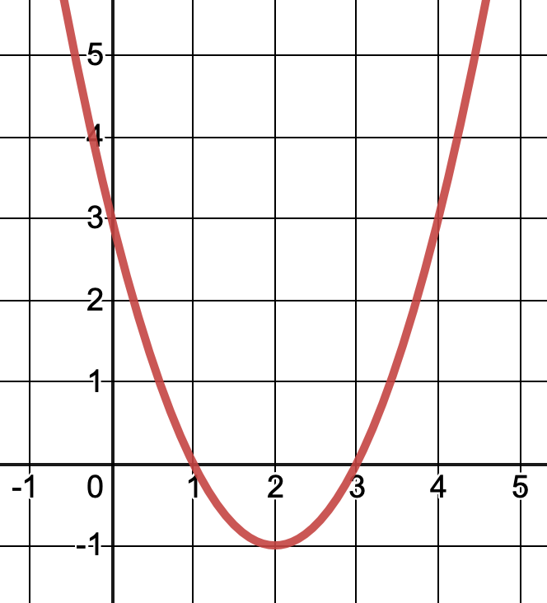
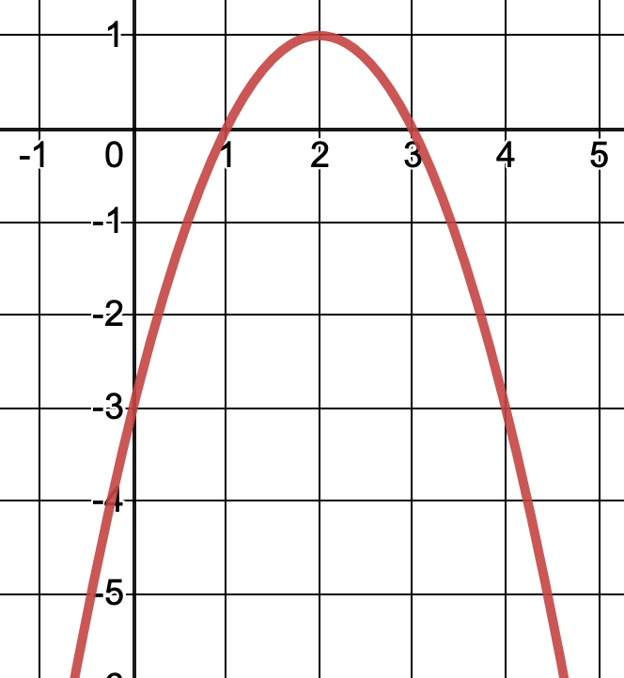
Solving Quadratic Inequalities Graphically
YOU DO 5 – 8 | WE DO
5) Here is the graph of $$y=(x−1)(x−3)$$ Show which part of the graph that represents $$\left(x−1\right)\left(x−3\right)<0$$ State the solution set of $$\left(x−1\right)\left(x−3\right)<0$$ | 6) Here is the graph of $$y=(x−1)(x−3)$$ Show which part of the graph that represents $$\left(x−1\right)\left(x−3\right)>0$$ State the solution set of $$\left(x−1\right)\left(x−3\right)>0$$
7) Here is the graph of $$y=(−x+1)(x−3)$$ Show which part of the graph that represents $$\left(−x+1\right)\left(x−3\right)<0$$ State the solution set of $$\left(−x+1\right)\left(x−3\right)<0$$ | 7) Here is the graph of $$y=(−x+1)(x−3)$$ Show which part of the graph that represents $$\left(−x+1\right)\left(x−3\right)>0$$ State the solution set of $$\left(−x+1\right)\left(x−3\right)>0$$

Slide 6
Solving Quadratic Inequalities by Factorising
I DO | WE DO | YOU DO
Solve the inequality $$x^{2}−x−2>0$$ | Solve the inequality $$x^{2}−3x−10≤0$$ | Solve the inequalities below: $$x^{2}+2x−3≥0$$ $$x^{2}+2x−3≤0$$ $$x^{2}+3x−4≤0$$ $$x^{2}+3x−4>0$$ $$x^{2}+4x−5>0$$ $$x^{2}−6x+5>0$$ $$x^{2}−7x+10>0$$ $${2x}^{2}−11x+5>0$$ $${3x}^{2}−16x+5>0$$ ANSWER IN YOUR BOOKS

Slide 7
Solving Quadratic Inequalities Using Quadratic Formula
I DO | WE DO | YOU DO
Solve the inequality $$x^{2}+4x−2<0$$ Give your answers to 2dp. | Solve the inequality $$x^{2}+7x−1≥0$$ Give your answers to 2dp. | Solve the inequalities below: $$x^{2}+5x−1>0$$ $$x^{2}+8x−1>0$$ $$x^{2}−8x−1>0$$ $$x^{2}+8x−1≤0$$ $$−x^{2}+8x−1≤0$$ $$−{2x}^{2}+8x−1≤0$$ $$−{2x}^{2}+8x−1>0$$ $$−{2x}^{2}+8x−1>5x^{2}−x+6$$ ANSWER IN YOUR BOOKS

