Slide 1
Plotting Quadratic Graphs
Full lesson PowerPoint, including I Do, We Do, You Do Example Sheet(s).

Slide 2
 | Plotting Quadratic Graphs

Slide 3
Plotting Quadratic Graphs (1)
I DO | YOU DO
Complete a table of values and plot the graph of y = x² + 3 for -3 ≤ x ≤ 3 | Complete a table of values and plot the graph of y = x² - 2 for -3 ≤ x ≤ 3
I DO | YOU DO
Complete a table of values and plot the graph of y = x² + 2x for -4 ≤ x ≤ 2 | Complete a table of values and plot the graph of y = x² + 4x - 1 for -5 ≤ x ≤ 1

Slide 4
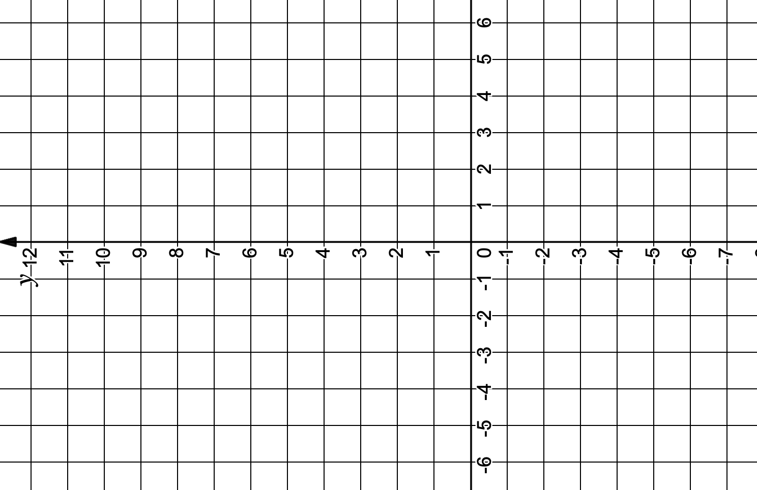

Slide 5
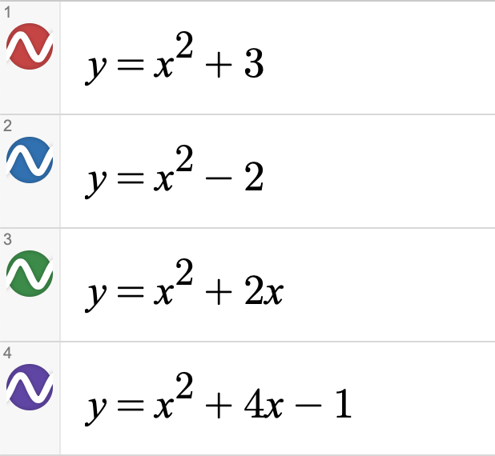
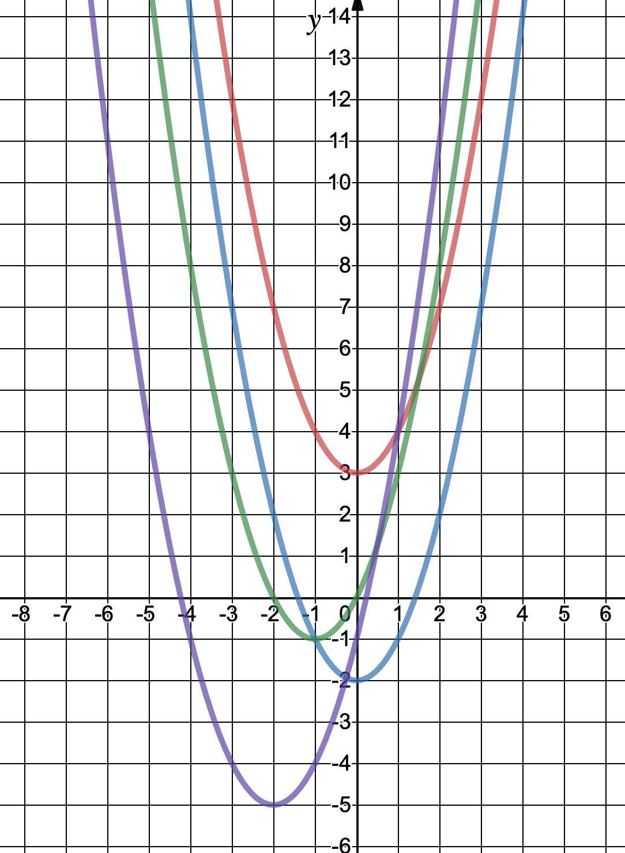

Slide 6
Plotting Quadratic Graphs (2)
I DO | YOU DO
Complete a table of values and plot the graph of y = -x² for -3 ≤ x ≤ 3 | Complete a table of values and plot the graph of y = 3 - x² for -3 ≤ x ≤ 3
I DO | YOU DO
Complete a table of values and plot the graph of y = -x² + 2x + 3 for -4 ≤ x ≤ 2 | Complete a table of values and plot the graph of y = 2x² - 3x + 1 for -5 ≤ x ≤ 1

Slide 7
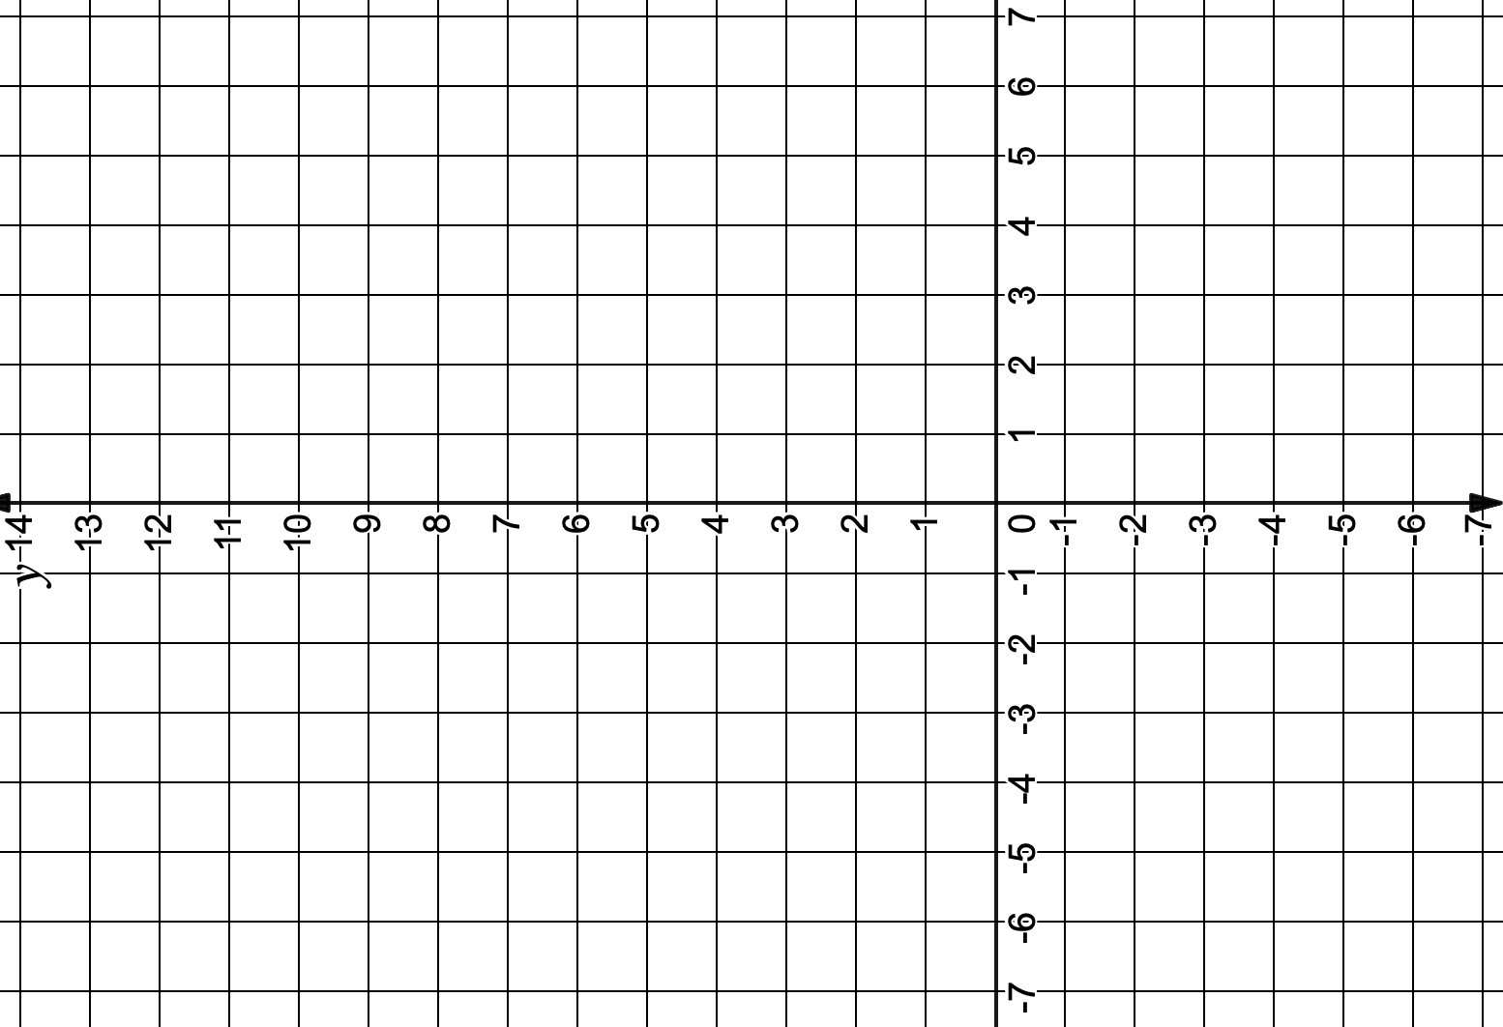

Slide 8
