Slide 1
Drawing Distance-Time Graphs
Full lesson PowerPoint, including I Do, We Do, You Do Example Sheet(s).

Slide 2
 | Drawing Distance-Time Graphs

Slide 3
 |  |  | Drawing Distance-Time Graphs
Learning Outcomes
 | I need help with distance-time graphs
 | I know what a distance-time graph represents (Grade 2)
 | I can draw a distance-time graph when given distances and times (Grade 3)
 | I can draw a distance-time graph when given speeds (Grade 4)
 | I can plot multiple distance-time graphs and compare journeys and solve problems (Grade 4+)

Slide 4
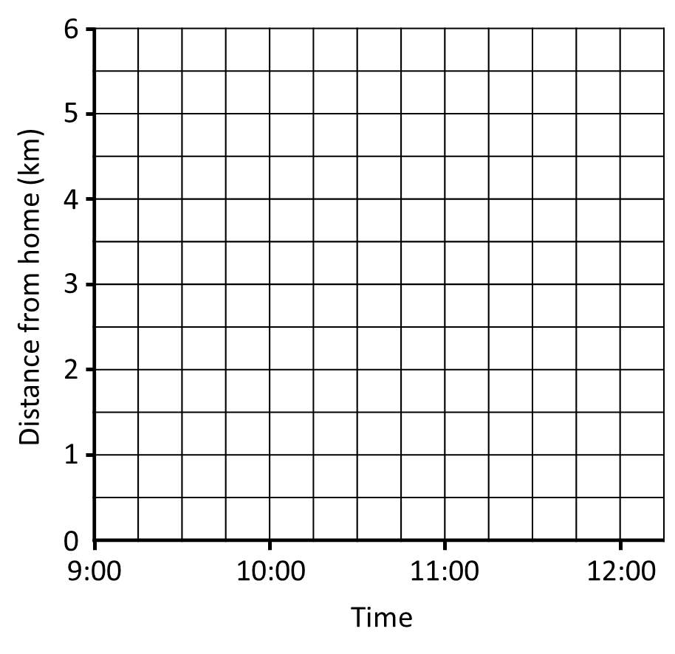
Drawing Distance-Time Graphs (1)
I DO | WE DO
Below is part of a distance-time graph for a walking group. The group stopped for a 30 minute coffee break at 10:00. Add this to the distance time graph. What time did the group start again? The group then turn around and return back to where they started. It takes them 1 hour 30 minutes. Add this to the distance-time graph. What time do they get back? | Below is part of a distance-time graph for a walking group. The group stopped for a 30 minute coffee break at 10:00. Add this to the distance time graph. What time did the group start again? The group then turn around and return back to where they started. It takes them 1 hour 30 minutes. Add this to the distance-time graph. What time do they get back?

Slide 5
Drawing Distance-Time Graphs (1)
YOU DO 1 | YOU DO 2
Below is part of a distance-time graph for a walking group. The group stopped for a 30 minute coffee break at 10:00. Add this to the distance time graph. What time did the group start again? The group then turn around and return back to where they started. It takes them 1 hour 30 minutes. Add this to the distance-time graph. What time do they get back? | Below is part of a distance-time graph for a walking group. The group stopped for a 30 minute coffee break at 10:00. Add this to the distance time graph. What time did the group start again? The group then turn around and return back to where they started. It takes them 1 hour 30 minutes. Add this to the distance-time graph. What time do they get back?

Slide 6
Drawing Distance-Time Graphs (1)
YOU DO 3 | YOU DO 4
Below is part of a distance-time graph for a walking group. The group stopped for a 45 minute coffee break at 10:00. Add this to the distance time graph. What time did the group start again? The group then turn around and return back to where they started. It takes them 1 hour 30 minutes. Add this to the distance-time graph. What time do they get back? | Below is part of a distance-time graph for a walking group. The group stopped for a 45 minute coffee break at 10:00. Add this to the distance time graph. What time did the group start again? The group then turn around and return back to where they started. It takes them 1 hour 15 minutes. Add this to the distance-time graph. What time do they get back?

Slide 7
Drawing Distance-Time Graphs (1)
YOU DO 5 | YOU DO 6
Below is part of a distance-time graph for a walking group. The group stopped for a 45 minute coffee break at 10:00. Add this to the distance time graph. What time did the group start again? The group then turn around and return back to where they started. It takes them 1 hour 15 minutes. Add this to the distance-time graph. What time do they get back? | Below is part of a distance-time graph for a walking group. The group stopped for a 45 minute coffee break at 10:00. Add this to the distance time graph. What time did the group start again? The group then turn around and return back to where they started. It takes them 45 minutes. Add this to the distance-time graph. What time do they get back?

Slide 8
Drawing Distance-Time Graphs (2)
I DO | WE DO
Below is part of a distance-time graph for a walking group. What speed did the group travel at in the first hour? The group continue walking at the same speed for another 1 hour. Add this to the graph. The group then stop for a 30 minute break. The group then continue their journey at the same speed as before for another 30 minutes. | Below is part of a distance-time graph for a walking group. What speed did the group travel at in the first hour? The group continue walking at the same speed for another 1 hour. Add this to the graph. The group then stop for a 30 minute break. The group then continue their journey at the same speed as before for another 30 minutes.

Slide 9
Drawing Distance-Time Graphs (2)
YOU DO 1 | YOU DO 2
Below is part of a distance-time graph for a walking group. What speed did the group travel at in the first hour? The group continue walking at the same speed for another 1 hour. Add this to the graph. The group then stop for a 30 minute break. The group then continue their journey at the same speed as before for another 30 minutes. | Below is part of a distance-time graph for a walking group. What speed did the group travel at in the first hour? The group continue walking at the same speed for another 1 hour. Add this to the graph. The group then stop for a 30 minute break. The group then continue their journey at the same speed as before for another 30 minutes.

Slide 10
Drawing Distance-Time Graphs (3)
I DO | WE DO
Below is part of a distance-time graph for a walking group. What speed did the group travel at in the first part of their journey? The group then stop for a 30 minute break. The group then continue their journey at a speed of 2km/h for 2 hours. Add this to the graph. | Below is part of a distance-time graph for a walking group. What speed did the group travel at in the first part of their journey? The group then stop for a 15 minute break. The group then continue their journey at a speed of 2km/h for 2 hours. Add this to the graph.

Slide 11
Drawing Distance-Time Graphs (3)
YOU DO 1 | YOU DO 2
Below is part of a distance-time graph for a walking group. What speed did the group travel at in the first part of their journey? The group then stop for a 30 minute break. The group then continue their journey at a speed of 2km/h for 1 hour. Add this to the graph. | Below is part of a distance-time graph for a walking group. What speed did the group travel at in the first part of their journey? The group then stop for a 30 minute break. The group then continue their journey at a speed of 2km/h for 1 hour. Add this to the graph.

Slide 12
Drawing Distance-Time Graphs (3)
YOU DO 3 | YOU DO 4
Below is part of a distance-time graph for a walking group. What speed did the group travel at in the first part of their journey? The group then stop for a 30 minute break. The group then continue their journey at a speed of 2km/h for 1 hour 30 mins. Add this to the graph. | Below is part of a distance-time graph for a walking group. What speed did the group travel at in the first part of their journey? The group then stop for a 30 minute break. The group then continue their journey at a speed of 2km/h for 1 hours 45 mins. Add this to the graph.

Slide 13
Drawing Distance-Time Graphs (3)
YOU DO 5 | YOU DO 6
Below is part of a distance-time graph for a walking group. What speed did the group travel at in the first part of their journey? The group then stop for a 15 minute break. The group then continue their journey at a speed of 2km/h for 1 hours 45 mins. Add this to the graph. | Below is part of a distance-time graph for a walking group. What speed did the group travel at in the first part of their journey? The group then stop for a 15 minute break. The group then continue their journey at a speed of 2km/h for 2 hours. Add this to the graph.

Slide 14
Drawing Distance-Time Graphs (3)
YOU DO 7 | YOU DO 8
Below is part of a distance-time graph for a walking group. What speed did the group travel at in the first part of their journey? The group then stop for a 15 minute break. The group then continue their journey at a speed of 2km/h for 2 hours. Add this to the graph. | Below is part of a distance-time graph for a walking group. What speed did the group travel at in the first part of their journey? The group then stop for a 15 minute break. The group then continue their journey at a speed of 2km/h for 2 hours. Add this to the graph.

Slide 15
Drawing Distance-Time Graphs (3)
YOU DO 9 | YOU DO 8
Below is part of a distance-time graph for a walking group. What speed did the group travel at in the first part of their journey? The group then stop for a 15 minute break. The group then continue their journey at a speed of 4km/h for 1 hour. Add this to the graph. | Below is part of a distance-time graph for a walking group returning home. What speed did the group travel at in the first part of their journey? The group then stop for a 15 minute break. The group then continue their journey at a speed of 4km/h for 1 hour. Add this to the graph. What time do they return home? What was the group’s overall average speed?

Slide 16
Drawing Distance-Time Graphs - Comparing
I DO | YOU DO
Two walking groups go on a hike. Their journeys are to be plotted on the grid below. The hike is 6km long. Group A set off at 09:00 and travel 1km in 45 mins and then have a 15 minute break. They then set off again at a constant speed of 2.5km/h. Group B set off 15 minutes later than Group A. Group B do not stop and travel at a constant rate of 3km/h. Use the graph to show Which group arrives first? Do the groups pass, and if so at what time? | Two walking groups go on a hike. Their journeys are to be plotted on the grid below. The hike is 6km long. Group A set off at 09:00 and travel 1km in 30 mins and then have a 30 minute break. They then set off again at a constant speed of 3km/h. Group B set off 30 minutes later than Group A. Group B do not stop and travel at a constant rate of 4km/h. Use the graph to show Which group arrives first? Do the groups pass, and if so at what time?

