Slide 1
Solving Linear Simultaneous Equations Graphically
Full lesson PowerPoint, including I Do, We Do, You Do Example Sheet(s).

Slide 2
 | Solving Linear Simultaneous Equations Graphically

Slide 3
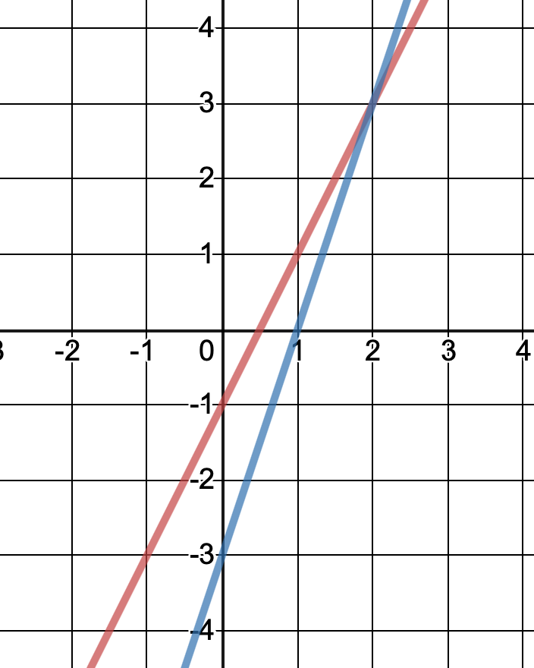
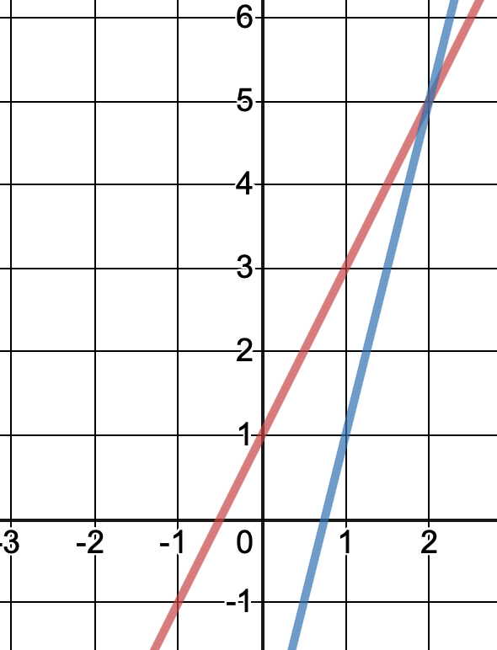
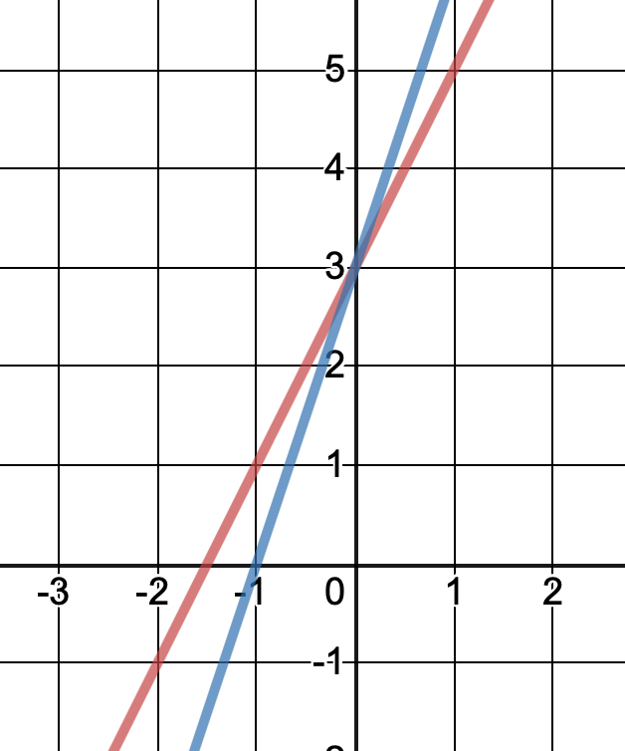
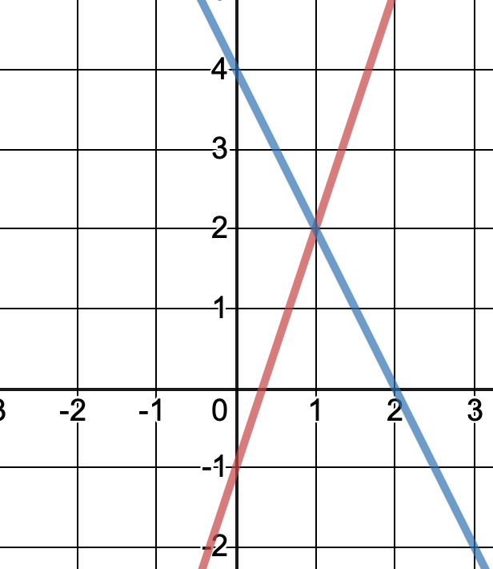
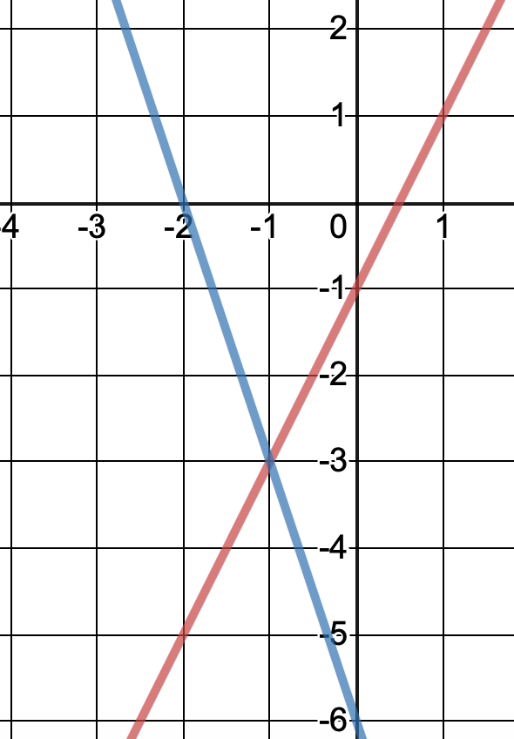
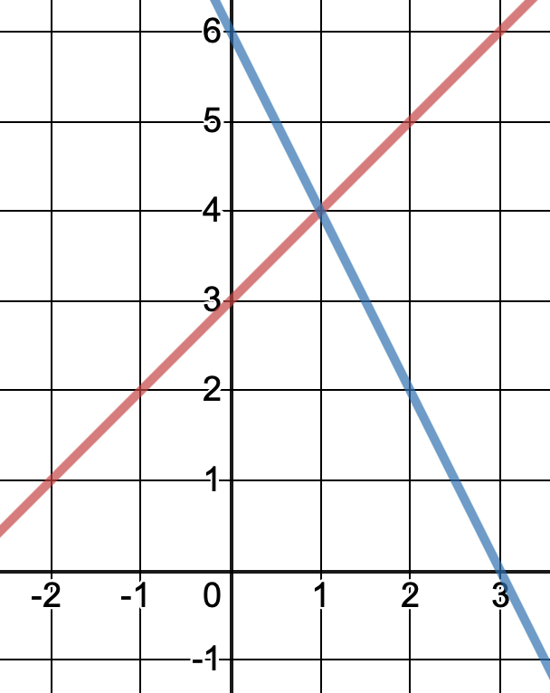
Solving Simultaneous Equations Graphically (1)
I DO | WE DO | YOU DO
The diagrams below each show two linear graphs. Write down the co-ordinates of the intersection point in each case. | The diagrams below each show two linear graphs. Write down the co-ordinates of the intersection point in each case. | The diagrams below each show two linear graphs. Write down the co-ordinates of the intersection point in each case.
y = 2x – 1
y = 2x + 3
y = 2x + 1
y = 3x – 3
y = 4x – 3
y = 3x + 3
y = -2x + 4
y = -3x – 6
y = -2x + 6
y = 2x – 1
y = x + 3
y = 3x – 1

Slide 4
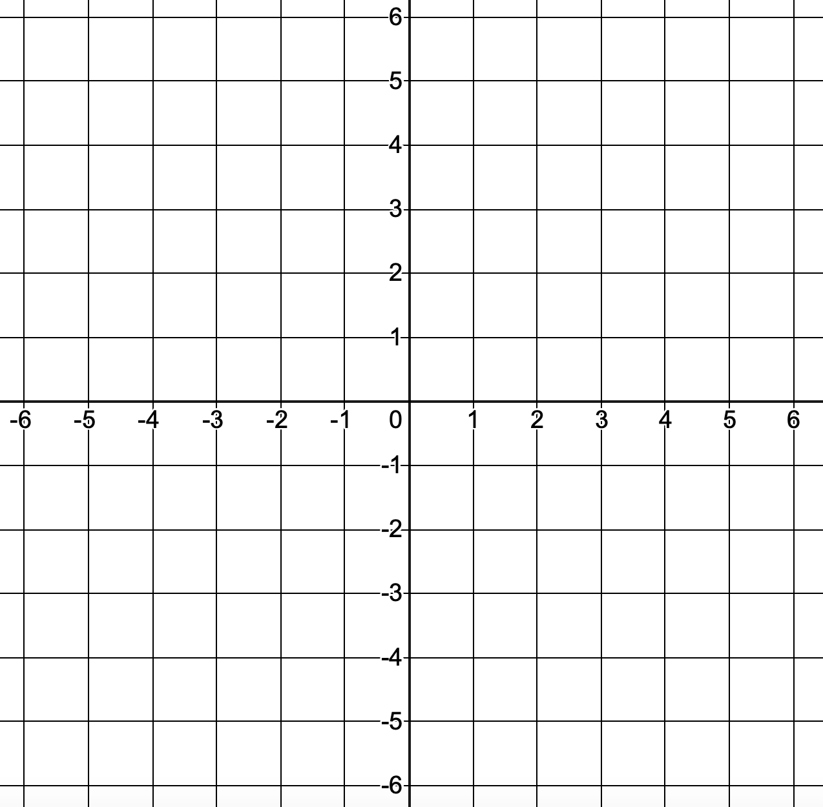
Solving Simultaneous Equations Graphically (2)
I DO | WE DO | YOU DO
On the axes below, plot the graphs of y = 2x + 1 and y = 3x + 4. Determine the intersection point. | On the axes below, plot the graphs of y = 2x + 2 and y = 3x + 1. Determine the intersection point. | On the axes below, plot the graphs of y = 2x - 1 and y = x + 2. Determine the intersection point.

Slide 5
Solving Simultaneous Equations Graphically (3)
I DO | WE DO | YOU DO
On the axes below, plot the graphs of y = -2x – 1 and y = $\frac{\text{1}}{\text{2}}$x + 4. Determine the intersection point. | On the axes below, plot the graphs of y = -4x – 4 and y = $\frac{\text{1}}{\text{2}}$x + 5. Determine the intersection point. | On the axes below, plot the graphs of y = -2x + 7 and y = $\frac{\text{1}}{\text{2}}$x + 2. Determine the intersection point.

