Slide 1
Rationalising the Denominator
I Do, We Do, You Do Example Sheet(s).

Slide 2
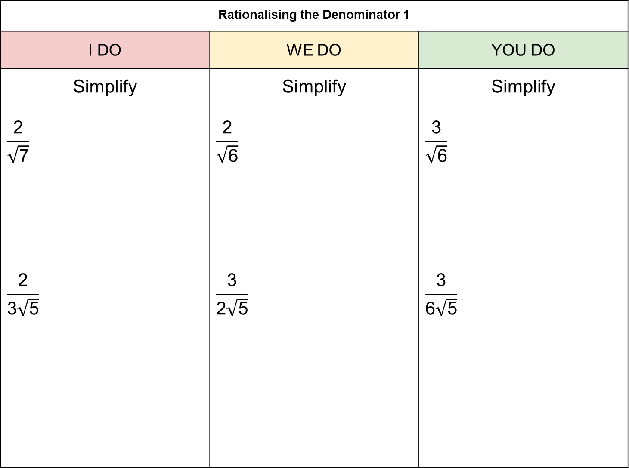
Rationalising the Denominator 1
I DO | WE DO | YOU DO
Simplify $$\frac{\text{2}}{\sqrt{\text{7}}}$$ $$\frac{\text{2}}{\text{3}\sqrt{\text{5}}}$$ | Simplify $$\frac{\text{2}}{\sqrt{\text{6}}}$$ $$\frac{\text{3}}{\text{2}\sqrt{\text{5}}}$$ | Simplify $$\frac{\text{3}}{\sqrt{\text{6}}}$$ $$\frac{\text{3}}{\text{6}\sqrt{\text{5}}}$$

Slide 3
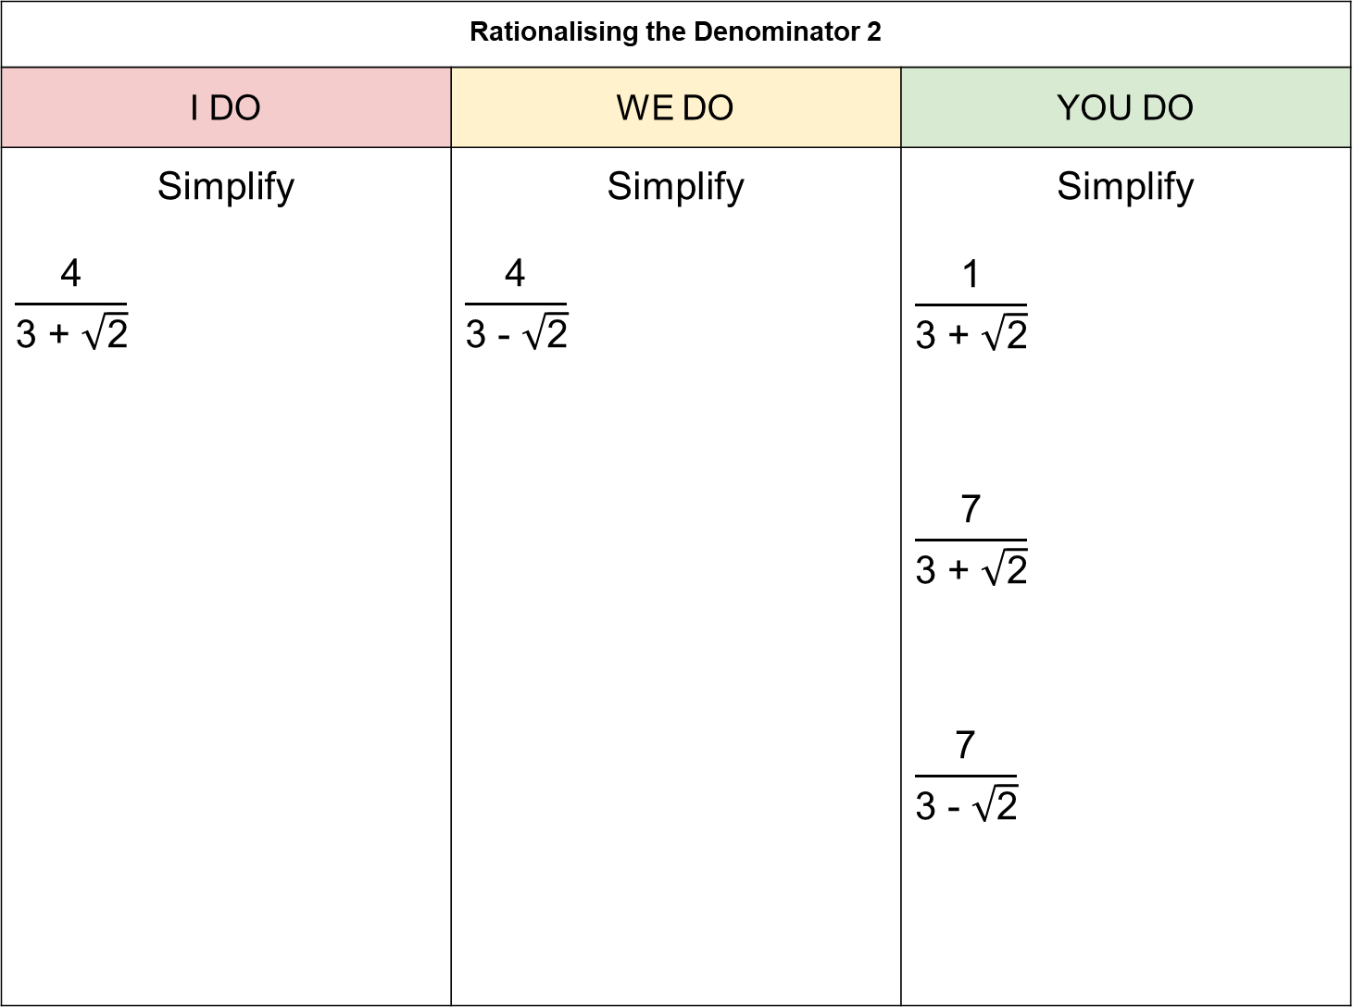
Rationalising the Denominator 2
I DO | WE DO | YOU DO
Simplify $$\frac{\text{4}}{\text{3 + }\sqrt{\text{2}}}$$ | Simplify $$\frac{\text{4}}{\text{3}\text{ - }\sqrt{\text{2}}}$$ | Simplify $$\frac{\text{1}}{\text{3 + }\sqrt{\text{2}}}$$ $$\frac{\text{7}}{\text{3 + }\sqrt{\text{2}}}$$ $$\frac{\text{7}}{\text{3 }\text{-} \sqrt{\text{2}}}$$

Slide 4
Rationalising the Denominator 3
I DO | WE DO | YOU DO
Simplify $$\frac{\text{1 + }\sqrt{\text{2}}}{\text{3 +} \sqrt{\text{2}} }$$ | Simplify $$\frac{\text{2}\text{ + }\sqrt{\text{5}}}{\sqrt{\text{5}}\text{ - 3}}$$ | Simplify $$\frac{\text{2}\text{ + }\sqrt{\text{5}}}{\text{3 +} \sqrt{\text{5}} }$$ $$\frac{\text{2 + }\sqrt{\text{5}}}{\text{3 }\text{-} \sqrt{\text{5}} }$$ $$\frac{\text{3}\text{ + }\sqrt{\text{5}}}{\sqrt{\text{5}}\text{ − }\text{2}}$$

