Slide 1
Iteration
Full lesson PowerPoint, including I Do, We Do, You Do Example Sheet(s).

Slide 2
 | Iteration

Slide 3
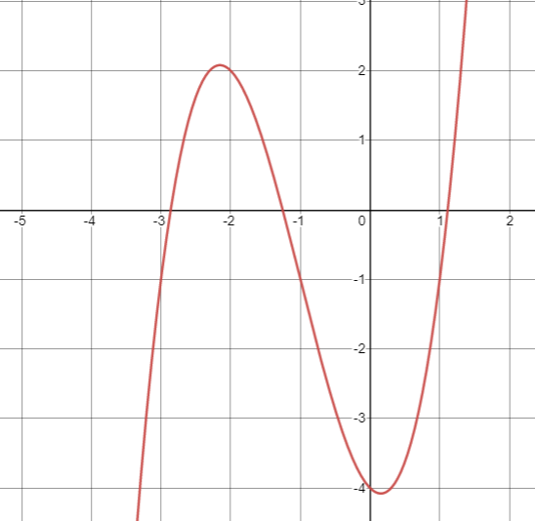
 |  |  | Iteration
Learning Outcomes
 | I need help with what a root is
 | I know what a root of an equation is (Grade 5)
 | I can use the Change of Sign rule to show a root takes place (Grade 7)
 | I can rearrange an equation to a given form and convert it to an iterative formula (Grade 8)
 | I can use an iterative process to determine a root to a given level of accuracy (Grade 8)

Slide 4
Change of Sign Rule
I DO | WE DO | YOU DO
Show that the equation $$y=x^{3}+3x^{2}−x−4$$ has a root between $x=1$ and $x=2$ | Show that the equation $$y=x^{3}+3x^{2}−x−4$$ has a root between $x=−2$ and $x=−3$ | Show that the equation $$y=x^{3}+2x^{2}−5x−4$$ has a root between: $x=1$ and $x=2$ $x=0$ and $x=−1$ $x=−3$ and $x=−4$

Slide 5
Determining an Iterative Formula
I DO | WE DO 1 | WE DO 2
Show that the quadratic equation $$x^{2}−5x+3=0$$ can be written in the form $$x=\sqrt{5x−3}$$ Hence convert your answer into an iterative formula | Show that the quadratic equation $$x^{3}+4x−1=0$$ can be written in the form $$x=\frac{1}{4}−\frac{x^{3}}{4}$$ Hence convert your answer into an iterative formula | Show that the quadratic equation $$3x−x^{3}=−10$$ can be written in the form $$x=\sqrt[3]{3x+10}$$ Hence convert your answer into an iterative formula

Slide 6
Determining an Iterative Formula
YOU DO 1 | YOU DO 2 | YOU DO 3
Show that the quadratic equation $$x^{2}−6x+3=0$$ can be written in the form $$x=\sqrt{6x−3}$$ Hence convert your answer into an iterative formula | Show that the quadratic equation $$x^{3}+3x−2=0$$ can be written in the form $$x=\frac{2}{3}−\frac{x^{3}}{3}$$ Hence convert your answer into an iterative formula | Show that the quadratic equation $$4x−x^{3}=−10$$ can be written in the form $$x=\sqrt[3]{4x+10}$$ Hence convert your answer into an iterative formula

Slide 7
Using an Iterative Formula to Determine Solutions
I DO | WE DO 1 | WE DO 2
Use the iterative formula $x_{n+1}=\sqrt{5x_{n}−3}$ where $x_{0}=4$ 4 times to estimate the solution to $$x^{2}−5x+3=0$$ correct to 3 decimal places | Use the iterative formula $x_{n+1}=\frac{1}{4}−\frac{x_{n}^{3}}{4}$ where $x_{0}=0$ 4 times to estimate the solution to $$x^{3}+4x−1=0$$ correct to 3 decimal places | Use the iterative formula $x_{n+1}=\sqrt[3]{3x_{n}+10}$ where $x_{0}=2$ 4 times to estimate the solution to $$3x−x^{3}=−10$$ correct to 3 decimal places

Slide 8
Determining an Iterative Formula
YOU DO 1 | YOU DO 2 | YOU DO 3
Use the iterative formula $x_{n+1}=\sqrt{6x_{n}−3}$ where $x_{0}=5$ 4 times to estimate the solution to $$x^{2}−6x+3=0$$ correct to 3 decimal places | Use the iterative formula $x_{n+1}=\frac{2}{3}−\frac{x_{n}^{3}}{3}$ where $x_{0}=0$ 4 times to estimate the solution to $$x^{3}+3x−2=0$$ correct to 3 decimal places | Use the iterative formula $x_{n+1}=\sqrt[3]{4x_{n}+10}$ where $x_{0}=2$ 4 times to estimate the solution to $$4x−x^{3}=−10$$ correct to 3 decimal places

