Slide 1
Expanding Double Brackets with Surds
2 x I Do, We Do, You Do Example Sheets

Slide 2
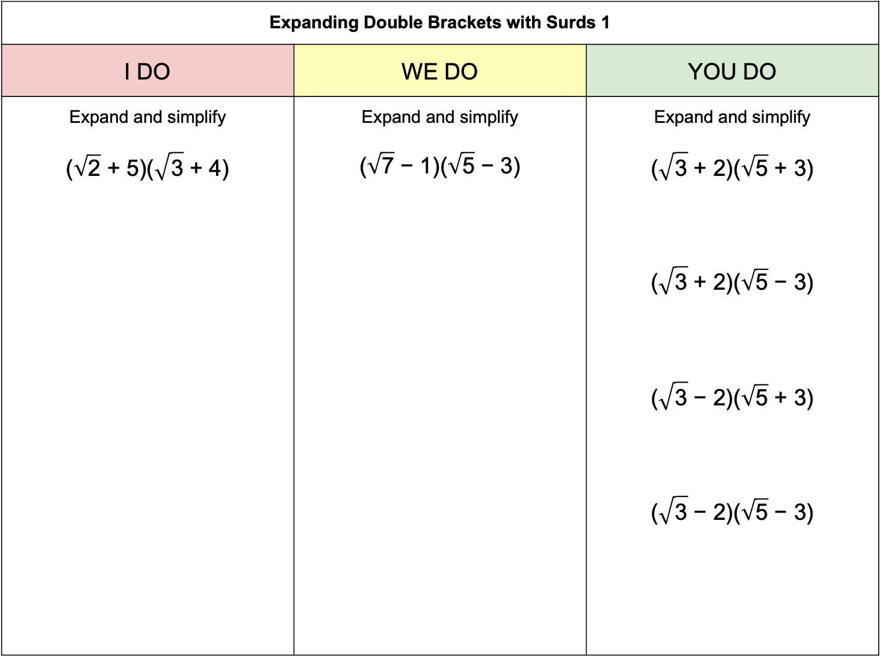
Expanding Double Brackets with Surds 1
I DO | WE DO | YOU DO
Expand and simplify $$\text{(}\sqrt{\text{2}}\text{ + 5)}\text{(}\sqrt{\text{3}}\text{ + 4)}$$ | Expand and simplify $$\text{(}\sqrt{\text{7}}\text{ − 1)(}\sqrt{\text{5}}\text{ − 3)}$$ | Expand and simplify $$\text{(}\sqrt{\text{3}}\text{ + 2)(}\sqrt{\text{5}}\text{ + 3)}$$ $$\text{(}\sqrt{\text{3}}\text{ + 2)(}\sqrt{\text{5}}\text{ − 3)}$$ $$\text{(}\sqrt{\text{3}}\text{ − 2)(}\sqrt{\text{5}}\text{ + 3)}$$ $$\text{(}\sqrt{\text{3}}\text{ − 2)(}\sqrt{\text{5}}\text{ − 3)}$$

Slide 3
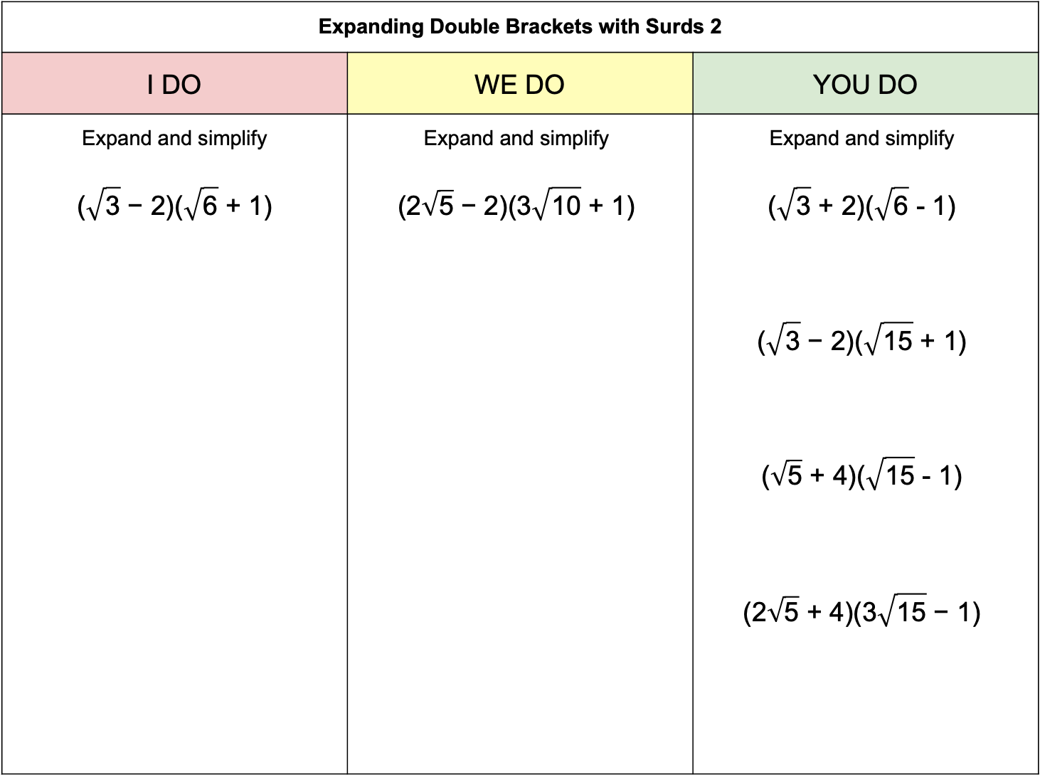
Expanding Double Brackets with Surds 2
I DO | WE DO | YOU DO
Expand and simplify $$\text{(}\sqrt{\text{3}}\text{ − }\text{2}\text{)(}\sqrt{\text{6}}\text{ + }\text{1}\text{)}$$ | Expand and simplify $$\text{(2}\sqrt{\text{5}}\text{ − 2)(3}\sqrt{\text{10}}\text{ + 1)}$$ | Expand and simplify $$\text{(}\sqrt{\text{3}}\text{ + 2)(}\sqrt{\text{6}}\text{ - 1)}$$ $$\text{(}\sqrt{\text{3}}\text{ − 2)(}\sqrt{\text{15}}\text{ + 1)}$$ $$\text{(}\sqrt{\text{5}} \text{+ 4}\text{)(}\sqrt{\text{15}} \text{-}\text{ 1)}$$ $$\text{(2}\sqrt{\text{5}}\text{ + 4)(}\text{3}\sqrt{\text{15}}\text{ − 1)}$$

Slide 4
Expanding Double Brackets with Surds 3
I DO | WE DO | YOU DO
Expand and simplify $${\left(\sqrt{\text{3}} \text{-} \text{6}\right)}^{\text{2}}$$ $$\text{(}\sqrt{\text{3}}\text{ − }\text{6}\text{)(}\sqrt{\text{3}} \text{+} \text{6}\text{)}$$ | Expand and simplify $${\left(\text{2}\sqrt{\text{3}} \text{+} \text{5}\right)}^{\text{2}}$$ $$\text{(}\text{2}\sqrt{\text{3}}\text{ − }\text{5}\text{)(}\text{2}\sqrt{\text{3}} \text{+}\text{ 5)}$$ | Expand and simplify $${\left(\text{4}\sqrt{\text{3}}\text{ − }\text{2}\right)}^{\text{2}}$$ $${\left(\text{4}\sqrt{\text{2}} \text{+}\text{ 2}\right)}^{\text{2}}$$ $$\text{(4}\sqrt{\text{3}}\text{ − }\text{2}\text{)(}\text{4}\sqrt{\text{3}}\text{ + }\text{2}\text{)}$$ $$\text{(4}\sqrt{\text{2}}\text{ − 2)(4}\sqrt{\text{2}}\text{ + 2)}$$ $$\text{(}\text{a}\sqrt{\text{b}} \text{+} \text{c}\text{)(}\text{a}\sqrt{\text{b}} \text{-} \text{c}\text{)}$$

