Slide 1

Completing the Square a≠1
Full lesson PowerPoint, including I Do, We Do, You Do Example Sheet(s).

Slide 2
 | Completing the Square a≠1

Slide 3
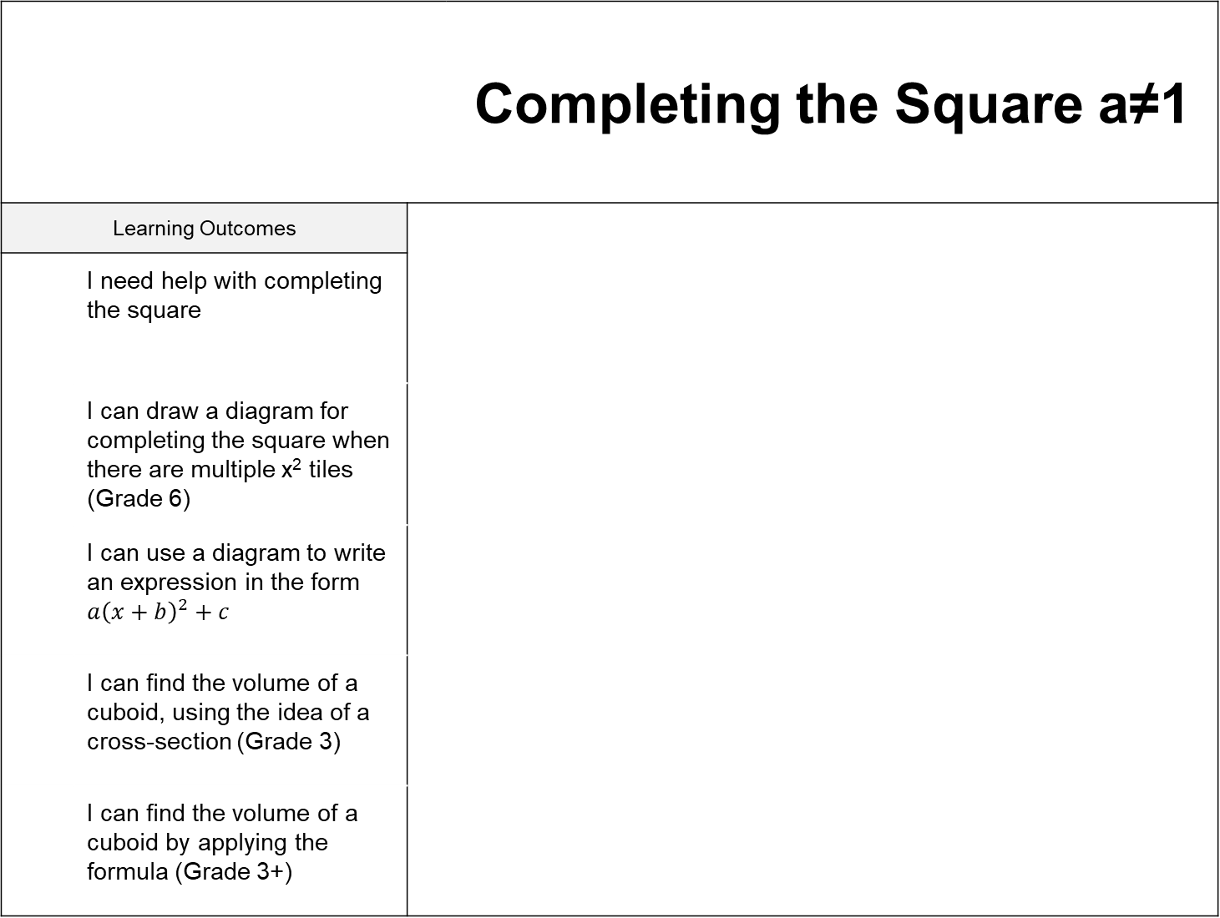
 |  |  | Completing the Square a≠1
Learning Outcomes
 | I need help with completing the square
 | I can draw a diagram for completing the square when there are multiple x² tiles (Grade 6)
 | I can use a diagram to write an expression in the form $a{\left(x+b\right)}^{2}+c$
 | I can find the volume of a cuboid, using the idea of a cross-section (Grade 3)
 | I can find the volume of a cuboid by applying the formula (Grade 3+)

Slide 4
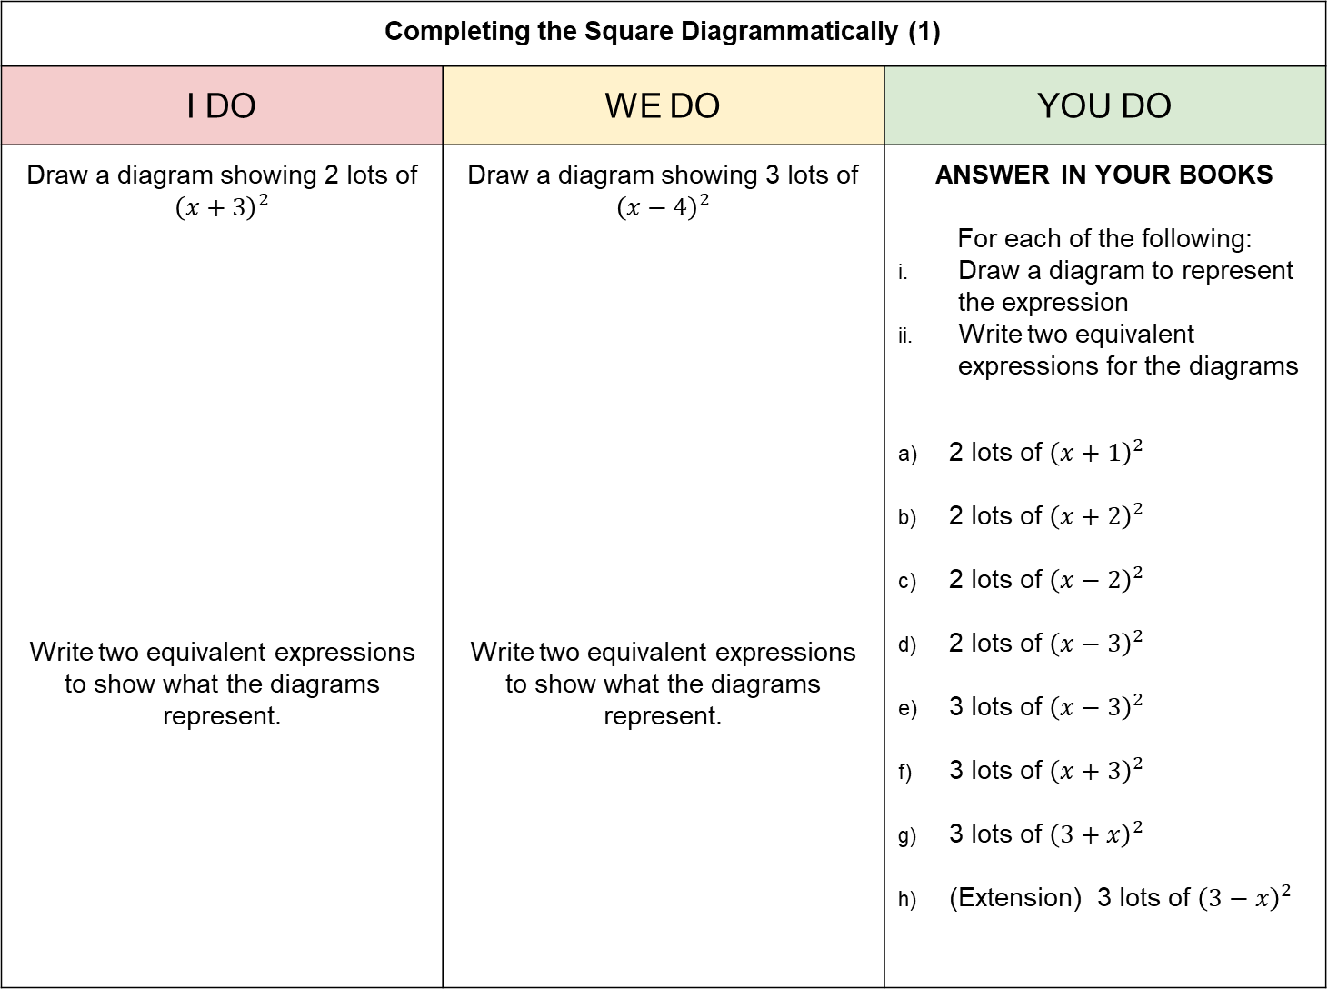
Completing the Square Diagrammatically (1)
I DO | WE DO | YOU DO
Draw a diagram showing 2 lots of ${\left(x+3\right)}^{2}$ Write two equivalent expressions to show what the diagrams represent. | Draw a diagram showing 3 lots of ${\left(x−4\right)}^{2}$ Write two equivalent expressions to show what the diagrams represent. | ANSWER IN YOUR BOOKS For each of the following: Draw a diagram to represent the expression Write two equivalent expressions for the diagrams 2 lots of ${\left(x+1\right)}^{2}$ 2 lots of ${\left(x+2\right)}^{2}$ 2 lots of ${\left(x−2\right)}^{2}$ 2 lots of ${\left(x−3\right)}^{2}$ 3 lots of ${\left(x−3\right)}^{2}$ 3 lots of ${\left(x+3\right)}^{2}$ 3 lots of ${\left(3+x\right)}^{2}$ (Extension) 3 lots of ${\left(3−x\right)}^{2}$

Slide 5
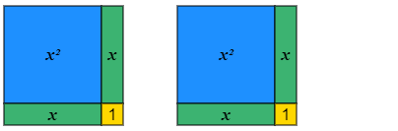
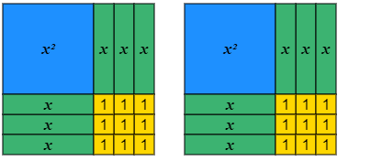
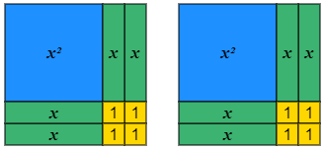
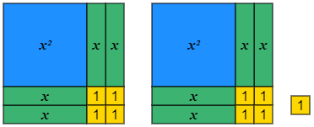
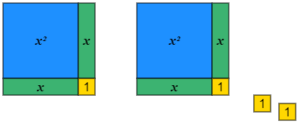
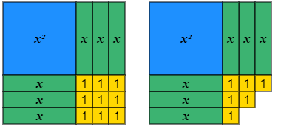
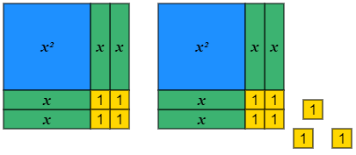
Completing the Square Diagrammatically (2)
I DO | WE DO | YOU DO
Write two equivalent expressions for the diagram below: Write two equivalent expressions for the diagram below: | Write two equivalent expressions for the diagram below: Write two equivalent expressions for the diagram below: | Write two equivalent expressions for each diagram below:

Slide 6
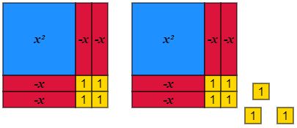
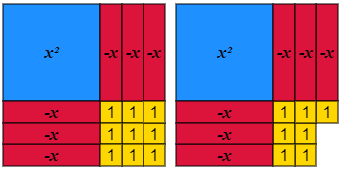
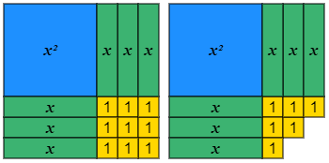
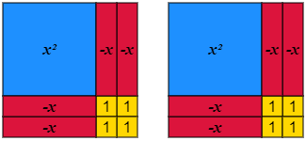
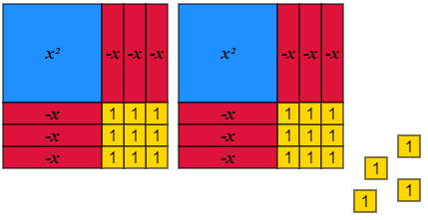
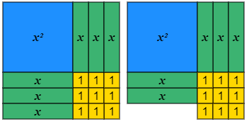
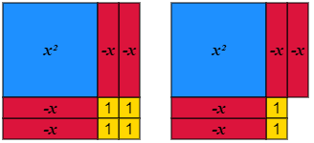
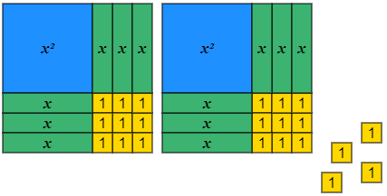
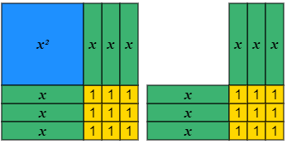
Completing the Square Diagrammatically (2)
YOU DO CONTINUED
Write two equivalent expressions for each diagram below:
a) | d) | g)
b) | e) | h)
c) | f) | i)

Slide 7
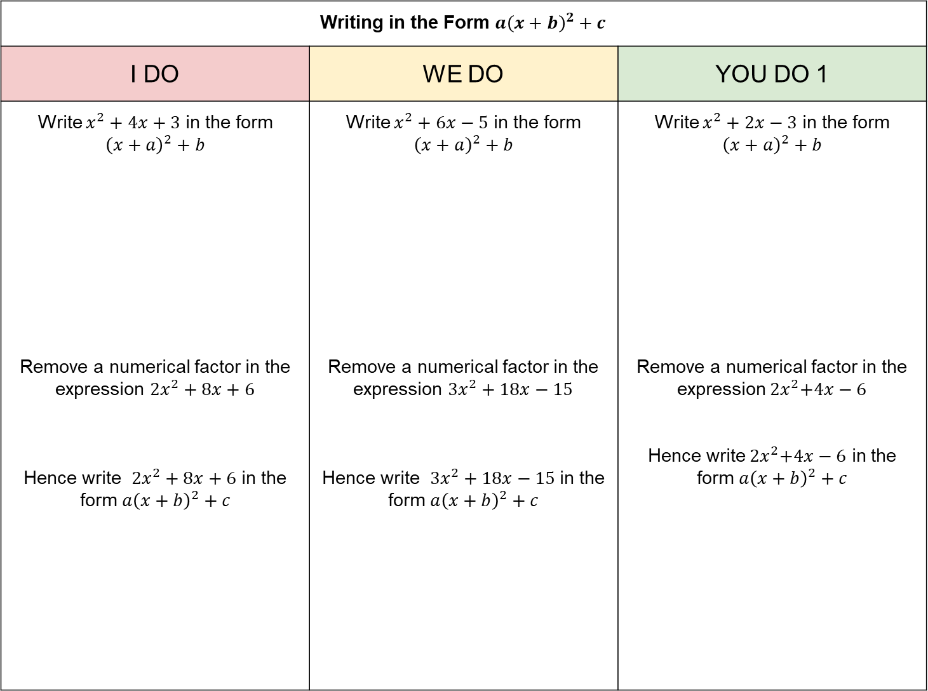
Writing in the Form ${a\left(x+b\right)}^{2}+c$
I DO | WE DO | YOU DO 1
Write $x^{2}+4x+3$ in the form ${\left(x+a\right)}^{2}+b$ Remove a numerical factor in the expression $2x^{2}+8x+6$ Hence write $2x^{2}+8x+6$ in the form ${a\left(x+b\right)}^{2}+c$ | Write $x^{2}+6x−5$ in the form $${\left(x+a\right)}^{2}+b$$ Remove a numerical factor in the expression $3x^{2}+18x−15$ Hence write $3x^{2}+18x−15$in the form ${a\left(x+b\right)}^{2}+c$ | Write $x^{2}+2x−3$ in the form $${\left(x+a\right)}^{2}+b$$ Remove a numerical factor in the expression${ 2x}^{2}+4x−6$ Hence write${ 2x}^{2}+4x−6$ in the form ${a\left(x+b\right)}^{2}+c$

Slide 8
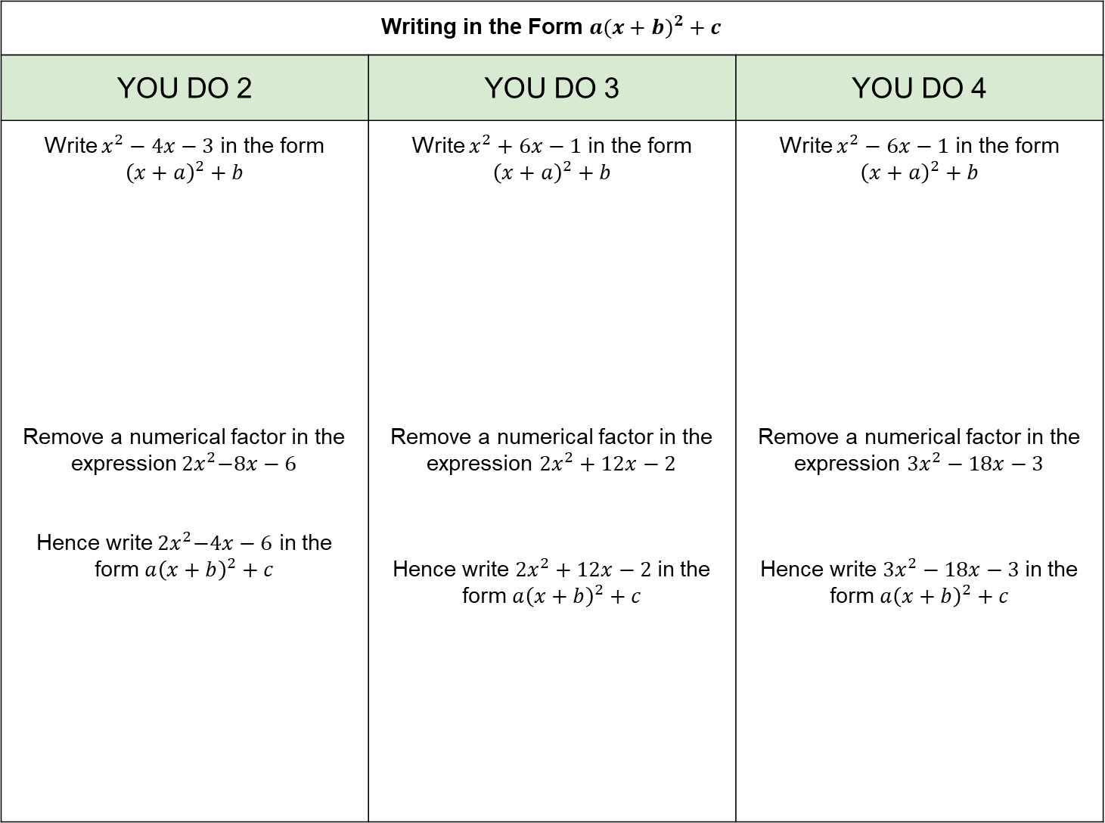
Writing in the Form ${a(x+b)}^{2}+c$
YOU DO 2 | YOU DO 3 | YOU DO 4
Write $x^{2}−4x−3$ in the form $${\left(x+a\right)}^{2}+b$$ Remove a numerical factor in the expression${ 2x}^{2}−8x−6$ Hence write${ 2x}^{2}−4x−6$ in the form ${a\left(x+b\right)}^{2}+c$ | Write $x^{2}+6x−1$ in the form $${\left(x+a\right)}^{2}+b$$ Remove a numerical factor in the expression $2x^{2}+12x−2$ Hence write $2x^{2}+12x−2$in the form ${a\left(x+b\right)}^{2}+c$ | Write $x^{2}−6x−1$ in the form $${\left(x+a\right)}^{2}+b$$ Remove a numerical factor in the expression $3x^{2}−18x−3$ Hence write $3x^{2}−18x−3$in the form ${a\left(x+b\right)}^{2}+c$

Slide 9
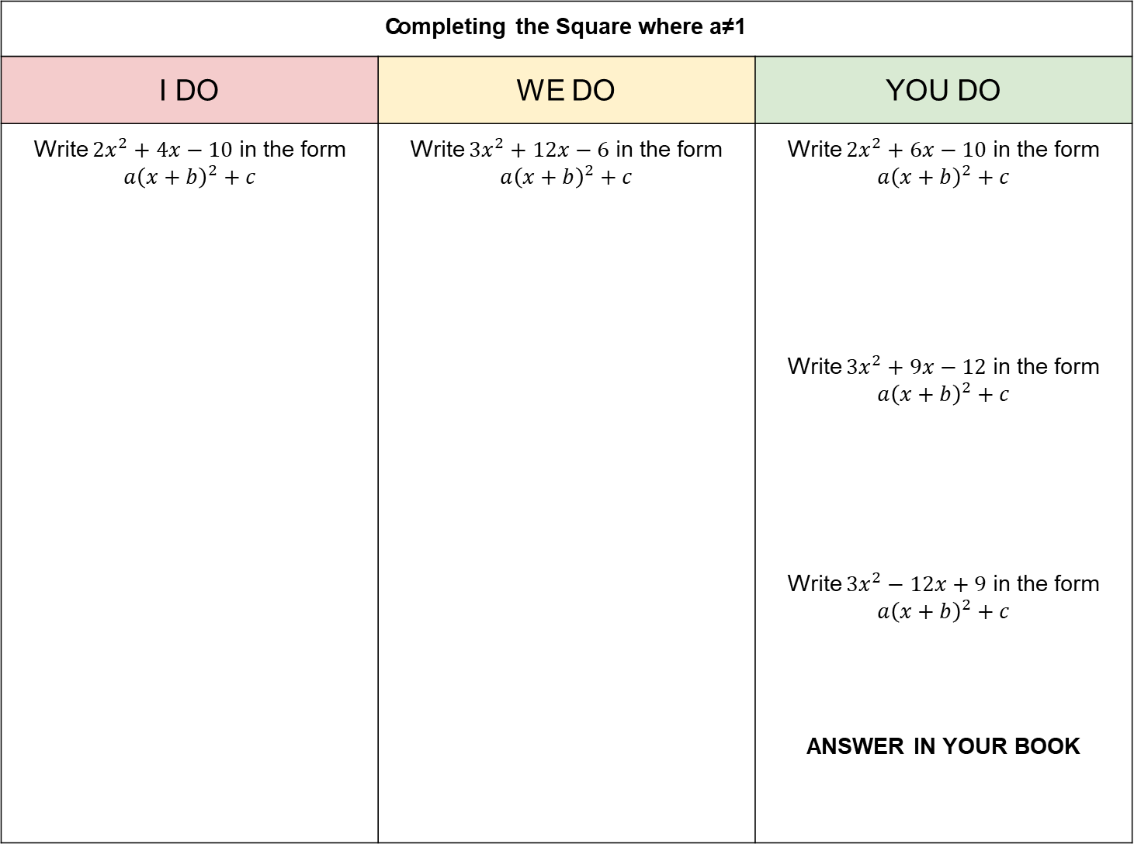
Completing the Square where a≠1
I DO | WE DO | YOU DO
Write $2x^{2}+4x−10$ in the form $a{\left(x+b\right)}^{2}+c$ | Write $3x^{2}+12x−6$ in the form $a{\left(x+b\right)}^{2}+c$ | Write $2x^{2}+6x−10$ in the form $a{\left(x+b\right)}^{2}+c$ Write $3x^{2}+9x−12$ in the form $a{\left(x+b\right)}^{2}+c$ Write $3x^{2}−12x+9$ in the form $a{\left(x+b\right)}^{2}+c$ ANSWER IN YOUR BOOK

Slide 10

Solving by Completing the Square where a≠1 (1)
I DO | WE DO | YOU DO
Solve $2x^{2}+4x−10=0$ | Solve $3x^{2}+12x−6=0$ | Solve $2x^{2}+6x−10=0$ Solve $3x^{2}+9x−12=0$ Solve $3x^{2}−12x+9=0$ ANSWER IN YOUR BOOK

Slide 11

Solving by Completing the Square where a≠1 (2)
I DO | WE DO | YOU DO
Solve $2x^{2}+6x−10=0$ | Solve $4x^{2}+20x−8=0$ | Solve $2x^{2}+10x−8=0$ Solve $4x^{2}−12x+8=0$ **Solve $3x^{2}−8x+1=0$ ANSWER IN YOUR BOOK

