Slide 1
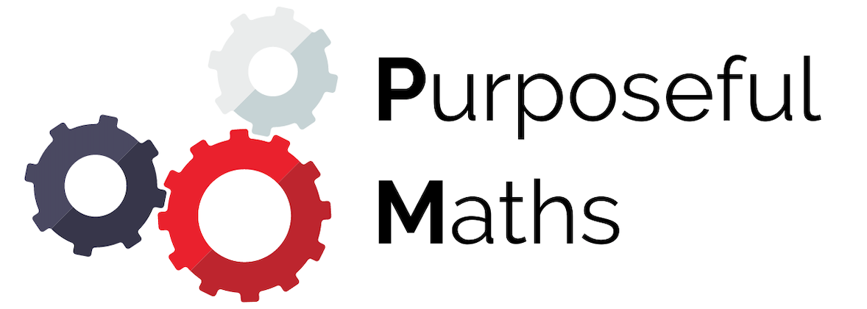
Angles Around a Point
Full lesson PowerPoint, including I Do, We Do, You Do Example Sheet(s).

Slide 2
 | Angles Around a Point

Slide 3
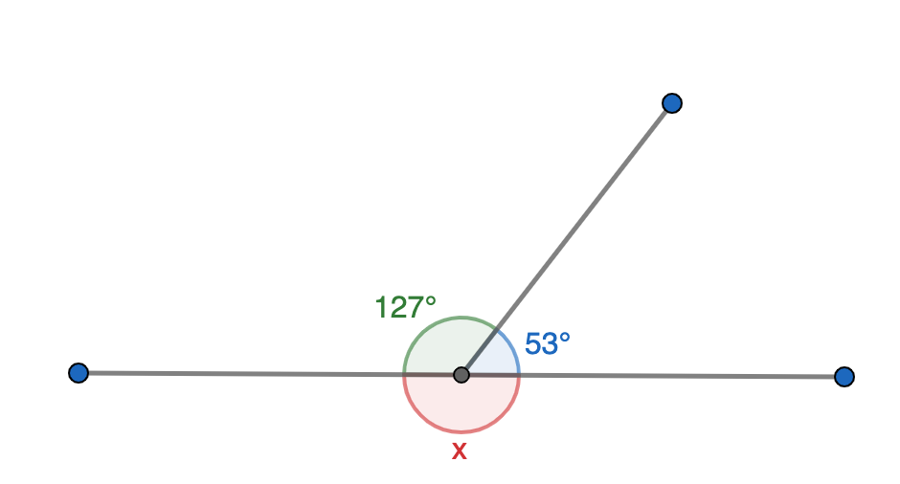
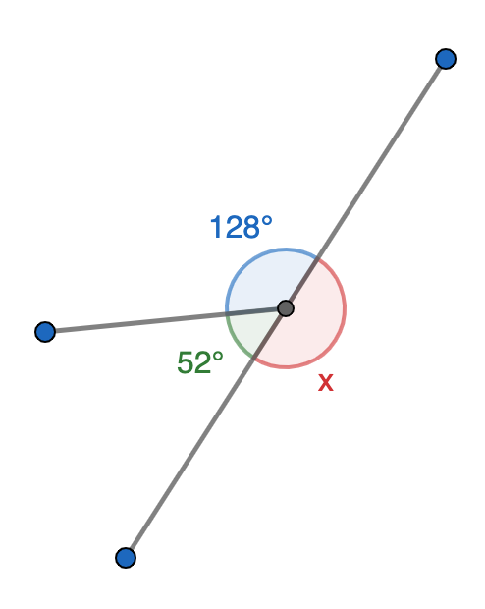
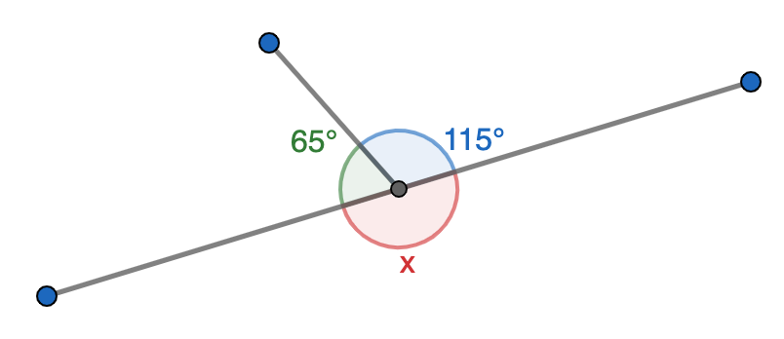
Angles on a Straight Line
What Do You Notice?
What is the size of angle x in each of the diagrams below?
What do the three angles add up to in each diagram?

Slide 4
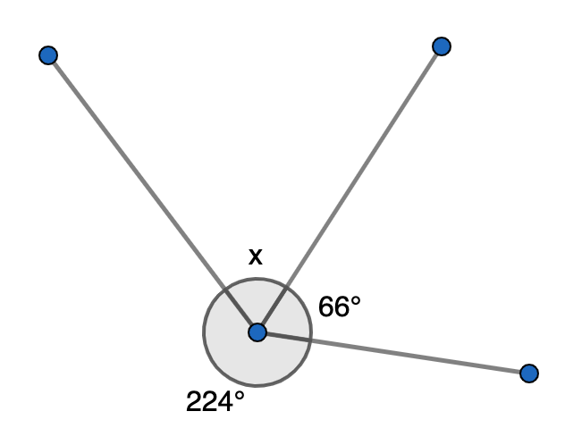
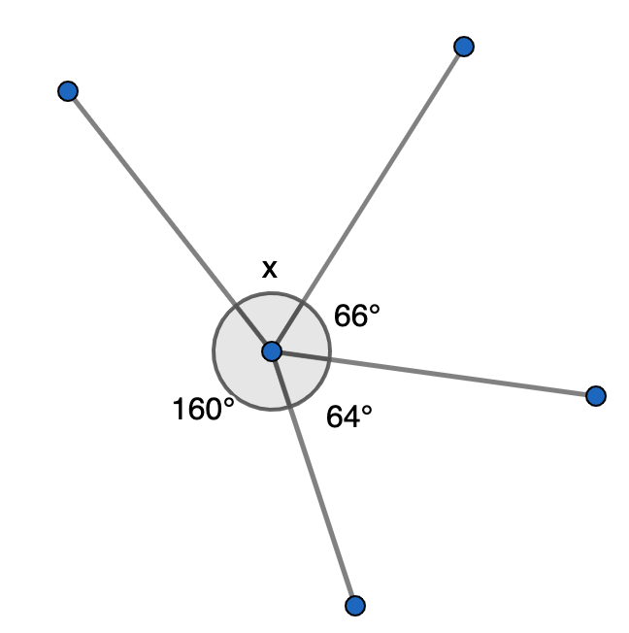
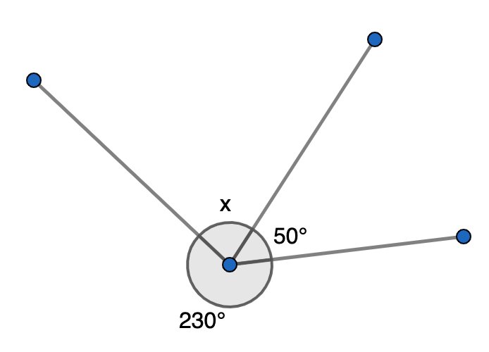
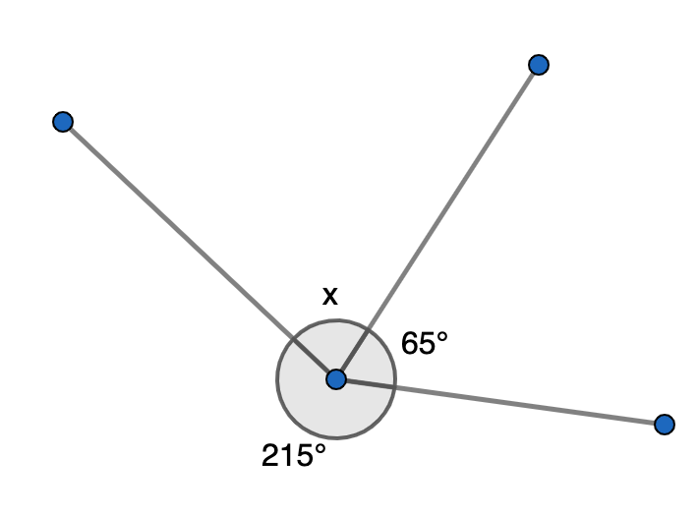
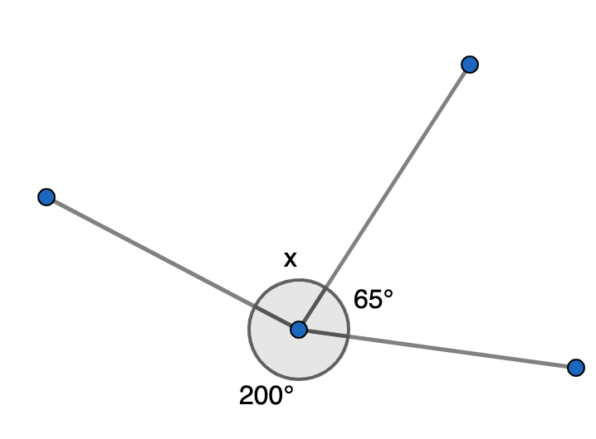
Angles Around a Point (1)
I DO | WE DO | YOU DO
For each diagram calculate the size of angle x.

Slide 5
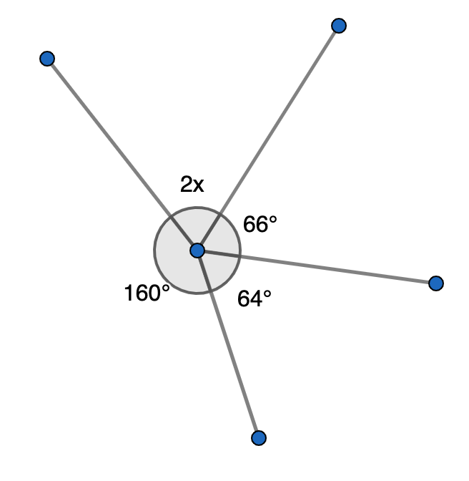
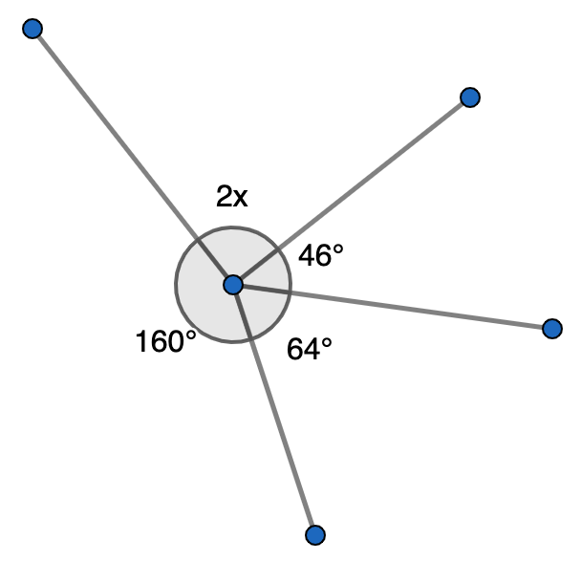
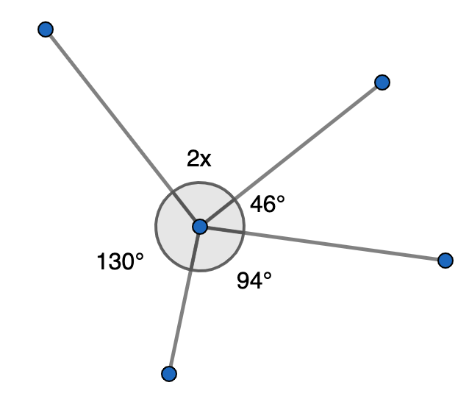
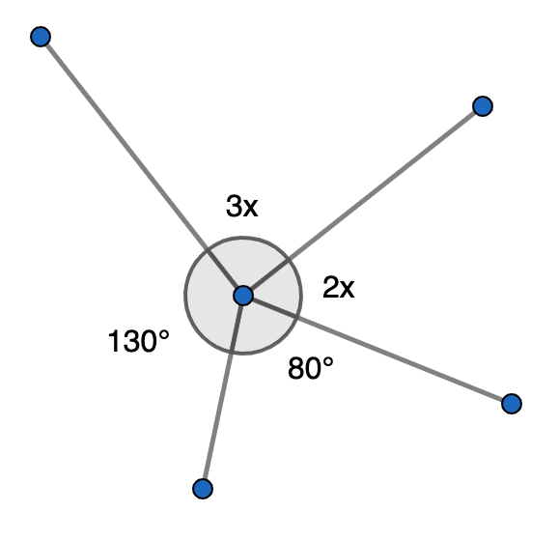
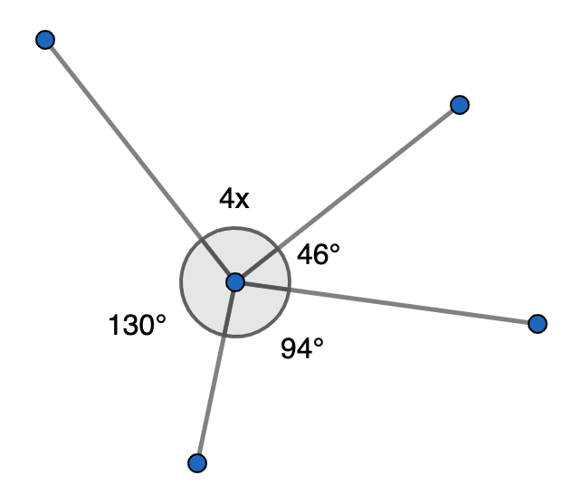
Angles Around a Point (2)
I DO | WE DO | YOU DO
For each diagram calculate x.

