Slide 1

Perimeter
Full lesson PowerPoint, including I Do, We Do, You Do Example Sheet(s).

Slide 2
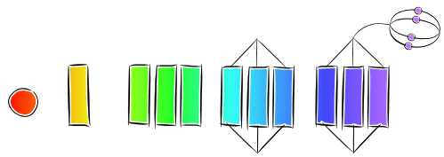
Bell Task
Which of the shapes below is the odd one out and why?

Slide 3
Perimeter
 | I need help with calculating the perimeter of shapes
 | I know what the word ‘perimeter’ means and I know how to calculate it (Grade 3)
 | I can calculate the perimeter of a 2D shape (Grade 4)
 | I can calculate the perimeter of a 2D shape when dimensions are missing (Grade 4)
 | I can calculate the lengths of sides when given the perimeter (Grade 4+)

Slide 4
Perimeter
The answer is all of the numbers added together
6
6 + 3 + 6 + 3
3
3
Answer: 18
What’s the connection between the shapes and the answer?
6
5 + 5 + 7
5
5
Answer: 17
7
I know what the word ‘perimeter’ means and I know how to calculate it (Grade 3)

Slide 5
Perimeter
The perimeter is the distance around the outside of a shape.
I know what the word ‘perimeter’ means and I know how to calculate it (Grade 3)

Slide 6
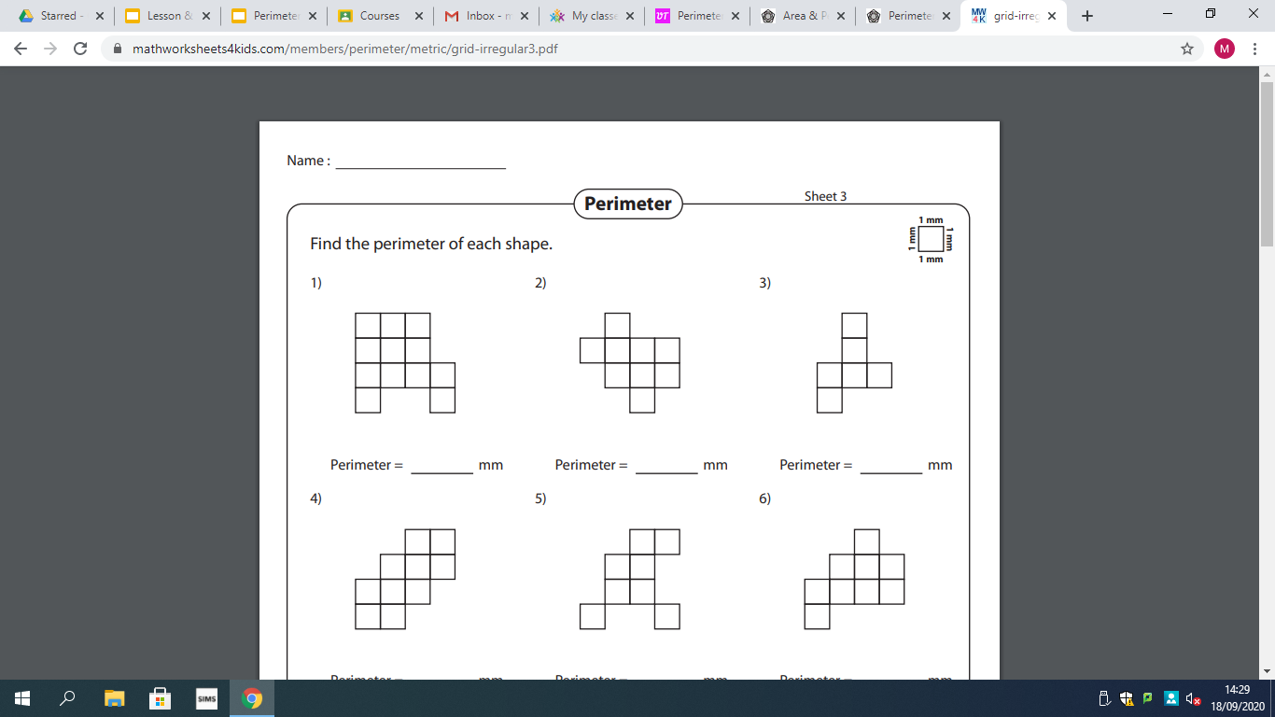
Don’t forget to | Reflect | Expect | Check | Explain | for each question
I DO
Write down the perimeter of the shape below
WE DO
Write down the perimeter of the shape below
YOU DO
Write down the perimeter of the shape below
Pick a point on the shape and imagine you are walking around the outside. Count as you go.
Perimeter = 18mm

Slide 7
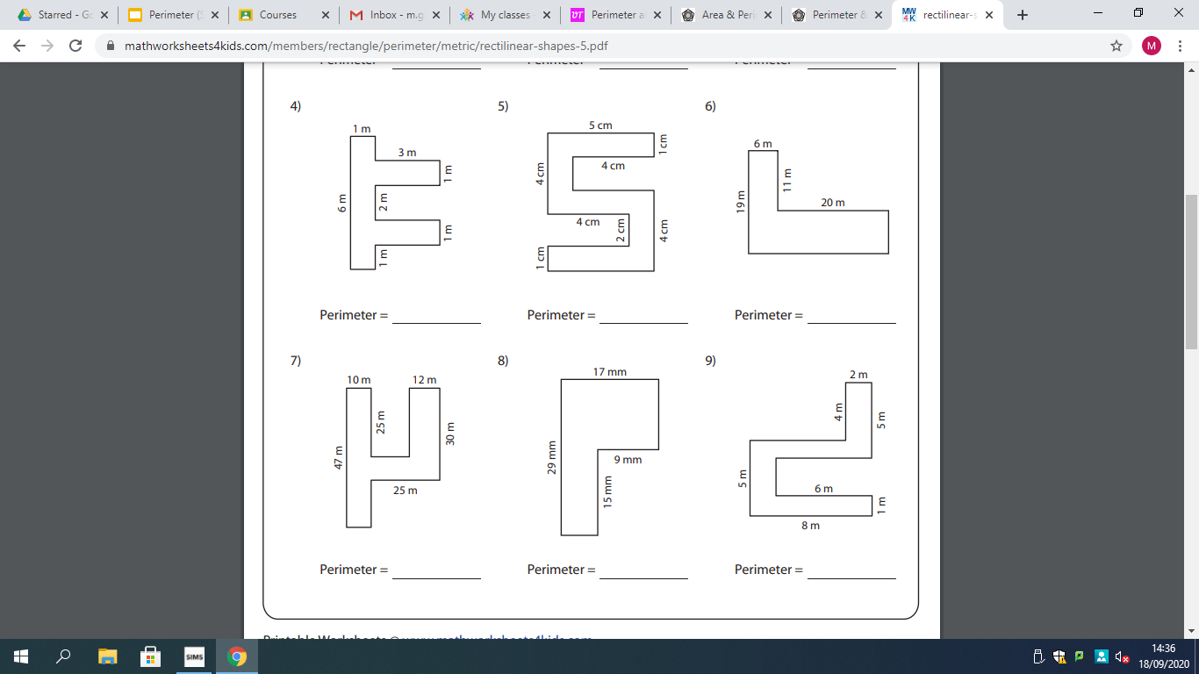
Don’t forget to | Reflect | Expect | Check | Explain | for each question
I DO
Write down the perimeter of the shape below
WE DO
Write down the perimeter of the shape below
YOU DO
Write down the perimeter of the shape below
25m
25-12=13m
47-30
=17m
10m
Work out the length of any missing side.
Add up all of the side:
10+25+13+25+12+30+25+17+10+47
= 214m

Slide 8
Calculating Perimeter
What would the perimeter of this shape be?
What about the perimeter of this one?
Perimeter =
1 + 3 + 3 + 2 + 4 + 5
= 18cm
Perimeter =
8 + 8 + 9 = 25cm
1
3
8
8
3
5
2
9
4
The perimeter is the distance around the outside of a shape.
I can calculate the perimeter of a 2D shape (Grade 4)

Slide 9

Calculating Perimeter
On your mini-whiteboards, calculate the perimeter of the shape below
9
4
4
9
Perimeter = 26cm
I can calculate the perimeter of a 2D shape (Grade 4)

Slide 10
Calculating Perimeter
On your mini-whiteboards, calculate the perimeter of the shape below
8
8
11
Perimeter = 27cm
I can calculate the perimeter of a 2D shape (Grade 4)

Slide 11
Calculating Perimeter
On your mini-whiteboards, calculate the perimeter of the shape below
5
5
6
6
Perimeter = 22cm
I can calculate the perimeter of a 2D shape (Grade 4)

Slide 12
Calculating Perimeter
On your mini-whiteboards, calculate the perimeter of the shape below
3
8
14
3
Perimeter = 28cm
I can calculate the perimeter of a 2D shape (Grade 4)

Slide 13
Calculating Perimeter
On your mini-whiteboards, calculate the perimeter of the shape below
5
8.5
7
7
8.5
Perimeter = 41cm
5
I can calculate the perimeter of a 2D shape (Grade 4)

Slide 14
Calculating Perimeter
On your mini-whiteboards, calculate the perimeter of the shape below
11
6.5
6.5
11
Perimeter = 35cm
I can calculate the perimeter of a 2D shape when dimensions are missing (Grade 4)

Slide 15
Calculating Perimeter
On your mini-whiteboards, calculate the perimeter of the shape below
5
5.5
9.5
10
4
15
Perimeter = 44cm
I can calculate the perimeter of a 2D shape when dimensions are missing (Grade 4)

Slide 16
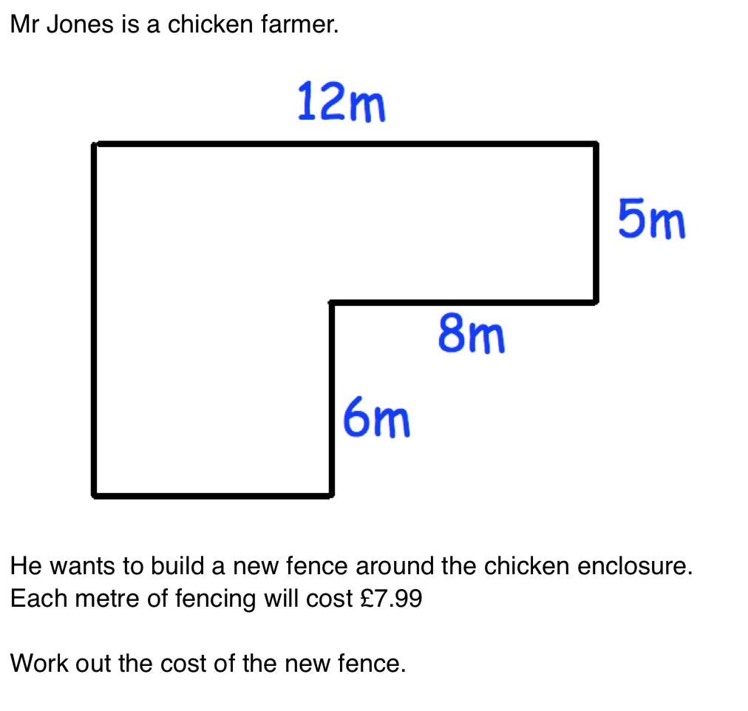
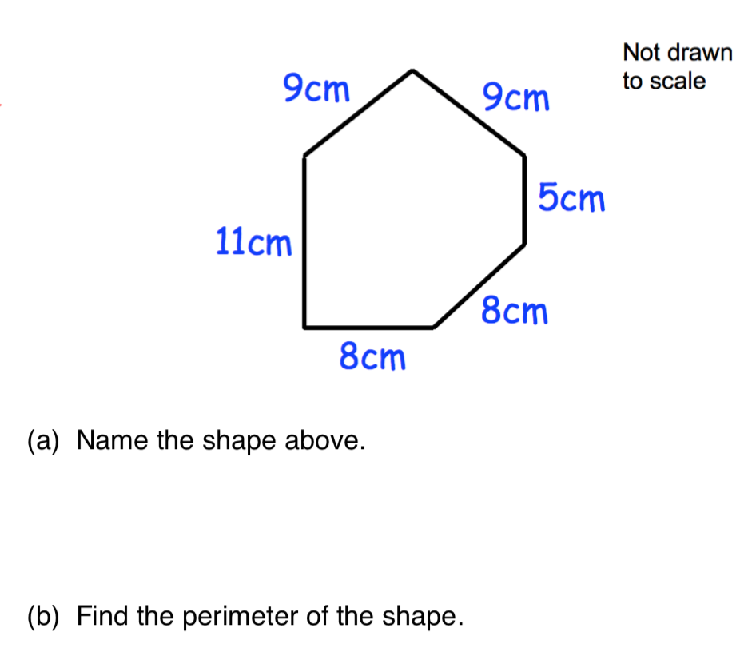
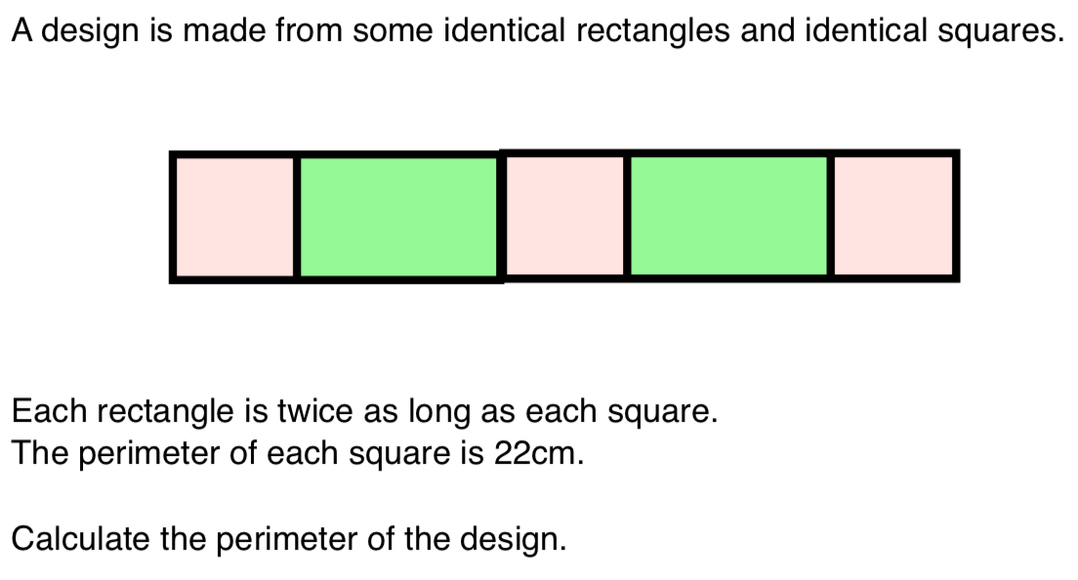
Plenary- Exam Questions

Slide 17
Plenary- Answers
£367.54
Irregular Hexagon
50cm
The sides of the square is 22/4 = 5.5cm. So the length of each rectangle is 11cm.
The perimeter is 88cm.

