Slide 1
Place Value with Decimals
Full lesson PowerPoint, including I Do, We Do, You Do Example Sheet(s).

Slide 2
 |  |  | Place Value with Decimals
Learning Outcomes
 | I need help understanding Place Value
 | I can represent a decimal using place value counters (Grade 2)
 | I can use place value counters to determine the value of a digit in a decimal (Grade 2)
 | I can add and subtract with place value counters without carrying (Grade 2)
 | I can add and subtract with place value counters with carrying (Grade 3)

Slide 3
Representing Decimals with Place Value Counters
I DO | WE DO
Show the number 25.31 using place value counters | Show the number 135.04 using place value counters
YOU DO 1 | YOU DO 2
Show the number 15.24 using place value counters | Show the number 140.25 using place value counters
100s | 10s | 1s | 0.1s | 0.01s
100s | 10s | 1s | 0.1s | 0.01s
100s | 10s | 1s | 0.1s | 0.01s
100s | 10s | 1s | 0.1s | 0.01s

Slide 4
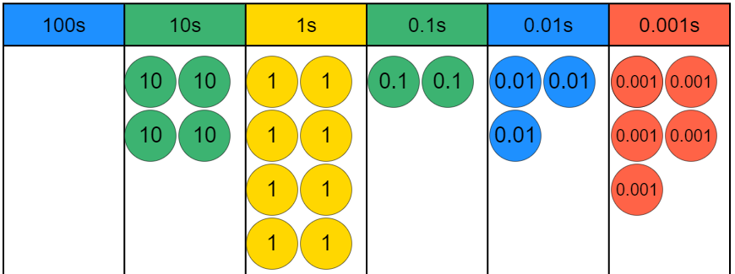
Decimals Represented by Place Value Counters
I DO | WE DO
Use the counters below to partition the number. Then write down the number represented. | Use the counters below to partition the number. Then write down the number represented.
YOU DO 1 | YOU DO 2
Use the counters below to partition the number. Then write down the number represented. | Use the counters below to partition the number. Then write down the number represented.

Slide 5
Decimals Represented by Place Value Counters
I DO | WE DO
Write down the value of the 3 digit in 5.312 | Write down the value of the 3 digit in 25.31
YOU DO 1 | YOU DO 2
Write down the value of the 3 digit in 25.13 | Write down the value of the 3 digit in 52.013

