Slide 1
Multiplying Fractions
I Do, We Do, You Do Example Sheets.
1) Pictorial, no simplifying involved. 2) No simplifying.
3) Simplifying after the calculation. 4) Simplifying before the calculation.
5) Mixed numbers. 6) Fraction multiplied by an integer.

Slide 2
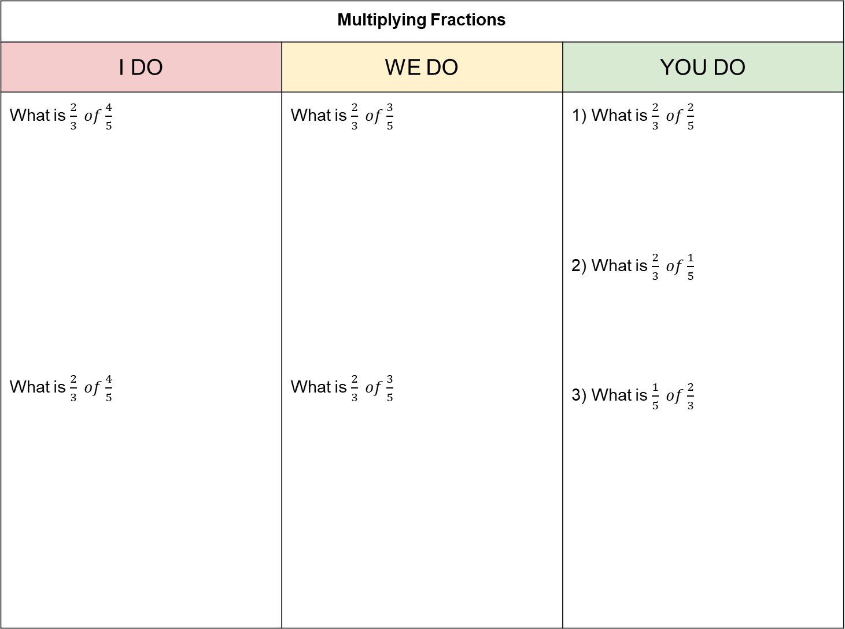
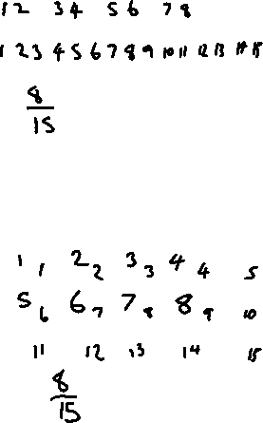
Multiplying Fractions
I DO | WE DO | YOU DO
What is $\frac{2}{3} of\frac{4}{5}$ What is $\frac{2}{3} of\frac{4}{5}$ | What is $\frac{2}{3} of\frac{3}{5}$ What is $\frac{2}{3} of\frac{3}{5}$ | 1) What is $\frac{2}{3} of\frac{2}{5}$ 2) What is $\frac{2}{3} of\frac{1}{5}$ 3) What is $\frac{1}{5} of\frac{2}{3}$
?
?

Slide 3
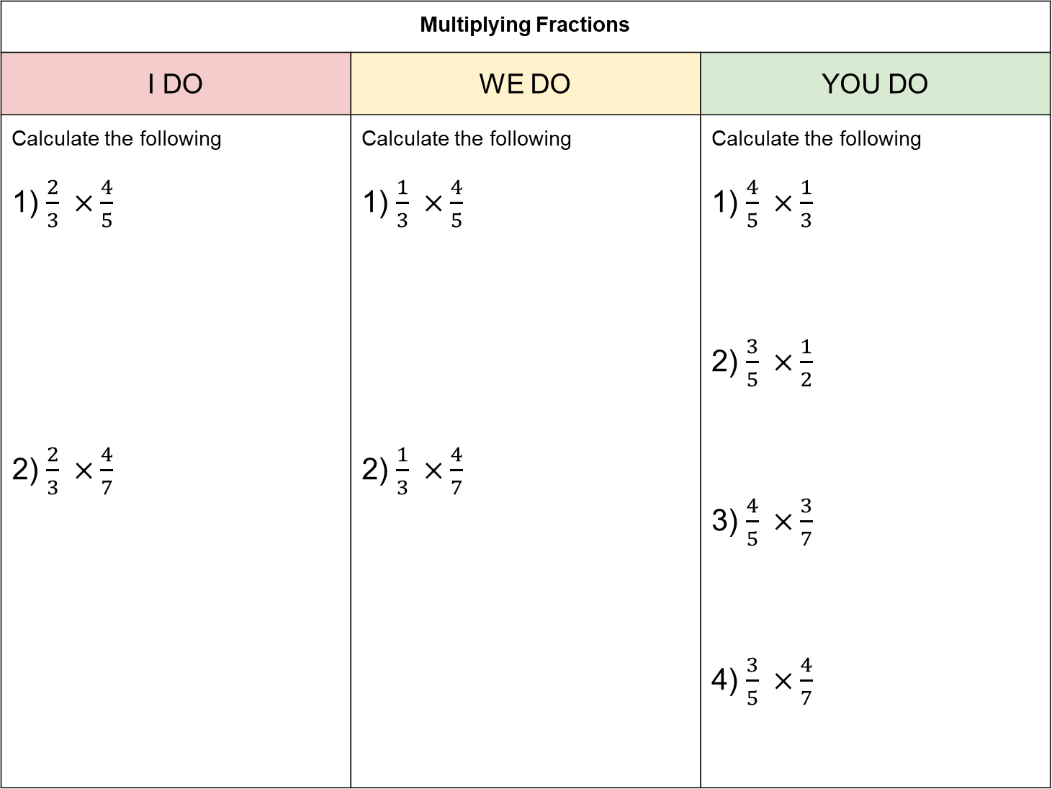
Multiplying Fractions
I DO | WE DO | YOU DO
Calculate the following 1) $\frac{2}{3} ×\frac{4}{5}$ 2) $\frac{2}{3} ×\frac{4}{7}$ | Calculate the following 1) $\frac{1}{3} ×\frac{4}{5}$ 2) $\frac{1}{3} ×\frac{4}{7}$ | Calculate the following 1) $\frac{4}{5} ×\frac{1}{3}$ 2) $\frac{3}{5} ×\frac{1}{2}$ 3) $\frac{4}{5} ×\frac{3}{7}$ 4) $\frac{3}{5} ×\frac{4}{7}$
?
?
?

Slide 4
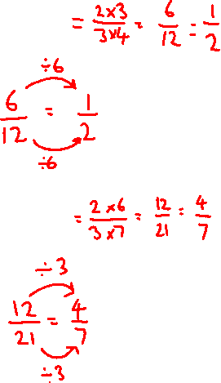
Multiplying Fractions
I DO | WE DO | YOU DO
Calculate the following 1) $\frac{2}{3} ×\frac{3}{4}$ 2) $\frac{2}{3} ×\frac{6}{7}$ | Calculate the following 1) $\frac{1}{3} ×\frac{3}{5}$ 2) $\frac{1}{3} ×\frac{6}{7}$ | Calculate the following 1) $\frac{4}{5} ×\frac{5}{6}$ 2) $\frac{3}{5} ×\frac{5}{6}$ 3) $\frac{4}{5} ×\frac{10}{11}$ 4) $\frac{3}{4} ×\frac{2}{9}$
?
?
?

Slide 5
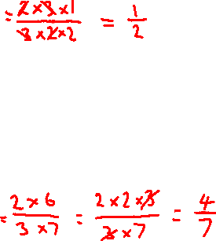
Multiplying Fractions
I DO | WE DO | YOU DO
Calculate the following 1) $\frac{2}{3} ×\frac{3}{4}$ 2) $\frac{2}{3} ×\frac{6}{7}$ | Calculate the following 1) $\frac{1}{3} ×\frac{3}{5}$ 2) $\frac{1}{3} ×\frac{6}{7}$ | Calculate the following 1) $\frac{4}{5} ×\frac{5}{6}$ 2) $\frac{3}{5} ×\frac{5}{6}$ 3) $\frac{4}{5} ×\frac{10}{11}$ 4) $\frac{3}{4} ×\frac{2}{9}$
?
?
?

Slide 6
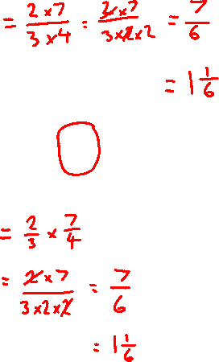
Multiplying Fractions
I DO | WE DO | YOU DO
Calculate the following 1) $\frac{2}{3} ×\frac{7}{4}$ 2) $\frac{2}{3} ×1\frac{3}{4}$ | Calculate the following 1) $\frac{2}{3} ×\frac{6}{5}$ 2) $\frac{2}{3} ×1\frac{1}{5}$ | Calculate the following 1) $\frac{4}{5} ×\frac{7}{6}$ 2) $\frac{4}{5} ×1\frac{1}{6}$ 3) $\frac{4}{5} ×2\frac{1}{6}$ 4) $1\frac{3}{5} ×2\frac{1}{6}$
?
?
?

Slide 7
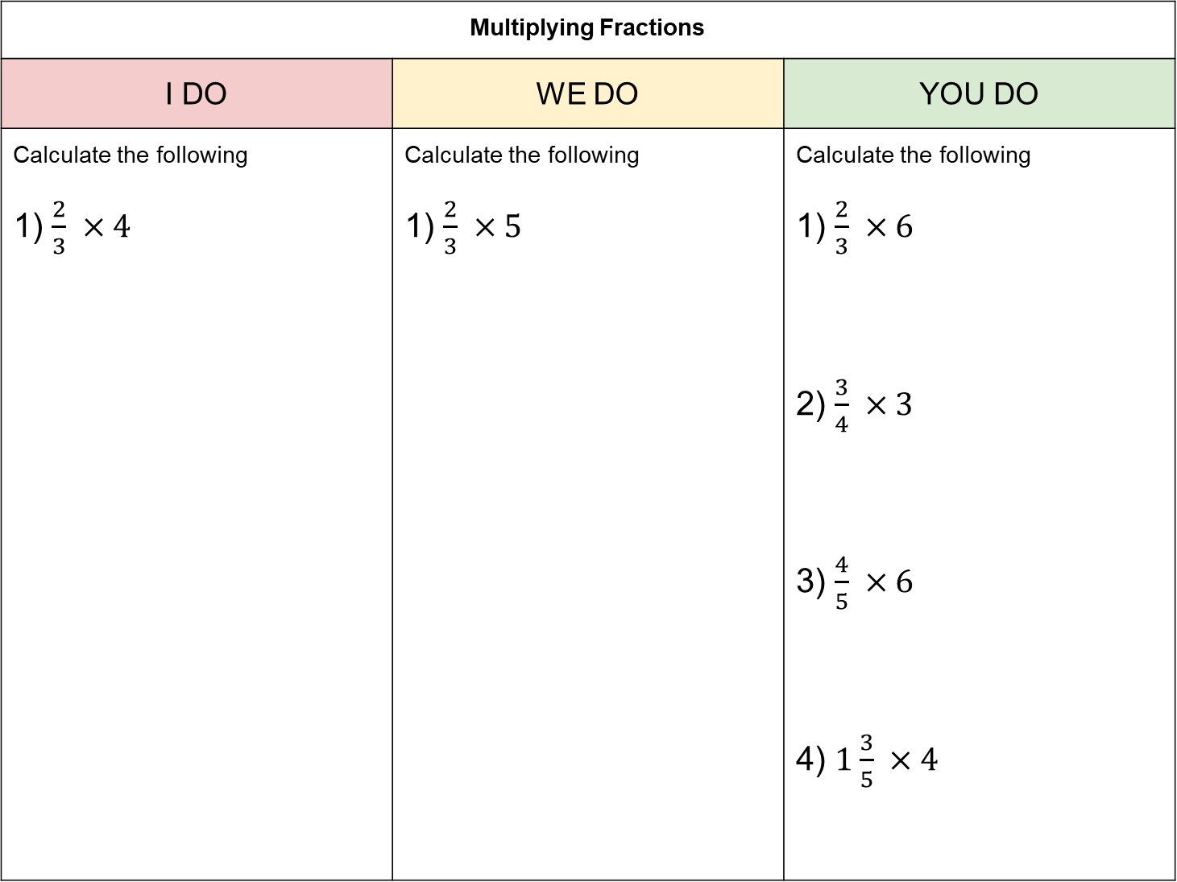

Multiplying Fractions
I DO | WE DO | YOU DO
Calculate the following 1) $\frac{2}{3} ×4$ | Calculate the following 1) $\frac{2}{3} ×5$ | Calculate the following 1) $\frac{2}{3} ×6$ 2) $\frac{3}{4} ×3$ 3) $\frac{4}{5} ×6$ 4) $1\frac{3}{5} ×4$
?
?
Could you think of it as:
4 lots of $\frac{2}{3}$
or $\frac{2}{3} ×\frac{4}{1}$

