Slide 1
Laws of Indices
I Do, We Do, You Do Example Sheets:
Slides 2-5: Laws of Indices (Multiplication)
Slides 6-8: Laws of Indices (Division)
Slides 9-11: Laws of Indices (Power on Power)

Slide 2
Laws of Indices (Multiplication) (1)
I DO | WE DO | YOU DO
Write each of the following as a single power: a) 3² x 3⁴ = 3x3 x 3x3x3x3 = 3⁶ b) 4³ x 4⁵ x 4² =4x4x4 x 4x4x4x4x4 x 4x4 = 4¹⁰ | Write each of the following as a single power: 7³ x 7⁵ 8² x 8⁴ x 8³ | Write each of the following as a single power: 3² x 3⁵ 6² x 6⁵ 6² x 6⁵ x 6 6² x 6⁵ x 6³ 6² x 6³ x 6⁵ 7³ x 7⁵ x 7² 9³ x 9⁵ x 9² 9³ x 9⁵ x 3⁴ ^{ANSWER IN YOUR BOOKS}

Slide 3
Laws of Indices (Multiplication) (2)
I DO | WE DO | YOU DO
Write each of the following as a single power: a) a³ x a² = 1xaxaxa x 1xaxa = 1x1 x axaxaxxaxa = a⁵ b) b² x b⁴ x b³ =1xbxb x 1xbxbxbxb x 1xbxbxb = 1x1x1 x bxbxbxbxbxbxbxbxb = b¹⁰ | Write each of the following as a single power: c² x c⁵ y x y⁴ x y² | Write each of the following as a single power: a² x a³ a³ x a² a x a³ x a b x b³ x b b⁴ x b³ x b b x b⁴ x b³ ^{ANSWER IN YOUR BOOKS}
Extension: What is the connection between the indices in each question and the indices in each answer? Can you generalise this?

Slide 4
Laws of Indices (Multiplication) (3)
I DO | WE DO | YOU DO
Write each of the following as a single power: a) m³ x m⁵ x m² =1xm³ x 1xm⁵ x 1xm² = 1x1x1 x m³⁺⁵⁺² = m¹⁰ b) m³ x m⁵ x m⁻² =1xm³ x 1xm⁵ x 1xm⁻² = 1x1x1 x m³⁺⁵⁺⁽⁻²⁾ = m⁶ | Write each of the following as a single power: z⁶ x z³ x z a⁻³ x a⁵ x a⁻⁴ | Write each of the following as a single power: b⁷ x b² b⁶ x b² b⁶ x b⁻² b⁻² x b⁶ b x b⁻³ x b⁶ c x c⁻³ x c⁶ ^{ANSWER IN YOUR BOOKS}
WHEN MULTIPLYING, IF BASE NUMBERS ARE THE SAME, WE ADD THE INDICES

Slide 5
Laws of Indices (Multiplication) (4)
I DO | WE DO | YOU DO
Write each of the following as a single power: a) 4a x 3a² = 4 x a x 3 x a x a = 4 x 3 x a x a x a = 12a³ b) 2b³ x 4b⁵ x 3b⁻² =2xb³ x 4xb⁵ x 3xb⁻² = 2x4x3 x b³xb⁵xb⁻² = 24 x b³⁺⁵⁺⁽⁻²⁾ = 24b⁶ | Write each of the following as a single power: 8a⁴ x 3a² b⁵ x 7b³ x 3b⁻⁴ | Write each of the following as a single power: 7a⁴ x 3a² 7a⁴ x 6a⁵ 7a⁴ x 2a³ x 3a² 14a⁵ x a x 3a³ ^{ANSWER IN YOUR BOOKS}

Slide 6
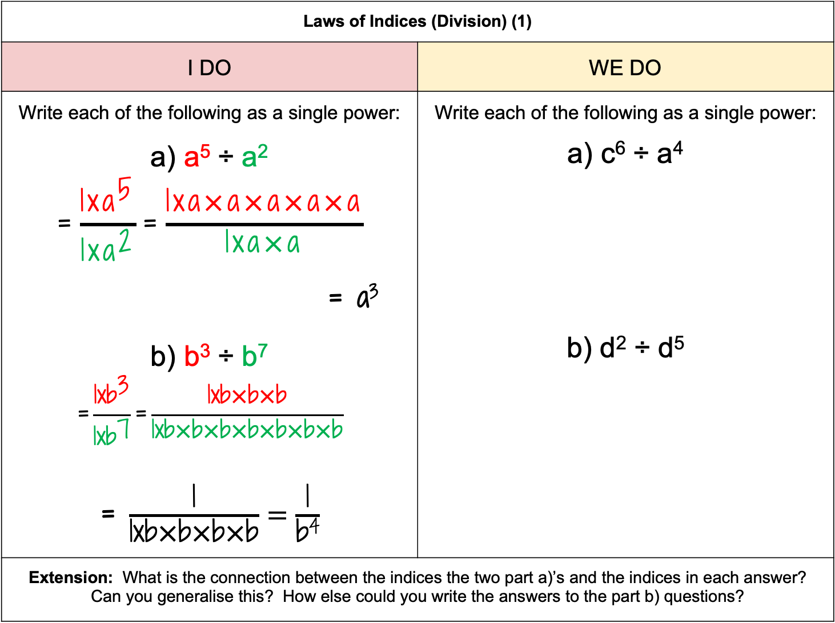
Laws of Indices (Division) (1)
I DO | WE DO
Write each of the following as a single power: a) a⁵ ÷ a² $$\text{=}\frac{{\text{1}\text{xa}}^{\text{5}}}{{\text{1}\text{xa}}^{\text{2}}}\text{=}\frac{\text{1}\text{xa}\text{×}\text{a}\text{×}\text{a}\text{×}\text{a}\text{×}\text{a}}{\text{1}\text{xa}\text{×}\text{a}}$$ = a³ b) b³ ÷ b⁷ $$\text{=}\frac{\text{1}\text{x}{\text{b}}^{\text{3}}}{\text{1}\text{x}{\text{b}}^{\text{7}}}\text{=}\frac{\text{1}\text{xb}\text{×}\text{b}\text{×}\text{b}}{\text{1}\text{xb}\text{×}\text{b}\text{×}\text{b}\text{×}\text{b}\text{×}\text{b}\text{×}\text{b}\text{×}\text{b}}$$ = $\frac{\text{1}}{\text{1}\text{xb}\text{×}\text{b}\text{×}\text{b}\text{×}\text{b}}=\frac{\text{1}}{\text{b}\text{4}}$ | Write each of the following as a single power: a) c⁶ ÷ a⁴ b) d² ÷ d⁵
Extension: What is the connection between the indices the two part a)’s and the indices in each answer? Can you generalise this? How else could you write the answers to the part b) questions?
Write as a fraction, then cancel the fraction down.

Slide 7
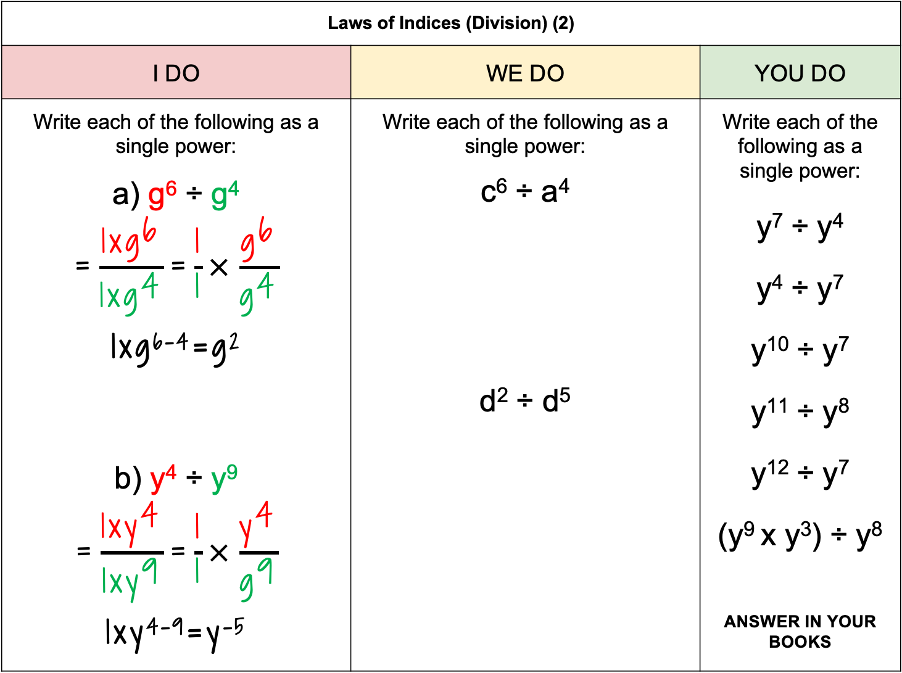
Laws of Indices (Division) (2)
I DO | WE DO | YOU DO
Write each of the following as a single power: a) g⁶ ÷ g⁴ $$\text{=}\frac{{\text{1}\text{xg}}^{\text{6}}}{{\text{1}\text{xg}}^{\text{4}}}\text{=}\frac{\text{1}}{\text{1}}\text{×}\frac{{\text{g}}^{\text{6}}}{{\text{g}}^{\text{4}}}$$ 1xg⁶⁻⁴=g² b) y⁴ ÷ y⁹ $$\text{=}\frac{{\text{1}\text{xy}}^{\text{4}}}{{\text{1}\text{xy}}^{\text{9}}}\text{=}\frac{\text{1}}{\text{1}}\text{×}\frac{{\text{y}}^{\text{4}}}{{\text{g}}^{\text{9}}}$$ 1xy⁴⁻⁹=y⁻⁵ | Write each of the following as a single power: c⁶ ÷ a⁴ d² ÷ d⁵ | Write each of the following as a single power: y⁷ ÷ y⁴ y⁴ ÷ y⁷ y¹⁰ ÷ y⁷ y¹¹ ÷ y⁸ y¹² ÷ y⁷ (y⁹ x y³) ÷ y⁸ ^{ANSWER IN YOUR BOOKS}
WHEN DIVIDING, IF BASE NUMBERS ARE THE SAME, WE SUBTRACT THE INDICES

Slide 8
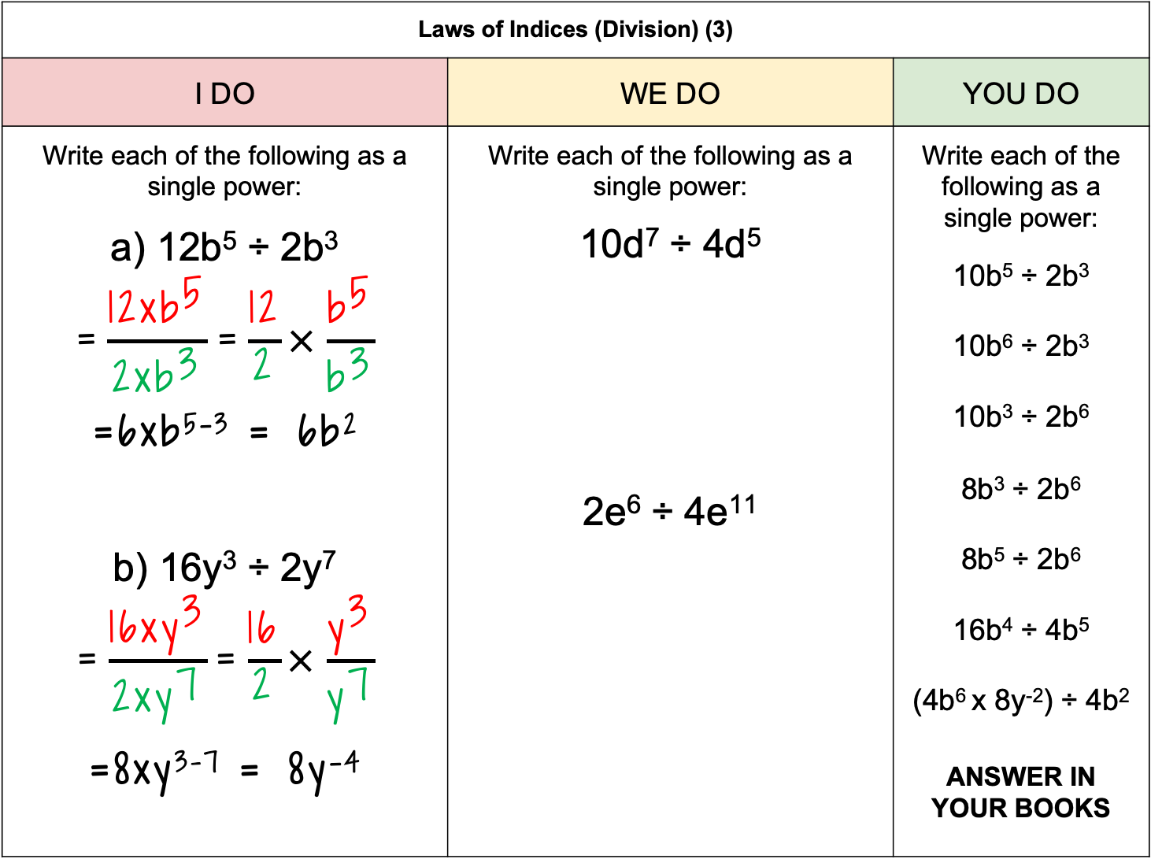
Laws of Indices (Division) (3)
I DO | WE DO | YOU DO
Write each of the following as a single power: a) 12b⁵ ÷ 2b³ $$\text{=}\frac{{\text{12}\text{xb}}^{\text{5}}}{{\text{2}\text{xb}}^{\text{3}}}\text{=}\frac{\text{12}}{\text{2}}\text{×}\frac{{\text{b}}^{\text{5}}}{{\text{b}}^{\text{3}}}$$ $$\text{=6}\text{x}\text{b}\text{5}\text{−}\text{3 }\text{=}\text{ 6}\text{b}\text{2}$$ b) 16y³ ÷ 2y⁷ $$\text{=}\frac{{\text{16}\text{xy}}^{\text{3}}}{{\text{2}\text{xy}}^{\text{7}}}\text{=}\frac{\text{16}}{\text{2}}\text{×}\frac{{\text{y}}^{\text{3}}}{{\text{y}}^{\text{7}}}$$ $$\text{=8}\text{x}\text{y}\text{3}\text{−}\text{7 }\text{=}\text{ 8}\text{y}\text{−4}$$ | Write each of the following as a single power: 10d⁷ ÷ 4d⁵ 2e⁶ ÷ 4e¹¹ | Write each of the following as a single power: 10b⁵ ÷ 2b³ 10b⁶ ÷ 2b³ 10b³ ÷ 2b⁶ 8b³ ÷ 2b⁶ 8b⁵ ÷ 2b⁶ 16b⁴ ÷ 4b⁵ (4b⁶ x 8y⁻²) ÷ 4b² ANSWER IN YOUR BOOKS

Slide 9
Laws of Indices (Power on Power Rule) (1)
I DO | WE DO | YOU DO
Write each of the following as a single power: a) (h²)³ =1xh² x 1xh² x 1xh² =1xhxh x 1xhxh x 1xhxh = 1x1x1 x h⁶ = h⁶ b) (e⁵)² = 1xe⁵ x 1xe⁵ =1xexexexexe x 1xexexexexe = 1x1 x e¹⁰ = e¹⁰ | Write each of the following as a single power: a) (d³)² b) (g⁴)³ | Write each of the following as a single power: (a²)⁴ (a²)⁵ (b⁵)² ANSWER IN YOUR BOOKS
Extension: What is the connection between the indices in each question and the indices in each answer? Can you generalise this?

Slide 10
Laws of Indices (Power on Power Rule) (2)
I DO | WE DO | YOU DO
Write each of the following as a single power: a) (b⁵)³ =1xb⁵ x 1xb⁵ x 1xb⁵ =1x1x1 x b⁵ x b⁵ x b⁵ = 1xb⁵⁺⁵⁺⁵ = 1xb^{(5x3)} = b¹⁵ | Write each of the following as a single power: a) (j²)⁶ b) (k³)⁴ | Write each of the following as a single power: (a²)⁴ (a⁴)² (a⁵)² (a⁵)³ (a⁵)⁶ ANSWER IN YOUR BOOKS
WHEN A POWER IS APPLIED TO ANOTHER POWER (POWER ON POWER) WE CAN MULTIPLY THE INDICES

Slide 11
Laws of Indices (Power on Power Rule) (3)
I DO | WE DO | YOU DO
Use two different methods to write the following as a single power: (2b⁴)³ =2xb⁴ x 2xb⁴ x 2xb⁴ =2x2x2 x b⁴xb⁴xb⁴ = 8xb⁴⁺⁴⁺⁴ = 8xb^{(4x3)} = 8b¹² OR (2b⁴)³ = 2³ x (b⁴)³ = 8 x b^{4x3} = 8b¹² | Use two different methods to write the following as a single power: (4a³)² | Write each of the following as a single power: (2a³)⁴ (2a⁴)³ (3a⁴)³ (3a⁴)² (3a⁴)⁻² ANSWER IN YOUR BOOKS
Notice that the second index is applied to the 2 and the b⁴

