Slide 1
Calculating with Upper and Lower Bounds
Full lesson PowerPoint, including I Do, We Do, You Do Example Sheet(s).

Slide 2
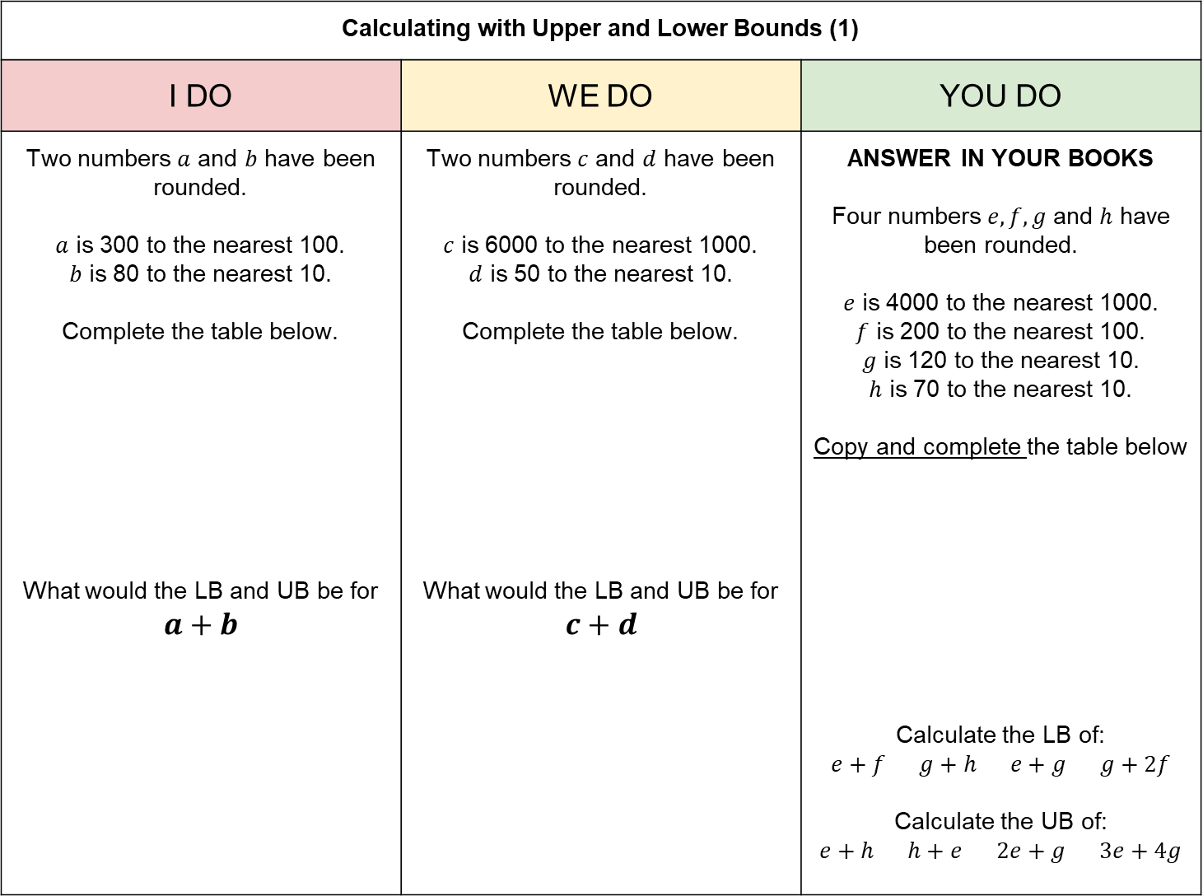
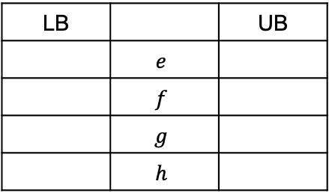
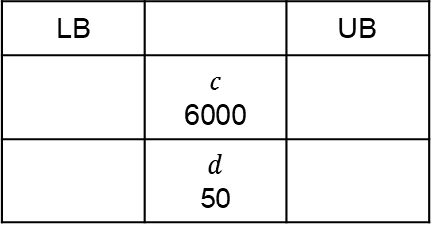
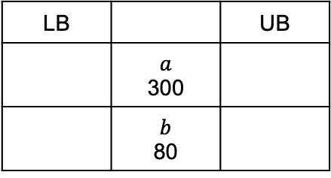
Calculating with Upper and Lower Bounds (1)
I DO | WE DO | YOU DO
Two numbers $a$ and $b$ have been rounded. $a$ is 300 to the nearest 100. $b$ is 80 to the nearest 10. Complete the table below. What would the LB and UB be for $$a+b$$ | Two numbers $c$ and $d$ have been rounded. $c$ is 6000 to the nearest 1000. $d$ is 50 to the nearest 10. Complete the table below. What would the LB and UB be for $$c+d$$ | ANSWER IN YOUR BOOKS Four numbers $e, f, g$ and $h$ have been rounded. $e$ is 4000 to the nearest 1000. $f$ is 200 to the nearest 100. $g$ is 120 to the nearest 10. $h$ is 70 to the nearest 10. Copy and complete the table below Calculate the LB of: $e+f$ $g+h$ $e+g$ $g+2f$ Calculate the UB of: $e+h$ $h+e$ $2e+g$ $3e+4g$
LB |  | UB
 | $$a$$ 300
 | $$b$$ 80
LB |  | UB
 | $$c$$ 6000
 | $$d$$ 50
LB |  | UB
 | $$e$$
 | $$f$$
 | $$g$$
 | $$h$$

Slide 3
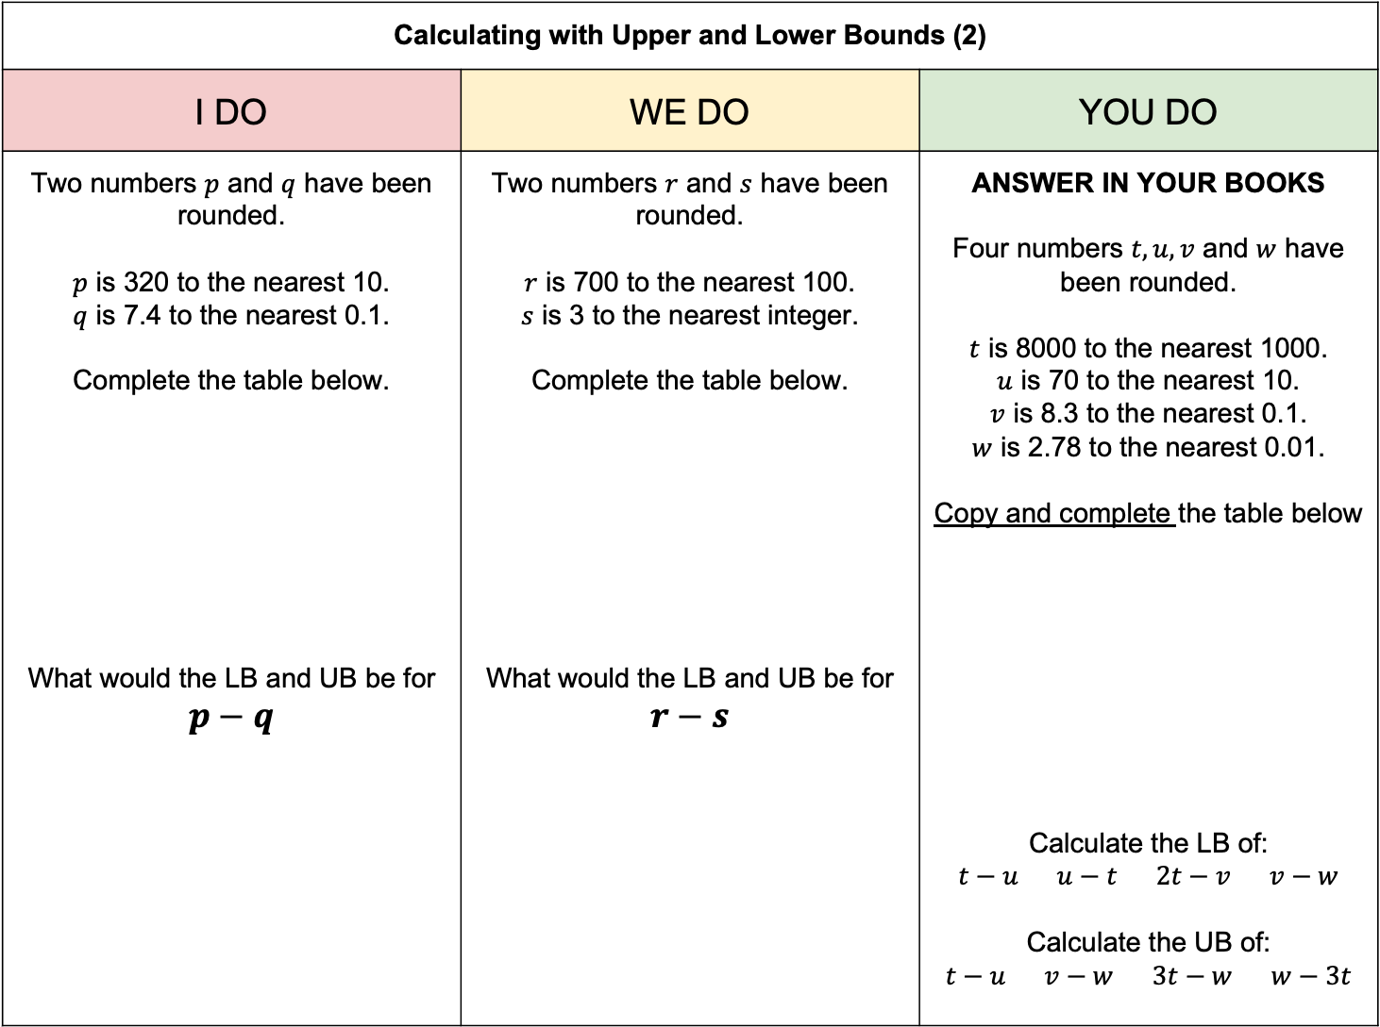
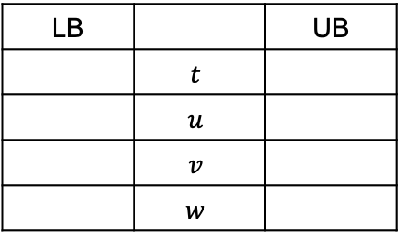
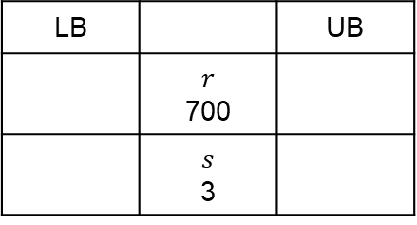
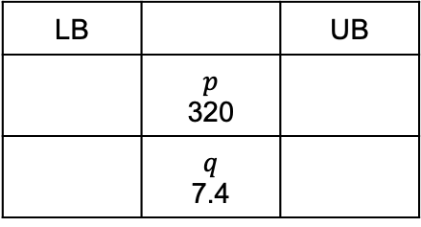
Calculating with Upper and Lower Bounds (2)
I DO | WE DO | YOU DO
Two numbers $p$ and $q$ have been rounded. $p$ is 320 to the nearest 10. $q$ is 7.4 to the nearest 0.1. Complete the table below. What would the LB and UB be for $$p−q$$ | Two numbers $r$ and $s$ have been rounded. $r$ is 700 to the nearest 100. $s$ is 3 to the nearest integer. Complete the table below. What would the LB and UB be for $$r−s$$ | ANSWER IN YOUR BOOKS Four numbers $t, u, v$ and $w$ have been rounded. $t$ is 8000 to the nearest 1000. $u$ is 70 to the nearest 10. $v$ is 8.3 to the nearest 0.1. $w$ is 2.78 to the nearest 0.01. Copy and complete the table below Calculate the LB of: $t−u$ $u−t$ $2t−v$ $v−w$ Calculate the UB of: $t−u$ $v−w$ $3t−w$ $w−3t$
LB |  | UB
 | $$p$$ 320
 | $$q$$ 7.4
LB |  | UB
 | $$r$$ 700
 | $$s$$ 3
LB |  | UB
 | $$t$$
 | $$u$$
 | $$v$$
 | $$w$$

Slide 4
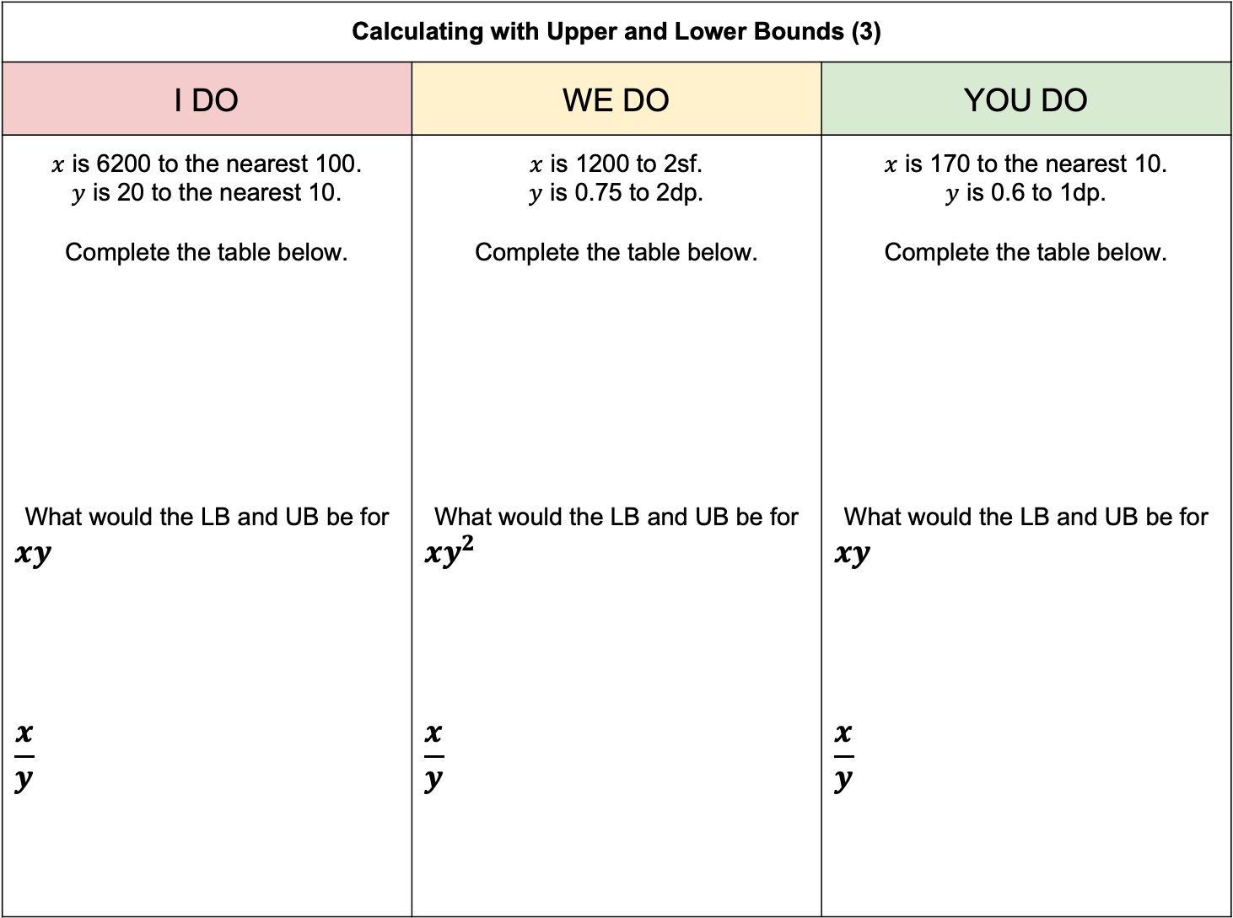
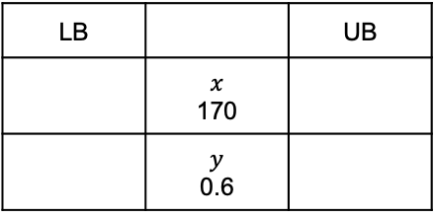
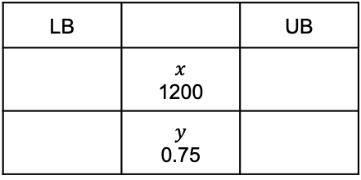
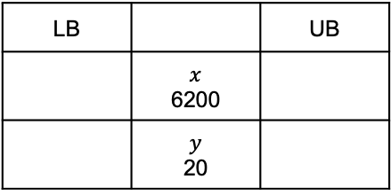
Calculating with Upper and Lower Bounds (3)
I DO | WE DO | YOU DO
$x$ is 6200 to the nearest 100. $y$ is 20 to the nearest 10. Complete the table below. What would the LB and UB be for $$xy$$ $$\frac{x}{y}$$ | $x$ is 1200 to 2sf. $y$ is 0.75 to 2dp. Complete the table below. What would the LB and UB be for $$xy^{2}$$ $$\frac{x}{y}$$ | $x$ is 170 to the nearest 10. $y$ is 0.6 to 1dp. Complete the table below. What would the LB and UB be for $$xy$$ $$\frac{x}{y}$$
LB |  | UB
 | $$x$$ 6200
 | $$y$$ 20
LB |  | UB
 | $$x$$ 1200
 | $$y$$ 0.75
LB |  | UB
 | $$x$$ 170
 | $$y$$ 0.6

Slide 5
Upper and Lower Bounds with Geometry
I DO | WE DO
The height and width of the triangle below have been rounded to 1dp. Work out the LB and UB for the area of the triangle. | The dimensions of the cuboid below have been rounded to 2dp. Work out the LB and UB for the volume of the cuboid.
4.5cm
1.56cm
10.2cm
0.47cm
3.61cm

Slide 6
Upper and Lower Bounds with Geometry
YOU DO 1 | YOU DO 2
The height and width of the rectangle below have been rounded to the nearest whole number. Work out the LB and UB for the area of the rectangle. | The height and width of the triangle below have been rounded to 1dp. Work out the LB and UB for the area of the triangle.
12cm
8cm
3.5cm
7.2cm

Slide 7
Upper and Lower Bounds with Geometry
YOU DO 3 | YOU DO 4
The height and width of the triangle below have been rounded as shown in brackets. Work out the LB and UB for the area of the triangle. | The height and width of the triangle below have been rounded as shown in brackets. Work out the LB and UB for the area of the triangle.
8.3cm
(1dp)
830cm
(2sf)
12cm
(Whole number)
1000cm
(1sf)

Slide 8
Upper and Lower Bounds with Geometry
YOU DO 5 | YOU DO 6
The dimensions of the cuboid below have been rounded as shown in brackets. Work out the LB and UB for the volume of the cuboid. | The dimensions of the cuboid below have been rounded as shown in brackets. Work out the LB and UB for the volume of the cuboid.
1.8cm
(1dp)
2.74cm
(2dp)
3.2cm
(1dp)
0.53cm
(2sf)
7.6cm
(1dp)
11.315cm
(3dp)

Slide 9
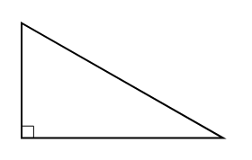
Upper and Lower Bounds with Geometry – Pythagoras’ Theorem
WE DO | YOU DO
Use Pythagoras’ Theorem to find the UB of the hypotenuse below. All lengths are correct to 1dp. | Use Pythagoras’ Theorem to find the LB and UB of the missing sides below. All lengths have been rounded as shown in brackets.
2.6cm
2.6cm
(1dp)
5.2cm
(1dp)
3.1cm
3.18cm
(2dp)
6.36cm
(2dp)
6.36cm
(2dp)
7.36cm
(2dp)
5.2cm
(1dp)
0.2cm
(1dp)
17cm
(2sf)
2cm
(1sf)
2.73cm
(3sf)
0.07036cm
(3sf)

